Slide 1



What is a health system?
Introduction to Complex Health Systems
ICHS 2
www.hpsa-africa.org
@hpsa_africa
www.slideshare.net/hpsa_africa

Slide 2
Outline
Definition of health system
Conceptual frameworks that help think about health systems as basis for action

Slide 3
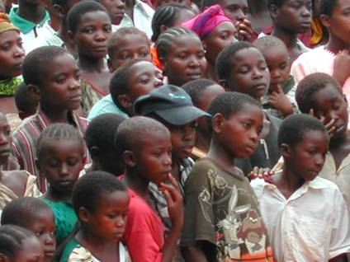
Health systems
“All organizations, people and action whose primary intent is to promote, restore or maintain health”
WHO, 2007 http://www.who.int/healthsystems/strategy/en/
Key social goal…
  Improve health by
  average level of population health
  health inequities
Notes:
3

Slide 4
Health System
Health
A system is
Beyond sickness
  mental & physical health
  social wellbeing
Beyond the individual
  all agents promoting health & wellbeing
  domestic/national AND international factors impacting on health and HS agents
any collection of related parts
  that interact
    in an organized way
        for a purpose

Slide 5
Starting points: What are the basic building blocks?

Slide 6
What is a health system?
It is the sum of all the organizations, institutions and resources whose primary purpose is to improve health.
A health system needs staff, funds, information, supplies, transport, communications and overall guidance and direction. And it needs to provide services that are responsive and financially fair, while treating people decently.

Slide 7
Growing recognition
Overall, there is a growing recognition that to maintain and improve the health of the world’s people governments must shape sound, efficient health systems that provide effective disease prevention and treatment to all women, men and children, no matter who they are or where they live.

Slide 8
1. Stewardship
Stewardship, sometimes more narrowly defined as governance, refers to the wide range of functions carried out by governments as they seek to achieve national health policy objectives.

Slide 9
2. Financing
The purpose of health financing is to ensure that adequate funding is available and the right financial incentives are in place to guarantee that all individuals have access to needed preventive and personal health care.

Slide 10
3. Workforce
The performance of health care systems depends on the knowledge, skills, motivation and distribution of the people responsible for organizing and delivering services.

Slide 11
4. Information
Accountability, resource allocation, programme improvement and management decisions all rely on sound health information

Slide 12
5. Drugs and technology
The availability, quality, efficacy, safety and rational use of drugs and health technology are necessary for effective health service delivery.

Slide 13
6. Service delivery
Just as the principal objective of a health system is to improve people's health, the chief function the system needs to perform is to deliver health services.

Slide 14
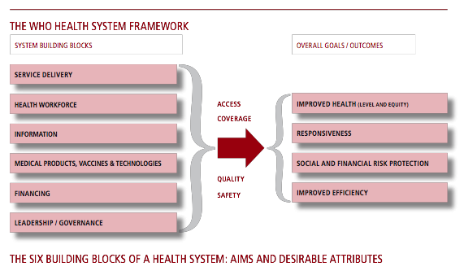
WHO, 2007
Notes:
Health equity does not mean health equality: how assess ‘fairness’? what values base?
Responsiveness
Social and financial protection
14

Slide 15
Caveat – no easy answers to how to improve a health system! politics and values matter….

