Slide 1
An Introduction to Organizational Behavior
BSc. Health Services Management and Planning
Adam Silumbwe, BSc. MPH. PhD Cand.

Slide 2
Lecture Overview
Organization theory
Organizational design and structure
Organizational behavior
Organizational culture

Slide 3
Organization theory
An organization is a collection of people who work together to achieve a wide variety of goals – such as earning money, providing innovating goods and services, etc.

Slide 4
Nature of Organisations and Organisation structure

Slide 5
What is an organization?
An organization is a consciously coordinated social unit, composed of two or more people, that functions on a relatively continuous basis to achieve a common goal or set of goals.
This is done through division of labor and function

Slide 6
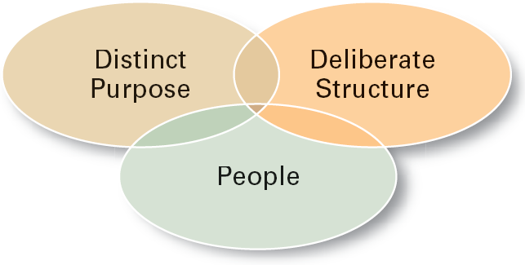
Characteristics of Organizations

Slide 7
Purpose of an organization
The purpose of an organization is to accomplish the goals and objectives as indicated within the organization's vision statement.
The mission statement will indicate how they plan on reaching those goals and objectives.

Slide 8
Purpose of Organizing
Divides work to be done into specific jobs and departments.
Assigns tasks and responsibilities associated with individual jobs.
Coordinates diverse organizational tasks.
Clusters jobs into units.
Establishes relationships among individuals, groups, and departments.
Establishes formal lines of authority.
Allocates and deploys organizational resources.

Slide 9
Organization Structure (cont’d)
Chain of Command
  The continuous line of authority that extends from upper levels of an organization to the lowest levels of the organization and clarifies who reports to who.

Slide 10
Organization Structure (cont’d)
Authority
  The rights inherent in a managerial position to tell people what to do and to expect them to do it.
Responsibility
  The obligation or expectation to perform.
Unity of Command
  The concept that a person should have one boss and should report only to that person.

Slide 11
Organization Structure (cont’d)
Span of Control
  The number of employees who can be effectively and efficiently supervised by a manager.
  Width of span is affected by:
    Skills and abilities of the manager
    Employee characteristics
    Characteristics of the work being done
    Similarity of tasks
    Complexity of tasks
    Physical proximity of subordinates
    Standardization of tasks

Slide 12
Organization Structure (cont’d)
Centralization
  The degree to which decision-making is concentrated at a single point in the organizations.
    Organizations in which top managers make all the decisions and lower-level employees simply carry out those orders.
Decentralization
  Organizations in which decision-making is pushed down to the managers who are closest to the action.
Employee Empowerment
  Increasing the decision-making authority (power) of employees.

Slide 13
NATURE OF ORGANIZATIONS
Broadly speaking there are two types of organizations FORMAL AND INFORMAL.

Slide 14
The formal organization
Deliberately planned and created
Concerned with the coordination of activities
Hierarchically structured with
  stated objectives
  the specification of tasks
  defined relationships of authority and responsibility

Slide 15
The informal organization
Is flexible and loosely structured
Relationships may be left undefined
Membership is spontaneous and with varying degrees of involvement

Slide 16
Classification
Two generic groups:
  Private enterprise
  Public sector
By major purpose
  Economic organizations (business firms)
  Protective (armies, police, trade unions)
  Associative (clubs and societies)
  Public service orgs (hospitals, local authorities)
  Religious organizations (churches)

Slide 17
Organizational behavior

Slide 18
Organizational behavior
Behavior in an organization refers to the behavior of individuals and groups within the organization as well as the interaction between members of the organization and the external environment
Organizational behavior is the scientific field of study dedicated to;
  Understanding, explaining and appreciating the many forces that affect behavior in the organizations
  And to making correct decisions about how to motivate and coordinate people and other resources to achieve organizational goals

Slide 19
Components of organization behavior
The behavior of people (individuals, groups and teams)
The process of Management
The organizational context in which the process of management take place (e.g. organisational structure)
Interactions with the external environment (interest rates, inflation and value of the local currency)

Slide 20
The group or team
There is strong worldwide trends towards organizing employees into teams in order to capitalize on the collective competencies that flow from human interaction.
Groups are dynamic – They are ‘born’, they ‘live and they ‘die’ according to organizational social needs.
Informal groups are a manifestation of social needs within the organization.
People in groups develop their own hierarchies and leaders, and group pressures can exert a major influence on the behavior and performance of individual group members

Slide 21
Interdisciplinary nature of organizational behavior
The study of organization behavior cannot be undertaken in terms of a single discipline, as it is a multidisciplinary behavioral science consisting
Psychology: concerned with the study of individual differences, perceptions, personality, attitudes, motivation and managing performance
Sociology: concerned with the study of work groups, communication, empowerment, decision making, social behaviour, relationships between social groups and societies and the maintenance of order.
Anthropology: concerned with the study of the cultural system, the beliefs, customs, ideas and values within a group or society, issues ethics and diversity

Slide 22
Challenges for organizational behavior
Managing the global environment
Adapting to discontinuity and change
Achieving excellence through management of human capital
Utilizing information technology for knowledge management
Managing a diverse workforce as a competitive advantage
Developing organizational ethics

Slide 23
Organizational Culture

Slide 24
What is culture?
A system of shared assumptions or meanings held by members that distinguishes one organization from others
Everything a group thinks, says does and makes – it customs, ideas morals, habits, traditions, languages, material artefacts and shared systems of attitudes and feelings that help to create standards for people to co-exists and which are acquired developed and passed on by a group of people, consciously or unconsciously, to subsequent generations.

Slide 25
A three –layered entity consisting
Basic assumptions in the organizations hold
Which give rise to shared feelings, beliefs and values and
Manifest in symbols, process, forms and some aspects of group behavior

Slide 26
Management and organizational culture, philosophy and performance
Organizational culture is the historically developed sense of an organization’s ‘legacy’ – what it is and what it stands for – that permeates the entire organization or system and is known to all who work in it.
Examples of values – duty, respect, trust, integrity, honesty, equity, and fairness.
Examples of shared beliefs – commitment to patients and to meeting their needs and respecting them as a people, with a fundamental belief that they are the primary reason for the HSO existence.

Slide 27
Cont’d
An HSO philosophy is its explicit and implicit view of itself and what it is. Generally expressed in the mission statement, the philosophy is directly linked to and rooted in the cultural values and beliefs that drive the organization or system.
Philosophy and culture must be compatible, each must reflect the other.
Philosophy – depicts the desired nature of relationships with the stakeholders – that is, between the organization and the individuals, groups, or other organizations
A well thought out philosophy is a prerequisite for strategic planning, resources allocation and use, customer service, and ability to cope with external environment

Slide 28
The importance of organizational culture
It creates a corporate identity that distinguishes one organization from others
As a result, it gives members of the organization an identity
Identifying with the organization creates greater commitment to organizational objectives
Organizational culture guides employees in terms of acceptance behaviors attitudes, especially when they have to make decisions and solve problems
It creates a social system stability with associated emotional security
It serves as yardstick for evaluating and correcting deviant behaviors and rewarding desired behaviors

Slide 29
Dominant culture and subculture
A dominant culture reflects the core values of an organization that are shared among most members
A subculture develops from the dominant culture and reflects common problem, experiences and situations with which members are confronted
Subcultures are likely to be defined by geographical separation or departmental designations.
If an organization lacks a uniform dominant culture and consists of subcultures that are remarkably different from each other, there will be confusion and members will struggle to determine whether certain behaviors are acceptable or not

Slide 30
Key characteristics that define organizational culture
Innovation and risk taking: the extent to which creativity, experimentation and renewal are encouraged
Attention to detail: the extent to which accuracy, analysis and perfection are required
Outcome orientation: the extent to which management focuses on results or outcomes instead of techniques and processes
People focus: the extent to which employees are valued and considered
Team approach: the extent to which organizational activities are organized around teams rather than individuals, and the extent to which teams are empowered to manage themselves
Aggressiveness: the degree to which organization members are aggressive and competitive instead of supportive
Stability: the degree to which the status quo is maintained in contrast to renewal growth and change

Slide 31
Types of cultures
Constructive culture – Members are encouraged to interact constructively with each other in order to attain goals and to grow and to develop. Emphasizes normative beliefs of achievement, self-actualization, human affiliation
Passive – defensive culture. Reinforces the belief that members must act passively in order to safeguard their job security. Reinforces normative beliefs associated with approval, traditional rules, etc.
Aggressive – defensive culture. Members are encouraged to act in a forceful way in order to protect their status and job security. Emphasizes competition, perfectionism, power and opposition
Notes:
Although research has not yet succeeded in establishing a clear link between specific types of culture and organizational performance, it is still useful to consider different types of culture, and how culture is likely to influence behavior

Slide 32
Types of cultures
Family culture – Strong hierarchical structure that endorses authority. The leader is a benevolent type that takes care of the subordinates
Eiffel tower culture – Represents a bureaucratic structure. It is defined by levels of authority, division of labor, impersonal rules and norms. Its mechanic and because people are comfortable in their roles/authority, they resist change
Guided missile culture – Represents organizations that egalitarian (equal membership). Experts in technical fields work independently on tasks rather than taking directs from superiors. Status is achieved through contribution and knowledge
Incubator culture - Organizations save as incubators of for self expression and self fulfillment. Highly creative, personal and egalitarian. Status is earned from exceptional creative contribution.

Slide 33
Patterns of leadership culture
The pioneering pattern – Open-minded, inclusive risk-taking and empowering. Leadership is visionary and based on relationship-driven need satisfaction.
The clan patterns – closed minded, optimistic, confident, cold, controlling and restrictive and experimenting. Inner and outer groups are evident, and privileges are reserved for the small inner group.
The heritage pattern – closed minded, optimistic, confident, impersonal, empowering, risk-avoiding and mistake-minimizing. Emphasizes past success and the status quo is maintained.
The doomsday – closed minded pessimistic, anxious, warm, personal, close, controlling, restrictive, risk-avoiding and mistake-minimizing. The attitude is that the world or organization is coming to an end and the supportive environment must be created while waiting for the inevitable.

Slide 34
How cultures are changed in organizations?
The more deep-rooted the culture is the more difficult it is to change it. Organizational change is costly and time consuming process
Many organizations attempt cultural change with a ‘quick fix’ rather than through a well planned and participative approach
Senior leadership is owns organizational culture and is responsible for establishing a culture that will contribute to the attainment of organizational goals

Slide 35
Steps in engineering organizational change
Define the optimum culture that will support overall organizational vision and values and will most likely result in success. Considers communication methods, risk-taking, individual characteristics versus group collaboration, financial stewardship and customer service
Assess the current culture by obtaining feedback from the employees through meetings/evaluations on the extent to which identified attributes and behaviors are evident in the organization work/tasks.
Conduct a gap analysis by comparing the current cultural attributes and behaviors with the desired ones. Determine whether the current culture is in alignment or in conflict with the vision and direction of the organization.

Slide 36
Cont’d
Engineer cultural change by using specific strategies and tools to reinforce the desired culture and related behaviors
  Start with management development programs and instill the right values and behaviors in key management members
  Coach and mentor key individuals who do not exhibit the desired behaviors
  Review the reward system to determine whether it promotes or prevents desired behaviors
  The senior leadership team should consistently highlight the relevance of the interventions so that it can becomes evidentt that they are part of the management philosophy
  Selective hiring process should be implemented to verify whether applicants have demonstrated the desired behaviors in previous positions.

Slide 37
How cultures are established and reinforced in organizations?
Commitment of senior leadership to a specific organizational culture
Orientation and training programs with both ideological and practical content
Internal training centers
On the job socialization by peers and immediate supervisors
Mentoring
Exposure to legendary stories of ‘heroic deeds’ and corporate exemplars
Unique language and terminology
Incentive and advancement criteria explicitly linked to cooperate ideology
Constant verbal and written emphasis on corporate values, heritage and the sense of being part of something special

Slide 38
Creating an ethical culture in an organization
Code of ethics – allows the organization to define its ethical position and provides guidelines for ethical decision making. Highlights specific practices such as receiving kickbacks, doctoring data or financial statements, withholding information or breaching confidentiality
Ethics audit – assess the ethical climate of the organization, identify problem areas and review ethics initiatives such as codes of conduct and ethics training
Hotline – or helpline provides organization members with anonymous medium of reporting unethical behavior
Notes:
Its imperative that the cross-functional task team representing various levels in the organization assist with writing and implementation of the code.

Slide 39
Cont’d
Whistle-blower protection – A whistle blower is a person who exposes unethical behavior or practices in the organization. It is important that whistle blowers are protected.
Ethics committee – A representative group of people who advocate ethics in the organization as such should serve an executive leadership role. It examines ethical issues, makes decisions, formulates strategies and implements programmes to promote ethics in the organization

Slide 40
Change Management

Slide 41
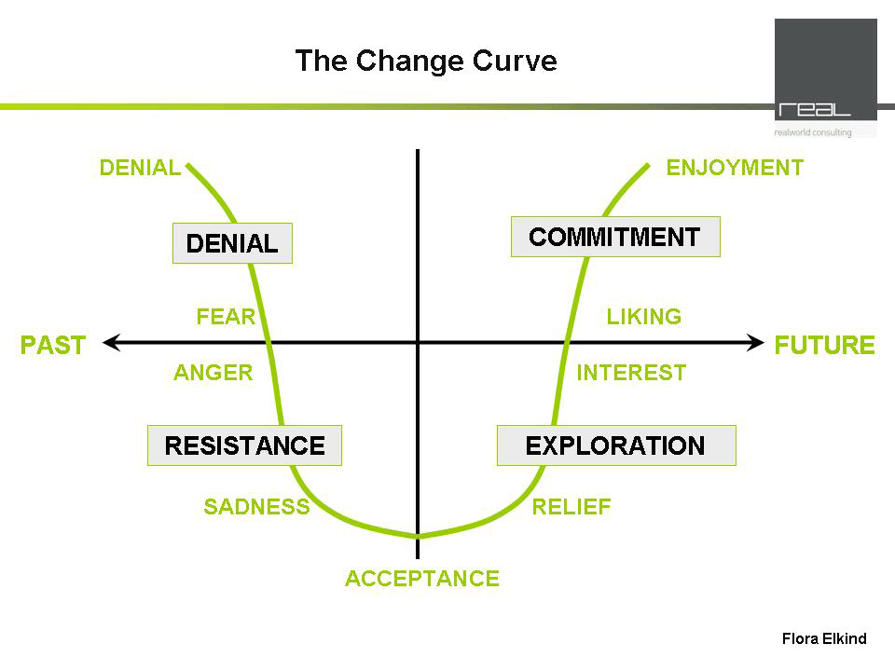
Notes:
It takes 18 months for a change to become effective.

Slide 42
Change as a Human Process
DENIAL
Anger
COMMITMENT
Internalising
Realisation
Self
Esteem
or
Morale
Shock
PAST
FUTURE
Depression
Search for meaning
RESISTANCE
Testing
Acceptance
& letting go
EXPLORATION
Time
Adapted from Adams, Hayes and Hopson : Transition, understanding and managing personal change; 1976

Slide 43
Why do we need to manage Change?
Rapid change is occurring as health care organizations (HCOs) strive to adopt new technology such as the electronic health record (EHR), implement quality improvement initiatives, and institute pay-for-performance plans
To deal with this change and help employees transition to new ways of doing things, managers need an edge

Slide 44
Change management models
Providing this edge are the philosophies of John Kotter and William Bridges, two of the most widely regarded thinkers in change management
Kotter believes that organizational change can be managed using a dynamic, nonlinear 8-step approach
Increase urgency, Build guiding teams, Get the vision right, Communicate for buy-in, Enable action, Create short-term wins, Don’t let up, Make it stick

Slide 45
Phases of change management

Slide 46
1. Creating a climate for change
Increase urgency: Ensuring that sufficient people act with urgency—with on your toes behavior that looks for opportunities and problems, that energizes colleagues, that beams a sense of let’s go.’
Build guiding teams: Development of a guiding team. Selecting the right members for a team is imperative.
Get the vision right: The health care manager, along with the guiding team, must develop a vision expressed in a clear, concise statement about the direction in which their organization is headed.
Notes:
“Making sure that sufficient people act with sufficient urgency—with on your toes behavior that looks for opportunities and problems, that energizes colleagues, that beams a sense of let’s go.’
As a sense of urgency grows among employees, managers must turn their attention to the development of a guiding team. Selecting the right members for a team is imperative because these individuals will guide the change management project throughout the remaining steps
The health care manager, along with the guiding team, must develop a vision expressed in a clear, concise statement about the direction in which their organization is headed.

Slide 47
2. Engaging and enabling the whole organization
Communicate for buy-in: develop methods of communication that address negative feelings and help employees to ‘‘think and act in accordance with the new direction’
Enable action: A guiding team must take the same approach to monitoring change as a thermostat monitors the temperature in a room.
Create short-term wins: As the pathways to change are cleared, empowered individuals and groups must be careful to choose and complete tasks that clearly show that the change management project is succeeding.
Notes:
The guiding team must develop methods of communication that address negative feelings and help employees to ‘‘think and act in accordance with the new direction’
A guiding team must take the same approach to monitoring change as a thermostat monitors the temperature in a room. Over the course of a change project, different individuals and groups will have a different temperature, represented by their feelings toward the changes taking place at a specific point in time.
As the pathways to change are cleared, empowered individuals and groups must be careful to choose and complete tasks that clearly show that the change management project is succeeding. Completed tasks provide examples of short-term wins that help to further build urgency and momentum within the HSO and to lessen the impact that negative comments made by critics have on the project.

Slide 48
3. Implementing and sustaining the change
Don’t let up: This kind of thinking, ‘‘we have won,’’ can be very detrimental to any type of change project. As short-term wins begin to pile up, people may start to believe that the change project is going to be a success and they start to lose their sense of urgency.
Make it stick: A belief exists that to get people to change their behaviour, you must first change the culture. However, according to Kotter, ‘‘culture change comes last, not first.... Culture changes when a new way of operating has been shown to succeed over some minimum period of time
Notes:
This kind of thinking, ‘‘we have won,’’ can be very detrimental to any type of change project. As short-term wins begin to pile up, people may start to believe that the change project is going to be a success and they start to lose their sense of urgency. To prevent this from occurring, the guiding team can look for external factors that force an HSO to look at its current position in comparison to their competition.
A belief exists that to get people to change their behaviour, you must first change the culture. However, according to Kotter, ‘‘culture change comes last, not first.... Culture changes when a new way of operating has been shown to succeed over some minimum period of time

Slide 49
Continued…,
Kotter’s model is not a step-by step approach to managing change. It is an iterative model, and its use will rely on the skills and knowledge of the health care manager charged with bringing about change within his or her HSO.

Slide 50
The End,
Thank you

