Slide 1
Module 4: M&E Systems and Frameworks
GHC M&E Training, April 19 – 30, 2020

Slide 2
Module 5: Outline
  Principles of M&E system
  Identifying the purpose and scope of the M&E system
  Design & set up of M&E system
  Definition of M&E frameworks
  Developing and implementing M&E frameworks

Slide 3
Principles of M&E system

Slide 4
Monitoring and evaluation should refer back to existing baseline data or begin with a baseline study.
Monitoring is an integral part of programme implementation.
Monitoring should be linked to the specific programme objectives that were defined through the programme planning process.
Monitoring information should be used in decision-making.

Slide 5
Evaluation should follow a specific methodology designed to gather information about programme success.
Monitoring and evaluation should respect principles of participation and involve all programme stakeholders, including programme implementers, beneficiaries, and other stakeholders.
Monitoring and evaluation should respect and protect the rights, welfare, and confidentiality of all those involved in the programme.

Slide 6
Identifying the purpose and scope of the M&E system

Slide 7
Definition of the purpose and scope of the intended M&E system informs budget levels, number of indicators to track, type of communication, staffing levels etc.
M&E system for any project informed by the M&E purpose, available resources and M&E expertise.
Define the scope of the M&E system by asking:
  What level of funding is potentially available?
  What level of participation in M&E by primary stakeholder and partner organization is desirable and feasible?
  How detailed does the M&E information have to be, either in terms of quantitative or qualitative data?

Slide 8
What sort of baseline study is desirable and feasible?
What are the current M&E capacities among primary stakeholder and partner organizations, and how will this effect M&E activities?
**Once you have a clear sense of the answers to these questions, you will have a broad parameter for your M&E system. The next steps are to develop these further into a plan for the project M&E.

Slide 9
Design & Set Up of M&E system

Slide 10
The following steps are involved in the set up of an M&E system:
  Step 1: Identify Program Goals and Objectives.
  Step 2: Define Indicators.
  Step 3: Define Data Collection Methods and Timeline.
  Step 4: Identify M&E Roles and Responsibilities.
  Step 5: Create an Analysis Plan and Reporting Templates.
  Step 6: Plan for Dissemination and Donor Reporting.
  Step 7: Formulate a budget

Slide 11
Definition of M&E Frameworks

Slide 12
Frameworks are key elements of M&E plans that depict the components of a project and the sequence of steps needed to achieve the desired outcomes.
Help increase understanding of the program’s goals and objectives, define the relationships between factors key to implementation; and
Are crucial for understanding and analyzing how a program is supposed to work.

Slide 13
The common types include:
  Results Framework
  Logic Model
  Theory of Change

Slide 14
M&E Frameworks
Models, pictures or maps
Visualize the factors that drive an intervention
Maps that illustrate how a program should work
Identify relationships between factors that influence program operation and the successful achievement of objectives
Notes:
Frameworks are borrowed from the social sciences. Helpful tool for planning programs, specific interventions, research, and M&E.
Comprehensive view of the factors that drive an intervention – the epidemiology of TB, local resources, donor efforts.
Helps us see what is contributing to challenges and successes.
Relationships can be synergistic or sometimes represent obstacles to our success.
***One example is health sector reform – can visualize how these changes will affect program with a framework and plan for anticipated challenges.

Slide 15
Why do we use M&E frameworks?
Communication and planning tool
As a ‘map’ for program goals
Links between resources and activities
Guide selection of indicators
Notes:
Purposes:
Clarify assumptions, goals, and interrelationships among factors relevant to the project or program
Define levels of performance and desired results in terms of planned activities and realistic, objective impacts
Monitoring and evaluation frameworks incorporate:
Program managers’ assumptions and objectives, in a given context
Schematic design displaying the directional linkages between key program elements and/or planned results, and other relevant factors
M&E takes place at multiple stages of a program. It is important to identify at the outset how we will gather information at each level of evaluation.
Framework drives selection of indicators and reporting process.

Slide 16
M&E LOGICAL FRAMEWORKS
Illustrate the relationships between program Inputs, Processes, Outputs, and Outcomes.
Links the program to desired Impact.
Notes:
Key relationship:
Inputs are necessary to create processes, which drive the production of outputs and outcomes.
Reiterates the point on the previous slide.

Slide 17
M&E logical framework for TB programme
INPUT
Resources
Clinical and managerial Staff
Drugs
Laboratories
PROCESS
Management
Communication
Advocacy
Human resources development
Surveillance system
OUTPUT
Diagnostic services
Treatment services
Knowledge
Reduced Stigma
OUTCOME
Case detection
Case treatment
Case holding
IMPACT
TB infection
TB morbidity
TB mortality
CONTEXT
Political commitment Health system Socio-economic conditions Epi-context
Availability HIV prevalence
Access Malnutrition
Utilization Alcoholism
Notes:
Here is a generic example of an M&E framework for a national TB program. This framework shows the linear relationships between inputs, processes, outputs, outcomes, and impact. It also provides a visual interpretation of the broad context for the NTP, which includes:
Political commitment
Health system variables
Socio-economic conditions
Epidemiological context of TB

Slide 18
Logic Framework example:
Directly Observed Therapy
INPUT
Drugs
Guidelines for DOT
Human Resources
PROCESS
Training of HCWs
Distribution of drugs
Supervision
OUTPUT
HCWs trained to provide DOT
Drugs available at facilities
Patients receiving DOT
Treatment outcomes reported
OUTCOME
Cure and treatment completion rates
Decreased failure and default rates
IMPACT
Morbidity/ mortality due to TB
Prevention of MDR TB
Notes:
Idea is to expand on it and create a M&E logical framework that could be used to guide planning, monitoring and evaluating the introduction of directly observed therapy as the standard of care for smear positive TB cases.

Slide 19
Logic Framework
Input ⇒ Process ⇒ Output ⇒ Outcome ⇒ Impact
Program Level Population level
Notes:
Another way to understand frameworks – think about the level of measurement.

Slide 20
Conclusion
Which program components should be monitored?
Strategic and systematic planning of M&E
Appropriate methodology for M&E activities
Indicator selection

Slide 21
C. Logic Model
logic model, sometimes called an “M&E framework,” provides
a streamlined, linear interpretation of a project’s planned use of
resources and its desired ends.
Also called Program Impact Pathway - a graphic representation of the relationship between the strategic program elements and the assumptions of risk that influence success or failure of the program.

Slide 22
C. Components of a logic model
Logic models have five essential components:
Inputs: The resources invested in a program - technical assistance, computers, condoms, or training.
Processes: The activities carried out to achieve the program’s objectives.
Outputs: The immediate results achieved at the program level through the execution of activities.
Outcomes: The set of short-term or intermediate results at the population level achieved by the program through the execution of activities.
Impacts: The long-term effects, or end results, of the program—for example, changes in health status.
Impact: refers to the health status or conditions that the program is intended ultimately to influence (mortality, morbidity, fertility, etc.), as measured by appropriate indicators.

Slide 23
Logic Framework Group Work
1. Read through the case study with your assigned group
2. Identify the goal, objectives and activities for addressing this problem and list them on form 1. Then use the logic model on form 1 to identify key inputs, processes, outputs and outcomes.
3. Each group will report back to the larger group on the draft framework/activity.

Slide 24
Identifying the variables that factor into program performance and depicting the ways that they interact, the results that can reasonably be expected from program activities.
This process permits program designers to develop valid measures for evaluating the success of the outcomes and also guides the identification of appropriate indicators.

Slide 25
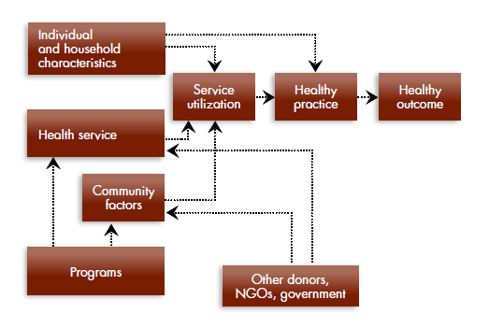

Slide 26
B. Results frameworks
Shows the direct causal relationships between the incremental results of the key activities all the way up to the overall objective and goal of the intervention.
Clarifies the points in an intervention at which results can be monitored and evaluated.
***Results frameworks are the type of framework used by USAID in what is called performance monitoring plans, or PMPs.

Slide 27
Components of the Results Framework.
Results frameworks include an overall goal, a strategic objective (SO) and intermediate results (IRs).
  A Goal defines the result that a project seeks to achieve.
  An SO is an outcome that is the most ambitious result that
  can be achieved and for which the organization is willing to
  be held responsible.
  An IR is a discrete result or outcome that is necessary to achieve an SO.

Slide 28
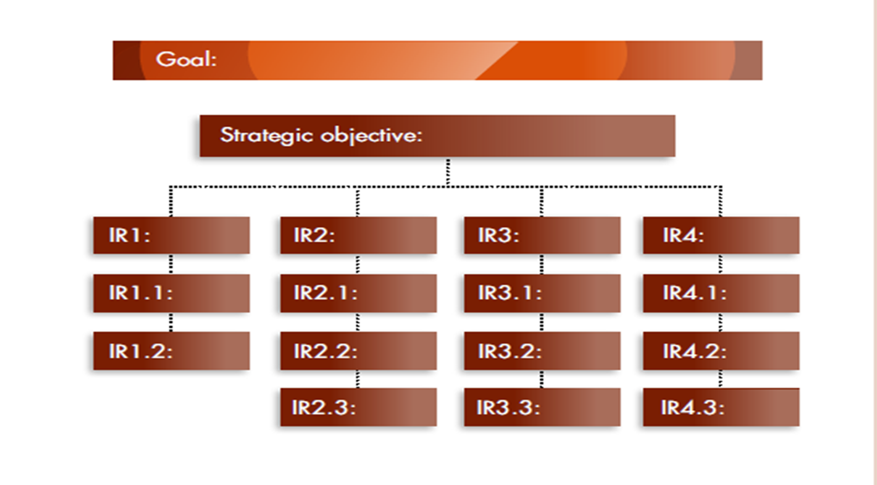
Results Framework illustration

Slide 29
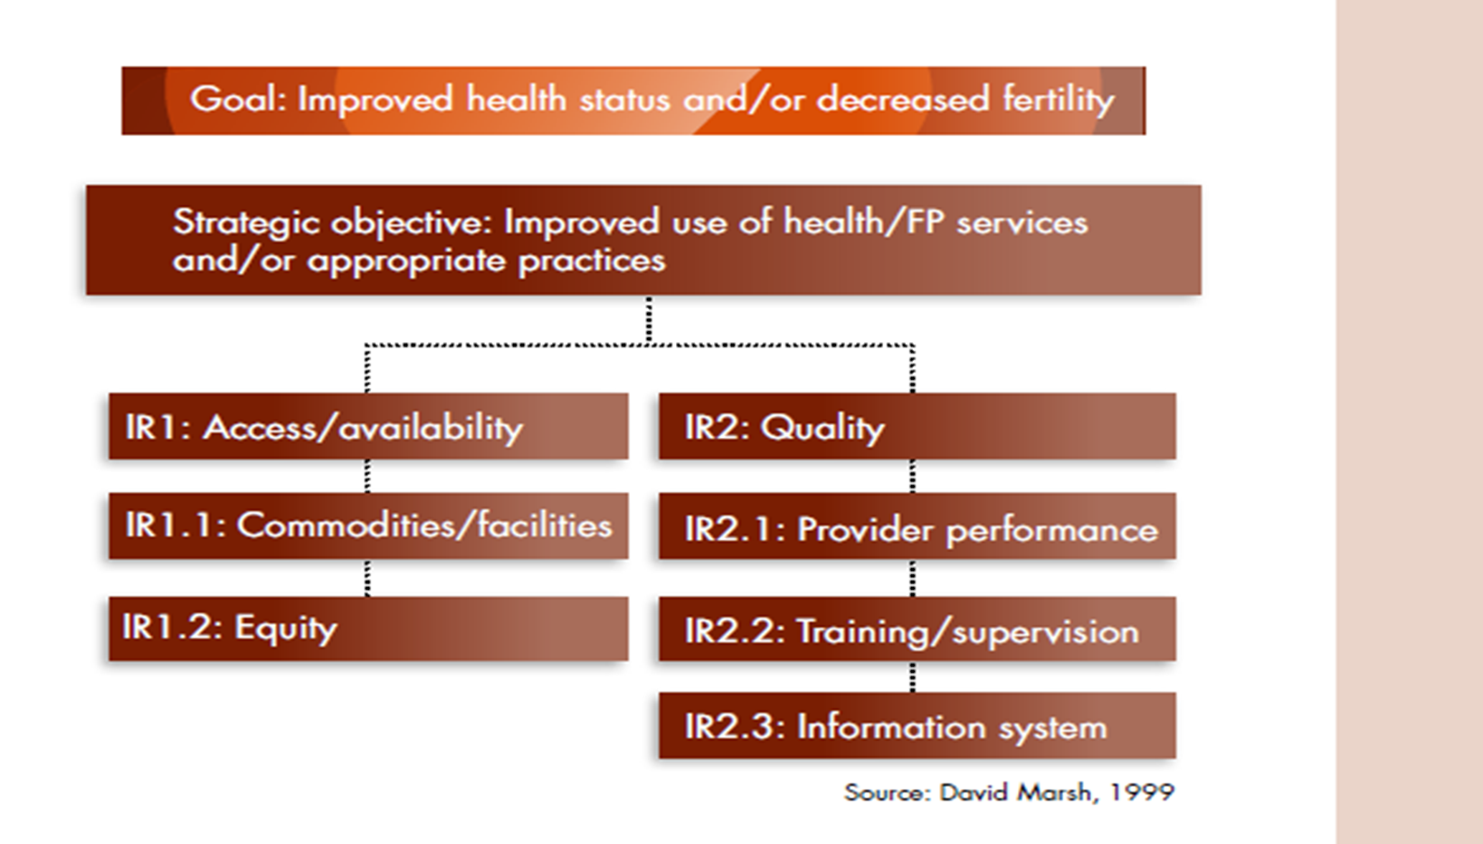
Project to improve health status and decrease fertility

Slide 30
Developing and Implementing M&E Frameworks

Slide 31
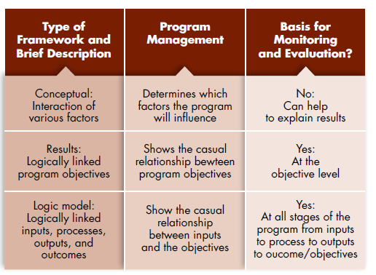
Factors to consider when developing and implementing M&E Frameworks.

Slide 32
Evaluation design
Evaluation design is the structure that provides the information needed to answer each of your evaluation questions.
Your intended evaluation design should be based on and aligned with the following:
  Your program’s theory of change and logic model
  Primary purpose of the evaluation and key research questions
  Funder’s evaluation requirements
  Resources available for the evaluation
Notes:
Facilitator notes: Up to this point in your evaluation plan, you’ve established the framework for your evaluation. After identifying the questions you want to answer, the next step is to explain the approach your evaluation will take to address those questions.
Evaluation design is essentially the structure that will provide you the information needed to answer each of your evaluation questions. The appropriate design for evaluating a program will largely depend upon certain considerations. This may include, but is not limited to:
Your program’s theory of change and logic model
Primary purpose of the evaluation and key research questions
Funder’s evaluation requirements: Many funders require their grantees to complete evaluations of their program. As you consider different evaluation designs, you should also have a clear understanding of whether your funder has any specific evaluation requirements that must be fulfilled. Those requirements may drive the purpose and scope of your evaluation. For example, it is important to note that CNCS has evaluation requirements for large and small re-competing grantees in terms of which evaluation design they may use to assess their programs. Large grantees are those receiving annual CNCS funds of $500,000 or more. Small grantees are those receiving annual CNCS funds of less than $500,000. You should note which type of design is required for your program.
Resources available for the evaluation: It is also important to take into consideration what resources (staff time, funding, evaluation expertise) are available to carry out the evaluation. In particular, your evaluation team must possess the skills and experience needed to carry out the type of evaluation design that is chosen. Think about whether you will be able to collect the data required for a given design. More complex evaluation designs require you to collect more data over multiple measurement points. This lengthens the data collection phase of the study and may require more sophisticated analyses to be conducted once the data are collected.

Slide 33
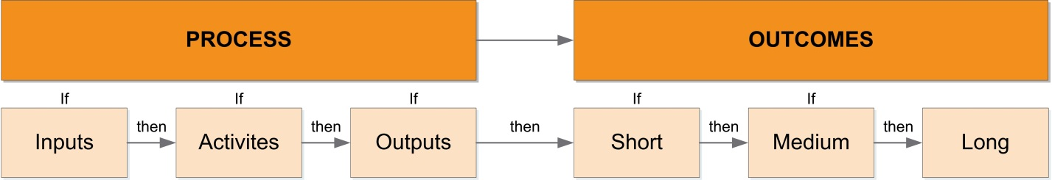
Evaluation design
What type of evaluation design will be used?
The two “sides” of a program’s logic model align with the two types of evaluation designs: process evaluation and outcome evaluation.
Notes:
Facilitator notes: Your evaluation plan should clearly explain the evaluation design that will be used and a rationale for why that design was selected for the evaluation. Just as there are process-oriented research questions and outcome-oriented research questions, there are two common types of evaluation design that fall along those same lines:
A process evaluation focuses on answering questions about your program’s inputs, activities, and outputs. A process evaluation examines how well the program’s implementation matches the theory behind its creation and confirms what the program actually does on the ground.
An outcome evaluation addresses how a program’s activities are related to changes, effects, and/or impacts on a program’s stated outcomes, whether short-term, medium-term, or long-term outcomes. In general, an outcome evaluation measures program beneficiaries’ changes in knowledge, attitudes, skills, or behaviors that are thought to result from the program.
Next, we are going to discuss each of these designs starting with the process evaluation.

Slide 34
Evaluation design
  Process evaluation
  Focuses on a program’s inputs, activities, and outputs
  Documents what the program is doing and the extent to which the program has been implemented as intended
  Informs changes or improvements in the program’s operations
  Includes qualitative and quantitative data collection
  Does not require advanced statistical methods
  Does not require a comparison or control group
Notes:
Facilitators Notes: We provide a few defining characteristics of process evaluations on this slide.
A process evaluation focuses on a program’s inputs, activities, and outputs
It can be used to document what a program is doing and to what extent and how consistently the program demonstrates fidelity to the program’s logic model.
The results of a process evaluation are most often used to change or improve the program. Process evaluations are able to address research questions about why a project is or is not successful, which can be very helpful for program staff and stakeholders because the results are useful for improving program practices.
The collection of both qualitative and quantitative data through interviews, surveys, and program administrative data is usually preferred.
Process evaluations mostly rely on simple descriptive statistics (means, frequencies, etc.) and do not require advanced statistical methods.
To answer the types of research questions associated with a process evaluation, generally a comparison or control group is not necessary. We will explain what a comparison or control group is on the next slide as we transition to talking about outcome evaluation designs.
It is also worth noting that the results of process evaluations are usually not generalizable, meaning that they can not be applied to similar program models being implemented in locations other than those participating in the evaluation. Note that a process evaluation design does not fulfill CNCS’s evaluation requirements for large, re-compete AmeriCorps grantees (i.e., grantees receiving funding of $500,000 or more annually), but does for small, re-compete grantees. This is because process evaluations focus on measuring how the program is operating rather than measuring it’s results (outcomes).
On the next few slides, we’ll talk about a few different outcome evaluation designs.

Slide 35
Evaluation design
Non-Experimental Outcome Evaluation Design
Outcomes are only tracked for the intervention group.
There are several variations within the category of non-experimental outcome designs, differing only in number and timing of outcome measurement points:
  Single group post-test
  Single group pre- and posttest
Intervention Group
 | Pre-test | Treatment | Post-test
a) Single group post-test |  | X | 0
b) Single group pre- and posttest | 0 | X | 0
X = intervention is administered
0 = measurement is taken
Notes:
Facilitator notes: A non-experimental outcome design only tracks or collects data on the outcomes for the intervention group (i.e., program beneficiaries). There are variations within the category of non-experimental outcome design, differing only in the number and the timing of outcome measurement points. These variations include:
Single group post-test: Data are collected only once from study participants, immediately after they complete the intervention/program. The major drawback of any single group post-test design is that it does not provide a baseline against which results can be compared. To assess change, you must be able to compare post intervention data with a baseline measure. As shown in the first row of the table.
Single group pre- and post-test: A pre- and post-test design measures outcomes among program beneficiaries before and after the intervention. With this design you simply administer the same measure twice, before and after the intervention. As shown in the second row of the table. The timing of the posttest measure is important. It should allow enough time for your program to have an effect, but not so much time that program effects are diluted or influenced by external factors such as participation in other programs or other environmental circumstances. You can improve upon the single group pre- and post-test design by additional measurement points post-intervention to gain a perspective on your program over time.
If you’ve chosen to use a non-experimental evaluation design, the number and timing of your outcome measurement points should be specified in your plan.
Compared to the other two outcome evaluation designs that we’ll talk about next – experimental and quasi-experimental – a non-experimental outcome evaluation design does not provide the least credible evidence of program effects and therefore does not fulfill CNCS’s impact evaluation requirement for large, re-compete grantees. Again, this is because a non-experimental outcome evaluation design does not follow a comparison or control group which is needed to produce estimates of what would have happened in the absence of the program. More rigorous outcome evaluations, such as quasi-experimental and experimental design studies, include a comparison or control group against which to measure changes in program beneficiaries, and are thus able to measure or estimate the impact of a program.

Slide 36
Evaluation design
Quasi-Experimental Evaluation Design
Defined by collecting data on two or more study groups – an intervention group and a comparison group.
The intervention and comparison groups are identified from pre-existing or self-selected groups and are not formed through a random assignment process.
 | Pre-test | Treatment | Posttest
Intervention Group | 0 | X | 0
Comparison Group | 0 |  | 0
X = intervention is administered
0 = measurement is taken
Pre-existing differences between the intervention and comparison groups at the outset of the intervention may lead to inaccurate estimates of the program’s effects.
Notes:
Facilitator notes: A quasi-experimental evaluation design is distinct from a non-experimental outcome evaluation design in that it’s defined by collecting data on two or more study groups – one is the intervention group (i.e., the program’s beneficiaries) and the other is a comparison group (i.e. the study participants that do not receive the intervention or program services and thus serve as the basis for comparison when assessing the effects of an intervention on a program’s beneficiaries). Including a comparison group enables you to answer specific questions related to causality – such as, what would have happened to people if they did not receive the intervention your program offers (i.e., whether the observed changes can be attributed to your intervention).
In a quasi-experimental evaluation design, the intervention and comparison groups are identified from pre-existing or self-selected groups and not through a random assignment process. We’ll talk about random assignment when we turn to the next slide on experimental evaluation design. In a quasi-experimental design, for example, the intervention group often consists of individuals who self-select to participate in the program being evaluated while the comparison group consists of individuals who have similar characteristics to the intervention group EXCEPT that they are not served by the program or are participating in a different program. The key is that your comparison group does not receive the same intervention that is being evaluated because you want that group to serve as a point of comparison for the group that does receive the intervention.
It is important to note that you should be thoughtful in your selection of a comparison group to ensure that it is as similar as possible to intervention group. This is key to ensuring that evaluation findings are an accurate estimate of the program’s effect. In most cases, you will want an experienced evaluator to use statistical matching to ensure that your comparison group is as similar as possible to the group of program beneficiaries in your evaluation.
Because the intervention and comparison groups are formed through a non random way, a limitation of quasi-experimental evaluation designs is that the study groups may differ in systematic ways, or in other words, in ways that are not due to chance, that then may account for some of the differences that are observed between the groups on the outcomes measured after the intervention. In a strong quasi-experimental design study, to reduce the potential for bias or error in the results, evaluators will attempt to use data (e.g., demographic data, baseline test scores) to make the intervention and comparison groups similar to one another on any observable characteristics that may affect the outcome(s) of interest. If using the homelessness prevention program as an example, the comparison group of families should be similar in size and structure (e.g., number of dependents, marital status), household income, parents’ education attainment, and racial/ethnic composition. An experienced evaluator will be able to use advanced statistical methods such as propensity score matching or statistical controls to ensure that the treatment and intervention groups are comparable.
If you’ve chosen to use a quasi-experimental evaluation design, the number and timing of your outcome measurement points for both your intervention and comparison groups should be specified in your plan.
In sum, a quasi-experimental design provides comparatively stronger evidence of program impact than a non-experimental design, and if well-designed and executed, may fulfill CNCS’s impact evaluation requirement for large, re-compete grantees. At the same time, a quasi-experimental design provides comparatively weaker evidence of program impact than an experimental design. This is because pre-existing differences between the intervention and comparison groups at the outset of the intervention may lead to inaccurate estimates of the program’s effects.
The image at the top right illustrates the most common form of a quasi-experimental design which includes a pretest and a posttest measure from both the intervention group and the comparison group.

Slide 37
Evaluation design
Experimental Evaluation Design (Randomized Controlled Trial)
 | Pre-test | Treatment | Posttest
Intervention Group Randomly assigned | 0 | X | 0
Control Group Randomly assigned | 0 |  | 0
Defined by collecting data on two or more study groups – an intervention group and a control group.
Random assignment techniques (e.g., lottery draw) are used by the evaluator to assign study participants to either the intervention or the control group.
X = intervention is administered
0 = measurement is taken
Random assignment ensures the study groups are equivalent prior to intervention, thus experimental designs are often considered the most credible design in regards to producing evidence of program impact.
Notes:
Facilitator notes: An experimental design is similar to a quasi-experimental design in that it follows two or more study groups – one is the intervention group and the other is the control group. In an experimental evaluation design, the term control group rather than comparison group is used to describe the study group against which to measure the outcomes of program beneficiaries. The key difference between a quasi-experimental and an experimental evaluation design has to do with how the intervention and control groups are formed. In an experimental evaluation design, the evaluator employs random assignment techniques (e.g., lottery draw) to assign study participants to either the intervention group or the control group. This means that each study participant has an equal chance of being assigned to either the intervention group or the control group. The control group in an experimental design may receive no services or alternative or delayed services. The use of random assignment in experimental designs creates as equal groups as possible by ensuring that there are no systematic differences between the program and control groups. The process of randomly assigning program applicants for experimental design studies is complex and generally requires specific tailoring to each program’s unique application and intake process. For this reason, random assignment is best conducted using a professional evaluator with experience completing these types of evaluations.
The key benefit of using random assignment is that it “evens the playing field.” This means that the groups will differ only in the program or treatment to which they are assigned. Random assignment does not guarantee that the groups are "matched" or equivalent, only that any differences are due to chance. If both groups are equivalent except for the program or treatment that they receive, then any change that is observed after comparing information collected about individuals at the beginning of the study and again at the end of the study can be attributed to the program or treatment. This way, the evaluator has more confidence that any changes that might have occurred are due to the intervention that’s being evaluated and not to the characteristics of the group. Evaluation studies that use an experimental design are often considered to be the most credible in regards to producing evidence of program impact. If well-designed and implemented, this design fulfills CNCS’s impact evaluation requirement for large, re-compete grantees.
Again, if you’ve chosen to use an experimental evaluation design, the number and timing of your outcome measurement points for both the intervention and control group should be specified in your plan.

Slide 38
Evaluation design
Describe your evaluation study group(s)
The evaluation design section of your plan should provide a description of each study group.
Explain how each study group will be identified.
  Define the target population from which you will recruit your study group participants.
  Describe how you will access or recruit participants for each study group.
  Specify any applicable eligibility criteria for each study group (e.g., study participants from your target population must be within a certain age range, hold a certain degree type).
Notes:
Facilitator notes: At this point, we’ve discussed the three main types of outcome evaluation designs: non-experimental, quasi-experimental, and experimental. As part of your description of the evaluation design that you’ve chosen to answer your research question(s), it is important to describe each of your evaluation study groups and how you plan to identify and recruit study participants.
Specifically, if you are conducting a non-experimental outcome evaluation design, only one group of study participants, that is, program beneficiaries, should be described. Quasi-experimental and experimental designs should describe both the intervention group and the comparison or control group and include an explanation of what the comparison or control group will receive (e.g., no intervention, a different intervention).

Slide 39
Evaluation design
Type of Outcome Evaluation Design | Control or Comparison | Ability to produce causal evidence about a program
Which one? | Randomly assigned intervention and control groups
Which one? | Statistically matched intervention and comparison groups
Which one? | Not statistically matched groups or group compared to itself
Notes:
Facilitator notes: To tie together our discussion of the three types of outcome evaluation designs, let’s work together to complete this table by indicating which type of design best fits the description in the two columns on the right.
Facilitator – Ask the audience which of the three designs meet the description for each row. Then ask them which designs may fulfill CNCS’s evaluation requirements for large, re-compete grantees.
Answer key: From bottom to top:
Non-experimental
Using the homelessness prevention program as an example, a non-experimental outcome evaluation would only collect data on the outcomes of families who participated in the homelessness prevention program.
Quasi-experimental
Using the homelessness prevention program as an example, a quasi-experimental evaluation would collect data on the outcomes of families who participated in the homelessness prevention program and a comparison group of families that did not participate in the program. The comparison group of families live in a neighboring county that does not have a homelessness prevention program and they are similar to the families that participated in the program with regard to certain demographic characteristics. Because the intervention and comparison groups were not formed through random assignment, the evaluator will use statistical techniques to make the two groups as similar as possible.
Experimental –
Using the homelessness prevention program as an example, an experimental evaluation would collect data on the outcomes of families who participated in the homelessness prevention program and a control group of families that did not participate in the program. In this case, the program had more applicants for homelessness prevention assistance than could be served at any one time. Families would be informed at the time of program application that they will either receive the homelessness prevention program services or no services at all (at least while the evaluation is being conducted). The evaluator would then randomly assign the recruited study participants to either the intervention group or the control group. Because each family had an equal chance of being in the intervention or the control group, there should be no systematic differences between the groups, that is, no differences other than those due to chance, thus any differences that are observed in the outcomes can be attributed to the program. ‘
The differences between national performance measure outcomes and evaluation outcomes are often confusing. If a grantee is planning to conduct an impact evaluation (e.g., quasi-experimental and experimental design studies), the addition of a control/comparison group provides an important element that differentiates evaluation from performance measurement. In impact evaluations, an outcome is the change resulting from a program’s activities or services relative to any change found in a control or comparison group.
For both impact evaluations and non-experimental outcomes evaluations, CNCS encourages grantees to build upon their national performance measure outcomes, when appropriate. However, they do not want grantees to simply report or reformulate these same outcomes for their evaluations. Instead, grantees should go beyond these measures in some way. Some options for grantees to consider include: 1) adding another outcome that is different from the performance measure outcome; 2) including one more post-test at a later point in time (6 or 12 month follow-up, for example); or 3) conducting an implementation evaluation alongside the outcome evaluation.

Slide 40
Timeline
Include a timeline of when you expect to carry out each of your key evaluation activities specified in your plan.
Evaluation Activities Q1: Sept-Nov; Q2: Dec-Feb; Q3: Mar-May; Q4: Jun-Aug | Example of Timing of Activities for Grant Year 1 – Grant Year 3
 | Year 1 |  |  |  | Year 2 |  |  |  | Year 3
 | Q1 | Q2 | Q3 | Q4 | Q1 | Q2 | Q3 | Q4 | Q1 | Q2 | Q3 | Q4
Develop/refine logic model | +
Hire/identify evaluator | +
Develop evaluation plan and data collection tools |  | + | +
Recruit study participants |  |  |  | +
Data collection |  |  |  |  | + | + | + | +
Analysis/ interpretation |  |  |  |  |  |  |  |  | +
Report/ dissemination |  |  |  |  |  |  |  |  | + | +
Notes:
Facilitator notes: Let’s turn now to one of the final sections of your evaluation which concerns your evaluation timeline. Your evaluation plan should include a detailed timeline of when you expect to carry out each of your key evaluation activities specified in your plan. What’s presented on this slide is a much simpler example of an evaluation timeline over a three year period to give you a general idea of some of the key evaluation activities to consider as you plan for your evaluation. You may find it helpful to lay out a more detailed timeline that lists each of your key evaluation activities and maps out when you expect the activity to start and end and who is responsible for carrying out the activity for added accountability. You want to make sure your timeline is feasible and aligns with any requirements set forth by your funder.

Slide 41
Budget and other
Include an estimated budget for your evaluation. Common cost categories:
  Staff time
  Materials, equipment, and supplies
  Travel
  Data collection
Include any other relevant information that is not in other sections of your evaluation plan:
  Institutional Review Board (IRB) clearance
Notes:
Facilitator notes:. An estimated budget for your evaluation also should be included in your plan. The cost of evaluations varies widely and will depend on the type of study design, the size of the study, the level of expertise and experience of the evaluator, and data collection expenses. Other common considerations for creating a program evaluation budget are: staff time; materials, equipment, and supplies; travel costs; and data collection. With respect to this last item, evaluations involving more primary data collection tend to be more expensive than those that rely on existing internal program records or external data sources. This is not a comprehensive list of cost consideration. Depending on the program to be evaluated and/or the actual evaluation activities, there may be additional expenses required.
If there is additional information relevant to the evaluation that does not align with the other key sections of your plan, consider it in this section. One example would be information on obtaining Institutional Review Board (IRB) clearance, if that is deemed necessary for your evaluation. IRBs are committees that review research protocols and other materials to ensure the rights, safety, and welfare of human subjects participating in studies. The IRB can certify that the rights of subjects will be protected, that any potential adverse effects on participants will be minimized, and the data will be securely managed and maintained. IRB clearance may be required by your agency leadership or funding source, so it is important to understand what is required before you begin to recruit study participants and collect data. An experienced evaluator should be aware of any IRB clearance requirements that will need to be fulfilled before data collection can begin.

Slide 42

End

