Slide 1

Overview of Impact Evaluation/ Assessment
Dr Margarate Munakampe

Slide 2

PROGRAM EVALUATION

Slide 3

Outline
  Process evaluations
  Outcome evaluations
  Impact evaluations

Slide 4
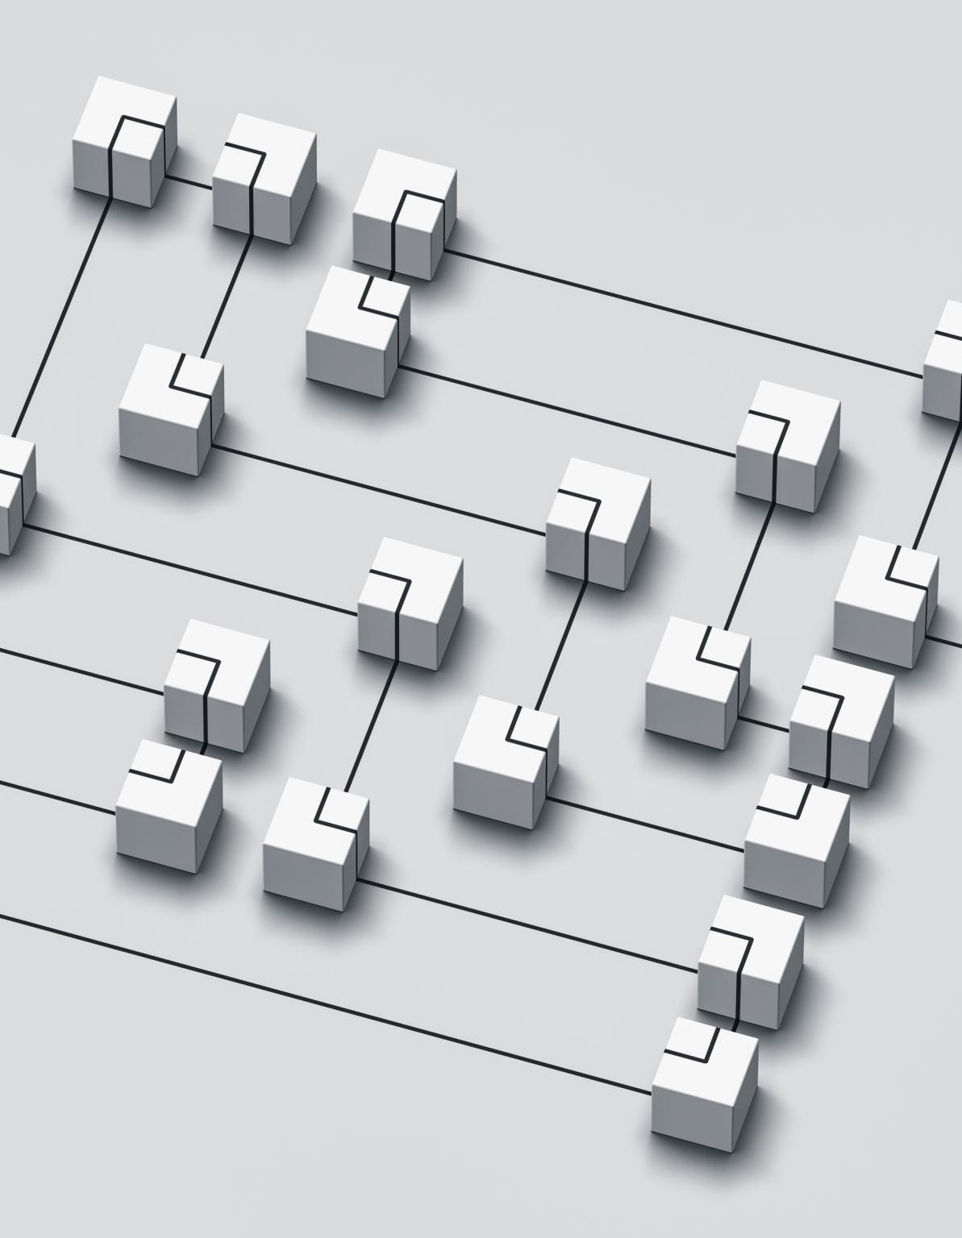
Process evaluation
A process evaluation is a systematic method used to assess the implementation of an intervention or program.
It involves examining how the intervention is delivered, the fidelity to its intended design, the interactions between different components, and the context in which it is implemented.

Slide 5
Process evaluation
The aim of a process evaluation is to understand the mechanisms of action, identify facilitators and barriers to implementation,
  and provide insights into the effectiveness of the intervention.
It helps researchers and stakeholders understand why an intervention succeeds or fails, and
  provides valuable information for improving future implementations.

Slide 6

BASELINES
For this reason, the more indicators there are, the more complex (and costly) the monitoring process can be.
In addition, if an impact evaluation is planned, baseline data needs to be collected on a representative sample of the whole eligible population to allow for the random selection of participants and nonparticipants.

Slide 7

BASELINES
This may considerably increase the cost of data collection.
Performance indicators and data collection strategies need to be grounded in the type of data system in place and the figures that can be produced
  (sources, collection methods, frequency and costs).

Slide 8

MID-LINES
A mid-term evaluation is conducted for an ongoing program or project.
It serves two immediate purposes:
  Decision-making; and
  Taking stock of initial lessons from experience.
Also known as mid-term review

Slide 9

END-LINES
End-line evaluation to assess the extent to which the project outputs have been achieved taking into account the indicators given in the project document.
To evaluate the level of contribution of the outputs towards the achievement of the expected project objectives, goals, and impact.
Impact assessment

Slide 10

Questions?

