Slide 1
Basic Concepts of District Health Planning
Linda Kampata-Olowski

Slide 2
Objectives
Identify the main groups of determinants of the district health status
Define planning and district health planning
Relate district health planning to national policy and strategies
Distinguish between short- medium- and long-term planning
Outline the planning cycle
Identify participants in the district health planning team
Identify the main important issues to take into account during the planning process

Slide 3
Introduction
What is planning?
What is a plan?
What is health planning?
What is health services planning?

Slide 4
Introduction
Plan
  a well thought decision about a course of action
Planning
  a systematic process
    identifying and specifying desirable future goals and
    outlining appropriate courses of action and
    determining the resources required to achieve them
Health planning
  improving the health status of a given population
  safeguarding equity and fairness of access
  responsiveness of the health system to the perceived needs of the community.
    resources and the available means and methods of health care.

Slide 5
Introduction
The health plan should achieve this goal through the provision of efficient and effective health services, taking into account available

Slide 6
Health Planning
Health planning requires a background understanding of the functioning of the health system in a given country
Health system
  three important elements that are highly interdependent
    community,
    health service delivery system and
    environment
Notes:
Figure 1 illustrates the interdependence of these elements
So let’s look at this triad

Slide 7
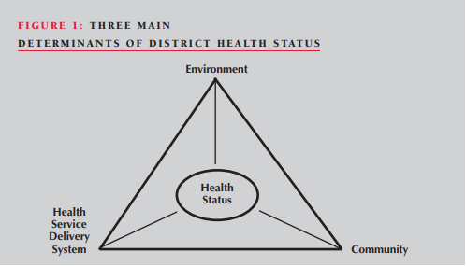
Determinants of health status
Notes:
Environment
This, for example, could be the context in which the health service delivery system operates.
The contextual environment could be the political system, health-care policies and development policies.
It could also include the socio-economic status or the physical environment, e.g. climatic conditions.
All these elements have a bearing on the health status of the individual and the community, as well as the functioning of the health service delivery system.
Health service delivery system
This depicts how health facilities are distributed in the community, which could also have a bearing on coverage.
Similarly, health services could be viewed in terms of their affordability and responsiveness to equity which contribute to the health status of the community
Community
The characteristics of the society, such as culture, gender, beliefs and health-seeking behaviour, together with the environment and health service delivery system, determine the health status
Now that we have an understanding on how the health status in our catchment area can be affected, how can we plan for health service delivery at district level?

Slide 8
District Health Planning
What is district health planning?
Notes:
District health planning is a process, which takes approximately one year, in which teams of health workers are guided, (with rigorously structured sequences of assignments) in:
conducting their own analysis of one high priority public health problem, for example in PHC or RH in their district
devising and then implementing their own solution to this problem over a one year period
conducting and presenting the results of their own evaluation of their implementation (progress, constraints, service improvements, and health impact)
developing the ability to gather and use data
developing good team work and improved managerial skills

Slide 9
District Health Planning
A process through which teams of health workers are guided, (with rigorously structured sequences of assignments)
Conducting their own analysis of priority public health problem in PHC or RH in their district
Devising and implementing solution to problem over a one year period

Slide 10
District Health Planning
Conducting and presenting evaluation results from implementation (progress, constraints, service improvements, and health impact)
Developing the ability to gather and use data
Developing good team work and improved managerial skills

Slide 11
Classification of Health Plans

Slide 12
Classification of Health Plans
Classification can be based on following criteria
  Flexibility of the plan
  Duration of the plan
  Nature and scope of the plan (level)

Slide 13
Flexibility of the plan
Fixed plan
  Covers rigid period of time, fixed objectives, fixed inputs for implementing the plan
Rolling plan
  Flexible, continuously revised and updated.
  Cover fixed period which is subdivided into units which dove tail one into another.
  Targets and resource inputs are flexible and dictated by prevailing circumstances.

Slide 14
Duration of the plan
Short-term plans
  District health plans are of one year duration
  Annual plans
Medium-term plans
  District may have plans which go beyond one year and cover 2-3 years
  These are rolling plans and forward budgets
Long-term plan
  District may have a plan covers a period exceeding 3 years, say up to 5 years

Slide 15
Nature and scope
Three types
  Strategic plan
  Tactical plan
  Operational plan
Each type takes place at all levels of management but at varying degrees
Strategic plan provides general framework for more detailed tactical and operational planning
Notes:
Strategic Plan
Prepare broad policies and strategies
Usually long term e.g five years or more
Usually cover large area
Set priorities for health development
Determine strategies to attain health goal
Relevance enhanced by “bottom – up” planning
Deals with broader level policy paradigms
Development of vision, mission, values, strategies
Tactical/operational
Formulate detailed objectives and timed targets
Products include; procedures, standards of performance, job descriptions, schedule of activities
Development of programmes and projects
Operationalisation of policy plans
Operational plan
Activity plan detailing precise timing, methods and modes of implementation.
Operational planning is about making things happen.
It is a tool for: managing existing resources effectively, monitoring implementation and resource use, ensuring that activities are carried out on time, ensuring that budgets are spent as intended e.t.c

Slide 16
Strategic Plan vs. Operational Plan
SP is the big picture while OP is the detail
OP is the engine room that drives the SP
Without the Operational Plan, the Strategic Plan remains a dream
OP is about inputs, activities, processes and outputs
SP is about outcome and impact

Slide 17
Levels of health planning
Micro plan
Plan at the regional level
Districts
Plan for services and interventions
Usually a short term
Operational perspective
Macro plan
Usually developed at higher levels
National or provincial
Usually long term
With strategic perspective
Notes:
Levels of health planning
Policy formulation
Macro-plans (national level)
Micro plans (intervention plans)
Usually at district/provincial level

Slide 18
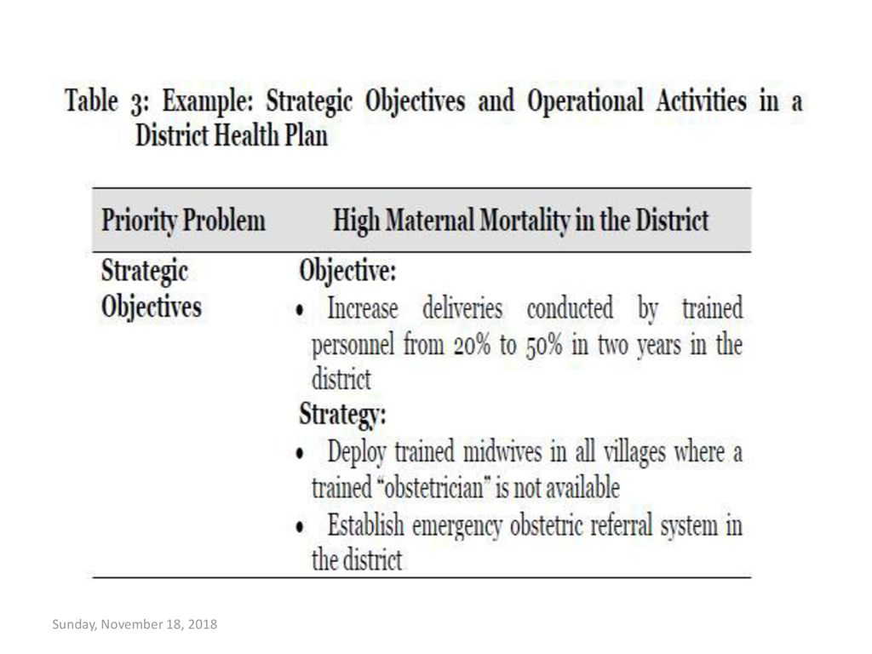

Slide 19
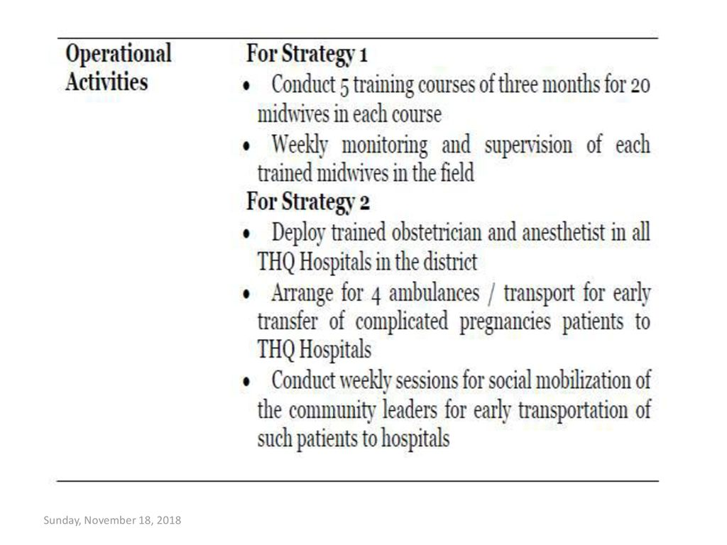

Slide 20
District Health Planning

Slide 21
District Health Planning
District is the basic unit for dispensing of health services
Consistent with the specific needs of the people, the growth potential of the area and budgetary allocation available
District is the micro decision making unit, it can implement innovation and experimentation to deal with own problems and satisfy the basic needs

Slide 22
District Health Planning…
Districts have a framework of the NHP, central 5 year plan, national plan and their priorities
Districts make plans according to local specific needs

Slide 23
Why is District Health
Planning Needed?

Slide 24
Reasons for District Health Planning
Translation of a “new” health policy statement into a plan of action
Translation of a “master plan” such as a national plan into a district plan
Re-planning on the basis of an already existing plan, for the purpose of
  reviewing existing health problems and needs and
  rendering services which are more effective and efficient.

Slide 25
Reasons for District Health Planning…
Emergence of a new health problem,
  e.g. HIV, Ebola, Covid 19,
  re- emergence of a known health problem, e.g. tuberculosis and malaria, which may require a special strategy or programme
Meeting the necessary standards and achieving the set objectives
Economizing on available resources
Ensuring coordinated effort and action

Slide 26
Reasons for District Health Planning…
Cope with major health issues in a sustainable manner
Ensure effective coordination and avoid unnecessary duplication
Promote optimum utilization of resources
Ensure equitable distribution of health resources and services
Facilitate monitoring and evaluation of health services

Slide 27
District health planning team
Core members may include:
  District health directors
  District planning officer
  DHMT members
  Community representative and users
  Regional health management team (RHMT) representative
  Representative from the rural health centre

Slide 28
Health Planning Cycle

Slide 29
Planning Cycle
A sequence of steps which must be followed in deciding what is to be included in the plan
The cycle seeks to answer the following questions:
  Where are we now?
    requires a situational analysis to identify current health and health-related needs and problems.
Notes:
The Planning Cycle (Steps of preparing a plan)
The planning cycle is a sequence of steps which must be followed in deciding what is to be included in the plan. The cycle seeks to answer the following questions:
Where are we now?
This requires a situational analysis to identify current health and health-related needs and problems.
What is situation analysis?
The Situation Analysis is the process of analyzing and interpreting all information available from the various sources, on the current situation of the health system as it prevails within the specific geographic area under Consideration
A methodology to assess where we are now
A comprehensive analysis of the past and present situation in terms of a selected number of variables
Identify and assess achievements and limitations of the past and ongoing health interventions
This includes the collection, assessment and interpretation of information in such a way that it provides a clear picture of the health situation
This involves assessing the following information required for situation analysis:
Epidemiological situation – statistics of morbidity and mortality, pattern and distribution of disease, etc.
Demographic situation – age, sex, total population, etc.
Socio-economic situation – living status and economical condition, etc.
Health status situation – incidence, prevalence of diseases
Vital statistical data
Health resource and health service situation – medical budget, medical care facilities
Cultural situation – attitudes and beliefs of the population towards disease and treatment
Data collection methods
Existing data – published, routine
Surveys – qualitative, quantitative
Sources of information
Vital Statistics
Census
Health Information Systems
Hospital Records
Health System Review, also called Health System Analysis
Special Surveys in the Field
Qualitative Methods for Data Collection
Components of situational analysis
Determine existing problems;
2. Prioritize problems;
3. Ascertain available resources for addressing existing
problems; and
4. Identify weaknesses and strengths of the existing
system

Slide 30
Planning Cycle
  Where do we want to go?
    Requires the selection of priorities
    Identification of objectives and targets to be met in order to improve the health situation and/or service delivery in a district
Notes:
The Planning Cycle (Steps of preparing a plan)
Conducting a need assessment or problem identification
A problem is difficulty or obstacle seen to exist between a present situation and a desired future objective
A perceived gap between what it is and what it should be
Problem has to analysed for
it’s magnitude
causes
consequences
Health planner has to set a clear definition of the problems including its extension and severity
To do this, the planner should conduct a needs assessment by collecting data from various sources
Generated information from local peoples, local hospitals and health establishments should be verified to confirm the actual situation
Where do we want to go?
This requires the selection of priorities and
What is priority setting? And what factors must be considered
Priority determination is a method of imposing peoples values and judgement
Community participation is essential to determine the priority
It is mainly depends on two factors:
The population
Large number of affected population
Risk group e.g. children, handicapped persons, elderly persons
Low income minority group
The diseases
The severity and type of diseases also determine the priority e.g. life threatening disease affecting few people gets priority than common cold affecting large population
Task prioritization
The task of prioritization involves analysis, assessment and grading of problems in order of relative importance
The criteria for ranking health problems is
Magnitude
Severity
Feasibility
Cost of intervention
Political commitment
There are different methods used to prioritize
80:20 rule
Urgent and important model
Nominal group technique
Modified delphi technique
Problem analysis tools used include
Cause and effect diagrams
Fishbone analysis
Problem tree
Define the problem
identification of objectives and targets to be met in order to improve the health situation and/or service delivery in a district.
Determination of program goals objectives and targets
Setting objectives and goals are specific process to solve a problem
Goals – broad and future oriented statement of the desired condition
Objectives – intended result of a successful activity/programme, should be SMART
Targets – quantified statement of desired change in a key indicator over a given time period in a specified geographic area
SMART – Specific, measurable, achievable, relevant, time-bound
Unless setting an objective and goal of the programme will be haphazard activity, uneconomical use of funds and poor performance will occur
The program goals, objectives and targets should be precise and specific e.g. by the year 2005 more than 90% of the population aged 6 to 17 years in Monze will not have lost any tooth as a result of caries and at least 40% will be caries free
Objectives are not only a guide to action but also a measuring stick of work after it is done

Slide 31
Planning Cycle…
  How to get there?
    Details and organizes the tasks or interventions to be carried out, by whom, during what period, at what costs and using what resources in order to achieve set objectives and targets
  How to know when we get there?
    Requires the development of measurable indicators for monitoring progress and evaluating results.
Notes:
How will we get there?
This details and organizes the tasks or interventions to be carried out, by whom, during what period, at what costs and using what resources in order to achieve set objectives and targets.
Assessment of resources
When a program is planted, the availability of the resources is to be identified
The term resources means man, money, materials and management (4-M)
The resources are assessed and balanced by comparing it with what is available in terms of resources
Identifying constraints
During the planning, there maybe many constraints that create, block or obstacle in achieving a certain goals or objectives
Constrains may result from organization, policies, resources limitation or characteristics of the community such as lack of funding, inadequate transportation system, labour shortage
All of the above mentioned problems and its possible solution or alternatives should be identified
Setting alternative strategies
Being aware of the existing constraints and given resources
It is important to generate a sufficient number of alternatives so that out of that at least one may be considered to be acceptable
Determination and analysis of strategies
A strategy denotes a broad line of actions to be undertaken at different levels of administration in and outside the sector in order to achieve the desired goals and objectives
To implement a strategy, a variety of activities with specific outcomes are needed for a specific time duration
In order to identify program/project strategies, it is first necessary to examine internal and external data related to your program
Internal data – describe the current status of your program and how it operates, gathered from your situtaional analysis
External data – describe the population that the program serves and the environment in which your program operates
Use these internal and external data to conduct a SWOT (strengths, weaknesses, opportunities and threats) analysis of the program
Program strengths – are the elements internal to the health program that facilitate reaching the program goals
Program weaknesses – are internal elements that are barriers to reaching the program goals
Program opportunities – are aspects of the external environment that facilitate reaching program goals
Program threats – are aspects of the external environment that are barriers to reaching program goals
Use the results of the SWOT analysis to determine the best approaches of the program to meet its stated goals. These approaches are the strategies
Major Activity identification
Identify the major activities for each selected strategy
Determine their sequence and timeframe
Prepare a plan of action including activities, timeframe and responsibilities
Programming and implementation
Many well considered plans have fallen down or failed because of delays in critical supplies, inappropriate use of staffs and similar factors
So, programming and implementation is essential for successful planning
Programming also includes finance and budgeting aspects
Estimate financial requirements for the necessary resources: physical, material, human resources, etc.
A detailed description of the costs of the project should be prepared
The budget should cover the whole project period year-wise
List each strategy and the activities associated with it
List the materials and equipment required for each activity
List operating costs under appropriate headings such as personnel, communication, transport, etc.
Contributions made by the organization such as manpower, equipment or buildings should be stated explicitly
Budget summary
Capital cost by items
Recurrent cost by items
The main considerations at the implementation stage includes:
Definition of roles and tasks
Distribution and responsibility of works should be done
The selection, training, motivation and supervision of the manpower involved
Organization and communication
How will we know when we get there?
This requires the development of measurable indicators for monitoring progress and evaluating results.
Monitoring
Monitoring is day to day follow-up of activities during their implementation to insure that they are proceeding as planned
It is a continuous process of observing, recording and reporting on activities of the organization or project
Monitoring is a process of identification of deviations and taking corrective action if excessive deviation occurs
Regular ongoing process to ensure that operations are proceeding as planned and on schedule
Monitoring tools
Schedules
Activity designs
Progress reports
Gantt charts, etc.
Evaluation
A systematic way of learning from experience and using lesson learned to improve the current activites and promote better planning by careful selection of alternative for future actions
Types of Evaluation
Input evaluation
Process (audit) evaluation
Efficiency (output) evaluation
Cost efficiency evaluation
Effectiveness (outcome) evaluation
Impact evaluation
Relevance and the adequacy of each components are considered in evaluation
Evaluation should be done to examine the quality and quantity of the work achieved during the procedure
It is a specific time interval or at the end of the project
The attitudes of the recipients of the program should also be examined to determine whether the program will be accepted to them, if not the program may need a revised plan

Slide 32
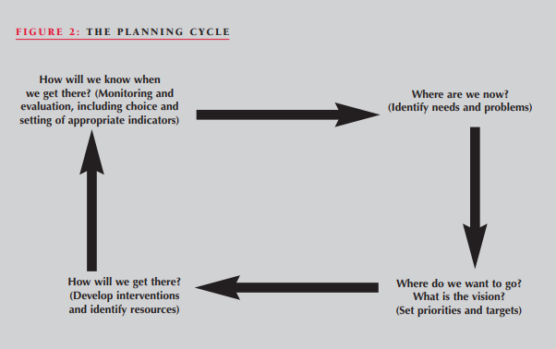

Slide 33
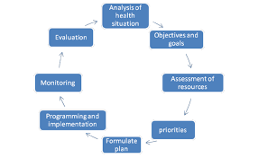
Planning Cycle…

Slide 34
Considerations during planning
Use of local (district) data
Community information
Local research information and data
Essential services
Delegation of planning and implementation
Community partnership
Cost-effectiveness
Accountability

Slide 35
District Health Profile

Slide 36
District Health Profile
Provides information about the district in an organized manner and in one document
Assists one to pick up and interpret important features of the district
Considering the importance of the district health profile in the planning and management of district health services, it should be
  updated regularly, preferably on an annual basis, and
  before the planning session commences

Slide 37
District Health Profile…
The district health profile should include information and data on:
  Geographical features;
  Economic activities, including food production;
  Literacy rates;
  Demographic data (total population, women of child bearing age, children under one and under five, population growth rate, crude birth rate, crude death rate, infant mortality rate, under-five mortality rate, maternal mortality rate, etc.);
  Epidemiological data (top 10 causes of morbidity and mortality) for inpatients and outpatients;

Slide 38
District Health Profile…
The district health profile should include information and data on:
  Health services provision and use (patient bed ratio, bed occupancy, etc.) ;
  Access to water and sanitation facilities;
  Health resource data (human, material, financial) including distribution and gaps;
  Physical health infrastructure, e.g. status of buildings;
  Major health status and health service problems by priority;
  Membership of district health board and facility committees;

Slide 39
District Health Profile…
The district health profile should include information and data on:
  Communication facilities (transport, telephone, radio, roads);
  A district map with the necessary details, including divisions, wards, roads, health facilities, etc;
  Major key partners in health in the district, e.g. NGOs, private (for profit and non-profit) community;
  Medical equipment;
  Existing training institutions and training resources;
  Available/functional health committees

Slide 40
Source information for
District Health Profile
The DHMT can obtain information and data for the preparation of the district health profile from a number of sources including:
  HMIS
  District annual reports
  Survey and research reports
  Project and programme plans and reports
  Vital statistics records
  Census

Slide 41
Questions???

