Slide 1
Health Services Planning and Budgeting
Planning for implementation

Slide 2
Lecture Objectives
By the end of this week, you should be able to;
  To assess equity issues in planning and implementation
  To identify barriers and facilitators of implementation
  Examine the impact of politics and policies on planning
  Understand the district health profile

Slide 3
Lecture outline
  Equity considerations in health service planning: tools and techniques
  Health service planning facilitators and barriers
  Prevailing political and policy impacts on health service planning
  Basic concepts of district health planning
  District health profile

Slide 4
Equity considerations in health service planning

Slide 5
MOH Mission Statement
To provide equitable access to cost effective, quality health services as close to the family as possible
But what is equity?

Slide 6
Equity
The absence of differences in health or access to health services/resources between social groups
Health among the population which can be said to be just or fair
The fair distribution of healthcare resources among the population
Inequity is unfair differences in health or access to health services between social groups
Equity different from equality

Slide 7
Equity vs. Equality
Equality
  Aims to ensure that everyone gets the same things in order to enjoy healthy lives
  Everyone should have same access to health care providers and services regardless of their ability to pay
  Everyone should have similar health status and similar health care needs
  Equality doesn’t result in fairness

Slide 8
Inequity
Inequity can be caused by the following;
  Social structure
  Political Institutions
  Economic institutions
  Legal institutions

Slide 9
Horizontal vs. Vertical Equity
Horizontal Equity
  Provision of the same health services to individuals in the same state of need (Fein 1972)
  Equal treatment for equal need
  E.g. TB patients should receive the same treatment regardless of their income, sex, race etc.
  Used synonymously with the general definition of equity

Slide 10
Horizontal vs. Vertical Equity
Vertical Equity
  Less explored form of equity
  Providing preferential treatment to those in greater need of care (Macinko, Starfield 2002)
  Acknowledges different starting points in life and therefore need for unequal treatment
  Giving preference to those that are considered to be worse off

Slide 11
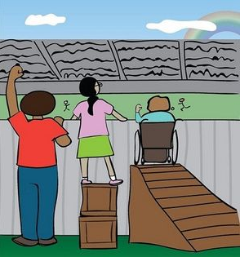
Vertical Equity

Slide 12
Equity or inequality in…
Health:
  Experiencing differences in health status that are not explainable by unavoidable factors (e.g. age)
Health care financing:
  Distribution of payment for health care
  Should be in line with ability-to-pay
Health care benefits:
  Distribution of benefits from service use
  Should be in line with need for care

Slide 13
Equity vs. Equality
Not all health disparities are unfair.
  For example, we expect young adults to be healthier than the elderly population.
  Female newborns tend to have lower birth weights on average than male newborns
However,
  Differences in nutritional status or immunisation levels between girls and boys, or black & white could be considered unfair

Slide 14
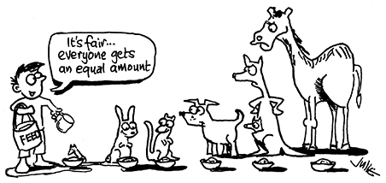
Equity vs. Equality

Slide 15


Equity vs. Equality

Slide 16
Equity considerations
Population size
Demographic composition
Burden of ill-health
Socio-economic status
Private sector use / insurance coverage
Population density or other factors that affect cost of providing health care

Slide 17
Health service planning facilitators and barriers

Slide 18
Funds and resources
Financial resources
Infrastructure
Availability of staff
  Skilled and lay human resource
Time
  Timing of planning and budget cycles

Slide 19
Political support
Competing interests and priorities
  What motivates politicians?
Political will
Leadership and management
Accountability and trust

Slide 20
Other factors
Skilled human resource
Culture
Religious beliefs
Information and communication
Literacy

Slide 21
Prevailing political and policy impact on health service planning

Slide 22
Politics in health service planning
The success of health service planning is about managing relevant actors and institutions
Involves building relationships with key players within the health sector
Paying attention to the interests of actors

Slide 23
Managing the politics
Manage interest groups
  Always interested in the gains from proposed plans
  The can influence uptake of interventions
Manage bureaucrats
  Street-level bureaucrats determine which plans get implemented
Manage financial decision makers
  Being able to provide evidence on the value for money for proposed plans and budgets
  Identifying windows of opportunity

Slide 24
Managing the politics
Managing political leaders
  Councilors, District commissioners, Members of Parliament, Ministers have influence over plans, budgets and policies
Managing healthcare beneficiaries
  Building trust with beneficiaries to ensure support of proposed health service plans and implementation
Managing donors
  Justifying donor resource use for continued support

Slide 25
Various ways of planning
Security planning
Economic and development planning
Social planning
Environmental and sustainability planning
Health planning

Slide 26
Policy impact on health services planning
Policies create a roadmap for planning and can affect the timing and the planning process
Policies can prescribe the amount of resource flow for planning
Policies can strengthen or weaken the planning process
  If policies are not clear, the planning process becomes challenging

