Slide 1

Project Time Management
Linda Kampata-Olowski
University of Zambia
School of Public Health

Slide 2
Project Time Management
Project time management includes the processes required to ensure timely completion of the project.
  It includes:
    Management of Plan Schedule
    Activity defining
    Activity sequencing
    Activity Resource Estimating
    Activity Duration Estimating
    Schedule development
    Schedule control
Notes:
Develop action plan and complete a financial assessment

Slide 3
Plan Schedule Management

Slide 4
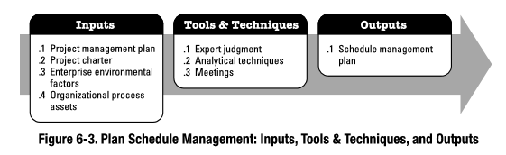
Plan Schedule Management
The process of establishing the policies, procedures, and documentation for planning, developing, managing and controlling the project schedule
The key benefit of this process is that it provides guidance and direction on how the project schedule will be managed throughout the project.
Notes:
Plan schedule management
The process of establishing the documentation for performing Project Time Management
How the project time management processes will be executed is defined in the schedule management plan

Slide 5
Plan Schedule Management - Inputs
Plan Schedule Management – Inputs
Project Management Plan | The project management plan contains information used to develop the schedule management plan which includes, but is not limited to scope baseline and other scheduling related cost, risk, and communications decisions
Project charter | The project charter defines the summary milestone schedule and project approval requirements that will influence the management of the project schedule
Enterprise Environmental Factors | The enterprise environmental factors that influence the Plan Schedule Management process include, but are not limited to: Organizational culture and structure; Resource availability and skills; Project management software, etc.
Organizational Process Assets | The organizational process assets that can influence the Plan Schedule Management process include, but are not limited to: Monitoring and reporting tools to be used; Historical information; Schedule control tools; etc.

Slide 6
Plan Schedule Management - Tools and Techniques
Plan Schedule Management – Tools and Techniques
Expert Judgment | Guided by historical information, provides valuable insight about the environment and information from prior similar projects. Expert judgment can also suggest whether to combine methods and how to reconcile differences between them.
Analytical techniques | Choosing strategic options to estimate and schedule the project such as: scheduling methodology, scheduling tools and techniques, estimating approaches, formats, and project management software
Meetings | Planning meetings to develop the schedule management plan. Participants include the project manager, the project sponsor, selected project team members, selected stakeholders, anyone with responsibility for schedule planning or execution, and others as needed

Slide 7
Plan Schedule Management - Outputs
Plan Schedule Management - Outputs
Schedule Management Plan | The schedule management plan can establish the following: • Project schedule model development: scheduling methodology and tool to be used • Level of accuracy: acceptable range used in determining realistic activity duration estimates is specified and may include contingencies. • units of measure: Each unit used in measurements (such as staff hours, staff days, or weeks for time, etc. defined for each of the resources. • organizational procedures links: The WBS provides the framework for the schedule management plan • Project schedule model maintenance: The process used to update the status and record progress in the schedule model during the execution of the project is defined. • control thresholds: Variance thresholds for monitoring schedule performance may be specified to indicate an agreed-upon amount of variation to be allowed before some action needs to be taken. • rules of performance measurement: Earned value management (EVM) rules or other physical measurement rules of performance measurement are set • reporting formats: The formats and frequency for the various schedule reports are defined. • Process descriptions: Descriptions of each of the schedule management processes are documented

Slide 8
Define Activities

Slide 9
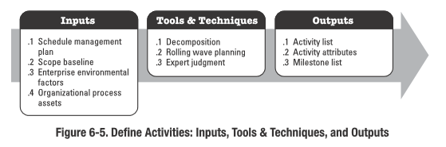
Define Activities
The process of identifying and documenting the specific activities or actions to be perform that the project team members and stakeholders must perform to produce the project deliverables.

Slide 10
Defining Activities
The key benefit is to break down work packages into smaller components called activities that provide a basis for estimating, scheduling, executing, monitoring, and controlling the project work.
An activity or task is an element of work normally found on the work breakdown structure (WBS) that has expected duration, a cost, and resource requirements
Activity definition involves developing a more detailed WBS and supporting explanations to understand all the work to be done so you can develop realistic cost and duration estimates

Slide 11
Define Activities - Inputs
Define Activities – Inputs
Schedule Management Plan | The criteria and the activities for developing, monitoring, and controlling the schedule
Scope Baseline | Approved version of a scope statement, work breakdown structure (WBS), and its associated WBS dictionary, that can be changed only through formal change control procedures and is used as a basis for comparison
Enterprise Environmental Factors | Industry-specific WBS standards, relevant to the nature of the project, may serve as external reference sources for creation of the WBS
Organizational Process Assets | The organizational process assets that can influence the Create WBS process include, but are not limited to: • Policies, procedures, and templates for the WBS; • Project files from previous projects; and • Lessons learned from previous projects.
Notes:
Approved version of a scope statement, work breakdown structure (WBS), and its
associated WBS dictionary, that can be changed only through formal change control procedures and is used as a basis for comparison
Project scope statement - description of the project scope, major deliverables, assumptions, and constraints
Work breakdown structure (WBS) - hierarchical decomposition of the total scope of work to be carried out by the project team to accomplish the project objectives and create the required deliverable
WBS dictionary - provides detailed deliverable, activity, and scheduling information about each component in the WBS

Slide 12
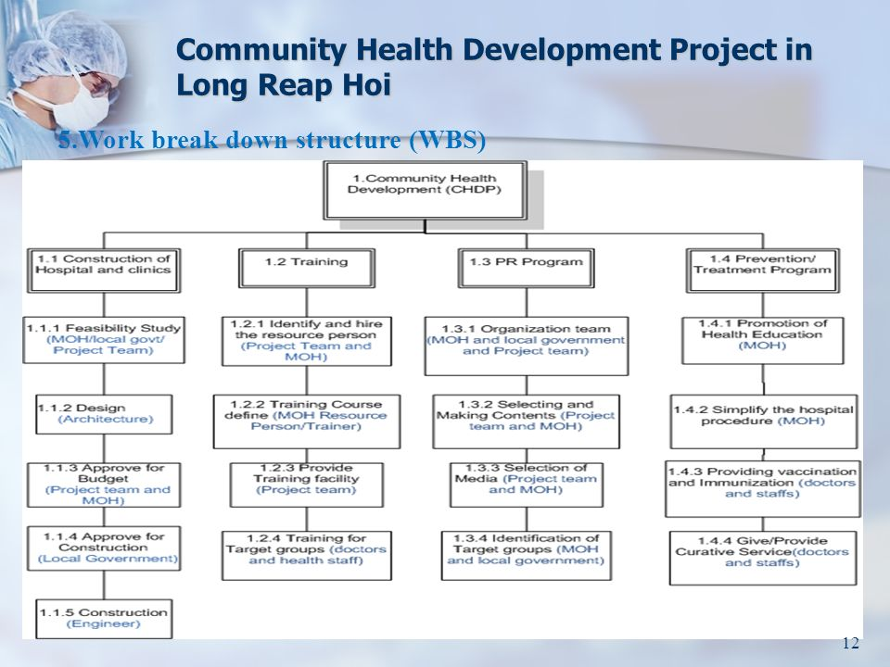

Slide 13
Define Activities - Tools and Techniques
Define Activities – Tools and Techniques
Decomposition | Technique used for dividing and subdividing the project scope and project deliverables into smaller, more manageable parts Activities represent the effort needed to complete a work package
Rolling Wave Planning | An iterative planning technique in which the work to be accomplished in the near term is planned in detail, while the work in the future is planned at a higher level of the WBS.
Expert Judgment | Project team members or other experts, who are experienced and skilled in developing detailed project scope statements, the WBS, and project schedules, can provide expertise in defining activities.

Slide 14
Define Activities - Outputs
Define Activities – Outputs
Activity List | Comprehensive tabulation of activities to be included on a project schedule that includes the activity name, an activity identifier or number and a brief description of the activity
Activity Attributes | Identification the multiple components associated with each activity activity ID, WBS ID, and activity name, activity description, predecessor activities, successor activities, logical relationships, leads and lags, resource requirements, imposed dates, constraints, and assumptions Used to identify the person responsible for executing the work and activity type such as level of effort (often abbreviated as LOE), discrete effort, and apportioned effort and for schedule development
Milestone List | identifies all project milestones and indicates whether the milestone is mandatory such as those required by contract, or optional, such as those based upon historical information It often takes several activities and lots of work to complete a milestone They’re useful tools for setting schedule goals and monitoring progress. Examples include obtaining customer sign-off on key documents or completion of specific products

Slide 15
Sequence Activities

Slide 16
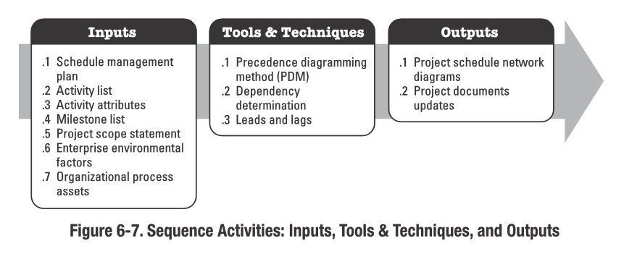
Sequence Activities
The process of identifying and documenting relationships among the project activities.
The key benefit of this type of process is that it defines the logical sequence of work to obtain the greatest efficiency given all project constraints.

Slide 17
Sequence Activities
Every activity, except the first and last, must be connected to at least one predecessor and one successor
Milestones are generally connected to predecessor and successor activities with some exceptions, particularly when the milestone denotes an external dependency or a major event that is outside of the project
Simplified by using project management software
Occurs during Planning
1
2
3
4
5

Slide 18
Sequencing Activities
Involves reviewing activities and determining dependencies
A dependency or relationship is the sequencing of project activities or tasks
You must determine dependencies in order to use critical path analysis
As with activity definition, it is important that the project stakeholders work together to define sequence (dependencies) of activities

Slide 19
Sequence Activities - Inputs
Sequence Activities – Inputs
Schedule Management Plan | Provides guidance and direction on how the project schedule will be managed throughout the project
Activity List | Contains all schedule activities required on the project, which are to be sequenced. Dependencies and other constraints for these activities can influence the sequencing of the activities
Activity Attributes | Activity attributes may describe a necessary sequence of events or defined predecessor or successor relationships.
Milestone List | The milestone list may have scheduled dates for specific milestones, which may influence the way activities are sequenced
Project Scope Statement | Contains the product scope description (PSD), which includes product characteristics that may affect activity sequencing, such as the physical layout of a plant to be constructed. Other information including project deliverables, project constraints, and project assumptions may also affect activity sequencing. The PSD is generally reviewed to ensure accuracy

Slide 20
Sequence Activities - Inputs
Sequence Activities – Inputs
Enterprise Environmental Factors | Enterprise environmental factors that influence the Sequence Activities process include, but are not limited to: • Government or industry standards, • Project management information system (PMIS), • Scheduling tool, and • Company work authorization systems.
Organizational Process Assets | The organizational process assets that can influence the Sequence Activities process include, but are not limited to: project files from the corporate knowledge base used for scheduling methodology, existing formal and informal activity planning-related policies, procedures, and guidelines, such as the scheduling methodology that are considered in developing logical relationships, and templates that can be used to expedite the preparation of networks of project activities. Related activity attributes information in templates can also contain additional descriptive information useful in sequencing activities.

Slide 21
Sequence Activities - Tools and Techniques
Sequence Activities – Tools and Techniques
Precedence Diagramming Method | A technique used to construct a project network diagram using boxes (nodes) to represent activities connected by arrows to show the logical relationships that exist between them. Most commonly used diagramming method. Better at showing different types of dependencies Has 4 types of dependencies or logical relationships: FS, FF, SS, & SF
Dependency Determination | There are 3 types of dependencies that define the activity sequencing: Mandatory, Discretionary, Internal or External
Applying Leads and Lags | The project management team determines the dependencies requiring leads or lags: Leads: allows acceleration of a successor activity Lag: directs a delay in a successor activity
Schedule Network Templates | Standardized schedule networks. Portions of networks are called sub-networks or fragment networks which are very useful for repeating activities to produce identical deliverables or common organizational activities.
Notes:
Leads and Lags
A lead is the amount of time whereby a successor activity can be advanced with respect to a predecessor
activity. For example, on a project to construct a new office building, the landscaping could be scheduled to start two weeks prior to the scheduled punch list completion. This would be shown as a finish-to-start with a two-week lead. Lead is often represented as a negative value for lag in scheduling software.
A lead allows an acceleration of the successor activity. For example, a technical writing team can begin writing the second draft of a large document (the successor activity) fifteen days before they finish writing the entire first draft (the predecessor activity). This could be accomplished by a finish-to-start relationship with a fifteen-day lead time.
A lag is the amount of time whereby a successor activity will be delayed with respect to a predecessor activity. For example, a technical writing team may begin editing the draft of a large document 15 days after they begin writing it. This can be shown as a start-to-start relationship with a 15-day lag. Lag can also be represented in project schedule network diagrams as shown in Figure 6-11 (see next slide) in the relationship between activities H and I, as indicated by the nomenclature SS+10 (start-to-start plus 10 days lag) even though offset is not shown relative to a timescale.
A lag directs a delay in the successor activity. For example, to account for a ten-day curing period for concrete, a ten-day lag on a finish-to-start relationship could be used, which means the successor activity cannot start until ten days after the predecessor is completed
The project management team determines the dependencies that may require a lead or a lag to accurately define the logical relationship. The use of leads and lags should not replace schedule logic. Activities and their related assumptions should be documented.

Slide 22
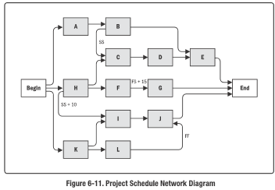
Sequence Activities - Outputs
Sequence Activities – Outputs
Project Schedule network diagrams | • Graphical representation of the logical relationships, also referred to as dependencies, among the project schedule activities • Precedence Diagramming Method (PDM) • Shows interdependencies between activities, excludes time estimates
Project documents updates | Project documents that may be updated include, but are not limited to: • Activity lists, • Activity attributes, • Milestone list, and • Risk register

Slide 23
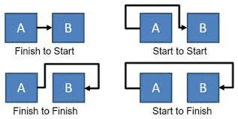
Precedence Diagramming Method
4 types of dependencies or logical relationships
  Finish-to-Start (FS)
    This relationship means Task A must complete before Task B can begin. This is the most common relationship.
  Finish-to-Finish (FF)
    Finish of successor activity depends on finish of the predecessor
  Start-to-Start (SS)
    Start of a successor activity depends on start of a predecessor activity.
  Start-to-Finish (SF)
    Finish of Successor depends
    on the start of preceding activity.
Notes:
Activities are represented by boxes
Arrows show relationships between activities
Sequence Activities – Finish to start (FS)
Most of your tasks were used this type of relationship, and it simply means that the must finish first before its successor can start.
As an example ‘the water must be boiled before I can add my coffee’.
Example: The awards ceremony (successor) cannot start until the race (predecessor)
has finished
Sequence Activities –Finish to finish (FF).
The predecessor activity must finish before the successor activity can finish.
An example might be ‘I must finish frying the chicken before cooking the sauce is finished’.
Example: Writing a document (predecessor) is required to finish before editing the
document (successor) can finish
Sequence Activities –Start to start (SS).
The predecessor activity must start before the successor activity can start.
An example is ‘I need to start creating the specification document before I can start editing it’
Example: Level concrete (successor) cannot begin until pour foundation (predecessor)
begins
Start-to-finish (SF). A logical relationship in which a successor activity cannot finish until a predecessor activity has started.
Example: The first security guard shift (successor) cannot finish until the second security guard shift (predecessor) starts

Slide 24
Sequence Activities
Dependency Determination
  Mandatory dependencies: legally or contractually required or inherent in the nature of the work being performed on a project, sometimes referred to as hard logic
  Discretionary dependencies: referred to as preferential logic, or soft logic are defined as best practices and are considered the preferred choice among the other alternatives
  External dependencies: involve relationships between project and non-project activities; external to the project and are not in project’s control.
    E.g. Deliverable from other project or expected new law
  Internal dependencies: involve a precedence relationship between project activities and are generally inside the project team’s control
    For example, if the team cannot test a machine until they assemble it

Slide 25
Estimate Activity Resources

Slide 26
Estimate Activity Resources
Before estimating activity durations, you must have a good idea of the quantity and type of resources that will be assigned to each activity;
Resources are people, equipment, and materials
Consider important issues in estimating resources
  How difficult will it be to do specific activities on this project?
  What is the organization’s history in doing similar activities?
  Are the required resources available?

Slide 27
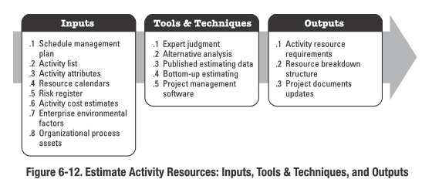
Estimate Activity Resources
The process of estimating the type and quantities of material, human resources, equipment, or supplies required to perform each activity.
The key benefit of this process is that it identifies the type, quantity, and characteristics of resources required to complete the activity which allows more accurate cost and duration estimate

Slide 28
Estimate Activity Resources - Inputs
Estimate Activity Resources – Inputs
Schedule Management Plan | Identifies the level of accuracy and the units of measure for the resource to be estimated
Activity List | Identifies the activities which will need resources
Activity Attributes | Provide the primary data input for estimating resources required for each activity in the activity list
Resource Calendars | Specifies when and how long identified project resources will be available during the project
Risk Register | Risk events may impact resource selection and availability.
Activity Cost Estimates | The cost of resources may impact resource selection
Enterprise Environmental Factors | Factors that can influence the EAR process include but are not limited to resource location, availability, and skills
Organizational Process Assets | Those that influence the EAR process such as policies and procedures related to staffing, rental purchase of supplies and equipment, historical information regarding types of resources used for similar work on previous projects

Slide 29
Estimate Activity Resources - Tools and Techniques
Estimate Activity Resources - Tools and Techniques
Expert Judgment | Required to assess the resource-related inputs to this process. Any group or person with specialized knowledge in resource planning and estimating can provide such expertise.
Alternative Analysis | Many schedule activities have alternative methods of accomplishment which may include using various levels of resource capability or skills, different size or type of machines, different tools (hand versus automated), and make-rent-or-buy decisions regarding the resource
Published Estimating Data | Companies publish updated production rates and unit costs of resources for an extensive array of labor trades, material, and equipment for different countries & geographical locations within countries
Bottom-up Estimating | Method of estimating project duration or cost by aggregating the estimates of the lower-level components of the WBS
Project Management Software | Helps plan, organize, and manage resource pools and develop resource estimates. Depending on the sophistication of the software, resource breakdown structures, resource availability, resource rates, and various resource calendars can be defined to assist in optimizing resource utilization
Notes:
Expert Judgment: Group or person with specialized knowledge in resource planning and estimating
Alternatives Analysis: Evaluating alternative methods of accomplishing project activities: resource skills and capabilities, size and types of machines, different tools, make or buy decisions
Published Estimating Data: Published and updated rates and unit costs of resources for an extensive array of labor trades, material, and equipment for different countries and geographical locations within countries
Bottom-Up Estimating: Decomposing an activity into more detail to be able to estimate resource needs with more confidence and aggregating the estimates into a total quantity. Dependencies must be documented.
Project Management Software (PMIS): Software that has the capability to help plan, organize and manage resource pools and develop resource estimates. Some are capable of providing resource breakdown structures, resource availability, resource rates and various resource calendars to optimize resource utilization

Slide 30
Estimate Activity Resources - Outputs
Estimate Activity Resources - Outputs
Activity Resource Requirements | Identify the types and quantities of resources required for each activity in a work iPackage. Requirements are aggregated to determine the estimated resources for each work package and each work period. The resource requirements documentation for each activity can include the basis of estimate for each resource, as well as the assumptions that were made in determining which types of resources are applied, their availability, and what quantities are used
Resource Breakdown Structure | A hierarchical representation of resources by category and type. Examples of resource categories include labor, material, equipment, and supplies. Resource types may include the skill level, grade level, or other information as appropriate to the project. The resource breakdown structure is useful for organizing and reporting project schedule data with resource utilization information.
Project Documents Updates | Project documents that may be updated include, but are not limited to: • Activity list, • Activity attributes, and • Resource calendars

Slide 31
Next lecture
Estimate Activity Durations

Slide 32
Estimate Activity Durations
Estimate Activity Durations is the process of estimating the number of work periods needed to complete individual activities with estimated resources.
The key benefit of this process is that it provides the amount of time each activity will take to complete, which is a major input into the Develop Schedule process.

Slide 33
Estimate Activity Durations
Estimating activity durations uses information on activity scope of work, required resource types, estimated resource quantities, and resource calendars.
The inputs of the estimates of activity duration originate from the person or group on the project team who is most familiar with the nature of the work in the specific activity.

Slide 34
Estimate Activity Durations
The Estimate Activity Durations process requires an estimation of the amount of work effort required to complete the activity and the amount of available resources estimated to complete the activity.
These estimates are used to approximate the number of work periods (activity duration) needed to complete the activity using the appropriate project and resource calendars.
All data and assumptions that support duration estimating are documented for each estimate of activity duration.

Slide 35
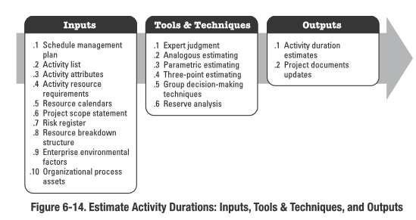
Estimate Activity Durations

Slide 36
Estimate Activity Durations - Inputs
Estimate Activity Durations – Inputs
Schedule Management Plan | Defines the method used and the level of accuracy along with other criteria required to estimate activity durations including the project update cycle
Activity List | Identifies the activities that will need duration estimates
Activity Attributes | Provide the primary data input for estimating durations required for each activity in the activity list
Activity Resource Requirements | The estimated activity resource requirements (number and level of resources) will have an effect on the duration of the activity. For example, if additional or lower-skilled resources are assigned to an activity, there may be reduced efficiency or productivity due to increased communication, training, and coordination needs leading to a longer duration estimate.

Slide 37
Estimate Activity Durations - Inputs
Estimate Activity Durations – Inputs
Resource Calendars | They influence the duration of schedule activities due to the availability of specific resources, type of resources, and resources with specific attributes. For example, when staff members are assigned to an activity on a full-time basis, in general, a skilled staff member can be expected to complete a given activity in less time than a relatively less-skilled staff member.
Project Scope Statement | The assumptions and constraints from the project scope statement are considered when estimating the activity durations. Examples of assumptions include, but are not limited to: Existing conditions, Availability of information, and Length of the reporting periods. Examples of constraints include, but are not limited to: Available skilled resources, and Contract terms and requirements.
Risk Register | The risk register provides the list of risks, along with the results of risk analysis and risk response planning.

Slide 38
Estimate Activity Durations - Inputs
Estimate Activity Durations – Inputs
Resource Breakdown Structure | The resource breakdown structure provides a hierarchical structure of the identified resources by resource category and resource type.
Enterprise Environmental Factors | Factors that can influence the Estimate Activity Durations process include, but are not limited to: • Duration estimating databases and other reference data, • Productivity metrics, • Published commercial information, and • Location of team members
Organizational Process Assets | Those that influence the Estimate Activity Durations process include, but are not limited to: • Historical duration information, • Project calendars, • Scheduling methodology, and • Lessons learned

Slide 39
Estimate Activity Durations - Tools and Techniques
Estimate Activity Durations - Tools and Techniques
Expert Judgment | Guided by historical information, can provide duration estimate information or recommended maximum activity durations from prior similar projects. Expert judgment can also be used to determine whether to combine methods of estimating and how to reconcile differences between them
Analogous Estimating | Estimating technique that uses parameters from a previous, similar project, such as duration, budget, size, weight, and complexity, as the basis for estimating the same parameter or measure for a future project
Parametric Estimating | Estimating technique that uses a statistical relationship between historical data and other variables (e.g., square footage in construction) to calculate an estimate for activity parameters, such as cost, budget, and duration
Three-Point Estimating | Duration estimates based on three points with an assumed distribution provide an expected duration and clarify the range of uncertainty around the expected duration.

Slide 40
Estimate Activity Durations - Tools and Techniques
Estimate Activity Durations - Tools and Techniques
Group decision-Making techniques | useful for engaging team members to improve estimate accuracy and commitment to the emerging estimates. Additionally, involved persons commitment increases towards meeting the resulting estimates
Reserve Analysis | May include contingency reserves, sometimes referred to as time reserves or buffers, into the project schedule to account for schedule uncertainty. The contingency reserve may be a percentage of the estimated activity duration, a fixed number of work periods, or may be developed by using quantitative analysis methods such as Monte Carlo simulation

Slide 41
Estimate Activity Durations - Outputs
Estimate Activity Durations - Outputs
Activity Duration Estimates | Activity duration estimates are quantitative assessments of the likely number of time periods that are required to complete an activity. Duration estimates do not include any lags. Activity duration estimates may include some indication of the range of possible results. For example: 2 weeks ± 2 days, which indicates that the activity will take at least eight days and not more than twelve (assuming a five-day workweek); and 15 % probability of exceeding three weeks, which indicates a high probability—85 %—that the activity will take three weeks or less.
Project Documents Updates | Project documents that may be updated include, but are not limited to: Activity attributes; and Assumptions made in developing the activity duration estimate, such as skill levels and availability, as well as a basis of estimates for durations.

Slide 42
Develop Schedule

Slide 43
Develop Schedule
Develop Schedule is the process of analyzing activity sequences, durations, resource requirements, and schedule constraints to create the project schedule model.
The key benefit of this process is that by entering schedule activities, durations, resources, resource availabilities, and logical relationships into the scheduling tool, it generates a schedule model with planned dates for completing project activities.

Slide 44
Develop Schedule
Developing an acceptable project schedule is often an iterative process.
The schedule model is used to determine the planned start and finish dates for project activities and milestones based on the accuracy of the inputs.
Schedule development can require the review and revision of duration estimates and resource estimates to create the project schedule model to establish an approved project schedule that can serve as a baseline to track progress.

Slide 45
Develop Schedule
Once timeline is set, assigned project staff review their assigned activities and confirm that the start and finish dates present no conflict with resource calendars or assigned activities in other projects or tasks and thus are still valid.
As work progresses, revising and maintaining the project schedule model to sustain a realistic schedule continues throughout the duration of the project

Slide 46
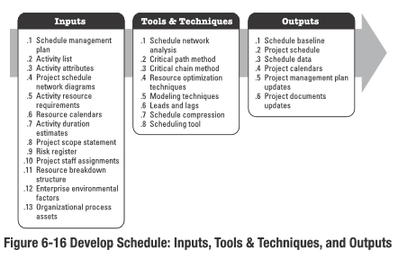
Develop Schedule

Slide 47
Develop Schedule - Inputs
Develop Schedule – Inputs
Schedule Management Plan | The schedule management plan identifies the scheduling method and tool used to create the schedule, and how the schedule is to be calculated
Activity List | The activity list identifies the activities that will be included in the schedule model.
Activity Attributes | The activity attributes provide the details used to build the schedule model.
Project Schedule Network Diagrams | The project schedule network diagrams contain the logical relationships of predecessors and successors that will be used to calculate the schedule.
Activity Resource Requirements | The activity resource requirements identify the types and quantities of resources required for each activity used to create the schedule model.

Slide 48
Develop Schedule - Inputs
Develop Schedule – Inputs
Resource Calendars | The resource calendars contain information on the availability of resources during the project
Activity Duration Estimates | The activity duration estimates contain the quantitative assessments of the likely number of work periods that will be required to complete an activity that will be used to calculate the schedule.
Project Scope Statement | The project scope statement contains assumptions and constraints that can impact the development of the project schedule.
Risk Register | The risk register provides the details of all identified risks and their characteristics that affect the schedule model.
Project Staff Assignments | The project staff assignments specify which resources are assigned to each activity

Slide 49
Develop Schedule - Inputs
Develop Schedule – Inputs
Resource Breakdown Structure | The resource breakdown structure provides the details by which resource analysis and organizational reporting can be done.
Enterprise Environmental Factors | The enterprise environmental factors include, but are not limited to: • Standards, • Communication channels, and • Scheduling tool to be used in developing the schedule model
Organizational Process Assets | The organizational process assets that can influence the Develop Schedule process include, but are not limited to: scheduling methodology and project calendar(s)

Slide 50
Develop Schedule - Tools and Techniques
Develop Schedule - Tools and Techniques
Schedule Network Analysis | A technique that generates the project schedule model. It employs various analytical techniques, such as, Critical path method, Critical chain method, What-if analysis, Resource optimization techniques to calculate the early and late start and finish dates for the uncompleted portions of project activities. Note the output of this technique may be identified and used in schedule compression analysis or other schedule analyses/management techniques.
Critical Path Method | The method used to estimate the minimum project duration and determine the amount of scheduling flexibility on the logical network paths within the schedule model.

Slide 51
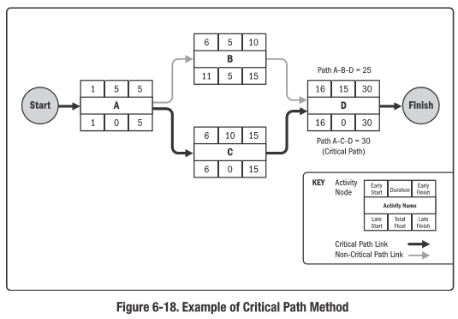
Critical Path Method
The critical path is the sequence of activities that represents the longest path through a project, which determines the shortest possible project duration.
  In Figure 6-18, the longest path includes activities A, C, and D, and, therefore, the sequence of A-C-D is the critical path.
The critical path method is used to calculate the amount of scheduling flexibility on the logical network paths within the schedule model

Slide 52
Develop Schedule - Tools and Techniques
Develop Schedule - Tools and Techniques
Critical Chain Method | The critical chain method (CCM) is a schedule method that allows the project team to place buffers on any project schedule path to account for limited resources and project uncertainties.

Slide 53
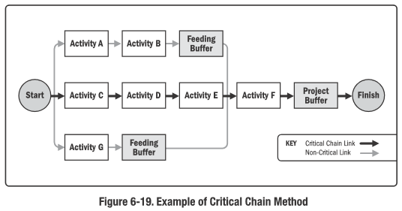
Critical Chain Method
The critical chain method adds duration buffers that are non-work schedule activities to manage uncertainty as shown in Figure 6-19
  Project buffer
    placed at the end of the critical chain
    protects the target finish date from slippage along the critical chain.
  Feeding buffers
    placed at each point where a chain of dependent activities that are not on the critical chain feeds into the critical chain.
    protect the critical chain from slippage along the feeding chains.

Slide 54
Develop Schedule - Tools and Techniques
Develop Schedule - Tools and Techniques
Resource Optimization Techniques | Examples of resource optimization techniques that can be used to adjust the schedule model due to demand and supply of resources include, but are not limited to: Resource Leveling A technique in which start and finish dates are adjusted based on resource constraints with the goal of balancing demand for resources with the available supply. Resource Smoothing A technique that adjusts the activities of a schedule model such that the requirements for resources on the project do not exceed certain predefined resource limits. In resource smoothing, as opposed to resource leveling, the project’s critical path is not changed and the completion date may not be delayed ( activities may only be delayed within their free and total float). Thus resource smoothing may not be able to optimize all resources.

Slide 55
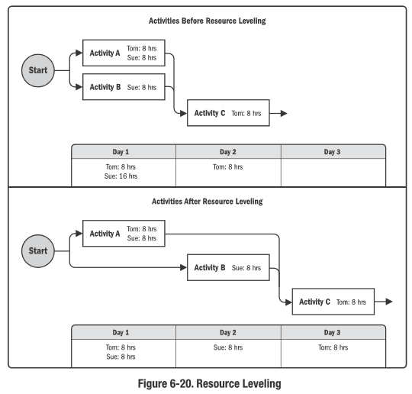
Resource leveling
Resource Leveling
  Can be used when shared or critically required resources are only available at certain times, or in limited quantities, or over-allocated, such as when a resource has been assigned to two or more activities during the same time period, as shown in Figure 6-20, or to keep resource usage at a constant level.
  Can often cause the original critical path to change, usually to increase

Slide 56
Develop Schedule - Tools and Techniques
Develop Schedule - Tools and Techniques
Modeling Techniques | Examples of modeling techniques include, but are not limited to: What-If Scenario Analysis Evaluating scenarios in order to predict their effect, positively or negatively, on project objectives. The outcome of the what-if scenario analysis can be used to assess the feasibility of the project schedule under adverse conditions, and in preparing contingency and response plans to overcome or mitigate the impact of unexpected situations. Simulation This involves calculating multiple project durations with different sets of activity assumptions, usually using probability distributions constructed from the three-point estimates to account for uncertainty The most common simulation technique is Monte Carlo analysis, in which a distribution of possible activity durations (durations with different sets of activity assumptions) is defined for each activity and used to calculate a distribution of possible outcomes for the total project.

Slide 57
Develop Schedule - Tools and Techniques
Develop Schedule - Tools and Techniques
Leads and Lags | Leads and lags are refinements applied during network analysis to develop a viable schedule by adjusting the start time of the successor activities. Leads are used in limited circumstances to advance a successor activity with respect to the predecessor activity. Lags are used in limited circumstances where processes require a set period of time to elapse between the predecessors and successors without work or resource impact.
Scheduling Tool | Automated scheduling tools contain the schedule model and expedite the scheduling process by generating start and finish dates based on the inputs of activities, network diagrams, resources and activity durations using schedule network analysis.

Slide 58
Develop Schedule - Tools and Techniques
Develop Schedule - Tools and Techniques
Schedule Compression | Used to shorten the schedule duration without reducing the project scope, in order to meet schedule constraints, imposed dates, or other schedule objectives. Schedule compression techniques include, but are not limited to: Crashing: A technique used to shorten the schedule duration for the least incremental cost by adding resources. E.g.: approving overtime, bringing in additional resources, or paying to expedite delivery to activities on the critical path. Crashing works only for activities on the critical path where additional resources will shorten the activity’s duration. Crashing does not always produce a viable alternative and may result in increased risk and/or cost. Fast tracking: A schedule compression technique in which activities or phases normally done in sequence are performed in parallel for at least a portion of their duration. An example is constructing the foundation for a building before completing all of the architectural drawings. Fast tracking may result in rework and increased risk. Fast tracking only works if activities can be overlapped to shorten the project duration.
Notes:
Schedule Compression
Shortens the project schedule without changing project scope
Crashing
Only works for activities where additional resources will shorten duration
Does not always produce a viable schedule
Always results in increased cost
Sometimes results in increase risk
Crashing leads to increased Cost and increased Risk
Fast Tracking
Phases or activities normally performed sequentially are performed in parallel
Only works if activities can be overlapped to shorten duration
May result in rework and increased risk
Can result in decreased cost
Fast Tracking leads to decreased Cost, increased Rework, increased Risk

Slide 59
Develop Schedule - Outputs
Develop Schedule - Outputs
Schedule Baseline | A schedule baseline is the approved version of a schedule model that can be changed only through formal change control procedures and is used as a basis for comparison to actual results. During monitoring and controlling, the approved baseline dates are compared to the actual start and finish dates to determine whether variances have occurred. The schedule baseline is a component of the project management plan
Project Schedule | The project schedule is an output of a schedule model that presents linked activities with planned dates, durations, milestones, and resources. Often presented graphically in the form of bar charts, milestone charts and project schedule network diagrams
Schedule Data | The collection of information for describing and controlling the schedule. It includes at least the schedule milestones, schedule activities, activity attributes, and documentation of all identified assumptions and constraints. Information frequently supplied as supporting detail includes, but is not limited to: Resource requirements by time period, in the form of a resource histogram; Alternative schedules, such as best-case or worst-case, not resource-leveled, or resource-leveled, with or without imposed dates; and Scheduling of contingency reserves. Schedule data could also include such items as resource histograms, cash-flow projections, and order and delivery schedules.
Notes:
Bar charts - also known as Gantt charts, represent schedule information where activities are listed on the vertical axis, dates are shown on the horizontal axis, and activity durations are shown as horizontal bars placed according to start and finish dates.
milestone charts - similar to bar charts, but only identify the scheduled start or completion of major deliverables and key external interfaces
project schedule network diagrams - commonly presented in the activity-on-node diagram format showing activities and relationships without a time scale, sometimes referred to as a pure logic diagram

Slide 60
Develop Schedule - Outputs
Develop Schedule - Outputs
Project Calendars | It identifies working days and shifts that are available for scheduled activities. It distinguishes time periods in days or parts of days that are available to complete scheduled activities from time periods that are not available. A schedule model may require more than one project calendar to allow for different work periods for some activities to calculate the project schedule. The project calendars may be updated.
Project Management Plan Updates | Elements of the project management plan that may be updated include, but are not limited to: • Schedule baseline • Schedule management plan
Project Documents Updates | Project documents that may be updated include, but are not limited to: • Activity resource requirements. • Activity attributes. • calendars. • risk register.
Notes:
Project documents that may be updated include, but are not limited to:
• Activity resource requirements. Resource leveling can have a significant effect on preliminary estimates for the types and quantities of resources required. If the resource-leveling analysis changes the project resource requirements, then the project resource requirements are updated.
• Activity attributes. Activity attributes are updated to include any revised resource requirements and any other revisions generated by the Develop Schedule process.
• calendars. The calendar for each project may consist of multiple calendars, project calendars, individual resource calendars etc., as the basis for scheduling the project.
• risk register. The risk register may need to be updated to reflect opportunities or threats perceived through scheduling assumptions.

Slide 61
Control Schedule

Slide 62
Control Schedule
Control Schedule is the process of monitoring the status of project activities to update project progress and manage changes to the schedule baseline to achieve the plan.
The key benefit of this process is that it provides the means to recognize deviation from the plan and take corrective and preventive actions and thus minimize risk.

Slide 63
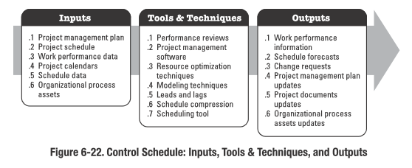
Control Schedule

Slide 64
Control Schedule - Inputs
Control Schedule – Inputs
Project Management Plan | The PMP contains the schedule management plan and the schedule baseline. The schedule management plan describes how the schedule will be managed and controlled. The schedule baseline is used as a reference to compare with actual results to determine if a change, corrective action, or preventive action is necessary.
Project Schedule | Project schedule refers to the most recent version with notations to indicate updates, completed activities, and started activities as of the indicated data date.
Work Performance Data | Information about project progress such as which activities have started, their progress (e.g., actual duration, remaining duration, and physical percent complete), and which activities have finished.
Project Calendars | A schedule model may require more than one project calendar to allow for different work periods for some activities to calculate the schedule forecasts

Slide 65
Control Schedule - Inputs
Control Schedule – Inputs
Schedule Data | Schedule data will be reviewed and updated in the Control Schedule process
Organizational Process Assets | The organizational process assets that influence the Control Schedule process include, but are not limited to: Existing formal and informal schedule control-related policies, procedures, and guidelines; Schedule control tools; and Monitoring and reporting methods to be used.

Slide 66
Control Schedule - Tools and Techniques
Control Schedule - Tools and Techniques
Performance Reviews | Performance reviews measure, compare, and analyze schedule performance such as actual start and finish dates, percent complete, and remaining duration for work in progress. Various techniques may be used, such as: Trend analysis: examines project performance over time to determine whether performance is improving or deteriorating. Critical path method: Comparing the progress along the critical path can help determine schedule status. The variance on the critical path will have a direct impact on the project end date. Evaluating the progress of activities on near critical paths can identify schedule risk. Critical chain method: Comparing the amount of buffer remaining to the amount of buffer needed to protect the delivery date can help determine schedule status. The difference between the buffer needed and the buffer remaining can determine whether corrective action is appropriate. Earned value management : Schedule performance measurements such as schedule variance (SV) and schedule performance index (SPI), are used to assess the magnitude of variation to the original schedule baseline.

Slide 67
Control Schedule - Tools and Techniques
Control Schedule - Tools and Techniques
Project Management Software | Project management software for scheduling provides the ability to track planned dates versus actual dates, to report variances to and progress made against the schedule baseline, and to forecast the effects of changes to the project schedule model.
Resource Optimization Techniques | Resource optimization techniques involve the scheduling of activities and the resources required by those activities while taking into consideration both the resource availability and the project time
Modeling Techniques | Modeling techniques are used to review various scenarios guided by risk monitoring to bring the schedule model into alignment with the project management plan and approved baseline.

Slide 68
Control Schedule - Tools and Techniques
Control Schedule - Tools and Techniques
Leads and Lags | Adjusting leads and lags is applied during network analysis to find ways to bring project activities that are behind into alignment with the plan. For example, on a project to construct a new office building, the landscaping can be adjusted to start before the exterior work of the building is complete by increasing the lead time in the relationship. Or, a technical writing team can adjust the start of editing the draft of a large document immediately after the document is completed by eliminating or decreasing lag time
Schedule Compression | Schedule compression techniques are used to find ways to bring project activities that are behind into alignment with the plan by fast tracking or crashing schedule for the remaining work.
Scheduling Tool | Schedule data is updated and compiled into the schedule model to reflect actual progress of the project and remaining work to be completed. The scheduling tool and the supporting schedule data are used in conjunction with manual methods or other project management software to perform schedule network analysis to generate an updated project schedule.

Slide 69
Control Schedule - Outputs
Control Schedule - Outputs
Work Performance Information | The calculated SV and SPI time performance indicators for WBS components, in particular the work packages and control accounts, are documented and communicated to stakeholders
Schedule Forecasts | Estimates or predictions of conditions and events in the project’s future based on information and knowledge available at the time of the forecast. The information is based on the project’s past performance and expected future performance, and includes earned value performance indicators that could impact the project in the future. Forecasts are updated and reissued based on work performance information provided as the project is executed.
Change Requests | Schedule variance analysis, along with review of progress reports, results of performance measures, and modifications to the project scope or project schedule may result in change requests to the schedule baseline, scope baseline, and/or other components of the project management plan. Change requests are processed for review and disposition through the Perform Integrated Change Control process (Section 4.5). Preventive actions may include recommended changes to eliminate or reduce the probability of negative schedule variances.

Slide 70
Control Schedule - Outputs
Control Schedule - Outputs
Project Management Plan Updates | Elements of the PMP that may be updated include, but are not limited to: Schedule baseline: The schedule baseline may be updated to reflect changes caused by schedule compression techniques. Schedule management plan: The schedule management plan may be updated to reflect a change in the way the schedule is managed. Cost baseline: The cost baseline may be updated to reflect approved change requests or changes caused by compression techniques
Project Documents Updates | Project documents that may be updated include, but are not limited to: Schedule Data: New project schedule network diagrams may be developed to display approved remaining durations and approved modifications to the schedule. In some cases, project schedule delays can be so severe that development of a new target schedule with forecasted start and finish dates is needed to provide realistic data for directing the work, measuring performance, and measuring progress. Project Schedule: An updated project schedule will be generated from the schedule model populated with updated schedule data to reflect the schedule changes and manage the project. Risk register: The risk register, and risk response plans within it, may also be updated based on the risks that may arise due to schedule compression techniques.

Slide 71
Control Schedule - Outputs
Control Schedule - Outputs
Organizational Process Assets Updates | Organizational process assets that may be updated include, but are not limited to: • Causes of variances, • Corrective action chosen and the reasons, and • Other types of lessons learned from project schedule control.

Slide 72
Questions!!!

Slide 73
Monitoring and Controlling

Slide 74
Monitoring and Controlling
Consist of processes required to
  track, review and regulate the progress and performance of the project
  Identify any areas in which changes to the plan are required
  Initiate the corresponding changes

Slide 75
Monitoring and Controlling
It also includes
  Controlling changes and recommending preventative action in anticipation of possible problems
  Monitoring the ongoing project activities against the project management plan and the project performance baseline
  Influencing factors that could circumvent integrated change control so only approved changes are implemented
Notes:
Circumvent – avoid, get around, by pass

Slide 76
Monitoring and Controlling
Monitoring includes status reporting, progress measurement and forecasting
Performance reports provide information on the project’s performance with regard to scope, schedule, cost, resources, quality, and risk, which can be used as inputs to other processes

Slide 77
Monitoring and Controlling
Continuous monitoring provides the project team insight into the health of the project and identifies any areas requiring additional attention
Key benefit of this process is that project performance is observed and measured regularly and consistently to identify variances from the project management plan

Slide 78
Questions!!!

Slide 79
Exercise 3: Time Management
Complete the following:
Adding more resources to a project so you can get it done faster is called____________ .
_________ is the process where you put the activities in order

Slide 80
Exercise 3 Answers: Time Management
Adding more resources to a project so you can get it done faster is called Crashing .
Sequence Activities is the process where you put the activities in order.

