Slide 1
Financial Management for Health Care
Introduction to Cost and Management Accounting
Dr. Davy Wadula Zulu

Slide 2
Objectives
  Introduce cost and managerial accounting
  Compare cost and managerial accounting
  History and international protocols governing practice in health service organizations, functions of management accounting
  Differentiate between management and financial accounting,
  Differentiate manufacturing and health services costing,
  Outline key concepts and approaches to health services costing
  Describe management accounting information systems (data sources and possible uses).
  Introduction to cost accounting
    Cost classification,
    Cost allocation techniques
    Cost behavior in health services organizations
    Cost analysis techniques for healthcare decision making

Slide 3

Introduction
•
Accounting
– Accounting is a wider term and includes recording, classifying and summarizing of business transactions in terms of money, preparation of financial reports and analysis and interpretation of these reports for the information and guidance of management.
– The business accounting system consists of three parts:
  Financial Accounting
  Cost Accounting
  Management Accounting

Slide 4
Financial Accounting
Financial accounting may be defined as the science and art of systematically recording, classifying and summarizing business transactions of financial character and finally interpreting the results for determining the financial profit or loss at the end of an accounting year.
It also shows the financial position of the firm, and thus, records and reports financial statements – Balance sheet, income statement and statement of cash flows.

Slide 5
Cost Accounting
Cost accounting is that branch of the accounting information system, which records, measures and reports information about costs.
The primary purpose of cost accounting is cost ascertainment and its use in decision making and performance evaluation.

Slide 6

COST ACCOUNTING
Cost accounting is concerned with recording, classifying, and appropriate allocation of expenditure for the determination of the costs of products or services, and for the suitably arranged data for purposes of control and guidance of information to management for decision making.
Cost means “the price paid for something”
Cost ascertainment is the computation of actual costs incurred
Cost estimation is a process of predetermining the costs of goods and services.

Slide 7

FUNCTIONS OF COST ACCOUNTING
Estimation of costs
Ascertainment of costs
Cost control
Cost reduction
Determining selling price
Facilitating preparation of financial and other statement
Providing basis for operating policy

Slide 8

Management Accounting
Managerial (management) accounting
  The field of accounting that focuses on all levels of an organization and is used internally for managerial decision-making
  It is the process of identifying, measuring, analysing, interpreting, and communicating information
How does managerial accounting add value to the organization?

Slide 9
Definition
Management Accounting is
“the application of appropriate techniques and concepts
in processing historical and projected economic data of an entity
to assist management in establishing plans for
reasonable economic objectives and
in the making of rational decisions
with a view towards these objectives”
[American Accounting Association]

Slide 10
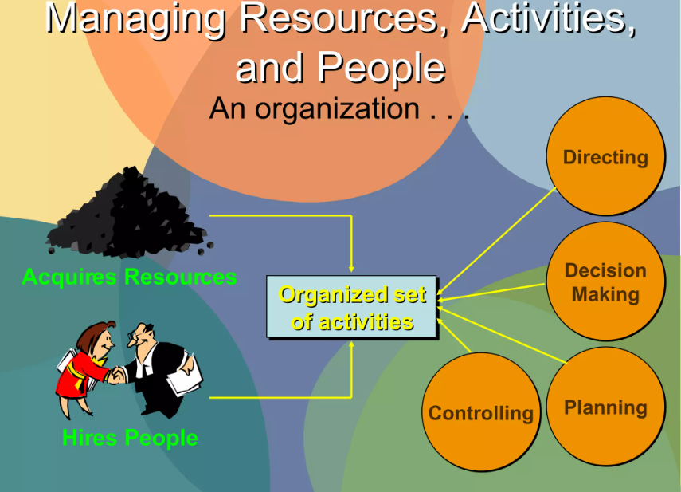
What organization managers do!

Slide 11
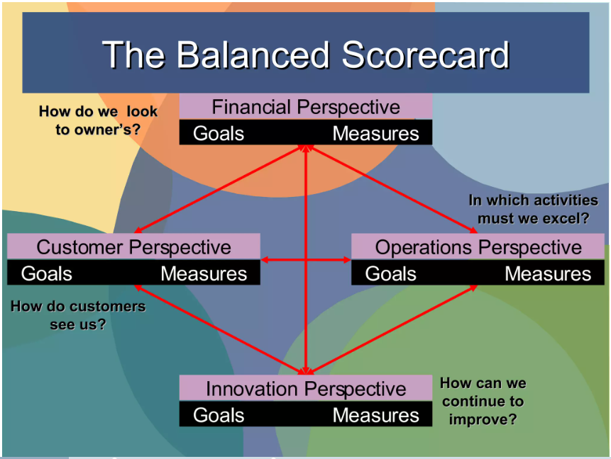
Perspectives to Management Accounting

Slide 12
Cost vs Managerial accounting
Cost accounting and managerial accounting are related, but different, types of accounting.
Characteristic | Cost accounting | Managerial accounting
Scope | Limited to costs | Includes costs and financing
Approach | Quantitative | Both quantitative and qualitative
Goal | Cost per unit | Decision (choice for efficiency and effectiveness)

Slide 13
Cost vs Managerial accounting
Example
Manufacturing companies often face the decision of whether to make certain components or purchase the components from an outside supplier.
Cost accounting would calculate the cost of each alternative. Let’s say the cost accountants determine that a company would save $0.50 per component if the units were purchased from an outside supplier rather than being produced by the company.
Managerial accounting would use that cost and supplement the cost with nonfinancial information to arrive at a decision. Managers would use the $0.50 per piece savings as well as nonfinancial considerations, such as the impact on the morale of current employees and the supplier’s ability to produce a quality product, to decide whether or not to purchase the component from the outside supplier.
In summary,
It may be helpful to think of cost accounting as a subset of managerial accounting.
And that the result of cost accounting is a number, whereas the result of managerial accounting is a decision

Slide 14
Functions of management accounting
Helpful in Planning & policy formation:-forecasting, setting goals, framing policies based on available information.
Help in decision-making:-makes decisions on cost, price, profit & savings.
Helpful in controlling: management accounting devices like standard costing & budgetary control help control performance
Motivating to employees: delegation increases the job satisfaction of employees & encourages them to look forward
Provides accounting information to management

Slide 15
Similarities between management and financial accounting
Branches of Accounting
Concerned with systematic recording and presentation of financial data
Follow the same principles of Dr and Cr
Same source of recording transactions
Common goal of assisting the organization they serve
Complementary to each other.

Slide 16
Management Accounting Vs.
Financial Accounting
Dimension | Management | Financial
 | Accounting | Accounting
1.Structure | Varies according | Unified Structure
 | to the information
2. Sources of | Whatever is useful | Generally Accepted
Principle | to management | Accounting Principles
3. Need | Optional | Statutory Obligation
4. Time orientation | Historical and estimates | Historical
 | of the future
5. Report entity | Responsibility Centers | Overall Organization
6. Purpose | A means to the end of assisting management | External reporting / statements for outside
7. Users | Relatively small group: | Relatively large group:
 | known identity | mostly unknown

Slide 17
Management Accounting Vs.
Financial Accounting
Dimension | Management | Financial
 | Accounting | Accounting
8. Information | Monetary and | Primarily Monetary
Content | non-monetary
9. Information | Many approximations | Few approximations
Precision
10. Report frequency | Varies with purpose: | Quarterly and annual
 | monthly or weekly
11. Report Timeliness | Report issued promptly | Delay of weeks or even
 | after end of period covered | months
12. Liability Potential | Management will take | Legally punishable.
 | action

Slide 18
Management accounting information systems (data sources).
Management accounting information systems (MAIS) are crucial for organizations as they provide data that is essential for decision-making and strategic planning. Here’s a brief overview of the data sources and possible uses of MAIS:
Data Sources for MAIS:
Sales Transactions: Data from sales can provide insights into revenue trends, customer preferences, and product performance.
Purchase Orders: Information from purchase orders helps in managing inventory levels and supplier relationships.
Payroll Records: Payroll data is used for labor cost analysis and workforce planning.
Inventory Levels: Monitoring inventory can optimize stock levels and reduce holding costs.
Financial Statements: These are used for reporting, compliance, and strategic financial analysis.

Slide 19
Management accounting information systems (possible uses).
Possible Uses of MAIS:
Budgeting and Forecasting: MAIS helps in creating accurate budgets and forecasts by analyzing historical data and predicting future trends.
Performance Measurement: It can track and measure the performance of different departments, products, and employees.
Cost Analysis: MAIS is used to analyze the costs associated with various business activities, aiding in cost control and reduction.
Decision Support: It provides managers with timely and relevant information to make informed decisions.
Compliance and Reporting: Ensures that financial reporting complies with legal and regulatory requirements.
The integration of digital data has expanded the capabilities of MAIS, allowing for more in-depth analysis and real-time reporting.
With the rise of digitalization, management accounting must adapt to utilize the breadth and variety of data available¹. An effective MAIS uses hardware and software to store and retrieve data efficiently, and it includes internal controls to protect sensitive information².
For a more detailed exploration of how digitalization is impacting management accounting and the methodological approaches to studying digital data environments, you can refer to the research published in the Journal of Management Control¹. Additionally, Investopedia provides a comprehensive breakdown of the components of an Accounting Information System (AIS), which can further enhance your understanding of the topic².

Slide 20
References
Barfield, J. T., Raiborn, C. A. & Kinney, M. R. (1994). Cost accounting: traditions and innovations. New York, NY: West Publishing Company.
Eldenburg, L. G. & Wolcott (2005). Cost management: measuring, monitoring and motivating performance. United States of American, USA: Susan Elbe
Lucey, T. (2009). Costing (7th ed.). United Kingdom, UK: BookPower
Warren, C. S., Reeve, J. M. & Fees, P. F. (1999). Financial and managerial accounting. United States of America, USA: International Thomson Publishing.
Principles of Accounting, Volume 1: Financial Accounting
“Download for free at https://openstax.org/details/books/principles-financial-accounting.”

