Slide 1
What is Health Policy & Systems Research?
Dr Munakampe

Slide 2
Key Takeaways…
Features that define HPSR are:
  the types of issues it addresses
  the fact that it seeks to address real-world situations and issues
  it is multidisciplinary, drawing on methods and perspectives from a range of disciplines.
HPSR investigates issues such as: how health care is financed, organized, delivered and used; how health policies are prioritized, developed and implemented; and how & why health systems do or do not generate health and wider social goals.

Slide 3
Key Takeaways…
It brings together health policy and health systems work into one integrated field. This combined focus on health policy and health systems issues provides a strong basis for identifying what can be done to:
  1. strengthen health systems so they can better achieve their health and broader social goals; &
  2. ensure that the related research is applied research that has the potential to support the implementation of health policies and health system development.

Slide 4
Key characteristics of HPSR

Slide 5
HPSR is defined as a field:
… that seeks to understand and improve how societies organize themselves in achieving collective health goals, and how different actors interact in the policy and implementation processes to contribute to policy outcomes. By nature, it is inter-disciplinary, a blend of economics, sociology, anthropology, political science, public health and epidemiology that together draw a comprehensive picture of how health systems respond and adapt to health policies, and how health policies can shape - and be shaped by − health systems and the broader determinants of health.
(Alliance for Health Policy and Systems Research, 2011)

Slide 6
key characteristics of hpsr
HPSR is a multidisciplinary research field, distinguished by the issues and questions addressed through the research rather than by a particular disciplinary base or set of methods;
HPSR includes research that focuses on health services as well as on the promotion of health in general;
HPSR includes concern for global and international issues as well as national and sub-national issues,
    as global forces and agencies have important influences over health systems in low- and middle-income countries;

Slide 7
key characteristics of hpsr
HPSR encompasses research on or of policy, which means that it is concerned with how policies are developed and implemented and the influence that policy actors have over policy outcomes
  – it addresses the politics of health systems and health system strengthening;
HPSR promotes work that explicitly seeks to influence policy, that is, research for policy

Slide 8
An integrated approach
In practice, therefore, the two apparently different areas 1. Health policies can be seen as the purposeful and
of work – health policy and health systems – overlap.
deliberate actions through which efforts are made to
Together they provide the knowledge base relevant to
strengthen health systems in order to promote
strengthen health systems whilst also showing how
population health.
knowledge and other forms of power together influence
2. Health policy actions must not only be informed by
policy decision-making. In these ways, HPSR work always
an understanding of the current dynamics of health
seeks to be policy relevant

Slide 9
central elements in HPSR
Four central elements in HPSR are:
    health systems
    health policy
    health system development or strengthening
    health policy analysis.
The issues related to each of these elements can be understood through a range of definitions, concepts and frameworks, which also help to generate relevant and appropriately framed research questions.
Such frameworks allow us to understand the various elements, characteristics and dimensions of a health system;
    and to identify the different connections and interrelationships within a health system that need to be considered in order to strengthen them.

Slide 10
central elements in HPSR
New health policies represent efforts to introduce deliberate and purposeful change within health systems.
Ideas and concepts related to policy and the analysis of such policy are an important part of HPSR.
In seeking to support better policy implementation, it is critical that we understand the factors that influence policy outcomes.
Through understanding the nature of policy and the processes of policy change, we gain new insights that help to explain how health system actors,
    and the relationships of power and trust among them, influence health system performance

Slide 11
The boundaries of HPSR
The issues HPSR addresses and how it differs from other related areas of health research are not always understood.
The four elements outlined in the previous section –
  health systems and
  their development,
  health policy and
  policy analysis
– provide the basis for HSPR

Slide 12
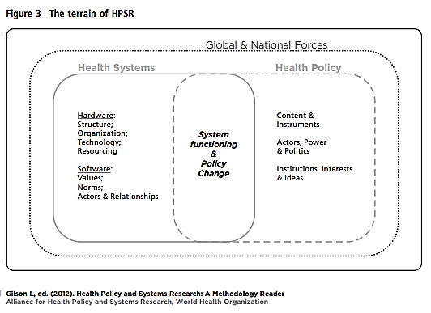

Slide 13
HPSR focuses on health policies and health systems – what they are; how policies are implemented; how health systems work;
    and what can be done to improve policy implementation and the functioning of health systems.
Issues relevant to HPSR are wide ranging, include a variety of actors, and may be studied at local, national and global levels.
HPSR can be distinguished from research focused on specific health programmes, for example
    those relating to malaria or HIV/AIDS, by its focus on the broader setting in which such programmes are implemented.

Slide 14
HPSR includes, for example, work on the financing, human resource or governance elements of the health system that underpin all service provision.
However, HPSR has fuzzy boundaries – it has overlaps with health services research and operational research,
    and there are some grey areas between HPSR and aspects of management and some discipline-specific research.

Slide 15
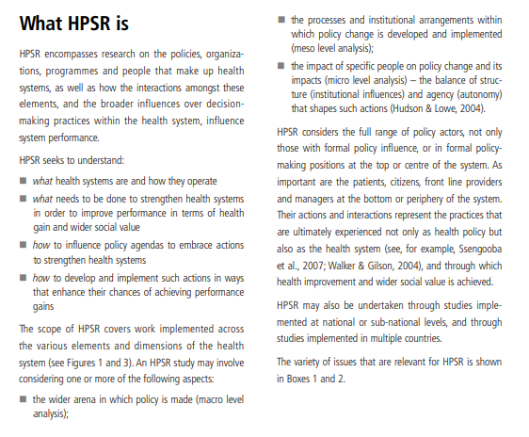

Slide 16
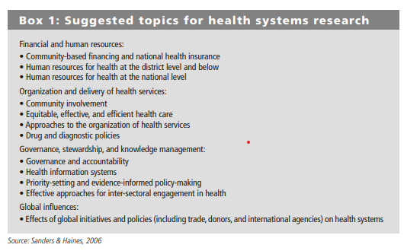

Slide 17
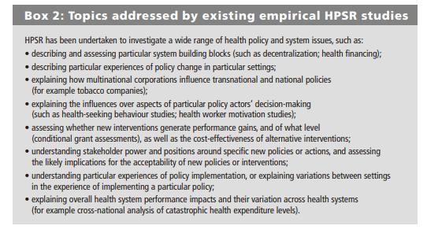

Slide 18
