Slide 1
Quantitative Methods in Research
Mumbi Chola
Dept. of Epidemiology & Biostatistics
UNZA School of Public Health
mumbi24@gmail.com

Slide 2
Outline
Lecture Objectives
Quantitative Methods
Sources of Quantitative Data
Questions in Quantitative Research
Units and Variables
Quantitative Designs
Summary

Slide 3
Lecture Objectives
Understand what quantitative research is
Understand the sources of quantitative data
Understand the type of questions answered by quantitative research
Know what a unit and variable is
Have a basic understanding of the various epidemiological designs and be able to distinguish among them

Slide 4
Quantitative Methods
Quantitative research is ‘Explaining phenomena by collecting numerical data that are analysed using mathematically based methods (in particular statistics)’. Aliaga and Gunderson (2000)

Slide 5
Quantitative Methods
Those which generate numerical data
Involve quantitative analysis using statistics to improve numerical data
Like all data collection and analysis, choice of quantitative method should be driven by a question

Slide 6
Sources of Quantitative Data
Primary data
  Data collected to answer a specific research question
  Usually involves the research collecting data
Secondary data
  Existing institutional data
  Routine data
  Usually collected for other purposed
  Typically analysed to answer research questions

Slide 7
Questions in Quantitative Research
There are four main types of research questions suited for quantitative research :
The first type of research question is that demanding a quantitative answer.
  E.g. How many have been affected by the Ebola virus?
2. Numerical change can likewise accurately be studied only by using quantitative methods.
  E.g. Are the numbers of Breast Cancer patients at UTH rising or falling?

Slide 8
Questions in Quantitative Research
3. Finding out about the state of something or other, we often want to explain phenomena.
  E.g. What factors are influencing pregnancies among teenagers in Lusaka?
4. Hypotheses testing. We might want to explain something
  E.g. Whether there is a relationship between disease outcome and type of birth of a child (i.e. natural and c-section)

Slide 9
Units and variables
Quantitative data is collected from someone or something which are known as Units or cases
The data that we are collecting from these units are known as variables
Variables are any characteristic of the unit we are interested in and want to collect (e.g. sex, age, marital status, HIV status).
The label ‘variable’ refers to the fact that these data will differ between units.
For example, HIV status will differ by province or level of knowledge will differ by education level

Slide 10
Quantitative Research Designs

Slide 11
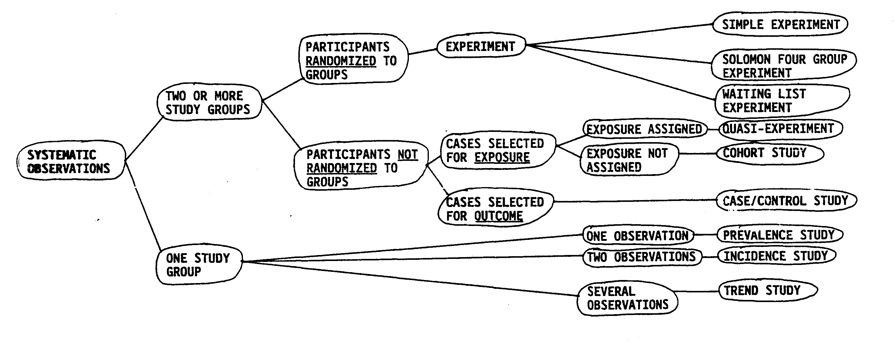
Quantitative approaches

Slide 12
Main types of epidemiological studies
Cross- sectional
Cohort
Observational
Case-control
Studies
Experimental
Trials
Intervention randomly assigned
Individually
randomised
Cluster
randomised

Slide 13
Epidemiologic Study Designs
CROSS-SECTIONAL STUDY
Exposed or
unexposed
Persons with disease
Persons without disease
The past
The future
(RETROSPECTIVE)
(PROSPECTIVE)
COHORT
STUDY
CASE-CONTROL
STUDY
Exposed persons
Disease or
no disease
Unexposed persons
Time
Now

Slide 14
Cross-sectional studies
All information usually collected at the same time
Primary data collection
Secondary data analyses (already existing data)
Can collect information on previous exposure
Prevalence studies
Surveys
Repeated cross-sectional studies: trend analyses

Slide 15
Cross-sectional studies
Usually population-based
Often random sample from a population with variation in both exposure and outcome (disease status)
Often stratified based on certain variables (age, gender)

Slide 16
Examples of Cross sectional Studies
Zambia Demographic and Health Survey
Census of Zambia
Living Conditions Monitoring Survey
Economic Census of Zambia

Slide 17
Epidemiologic Study Designs
CROSS-SECTIONAL STUDY
Exposed or
unexposed
Persons with disease
Persons without disease
The past
The future
(RETROSPECTIVE)
(PROSPECTIVE)
COHORT
STUDY
CASE-CONTROL
STUDY
Exposed persons
Disease or
no disease
Unexposed persons
Time
Now

Slide 18
Epidemiologic Study Designs
CASE-CONTROL STUDY
Exposed or
unexposed
Persons with disease
Persons without disease
The past
The future
(RETROSPECTIVE)
(PROSPECTIVE)
COHORT
STUDY
CASE-CONTROL
STUDY
Exposed persons
Disease or
no disease
Unexposed persons
Now
Time

Slide 19
Advantages Of Case-control Studies
Advantages:
1. Useful in studying relatively rare diseases
2. Important in understanding new diseases
3. Commonly used in outbreak investigation
4. Useful if induction period is long
5. Relatively inexpensive

Slide 20
Disadvantages Of Case-control Studies
1. Susceptible to bias if not carefully designed (and matched)
2. Especially susceptible to exposure misclassification
3. Especially susceptible to recall bias
4. Restricted to single outcome
5. Incidence rates not usually calculable
6. Cannot assess effects of matching variables

Slide 21
Examples of Case-Control Studies
Cholera outbreak in Lusaka from October 2017 in Zambia has resulted in
  approximately 5,900 cases and 114 deaths. (Sinyange et al, 2018) https://www.ncbi.nlm.nih.gov/pmc/articles/PMC6048949/
1950's
Cigarette smoking and lung cancer
1980's
AIDS and sexual practices

Slide 22
Epidemiologic Study Designs
CROSS-SECTIONAL STUDY
Exposed or
unexposed
Persons with disease
Persons without disease
The past
The future
(RETROSPECTIVE)
(PROSPECTIVE)
COHORT
STUDY
CASE-CONTROL
STUDY
Exposed persons
Disease or
no disease
Unexposed persons
Now
Time

Slide 23
Advantages Of Cohort Studies
Can assess several outcomes
2. Time-order generally clear
3. Prospective control over exposure and outcome measurement possible (in prospective studies)
4. Somewhat less potential for bias than case-control studies, but equal potential for confounding

Slide 24
Disadvantages Of Cohort Studies
1. Generally costly and require large samples
2. Not useful for rare outcomes
3. As an observational study, can never be assumed to be free of confounding and bias
4. Must usually control for potential confounding in the analysis, though can control in the design

Slide 25
Examples of Cohort Studies
Aspirin use and chronic diseases: a cohort study of the elderly.
  OBJECTIVE: To evaluate the associations between the use of aspirin and the incidences of cardiovascular diseases, cancers, and other chronic diseases
  SUBJECTS--All 22,781 residents of the community
  61% responded (13,987, 8881 women and 5106 men; median age 73).
  They formed the cohort that was followed up for 6 1/2 years
http://www.bmj.com/content/299/6710/1247.short

Slide 26
Ecological Studies
Studies of risk-modifying factors on health or other outcomes based on populations defined either geographically or temporally.
Both risk-modifying factors and outcomes are averaged for the populations in each geographical or temporal unit and then compared using standard statistical methods

Slide 27
Ecological Studies
Unit of observation is the population or community.
Disease rates and exposures are measured in each of a series of populations and their relationship is examined.
Often the information about disease and exposure is abstracted from published statistics and therefore does not require expensive or time consuming data collection.
The populations compared may be defined in various ways.

Slide 28
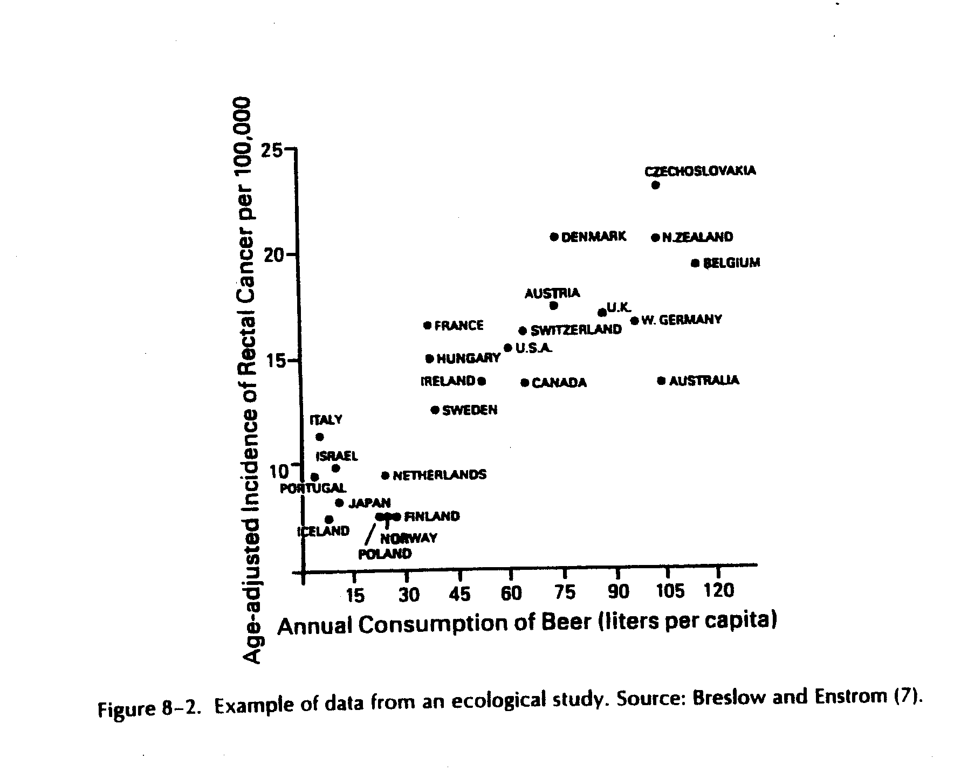
Ecologic/aggregate cross-sectional studies

Slide 29
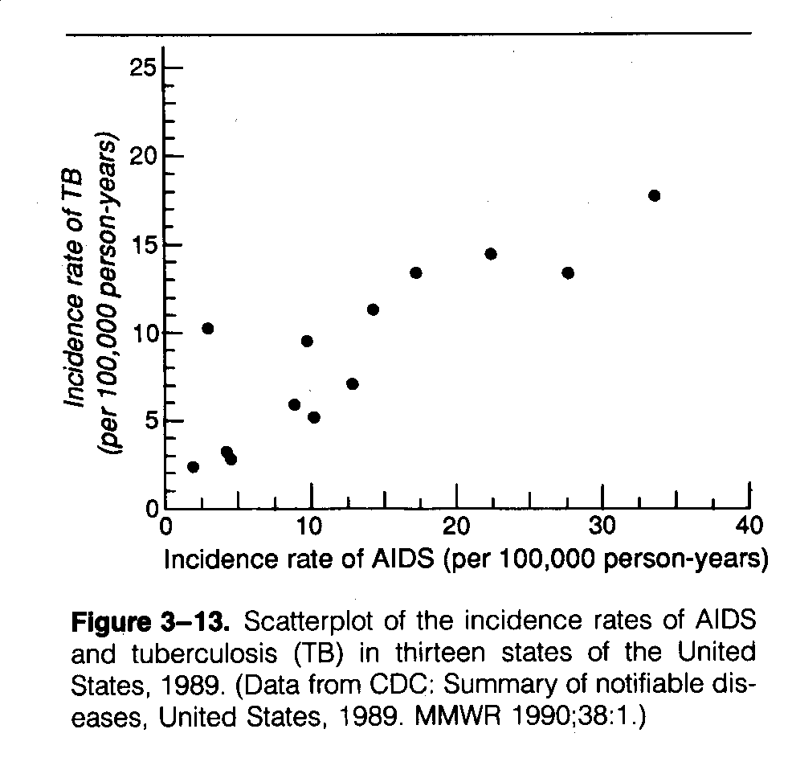

Slide 30
Ecologic studies advantages
Relatively quick to conduct (existing data often used)
International, geographical or regional differences in morbidity or mortality can be revealed
Time trends can be seen with a cross-section series

Slide 31
Experimental Studies
“A test under controlled conditions that is made to demonstrate a known truth, to examine the validity of a hypothesis or to determine the efficacy of something previously untried.” American Heritage Dictionary of the English language
Also referred to as intervention studies
Typically has the experimental arm and control arm

Slide 32
Experimental Studies
Have 4 main elements;
Manipulation – environment is purposefully changed by the researcher
Control- prevent external factors from influencing the outcome
Random selection – participants are selected randomly
Random allocation (or assignment)– randomization; participants are allocated or assigned to treatment and control arms randomly

Slide 33
Examples of Experimental Studies
Microbicides study
  Clinical trail testing the effectiveness of the anti-AIDS virus gel, Microbicide PRO 2000 – a topical compound that can be used to protect against STDs during rectal or vaginal intercourse
  The study involved more than 9000 women in four African countries including Zambia
  Revealed no difference in the rate of HIV infection between women given the PRO 2000 gel and those on placebo gel during the trial.

Slide 34
Examples of Experimental Studies
CISMAC Study - “The effectiveness of a girl empowerment programme on early childbearing, marriage and school dropout in rural Zambia: A cluster trial”
The study will examine links between adolescent pregnancies and different approaches to empower adolescent girls in Zambia.
https://www.uib.no/en/cih/89808/cismac-study-zambia-receives-globvac-funding

Slide 35
Summary
Three things that quantitative methods do?
What are the 2 types of sources of quantitative data?
What is a unit and a variable?
What are the different quantitative designs?
What is the difference between case-control studies and cohort studies?
What is the difference between cross sectional studies and ecological studies?
What are the main features of experimental studies?

Slide 36
Questions, comments & Discussions

