Slide 1
QUESTIONNAIRE DESIGN: AN INTRODUCTION
Dr. Zulu Davy Wadula
Notes:
Non-Profit Evaluation & Resource Center, Inc. (NPERCI)

Slide 2
Learning Objectives
To understand a questionnaire’s cultural, psychological, economic, and political context
Learn how to ask valid questions and how to ask them correctly

Slide 3
What Is A Questionnaire?
A tool for collecting information to describe, compare, or explain an event or situation, as well as, knowledge, attitudes, behaviors, and/or sociodemographic characteristics on a particular target group.

Slide 4
Questionnaire General Format
Self-administered (by mail or personal contact)
In person (face-to-face)
Telephone interviews

Slide 5
The Questions or Items
Are the focus on any survey or questionnaire
It is crucial to know how to ask the questions in written and spoken form
The way you ask the questions determines the answers

Slide 6
Questions Context
Identify the questionnaire’s specific purpose(s)
Clarify the terms used to state the questionnaire’s purpose(s)
Be sure to have the specific objectives of the questionnaire
Know the respondents

Slide 7
Questions Context
Standardize the interviewer
Standardize the response format
Ask questions in a social, cultural, and economic context
Keep confidentiality and voluntary participation
Include a letter of introduction or presentation

Slide 8
Questions Format
Open questions - more information but difficult to codify, enter, and analyze
Closed questions - less information but easy to codify, enter, and analyze

Slide 9
Choices And Measurement Of Responses
Nominal or categorical choices
Ordinal
Numerical

Slide 10
How To Obtain
Valid Information
Ask purposeful questions
Ask concrete questions
Use time periods based on importance of the questions
Use conventional language

Slide 11
How To Obtain
Valid Information
Use complete sentences
Avoid abbreviations
Review questions with experts and potential respondents
Use shorter questions

Slide 12
How To Obtain
Valid Information
Avoid two-edged questions
Avoid negative questions
Adopt/adapt questions used successfully in other questionnaires

Slide 13
Types of Quantitative Research Questions
Dichotomous Questions
Dichotomous questions are those with a margin for only two possible answers. They are usually used when the answers are “Yes/No” or “True/False.” These questions significantly simplify the research process and help collect simple responses.
Example: Have you ever visited Istanbul?

Slide 14
Multiple Choice Questions
Multiple-choice questions have a list of possible answers for the participants to choose from. They help assess people’s general knowledge, and the data gathered by multiple-choice questions can be easily analysed.
Example: Which of the following is the capital of France?

Slide 15
Multiple Answer Questions
Multiple-answer questions are similar to multiple-choice questions. However, there are multiple answers for participants to choose from. They are used when the questions can’t have a single, specific answer.
Example: Which of the following movie genres are your favourite?

Slide 16
Likert Scale Questions
Likert scale questions are used when the preferences and emotions of the participants are measured from one extreme to another. The scales are usually applied to measure likelihood, frequency, satisfaction, and agreement. The Likert scale has only five options to choose from.
Example: How satisfied are you with your job?

Slide 17
Semantic Differential Questions
Similar to Likert scales, semantic differential questions are also used to measure the emotions and attitudes of participants. The only difference is that instead of using extreme options such as strongly agree and strongly disagree, opposites of a particular choice are given to reduce bias.
Example: Please rate the services of our company.

Slide 18
Rank Order Questions
Rank-order questions are usually used to measure the preferences and choices of the participants efficiently. In this, multiple choices are given, and participants are asked to rank them according to their perspective. This helps to create a good participant profile.
Example: Rank the given books according to your interest.

Slide 19
Matrix Questions
Matrix questions are similar to Likert scales. In Likert scales, participants’ responses are measured through separate questions, while in matrix questions, multiple questions are compiled in a single row to simplify the data collection method efficiently.
Example: Rate the following activities that you do in daily life.

Slide 20
How To Write Quantitative Research Questions?
Step 1: Determine the Research Goals
The first step in writing quantitative research questions is to determine your research goals. Determining and confirming your research goals significantly helps you understand what kind of questions you need to create and for what grade. Efficiently determining the research goals also reduces the need for further modifications in the questionnaire.
Step 2: Be Mindful About the Variables
There are two variables in the questions: independent and dependent. It is essential to decide what would be the dependent variable in your questions and what would be the independent. It significantly helps to understand where to emphasise and where not. It also reduces the probability of additional and vague questions.

Slide 21
Step 3: Choose the Right Type of Question
It is also important to determine the right type of questions to add to your questionnaire. Whether you want Likert scales, rank-order questions, or multiple-answer questions, choosing the right type of questions will help you measure individuals’ responses efficiently and accurately.
Step 4: Use Easy and Clear Language
Another thing to keep in mind while writing questions for a quantitative research questionnaire is to use easy and clear language. As you know, quantitative research is done to measure specific and simple responses in empirical form, and using easy and understandable language in questions makes a huge difference.

Slide 22
Step 5: Be Specific About The Topic
Always be mindful and specific about your topic. Avoid writing questions that divert from your topic because they can cause participants to lose interest. Use the basic terms of your selected topic and gradually go deep. Also, remember to align your topic and questions with your research objectives and goals.
Step 6: Appropriately Write Your Questions
When you have considered all the above-discussed things, it’s time to write your questions appropriately. Don’t just haste in writing. Think twice about the result of a question and then consider writing it in the questionnaire. Remember to be precise while writing. Avoid overwriting.

Slide 23
Step 7: Gather Feedback From Peers
When you have finished writing questions, gather feedback from your researcher peers. Write down all the suggestions and feedback given by your peers. Don’t panic over the criticism of your questions. Remember that it’s still time to make necessary changes to the questionnaire before launching your campaign.
Step 8: Refine and Finalise the Questions
After gathering peer feedback, make necessary and appropriate changes to your questions. Be mindful of your research goals and topic. Try to modify your questions according to them. Also, be mindful of the theme and colour scheme of the questionnaire that you decided on. After refining the questions, finalise your questionnaire.

Slide 24
Advantages & Disadvantages of Questionnaires in Quantitative Research
Advantages | Disadvantages
It is an efficient source for quickly collecting data. | It restricts the depth of the topic during collection.
There is less risk of subjectivity and research bias. | There is a high risk of artificial and unreal expectations of research questions.
It significantly helps to collect extensive insights into the population. | It overemphasises empirical data, avoiding personal opinions.
It focuses on simplicity and particularity. | There is a risk of over-simplicity.
There are clear and achievable research objectives. | There is a risk of additional amendments and modifications.

Slide 25
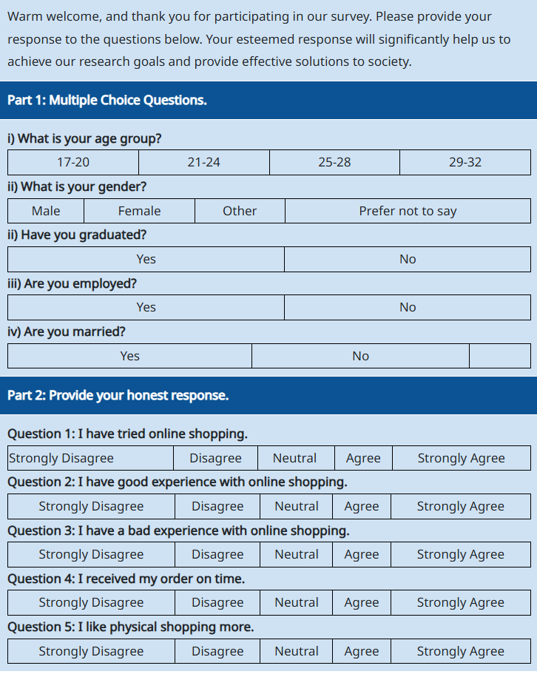
Sample questionnaire

Slide 26
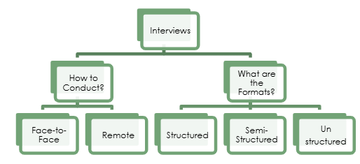
INTERVIEW TECHNIQUES

Slide 27
IN-DEPTH INTERVIEWS
Typically an exchange between one interviewer and one respondent.
Study participant take a more active role in determining the flow of the discussion
A qualitative interview should not be a mechanical reading of standardized questions; Collecting information-rich data requires mental agility, sensitivity and always practice.

Slide 28
IN-DEPTH INTERVIEWS
Framing qualitative questions
  Questions are informal, nonjudgmental, and open
  Avoid any suggestion that one answer might be more desirable than another
  Most interviews follow a pattern comprised of three kinds of questions: Main, Follow-up and Probes

Slide 29
Effective questioning
Main Question
  Should reflect the logical flow anticipated in the conversation, moving from easy and least threatening questions to more complex and interesting issues as rapport is being built.
  Note that participants often answer the main question before you have asked it.
  More difficult questions should be asked more than once, from different angles and at different points in the interview.
  Make sure pursue each main question to its logical conclusion while not neglecting questions or new ideas.

Slide 30
Effective questioning
Follow-up question
  Moves the interview or discussion to a deeper level by asking for detail
  To some extent one can anticipate follow-up questions in advance.
Probe
  A kind of a follow-up question that takes the discussion into still deeper territory, with or without specific reference to the topic.
  Note, however, the importance of maintaining a comfortable balance between too much detail and not enough.

Slide 31
Focus Group Discussions

Slide 32
Focus Group Discussions (FGDs)
  Use of group interaction to produce data and insights that would be less accessible without the interaction found in the group.
  Mostly, the group should be homogeneous with 8-10 participants
  Before beginning the discussion, it is important to collect background information for each participant-might valuable information for later analysis.

Slide 33
FGDs
  The moderator need to keep the discussion focused and moving.
  Should also show interest, curiosity, empathy and encouragement
  Should also be creative, and able to tailor questions and comments to the unique responses of each participant.
  For an effective partnership between researchers and participants, cultural norms should be considered in determining who should be the moderator e.g. Gender, Language .

Slide 34
FGDs
  To ensure accurate data and to facilitate analysis, FGDs are usually taped.
  Apart from the moderator there should be a Note taker to monitor the tape recorder and recording the discussion as much as possible
  The Note taker need to expand the notes immediately after the interview.
  The note taker also needs to note the nonverbal messages that have a bearing on the discussion

Slide 35
FGDs
  The note taker need to identify the participants using codes.
  The moderator welcomes the group and introduces herself or himself and the note taker and explaining the role of each
  The moderator also needs to explain the purpose of the recorder
  Assure the participants confidentiality and that there are not right or wrong answers and that all opinions are welcome.

Slide 36
Data generation
Focus Group Discussions
  Participants should understand the goals of the discussion i.e. communicating what you want to know from them and not revealing questions under study.
  Once there is general understanding on the topic and procedures, the moderator may ask the participants to introduce themselves unless anonymity in the group is important
  Also ask the participants to talk one at a time, slowly and clearly. Also ask the participants to add on the ground rules.

Slide 37
Focus groups – Key points
One or two researchers and participants meet as a GROUP to discuss a research topic
Use of group interaction to produce data and insights that would be less accessible without the interaction found in the group.
Essentially effective for capturing information about social norms and variety of views

Slide 38
Focus groups
It should have a moderator and a note taker
Mostly, the group should be homogeneous with 8-10 participants
Before beginning the discussion, it is important to collect background information for each participant-might valuable information for later analysis (the note taker usually does this).
To ensure accurate data and to facilitate analysis, FGDs are usually taped.
Time frame –one to two hours

Slide 39
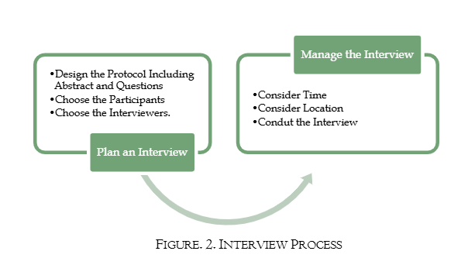
Interview Process

Slide 40
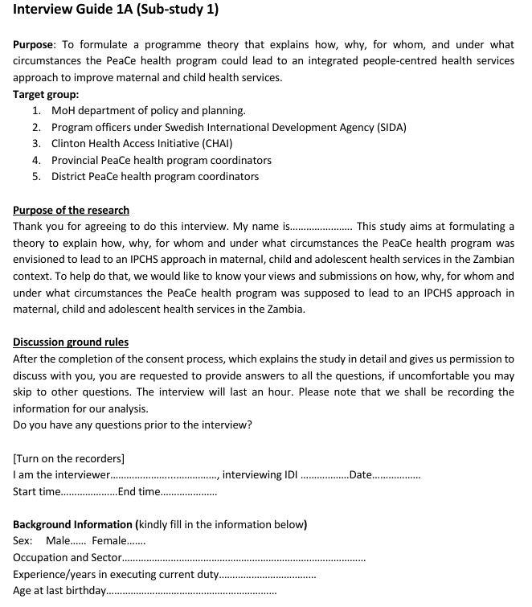

Slide 41
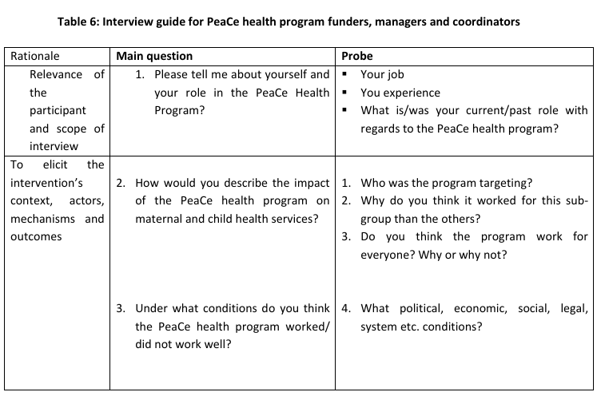
Sample interview guide

Slide 42
Suggested Readings
How to Conduct Surveys by Fink and Kosecoff, Sage Publications, 1998
Survey Research by Roger Sapsford, Sage Publications, 1999
Taherdoost, H. (2021). Data Collection Methods and Tools for Research; A Step-by-Step Guide to ChooseData Collection Technique for Academic and Business Research Projects, International Journal of AcademicResearch in Management, 10(1), 10-38.
Bampton, R., & Cowton, C. J. (2002). The e-interview. Paper presented at the Forum QualitativeSozialforschung/Forum: Qualitative Social Research.
Bolderston, A. (2012). Conducting a research interview. Journal of Medical Imaging and Radiation Sciences,43(1), 66-76
(PDF) How to Conduct an Effective Interview; A Guide to Interview Design in Research Study. Available from: https://www.researchgate.net/publication/359596183_How_to_Conduct_an_Effective_Interview_A_Guide_to_Interview_Design_in_Research_Study [accessed Apr 03 2025].
Notes:
Sage Publications, 1998
Sage Publications, 1999

