Slide 1
Occupational lung diseases
Allan R Mbewe

Slide 2
Size and Location of Occupational Respiratory Diseases Outcome

Slide 3
Content
    Occupational pulmonary diseases and control
    Pneumoconiosis;
    silicosis
    asbestosis
    occupational bronchitis and emphysema
    occupational asthma
    byssinosis
    extrinsic allergic alveolitis

Slide 4
Occupational diseases and conditions
Definition
Occupational diseases are those diseases contracted as a result of a particular employment
Many occupational diseases are prescribed
  approved for compensation in which case benefit is payable under the Social Security laws
“Each Member should, under prescribed conditions, regard diseases known to arise out of the exposure to substances and dangerous conditions in processes, trades or occupations as occupational (ILO, 2011)
An occupational disease is any chronic ailment that occurs as a result of work or occupational activity.
It is an aspect of occupational safety and health (Norway, 2016). Definition

Slide 5
Occupational diseases and conditions Cont.
Occupational diseases are those diseases contracted as a result of a particular employment
Many occupational diseases are prescribed
  approved for compensation in which case benefit is payable under the Social Security laws
Each Member should, under prescribed conditions, regard diseases known to arise out of the exposure to substances and dangerous conditions in processes, trades or occupations as occupational (ILO, 2011)
An occupational disease is any chronic ailment that occurs as a result of work or occupational activity.
It is an aspect of occupational safety and health (Norway, 2016).

Slide 6
Prescribed disease
A disease may be prescribed if:
  It ought to be treated, after having identified its causes and incidence and other relevant considerations, as a risk of occupation and not as a risk common to all persons
  It can be established with reasonable certainty that the disease was got due to nature of his/her employment.

Slide 7
Classification of occupational
A summary of occupational diseases may be grouped under the following groups of occupational hazards to which a worker may be exposed to as follows:
  Physical and or mechanical hazards
  Biological hazards
  Psychosocial hazards
  Ergonomic hazards
  Chemical hazards

Slide 8
1. Physical and mechanical
  Heat: Heat cataract, heat stroke, heat exhaustion, heat cramps, military dermatosis, sun burn
  Cold: Hypothermia, trench foot, frost bite
  Light: Headache, vertigo, eye strain, miner’s nystagmus, occupational cataract
  Noise: Occupational deafness.
  Pressure: Air embolism, blast (explosion)
  Vibration: HAVS, dupuytren’s contracture (injury of the palm), bursitis, carpal tunnel syndrome

Slide 9
1. Physical and mechanical cont’d
  Ionizing radiation: Cancer, leukaemia, aplastic anemia, somatic and genetic effects, ulceration, sterility.
  Ultraviolet radiation: Welding affecting eyes leading conjunctivitis and keratitis (welder’s flash) symptoms
  Electricity and electromagnetic fields: Burns and electric shocks

Slide 10
2. Biological hazards
Originate from living things which are capable of causing illness or disease in humans.
Encountered by workers at their workplaces; through
  inhalation,
  ingestion
  skin
Considered under the following headings:
  Bacteria
  Fungi
  viruses
  parasitic
  worms
  Plants miscellaneous

Slide 11
Diseases caused by biological hazards a) Bacteria
Name of disease | Causal organism | Means of transmission | Occupations at risk
Anthrax | Bacillus anthracis | Skin, inhalation and ingestion | Farm workers, Veterinarians, workers handling hides, wool and abattoir workers
Leptospirosis or Weil’s disease | Leptospira interrogans | Contaminated urine transmitted through the mucous membrane or skin | Coal miners, abattoir workers, sewer workers, or workers in areas where rats are present
Tuberculosis | M. tuberculosis | Inhalation, ingestion | Workers in close contact with infected persons

Slide 12
Diseases caused by biological hazards: Bacteria cont.
Name of disease | Causal organism | Means of transmission | Occupations at risk
Brucellosis | Brucella abortus | Orally | Farm workers, veterinarian, abattoir workers, workers in contact with animals and carcases
Farmer’s lung | Aspergillus species | Allergic reaction through inhalation of spores (Chronic bronchitis) | Agricultural workers
Eryspeloid | E. rhusiopathiae | Inhalation | Butchers, fishmongers, poultry handlers
Tetanus or Lockjaw | Clostridium tetani | Broken skin | Workers in muddy or dirty conditions
Legionnaire disease | Legionella pneumophilia | Inhalation from contaminated air conditioning units | Workers in air conditioned offices

Slide 13
Diseases caused by biological hazards Cont. b) Fungi
Name of disease | Causal organism | Means of transmission | Occupations at risk
Tinea or Ringworm and Athlete’s Foot | Microsporum, Trichophyton Epidermophyton | Infection of the skin, hair and nails | Workers in contact with animals, miners athletes
Thrush or Candiasis | Candida albicans | Mouth, gastrointestinal tract | Dish washers, cleaners

Slide 14
Diseases caused by biological hazards Cont. c) Viruses
Name of disease | Causal organism | Means of transmission | Occupations at risk
Viral hepatitis | Hepatitis virus | Inhalation | Workers in contact infected persons, human blood
Psittacosis | Psittacosis virus | inhalation | Workers in contact with parrots and similar birds e.g. pet shops workers
German Measles or Rubella | Rubella virus | inhalation | Nurses, nursery teachers, teachers

Slide 15
Diseases caused by biological hazards Cont. c) Viruses
Name of disease | Causal organism | Means of transmission | Occupations at risk
Ornithosis | Ornithosis virus | inhalation | Workers in contact with birds, poultry, pigeons
Rabies | Rabies virus | Broken skin (dog bite) | Workers in contact with infected animal (dogs)
Newcastle Disease or pneumoencephalitis | Mycovirus multiforme | inhalation | Farm workers, veterinarian, workers in contact with birds, poultry, research

Slide 16
Diseases caused by biological hazards Cont. d) Worms
Name of disease | Causal organism | Means of transmission | Occupations at risk
Ankylostomiasis or Round worms | A. duodenale | Skin | Miners, tunnel workers, bricklayers
Tapeworms | Taenia solium or T. saginata | Ingestion | Ingestion of improperly cooked meat prepared by staff with poor personal hygiene
Schistosomiasis | S. species | Skin | Farm workers, fisher men
Malaria | Malaria parasites | Mosquito bites | Farm workers and migrating workers

Slide 17
Diseases caused by biological hazards Cont. e) Miscellaneous
Name of disease | Causal organism | Means of transmission | Occupations at risk
Allergy to African boxwood dust | Gonioma kamassi | inhalation | Handlers or workers with African boxwood
Byssinosis or Asthma | Cotton dust | inhalation | Workers in cotton spinning industry
Bagassosis | Cane sugar dust | inhalation | Workers at sugar processing industry
Tobaccosis | Tobacco dust | inhalation | Workers in tobacco processing industry

Slide 18
3. Psychosocial hazards and conditions
Workers’ failure to adapt to an alien psychosocial work environment:
Frustration
lack of job satisfaction
Insecurity
poor human relationships
emotional tension

Slide 19
3. Psychosocial conditions cont’d
Psychosocial health effects can be classified in two main categories:
    Psychological and behavioural changes:
    including hostility
    Aggressiveness
    Anxiety
    Depression
    Tardiness
    Alcoholism
    drug abuse
    Sickness
    absenteeism

Slide 20
3. Psychosocial conditions cont’d
    Psychosomatic illness:
    including fatigue
    Headache
    pain in the shoulders
    neck and back
    propensity to peptic ulcer
    hypertension
    heart disease and rapid ageing

Slide 21
4. Ergonomic conditions
Poor organisation and arrangement of work and working equipment
  Poor job movements: in relation to handwriting or typewriting may cause cramps
  Friction and pressure may cause bursitis, cellulites i.e.
  beat hand, traumatic inflammation of the tendons or associated with tendon sheaths of the hand
  forearm i.e. tenosynovitis

Slide 22
4. Ergonomic conditions and hazards cont’d
Poor manual handling injuries and conditions can be both external and internal.
  External injuries:
  cuts, bruises, crush injuries and lacerations to fingers, hands, ankles and feet.
  Includes more serious internal forms of injury:
  muscle and ligament tears, hernia (ruptures), prolapsed intervertebral discs and damage to knee, ankle, shoulder and elbow joints

Slide 23
Introduction: Pneumoconiosis
  Pneumoconiosis = accumulation of inorganic dust in lungs, following non-neoplastic tissue reaction.
  They are pulmonary diseases caused by mineral dust inhalation in workplace.
  The specific types of pneumoconiosis are named by the substance inhaled e.g.
  silicosis, asbestosis, and anthracnosis

Slide 24
Introduction: Pneumoconiosis Cont. a) Lung diseases
Pneumoconiosis
  is a generic name covering the group of lung disorders which result from the inhalation of “inorganic dust”

Slide 25
Introduction: Pneumoconiosis Cont. b) Dust lung
  Permanent damage to the lung structure due to inhalation of mineral dust and the tissue reaction to its presence (The British Industrial injuries Advisory Council 2014)
  Effects are confined to the lungs
  In medicolegal practice at least, presence of dust alone is insufficient to indicate pneumoconiosis
  For compensation to be considered, the mineral dust must alter the structure of the lung and cause disability

Slide 26
c) Falling of dust
Mineral dust ρ = 2.6 g/m³, no wind
Particle size (μm)
100
50
10
5
1
0.2
0.1

Slide 27
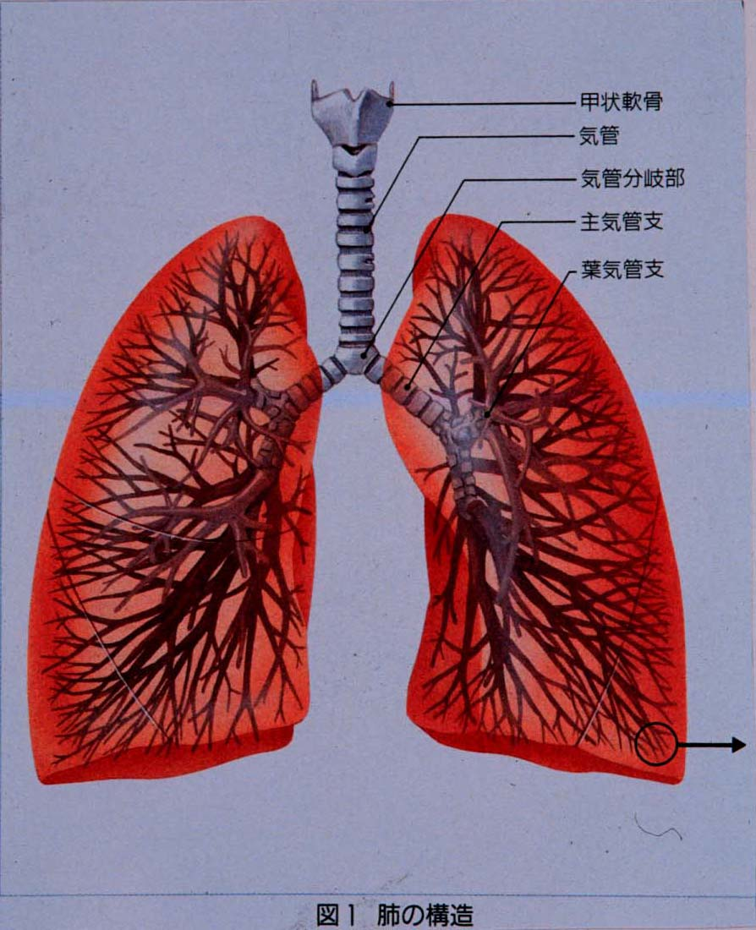

Slide 28
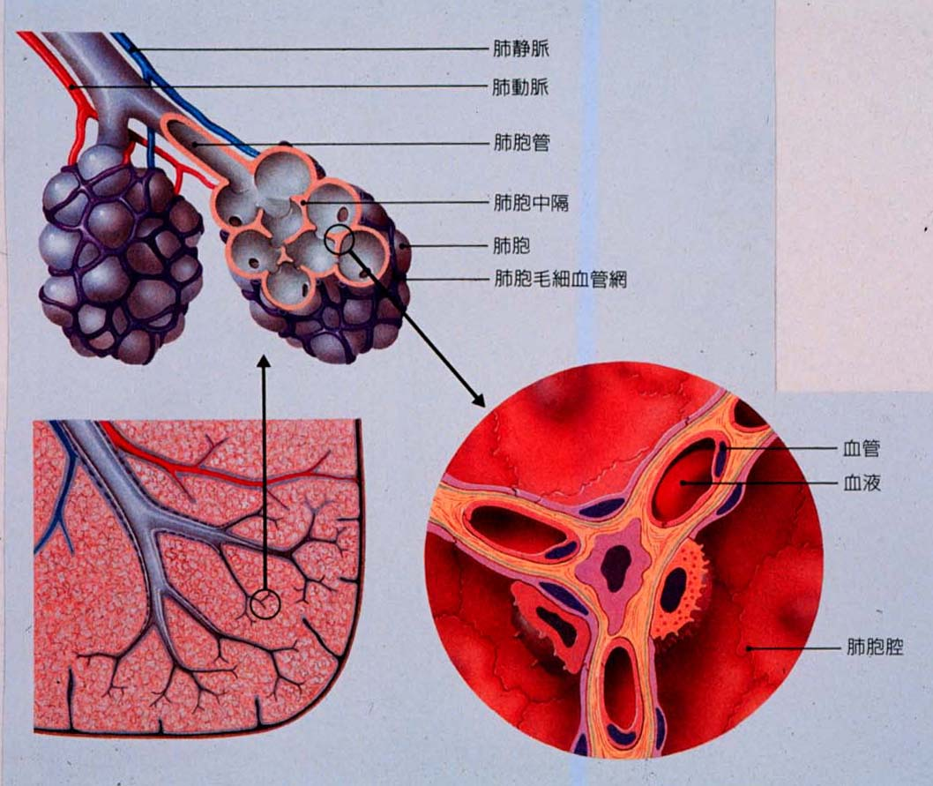

Slide 29
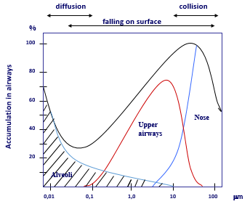
Dust in airways, effect of particle size

Slide 30
Dust in airways, effect of particle size
diffusion
collision
falling on surface
%
100
80
60
Accumulation in airways
Nose
40
Upper airways
20
Alveoli
0,01
0,1
1,0
10
100
μm

Slide 31
Breathing
During rest
0,5 l x 20 min = 4800 l/8 t
During heavy work
2 l x 40 min = 38400 l/8 t
If there are 0.5 fibers/cm³ in the breathing zone, a worker in heavy work will inhale 1 920 000 fibers in 8 hours.
Fibers thinner than 10 µm can reach the terminal bronchioles and alveoli

Slide 32
Major Pneumoconiosis
Inhalation of some dusts results in “major fibrosis” of the lungs, which results in interference of lung architecture or lung function tests.
As:
  Silica → silicosis
  Asbestos → asbestosis
  Talc → talcosis
  Coal → coal workers pneumoconiosis (anthracosis)

Slide 33
Examples of Benign Pneumoconiosis
It can result from the inhalation of:
  Iron dust→ sidrosis
  Tin dust→ stannosis
  Calcium dust→ chalicosis
They are characterized by the presence of small rounded dense opacities on a chest film due to perivascular collections of dusts.
Hilar lymph nodes may be prominent.
The deposits in the lung disappear when exposure is discontinued

Slide 34
Pathogenesis 1
The development of pneumoconiosis depends on:
  the amount of dust retained in the lung and airways
  the size, shape, and buoyancy of the particles
  solubility and physiochemical reactivity
  the possible additional effects of other irritants (e.g., concomitant tobacco smoking)

Slide 35
Pathogenesis 2
  The amount of dust retained in the lungs is determined by
      dust concentration in surrounding air
      duration of exposure
      effectiveness of clearance mechanisms

Slide 36
Pathogenesis 3
The size, shape, and buoyancy of the particles
  The most dangerous particles range from 1 to 5 μm in diameter because they may reach the terminal small airways and air sacs and settle in their linings

Slide 37
Pathogenesis 4
The solubility and cytotoxicity of particles modify the nature of the pulmonary response
  smaller particles tend to cause acute lung injury
  larger particles resist dissolution and so may persist within the lung parenchyma for years ‐ tend to evoke fibrosing collagenous pneumoconioses

Slide 38
Pathogenesis 5
  The possible additional effects of other irritants e.g.
  concomitant tobacco smoking
  Tobacco smoking worsens the effects of all
  inhaled mineral dusts

Slide 39
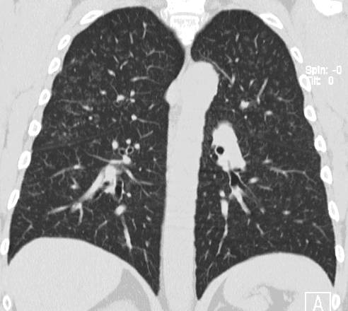
Pneumoconiosis: a) Simple Pneumoconiosis
  Deposition of coal dust in the lung and tissue reaction to its presence
  Incidence is related to total dust exposure
  Changes are graded on chest X-ray appearance
  Predisposes to progressive massive fibrosis

Slide 40
b) Progressive Massive Fibrosis
Round fibrotic masses several centimeters in diameter form in the upper lobes
Presents with exertional dyspnoea, cough, black sputum and eventually respiratory failure
Symptoms progress, or may even start, after exposure to coal dust has ceased
Lung function tests show a mixed restrictive and obstructive picture with loss of lung volume, irreversible airflow limitation and reduced gas transfer

Slide 41
c) Fibers, Fine Particles, and Dust (Asbestos)
Human carcinogens.
Increased rates of mesothelioma, a rare cancer of the lining of the lung and abdominal cavity, and cancer of the lung in a variety of occupations
Fibers are released into the environment from the use and deterioration of more than 5,000 asbestos products: roofing, thermal, and electrical insulation; cement pipe and sheet; flooring; gaskets; plastics; and textile and paper products

Slide 42
c) Fibers, Fine Particles, and Dust (Asbestos) Cont.
Greatest risks among.
workers who smoke
workers in asbestos insulation
brake maintenance and repair
building demolition jobs are exposed to high levels of asbestos.

Slide 43
Mean Fall in Lung Function in Subjects who Deteriorated Over 10 Years Prior to Death
Fall as % of Initial Result:
Vital capacity 6 ± 5%
FEV1 5 ± 4%
DLCO 27 ± 7%
KCO 36 ± 17%

Slide 44
Simple silicosis
Industrial exposures are:
free silica in mining, quarrying, and tunneling;
stonecutting, polishing, and cleaning monumental masonry
sandblasting and glass manufacturing
foundry work, pottery and porcelain manufacturing, brick lining, boiler scaling, and vitreous enameling.
Coal miners are exposed to dusts that contain a mixture of coal, mica, kaolin, and silica in varying proportions

Slide 45
Less Common Mineral Pneumoconioses Iron (Siderosis)
Individual susceptibility does play a role in the occurrence and clinical course
Disorders result mainly from excessive cumulative exposures to the offending mineral dusts
In some parenchymal lung diseases, individual host susceptibility – rather than exposure intensity - is the main determinant of occurrence

Slide 46
Three ‘types’ of Silicosis a) Simple chronic silicosis
  Most common form
  After long-term exposure (10 – 20 years) to low amounts of silica dust
  Nodules of chronic inflammation and scarring form in the lungs and chest lymph nodes

Slide 47
Three ‘types’ of Silicosis Cont. b) Accelerated silicosis c) Progressive massive fibrosis
Occurs after exposure to larger amounts of silica over a shorter period of time (5 – 10 years).
Inflammation, scarring, and symptoms progress faster in accelerated silicosis
Patients have symptoms, especially shortness of breath

Slide 48
Three ‘types’ of Silicosis Cont. c) Acute silicosis
From short-term exposure to very large amounts of fine silica dust.
The lungs become very inflamed, causing severe shortness of breath and low blood oxygen level.
Killed hundreds of workers during Hawk’s Nest Tunnel construction in early 1930s

Slide 49
Clinical features
The main symptom is breathlessness, first noted during exertion and later at rest as the large working reserve of the lung is diminished.
a patient with chronic silicosis may present without symptoms for assessment of an abnormal chest radiograph
Cough and sputum production are common symptoms and usually relate to chronic bronchitis

Slide 50
Treatment
Silicosis is an irreversible condition with no cure.
Treatment options focus on alleviating the symptoms and preventing complications
The disease will generally progress even without further exposure, but the rate of deterioration is probably reduced
Treatment of all forms of silicosis should be directed toward control of mycobacterial disease
Prevention is the key

Slide 51
Legal requirements
Public Health Act Cap 295
Food and Drugs Act Cap 303
Workers Compensation Act
Occupational Health and Safety Act of 2010
Factories Act
The Environmental Management Act, 2011 which includes the following regulation:
  Air Control (Licensing and Emissions Standards

Slide 52
Legal requirements Cont.
  Environmental Impact Assessment Regulations
  Pesticides and Toxic Substances Regs
  Waste Management (Licensing of transporters of wastes and Waste disposal Sites) Regs
  Water Pollution Control (Effluent and Waste water) Regs
  Hazardous Waste Management Regs
  Ozone Depletion Substances Regs

Slide 53
Zoonotic disease Class task
Group of four, discuss the following diseases
Anthrax
Brucellosis
Leptorososis
Rabies

Slide 54
The end
Thanks

