Slide 1
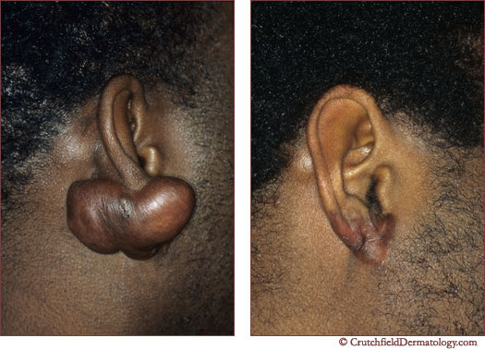
keloids

Slide 2
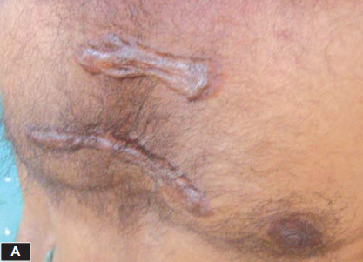
It’s a tough heaped up scar that rises abruptly above normal skin
Genetically predisposed
Causes
Skin trauma
infection
Skin tension
Spontaneus keloid
Risk factor
Darker complexions
Age 20-30yrs

Slide 3
PATHOPHYSIOLOGY
Results as an over growth of granulation tissue
Increases proliferation of fibroblasts producing abundant extracellular matrix,increased mesenchymal cell density and blood vessel density

Slide 4
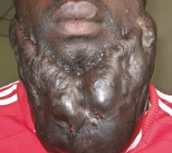
CLINICAL FEATURES
Scar grows over normal skin
Lumpy,ridged area on skin
Shiny,hairless
Can be painful and itchy
Pink to red or of normal skin
Rubbery,hard
Commonly found on
Chest,upper arm,ear lobe,cheeks

Slide 5
INVESTIGATIONS
Physical examination
histology

Slide 6
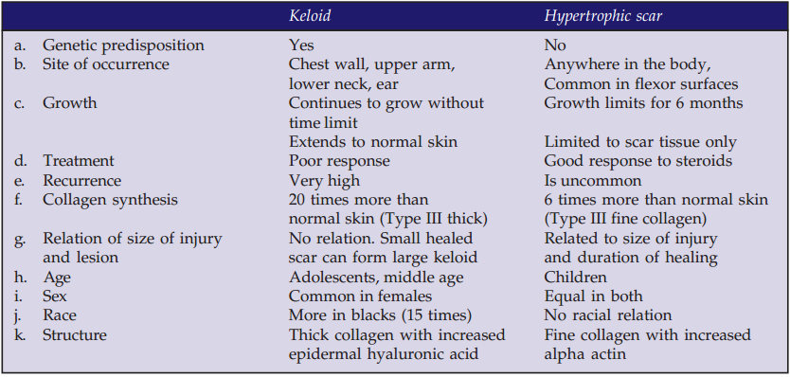
DIFFERENTIAL DIAGNOSIS
Hypertrophic scar

Slide 7
TREATMENT
Mechanical compression
Silicone gel sheet occlusion
Irradiation
Steroid injection
Laser therapy
Surgical excision
crayotherapy

