Slide 1
Bleeding in Cancer
Moderator: dr mwanza
presenter: bright nyongo nyirenda
OUTLINE
Introduction
Presentation/Pathology
Investigations
Management

Slide 2
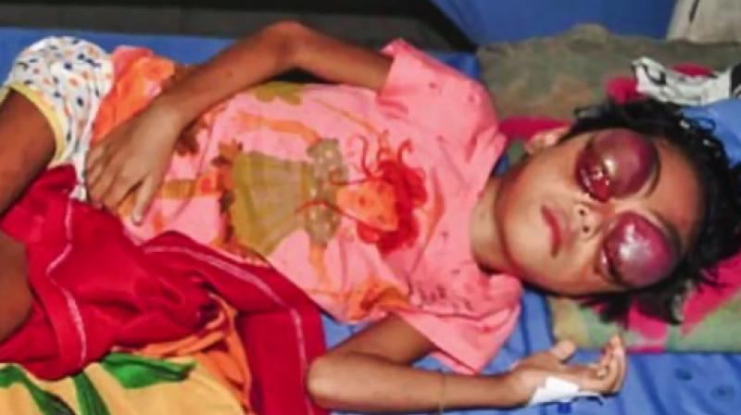
Introduction
Bleeding is a frequent problem for patients with advanced cancer, (stage 4)
with approximately 10% of all patients having at least one episode and almost 30% in patients with hematologic malignancies.
These episodes may range from low-grade oozing to major episodic bleeding or even catastrophic bleeds.
It is the immediate cause of death in around 6% of cases

Slide 3
Presentation
It can present in a variety of ways, from occult bleeds causing anemia over weeks to months, to overt external bleeding from particular anatomical sites.
Cancer along the digestive tract can cause bleeding in the stool.
Cancer anywhere along the urinary tract can cause bleeding in the urine.
Bleeding into the lungs can cause the person to cough up blood.
Hematologic cancers; nosebleeds, petechiae, ecchymosis, prolonged hemorrhages from injuries
Bleeding malignant wounds
Other cancers can bleed into internal areas of the body.

Slide 4
Pathology
Cancer invasion and destruction: tumor invasion of surrounding tissues leading to destruction of blood vessels and angiogenesis producing fragile blood vessels
Treatment-related causes: Mucositic and myelosuppressive effects of chemotherapy and radiotherapy
Thrombocytopenia/marrow failure: Hematologic cancers; leukemia, lymphoma and myeloma as well as metastasis to the bone marrow by other forms of cancer
Nutritional deficits: In the patient with cancer who is nutritionally compromised, vitamin deficiencies should always be considered
Drugs: Anti-coagulants and NSAIDs
Concurrent illness, including infection: Local infection within tumour cavities can also increase the risk of bleeding
Coagulation disturbances: Cancer causes DIC and the body responds extensively with fibrinolysis which eventually, hemostasis eventually is imbalanced with spontaneous bleeds.

Slide 5

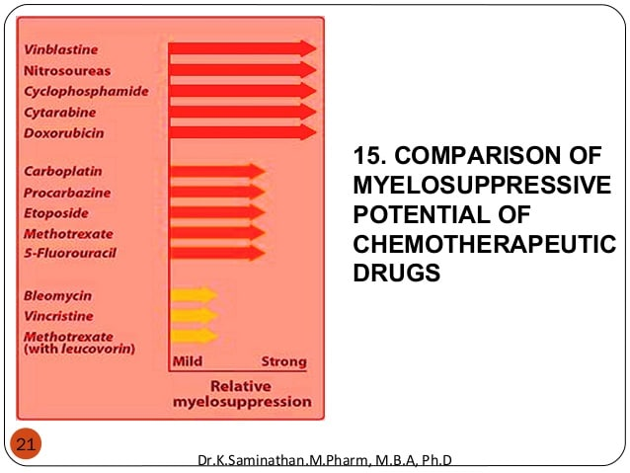
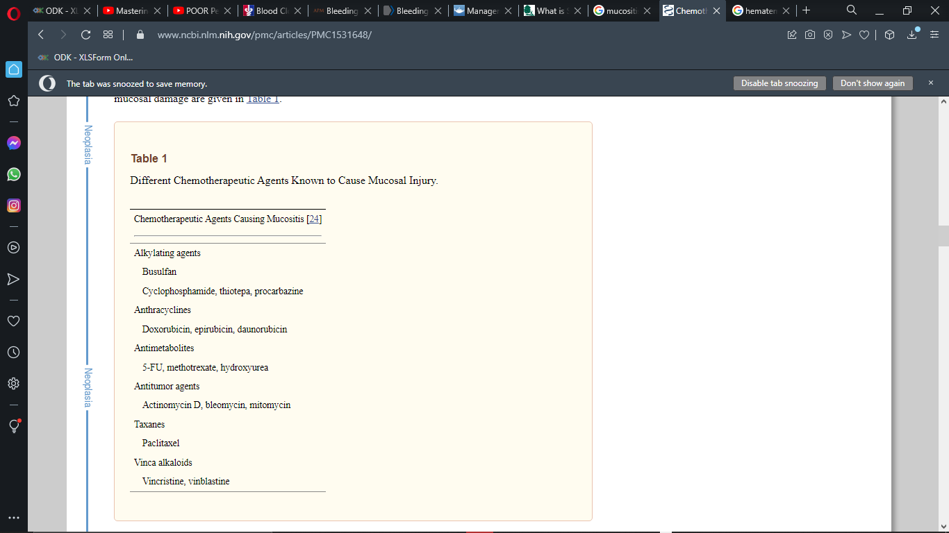
Mucositic and myelosuppressive drugs

Slide 6
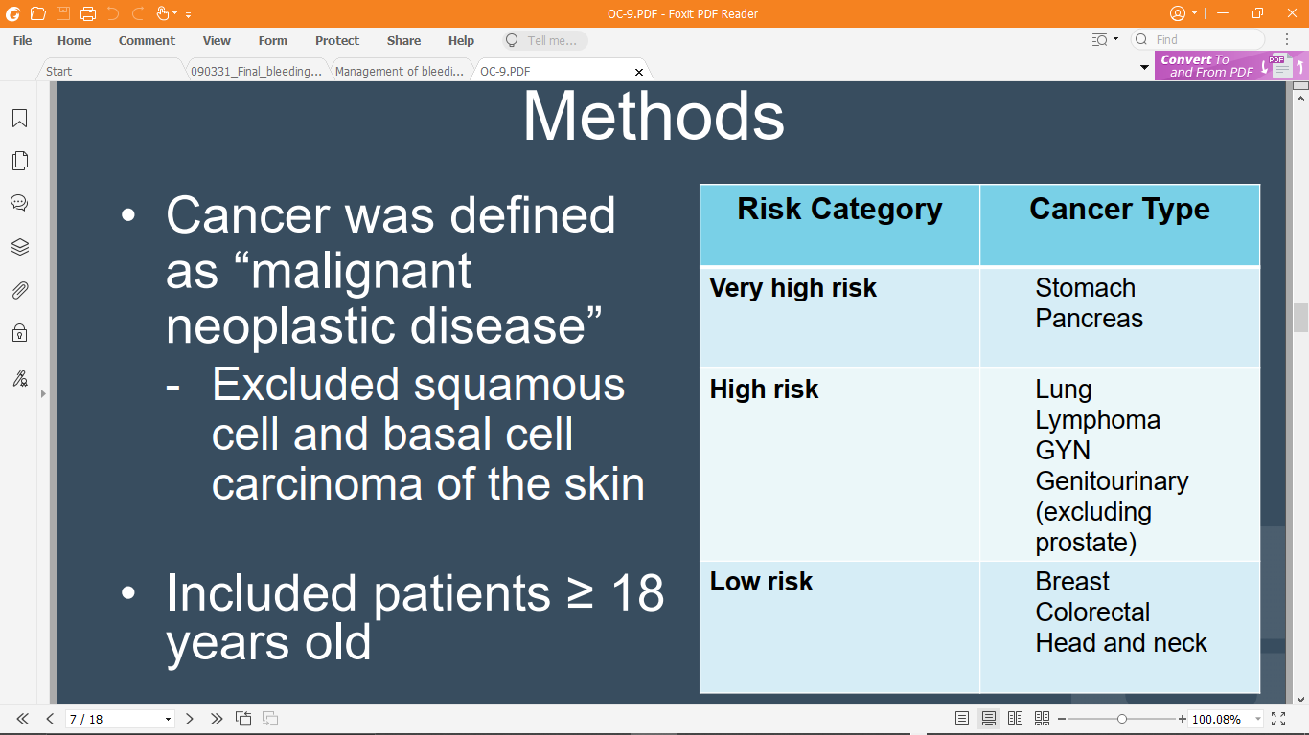
Risk of bleeding

Slide 7
Investigations
Analysis should include
Complete blood count, xmatch
Coagulation profile,
Complete metabolic panel with assessment of liver enzymes and function.
Imaging studies including MRI/CT scan and angiography of the area suspected of bleeding,
Endoscopy and colonoscopy for GIT bleeds
If infection is thought to precipitate haemorrhage, consider wound swabs and cultures for microbiological identification of pathogens and antimicrobial sensitivities

Slide 8
Management
Goals of care
For patients at risk of catastrophic bleeding, patients and their families should be prepared for the visually and mentally disturbing effects of such an episode.
Encourage the use of dark sheets, towels, blankets, and clothing to reduce the visual shock of seeing a massive bleed.
Instructing family/caregivers how to apply pressure if there is a specific bleeding site, instructing family/caregivers how to position a patient with massive hemoptysis or hematemesis
Fast acting sedatives such as intravenous or subcutaneous midazolam should be available, and families should be instructed on their use if the patient is at home.
Urgently move the patient to a health center for clinical management

Slide 9
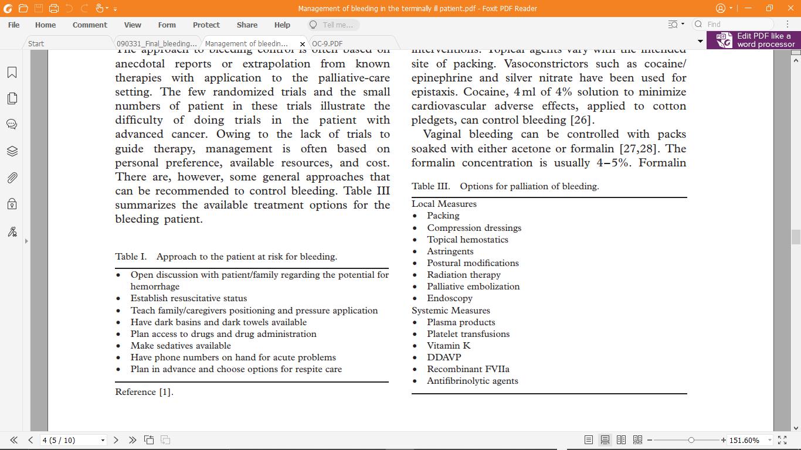
Management

Slide 10

END!!!!!
IF YOU WERE NOT PAYING ATTENTION!!!!!!!

