Slide 1
RADIOTHERAPY
PRESENTER: KAIMBO COMFORT
MODERATOR:DR MWANZA

Slide 2
CONTENT
Introduction
Mechanism of action
Aims of radiotherapy
Types
Classification
Indication
Contraindication
Side effects
Treatment plan

Slide 3
What is radiotherapy
Radiotherapy is a Medical use of ionizing radiation in the treatment of malignant cancers.
Ionizing radiation is radiation with sufficient energy to cause ionization.
Source of radiation used in radiotherapy
1.xrays
2.gamma rays
3.high energy rays
4.high energy electrons

Slide 4
-The absorbed dose of radiation is expressed as the unit Gray(GY) and is commonly delivered in a series of small doses called Fractions rather than a single dose [2 GY in 30 fractions Per day,5 days per week over 6 weeks].
Reason for fractionation:
4R -Repair
-Reoxygenation
-Redistribution
-Repopulation

Slide 5
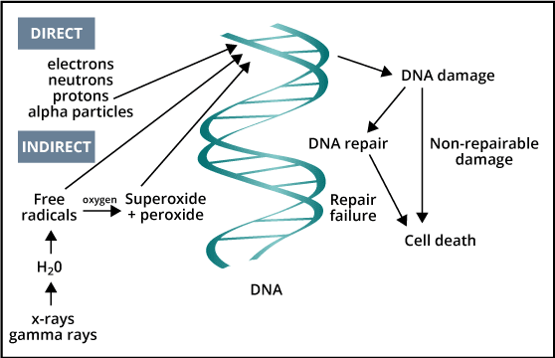
Mechanism of action

Slide 6
Aims of radiotherapy
-delivering of an optimal dose to the tumor with minimum damage to the surrounding tissue and organs.
-eradication of tumor
-symptom control
-improvement of quality of life.
-prolongation of survival

Slide 7
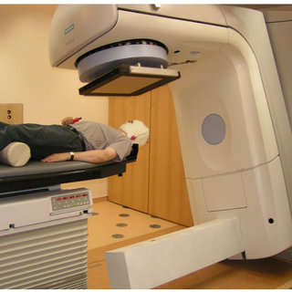
Types of radiotherapy
1.External beam radiation=> therapy delivers radiation by use of a linear accelerator.
applicational (0cm)
Close distance (1.5-30cm)
Far distance (30cm-2m)

Slide 8
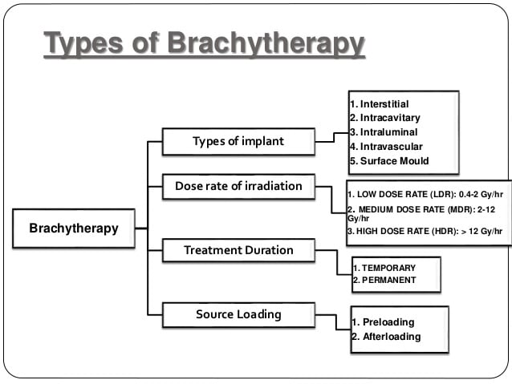
2.Internal RT(brachytherapy)

Slide 9
Classification of radiotherapy
1.adjuvant
Following BCS
Following mastectomy
2.curative/radical
Primary incision not possible( head or neck cancers)
3. neo-adjuvant
Large fungating lesion(e.g rectal cancer)
4.Palliative
Large fungating lesions
Metastic cancer

Slide 10
Indication
Malignant tumors
-Ca cervix
-Anal and skin cancer
-Head and neck cancer
-Bladder Cancer
-early lung cancer
-early Ca Esophagus
Metastatic injuries
Some relapsing beign tumors(brain tumors)
Hemoblatoses; Hodgkin's disease, non-Hodgkin’s malignant
Lymphoma, multiple myeloma.

Slide 11
contraindication
Absolute :
Pregnancy
pacemaker in the RT field :
significant pre existing lung disease, if diffusing capacity is severely reduced .
-Relative :
connective tissue disorders (SLE , scleroderma)
prior radiation therapy to the same part

Slide 12
Side effects
Acute
Nausea and vomiting
Skin desquamation
Diarrhea
Late
Fibrosis
Alopecia
Lymphoedema
Pneumonitis
Cancer
Cardiac problems

Slide 13
Treatment planning
Process by which practioners determine the appropriate radiotherapy for a patient with cancer.
This involves:
Initial consultation: review medical hx,MRI,CT, physical examination and obtaining of consent. Discus Tx options.
2. CT Stimulation: used to design the radiotherapy
=>Immobilization
=>Tattoo marking: help localize the exact point for beam line up.(3 small non permanent points are made.

Slide 14
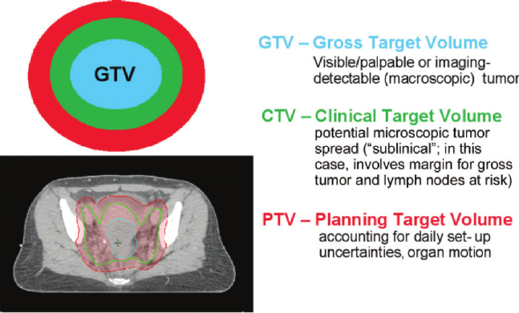
volume definition

Slide 15
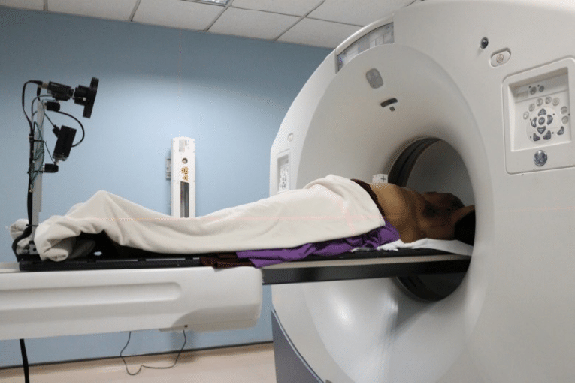

Slide 16
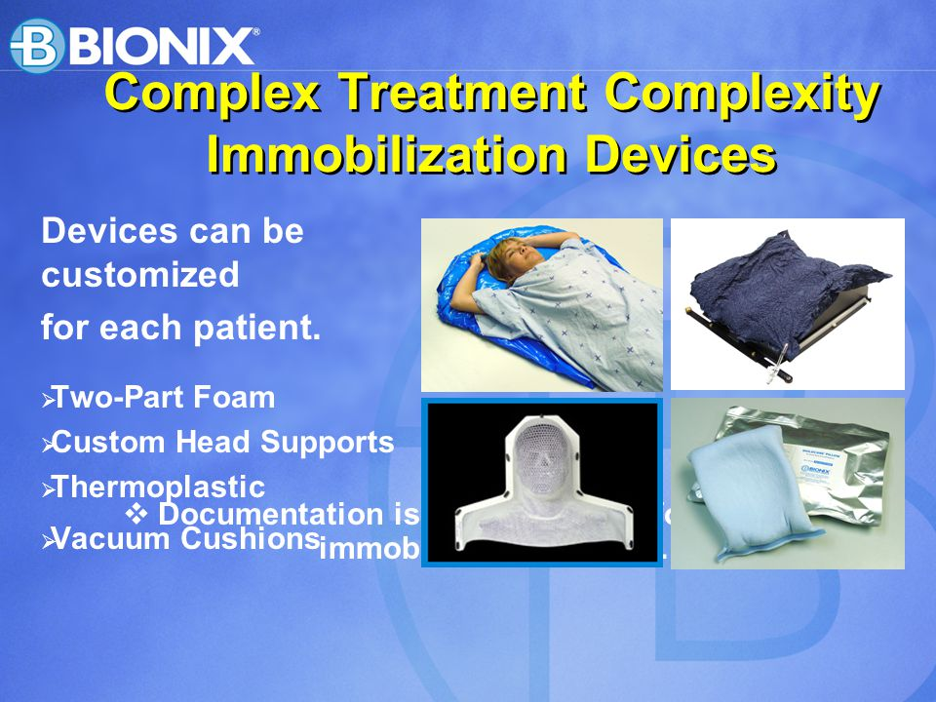
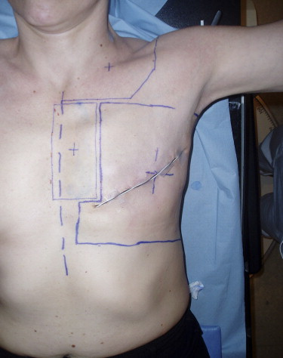

Slide 17
4.Treatment plan- type of radiation machine, the amount of radiation and number of treatments.
5.Treatment delivery
6.Post treatment follow up

Slide 18
THANK YOU

