Slide 1
University of Zambia School of Medicine
CERVICAL CANCER
PRESENTER : RUTH MTONGA
MODERATOR : DR. MWANZA

Slide 2
INTRODUCTION
Cervical cancer is a malignant tumour/neoplasm deriving from cells of the cervix.
It is the third most common cancer in women worldwide, and it remains a leading cause of cancer-related death for women in developing countries (second most common cancer).
It develops slowly and begins with a precancerous condition known as dysplasia.
Dysplasia is easily detected in a routine Papanicolaou (Pap) smear and is completely treatable
Education about the benefit of HPV vaccination is also important but must be accompanied by the information that vaccination does not substitute for regular screening.

Slide 3
AETIOLOGY
Human papillomavirus (HPV) infection must be present for cervical cancer to occur.
HPV infection occurs in a high percentage of sexually active women. However, approximately 90% of HPV infections clear on their own within months to a few years and with no sequelae.
On average, only 5% of HPV infections will result in the development of CIN grade 2 or 3 lesions (the recognized cervical cancer precursor) within 3 years of infection.
Only 20% of CIN 3 lesions progress to invasive cervical cancer within 5years, and only 40% of CIN 3 lesions progress to invasive cervical cancer in 30years
Because only a small proportion of HPV infections progress to cancer, other factors must be involved in the process of carcinogenesis.

Slide 4
Aetiology cont. /risk factors
The following factors have been postulated to influence the development of CIN 3 lesions:
The type and duration of viral infection, with high-risk HPV type and persistent infection predicting a higher risk for progression; low-risk types do not cause cervical cancer
Host conditions that compromise immunity (eg, poor nutritional status, immunocompromise and HIV infection)
Environmental factors (eg, smoking and vitamin deficiencies)
Lack of access to routine cytology and screening
Gynecologic factors which include early age of first intercourse and higher number of sexual partners
Promiscuous male partners
Hx of sexually transmitted diseases
Genetic susceptibility i.e women who have an affected first degree biologic relative have a 2-fold relative risk of developing a cervical tumor compared with women who have a non-biological first degree relative with cervical tumor

Slide 5
Human papillomavirus
Comprises a heterogeneous group of viruses that contain closed circular double-stranded DNA
The viral genome encodes 6 early open reading frame proteins (ie, E1, E2, E3, E4, E6 and E7), which funtion as regulatory proteins, and 2 late open reading frame proteins (ie L1 and L2), which make up the viral capsid.
To date, more than 115 different genotypes of HPV have been identified and cloned.
More than 90% of all cervical cancers worldwide are caused by 8 HPV types: 16, 18, 31, 33, 35, 45, 52 and 58.
Three types-16, 18 and 45 cause 94% of cervical adenocarcinomas
HPV 16 may pose a risk of cancer that is an order of magnitude higher than that posed by other high-risk HPV types.
The HPVs that infect the human cervix fall into 2 broad risk categories. The low-risk types (eg, HPV 6 and 11) are associated with condylomata and a very number of low-grade squamous epithelial lesions (SILs) but never found in invasive cancer. The high-risk types(eg, HPV 16) vary in prevalence according to the cervical disease state.

Slide 6
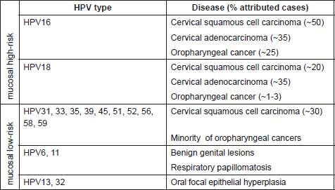

Slide 7
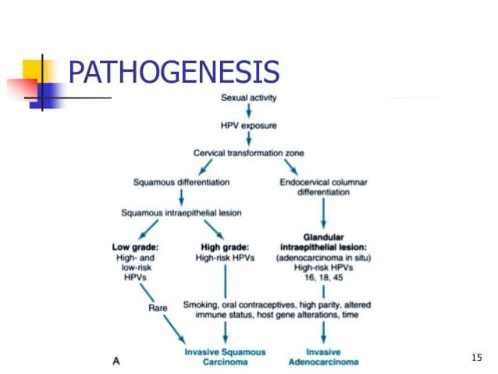

Slide 8
PATHOPHYSIOLOGY
Upon integration into the human genome, the linearization of high-risk HPV DNA places the E6 and E7 genes in a position of enhanced replication.
E7 binds and inativates the Rb protein while E6 binds p53 and directs its degradation, and the funtional loss of the TP53 and RB genes leads to resistence to apoptosis, causing uncensored cell growth after DNA damage. This ultimately results in progression to malignancy

Slide 9
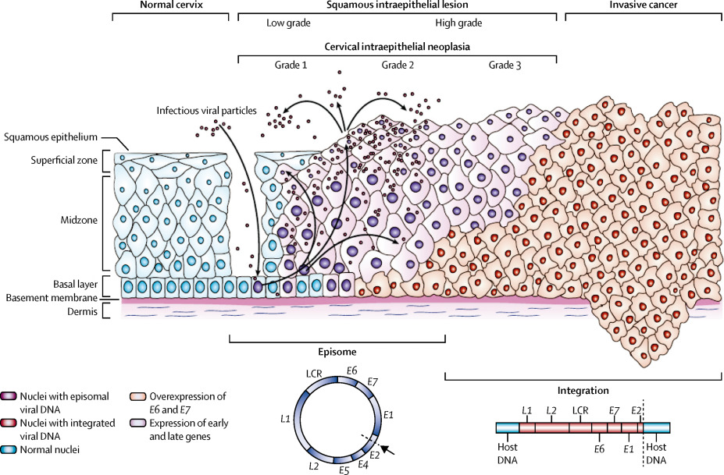

Slide 10
Clinical Presentation
Symptomatic:
Vaginal bleeding-irregular, intermenstrual, post-coital, postmenopausal
Vaginal discharge- copius, purulent, malodorous
Cachexia
Micturition symptoms-dysuria, frequency, urinary incontinence from VVF
Rectal symptoms- rectal pain
Pedal oedama
Pain- dyspareunia, low backache, deep pelvic ache, sciatica.

Slide 11
Investigations
Diagnostic:
Pap smear (if no obvious lesion)
Colposcopy
Cervical Biopsy for histology (for obvious lesions)
Pre-treatment:
FBC
Urinalysis
E/U/Cr
LFT
Chest X-ray

Slide 12
ECG
Abd-pelvic USS
CT/MRI-evaluate liver, urinary tract, bones, nodules sizes
IVU-assesses renal, ureter position
Positron emission tomograghy- lymph node metastasis, distant metastasis
Cystoscopy-tumour invasion imto the bladder
Proctosigmoidoscopy-tumour invasion into the rectum
Examination under anesthesia- extent of pelvic tumor spread, clinical staging

Slide 13
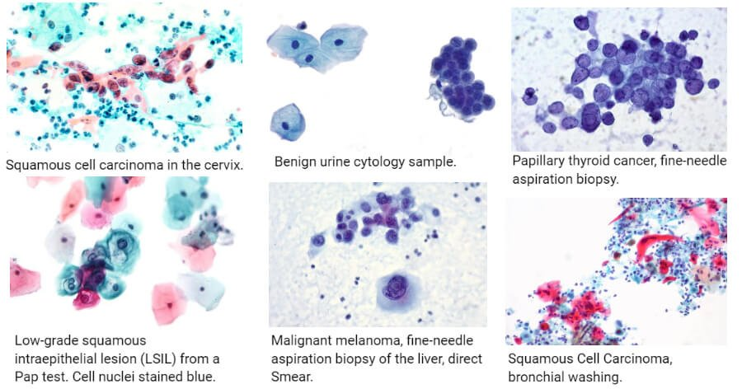

Slide 14
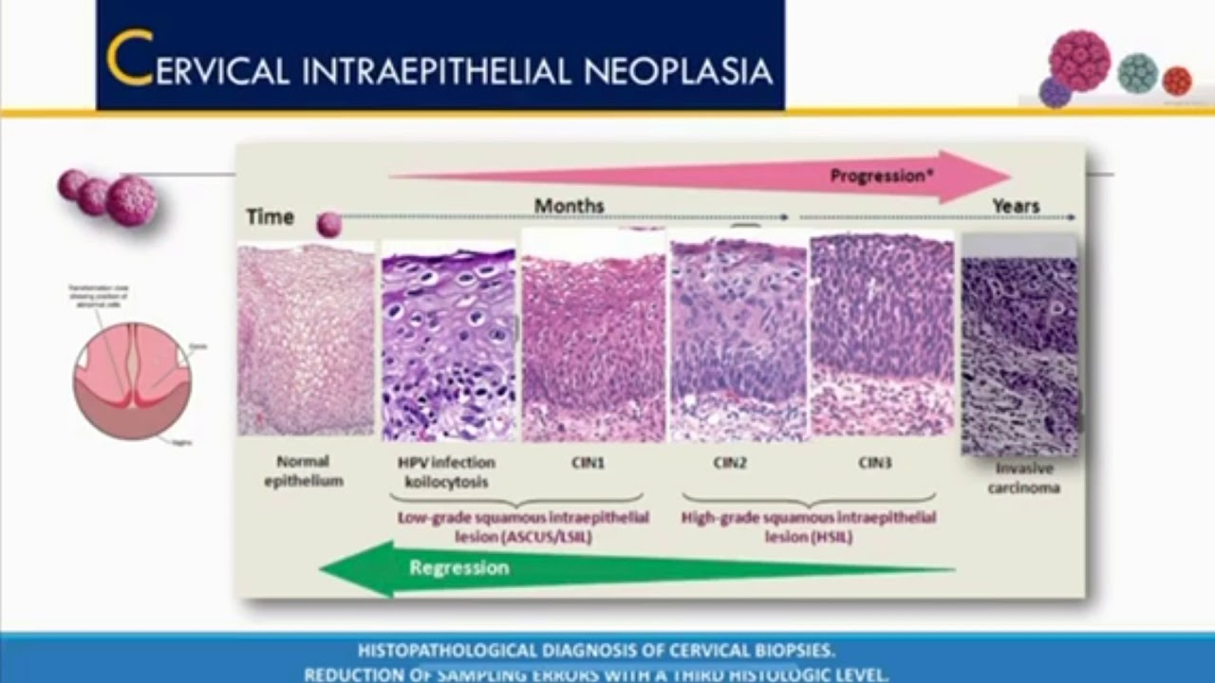

Slide 15
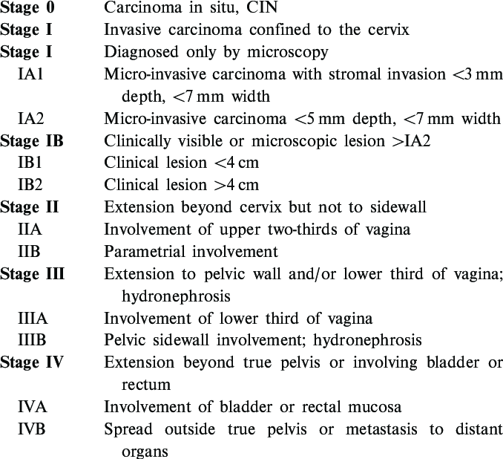

Slide 16
Management
Stage-based treatment
Stage 0: Carcinoma in situ is treated with local ablative or excisional measures such as cryosurgery, laser ablation, and loop excision; surgical removal is preferred
Stage IA1: the treatment of choice for stage IA1 disease is surgery; total hysterectomy, radical hysterectomy, and conization
Stage IA2, IB, or IIA: combined external beam radiation with brachytherapy and radical hysterectomy with bilateral pelvic lymphadenopathy for pts with IB or IIA disease; radical vaginal trachelectomy with pelvic lymph node dissection is appropriate for fertlity preservation in women with stade IA2 disease and those with stage IB1 disease whose lesions are 2cm or smaller.
Stage IIB, III,or IVA: Cisplatin-based chemotherapy with radiation is the standard of care
Stage IVB and recurrent cancer: individualized therapy is used on a palliative basis; radiation therapy is used alone for control of bleeding and pain; systemic chemotherapy is used for disseminated disease

Slide 17
Immunization:
9-valent HPV vaccine (Gardasil 9[9vHPV])- covers subtypes 6, 11, 16, 18, 31, 33, 45, 52 and 58.
Gardasil (4vHPV)
Cervarix (2vHPV)

Slide 18
Prognosis
Stage I- greater than 90%
Stage II- 60-80%
Stage III- approximately 50%
Stage IV- less than 30%

Slide 19
THE END

