Slide 1
TUMOR LYSIS SYNDROME
PRESENTER: ELIZABETH T.J HIKAUMBA
MODERATOR: DR MWANZA

Slide 2
What is it?
Is an oncologic emergency
Constellation of metabolic disturbances that occur when large numbers of neoplastic cells are killed rapidly
Leads to the release of ions and metabolic byproducts into the systemic circulation
Typically associated with bulky, rapidly proliferating, treatment responsive tumors
E.g ALL, non-Hodgkin lymphomas like Burkitt lymphoma

Slide 3
Risk factors
Hematologic malignancies
High tumor cell proliferation rate
Chemosensitivity of the malignancy
Large tumor burden
Pretretment hyperuricemia or hyperphosphatemia
Preexisitng nephropathy
Dehydration

Slide 4
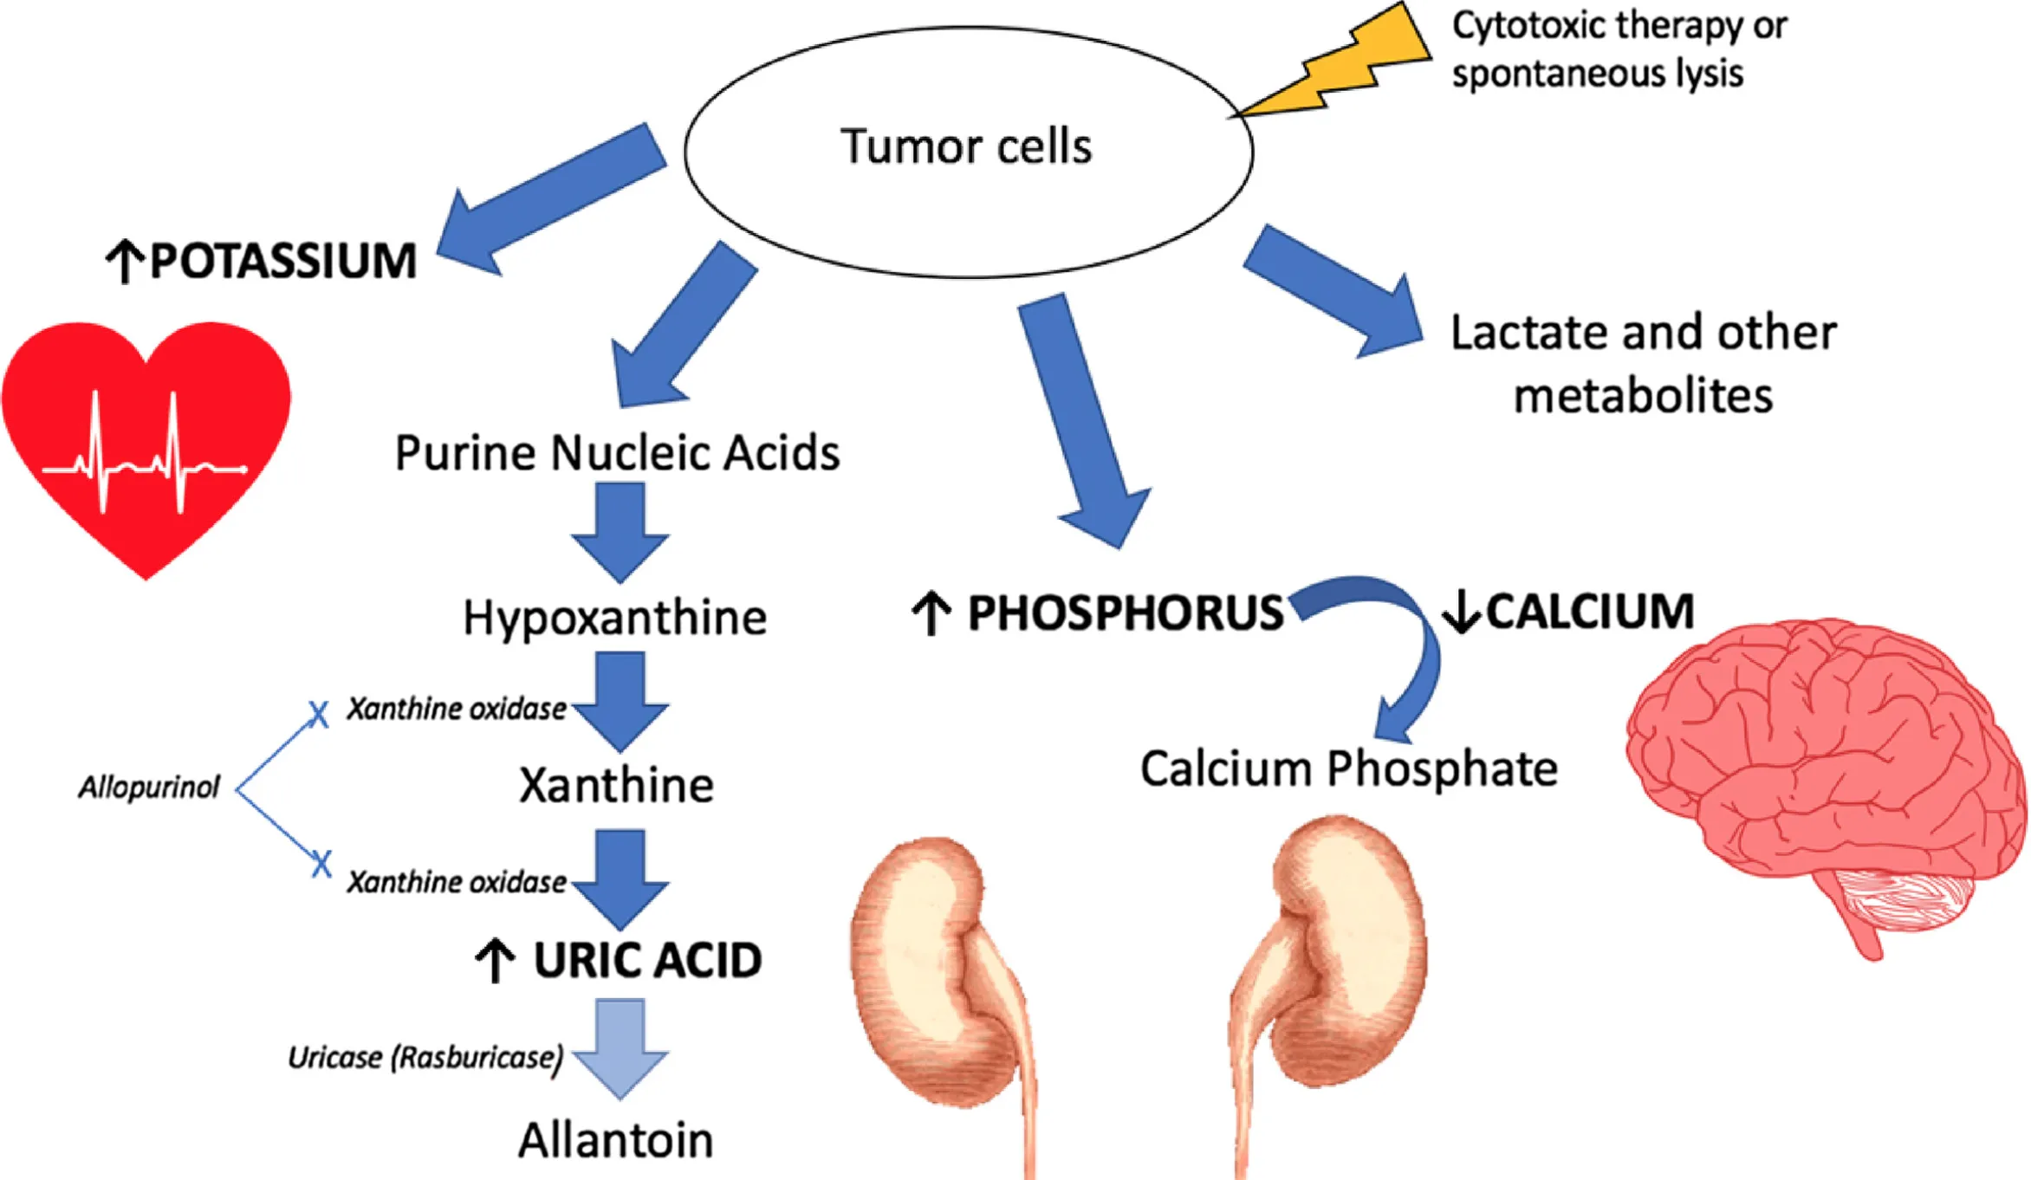
Pathophysiology

Slide 5
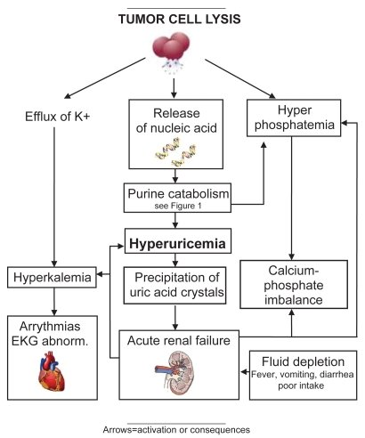

Slide 6
Clinically characterized by;
Hyperuricemia
Hyperkalemia
Hyperphosphatemia
Hypocalcemia
Acute kidney injury

Slide 7
Clinical presentation
Urinary symptoms;
Dysuria
Oliguria
Flank pain
hematuria

Slide 8
Symptoms of hypocalcemia;
Anorexia
Vomiting
Seizures
Spasms
Altered mental status
Paresthesia and tetany (+ve Chvostek and Trousseau signs)

Slide 9
Symptoms of hyperkalemia;
Weakness
Paralysis
Cardiac arrhythmias

Slide 10
Symptoms due to calcium deposition;
Pruritus
Arthritis
Iritis
Gangrenous changes of skin

Slide 11
Other manifestations
Cardiac dysrhythmias
Lethargy
Fluid overload
Syncope
Sudden death

Slide 12
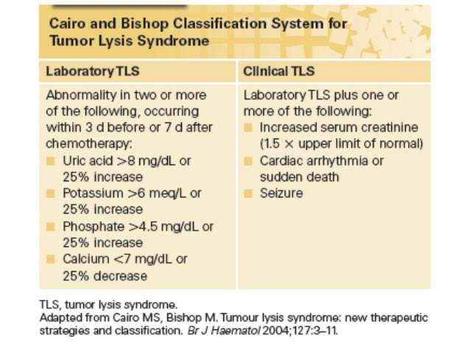
Diagnosis

Slide 13
Principles of management
Identification of high risk patients with initiation of preventive therapy
Early recognition of metabolic and renal complications and prompt administration of supportive care (i.e hemodialysis)

Slide 14
Preventive measures
Foremost hydration (when possible, delay tumor therapy)
Allopurinol (24hrs before chemo) or rasburicase

Slide 15
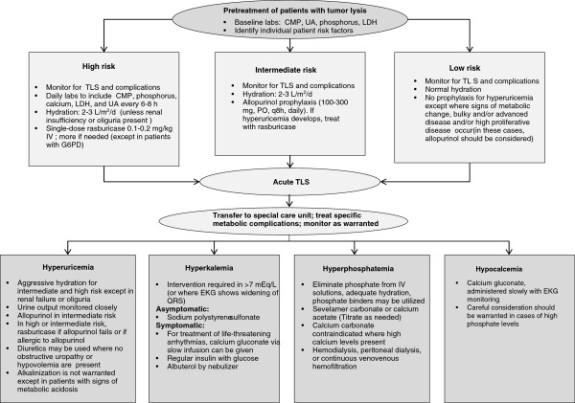
Treatment of TLS

Slide 16
QUESTIONS??

