Slide 1
TUMOUR LYSIS SYNDROME
Presenter: Tiza Chipungu
Moderator: Dr Mwanza

Slide 2
Contents
Definition
Epidemiology
Risk Factors
Pathophysiology
Clinical presentation
Investigations
Treatment Approached

Slide 3
Definition
TLS is a condition that occurs when a large number of cancer cells die within a short period, releasing their contents such as ions and metabolic by products in to the blood.
Can either be spontaneous or in response to therapy.
It is typically associated with the response to treatment in the following tumors; ALL, non-Hogkin lymphomas like Burkitt Lymphoma.

Slide 4
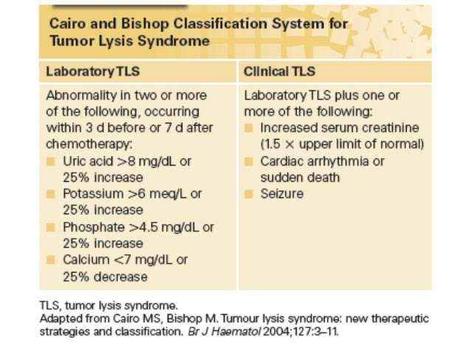
Classification

Slide 5
Epidemiology
The incidence of clinical tumor lysis syndrome is estimated at 3-7% in leukemia and 4-11% in lymphomas overall

Slide 6
Risk Factors
Patients with a large “tumor burden” of cancer cells
Hematologic malignancies
Tumors that typically have rapidly dividing cells, such as acute leukemia or high-grade lymphoma
Tumors that are highly responsive to therapy
Patients within a week of starting cancer treatment
Preexisting neuropathy
Dehydration
Pre-existing hyperuricaemia or hyperphosphatemia

Slide 7
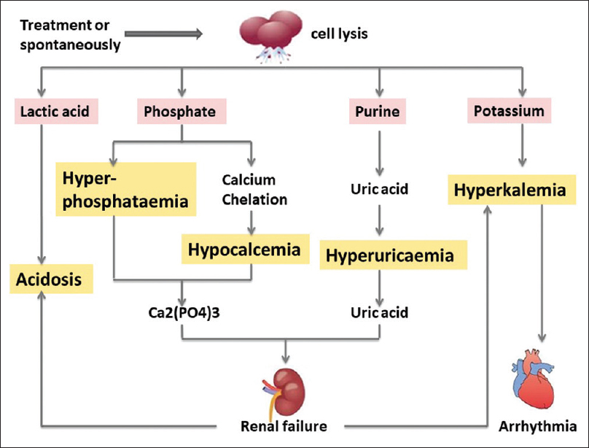
Pathophysiology

Slide 8
Pathophysiology
There is rapid lysis of tumour cells which results in the release of massive quantities of intracellular contents such as potassium, phosphate, and nucleic acids that can be metabolized to uric acid, into the systemic circulation.
The metabolic consequences include hyperkalemia, hyperphosphatemia, secondary hypocalcemia, hyperuricemia, and acute kidney injury.

Slide 9
Clinical Presentation
Hyperkalemia:
Potassium> 6.0mmol/litre
Weakness
Paresthesia
Arrhythmias
Myalgias

Slide 10
Clinical Presentation
Secondary Hypocalcemia;
Corrected calcium<1.75mmol/litre or ionized calcium<0.3mmol/litre
Arrhythmias
Seizures
Neuromuscular irritability (tetany, paresthesias, muscle twitching,Trousseau’s sign, Chvostek’s sign, laryngospasm, or bronchospasm),
hypotension, or heart failure .

Slide 11
Clinical Presentation
Acute Kidney Injury:
Increase in the serum creatinine level of 0.3 mg/dl (26.5 μmol/liter)
oliguria, defined as an average urine output of <0.5 ml/kg/hr for 6 hr
Uric acid nephropathy
Dysuria
Flank pain
Hematuria

Slide 12
Investigations
NOTE: Early recognition of signs and symptoms
Bloods; serum sodium, potassium, chloride and bicarbonate.
Urine pH and output
Chest x-ray
Ultrasound or CT scan of abdomen and retroperitoneum
Cardiac monitoring

Slide 13
Treatment Approach
Risk assessment
Prophylaxis
Therapy

Slide 14
Prophylaxis
Hydration
Allourinol or Rasburicase 24 hrs before therapy

Slide 15
Therapy
Aluminium hydroxide for hyperphosphotamia
Rasburicase for hyperuricemia
Allopurinol
Intravenous fluid

Slide 16
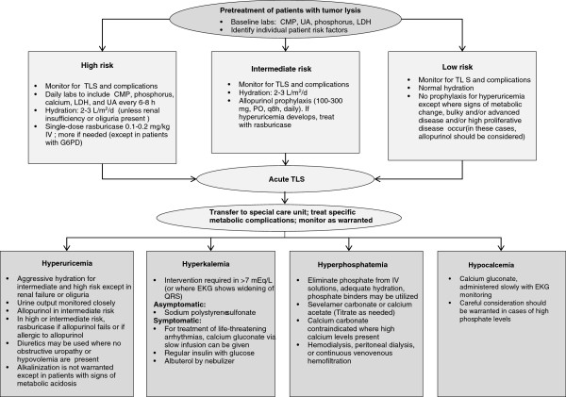
Treatment

