Slide 1
Acromegaly
B. Kamanga, MD

Slide 2
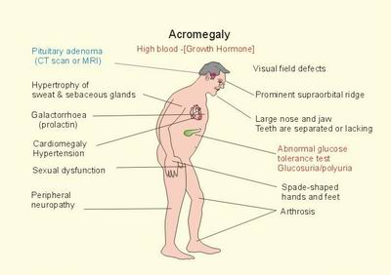

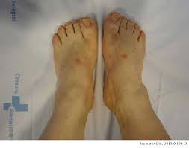
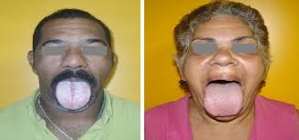
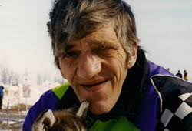

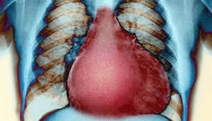

Slide 3
Robert Wadlow, the “Alton Giant” is said to be the tallest human in history, stood at 8’11 ½” and died at age 22 from an infected leg ulcer

Slide 4
Growth Hormone
Growth hormone (GH) is the principal hormone responsible for growth during childhood and adolescence.
GH is secreted by acidophilic somatotrophs
IGF-1 mediates growth promoting and anabolic actions
Prophet of Pit-1 (PROP1) gene is responsible for the development and proliferation of somatotrophs
Notes:
Acromegaly results from GH over-secretion in after closure of epiphyseal plates

Slide 5
Growth Hormone
Growth hormone–releasing hormone (GHRH) stimulates the synthesis and secretion of GH
Somatostatin suppresses the secretion of GH
Ghrelin from the gastrointestinal tract also promotes the release of GH
Somatotrophs express receptors for GHRH, ghrelin, and somatostatin

Slide 6
Growth Hormone
Normal GH production from the pituitary gland is pulsatile
Most GH values fall in the range of 0.1-0.2 μg/L in normal subjects
Maximum GH production occurs at night
Assess overall daily GH production by obtaining a mean GH over 24 h by frequent GH sampling

Slide 7
Acromegaly
A rare disorder; Prevalence of 38-69 cases per million
Results from excessive secretion of growth hormone (GH) by a pituitary adenoma, very rarely from an ectopic GHRH source
Pituitary adenomas result from a monoclonal proliferation of somatotrophs, leading to increased GH secretion.
Occurs in individuals with fused epiphyseal plates.
Notes:
The name acromegaly comes from the Greek words for "extremities" and "enlargement"

Slide 8
Pathogenesis
More than 95% of patients with acromegaly harbor a GH-secreting pituitary adenoma
Mammo-somatotroph adenomas produce both GH and PRL from a single cell
Pluripotent adenomas may express GH with any combination of PRL, TSH, or ACTH
Patients with pluripotent adenomas present with clinical features of acromegaly as well as hyperprolactinemia, Cushing’s disease, or, rarely hyperthyroidism

Slide 9
Pathogenesis
GHRH produced by the hypothalamus
Abdominal and chest neuroendocrine tumors may secrete GHRH
Hypothalamic tumors, including hamartomas, choristomas, gliomas, and gangliocytomas, may produce GHRH
GHRH causes somatotroph hyperplasia with resultant unrestrained GH secretion and acromegaly

Slide 10
Multiple Endocrine Neoplasia Type 1
Multiple endocrine neoplasia type 1 syndrome (MEN1) is an autosomal dominant condition
Presents with a GH-producing adenoma, and parathyroid as well as pancreatic tumors
Results from the inactivation of the MENIN tumor suppressor gene
Notes:
The name acromegaly comes from the Greek words for "extremities" and "enlargement“
McCune-Albright Syndrome: A rare hypersecretory syndrome consisting of polyostotic fibrous dysplasia, cutaneous pigmentation, sexual precocity, hyperthyroidism, hypercortisolism hyperprolactinemia, and acromegaly due to somatotroph hyperplasia
Results from an activating mutation in the Gsα in both endocrine and nonendocrine tissues

Slide 11
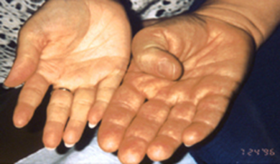
Clinical Features
Enlargement of acral parts of body (nose, lips, hands and feet)
Enlargement of soft tissues &internal parts of the body (except the brain)
Mass effects of tumor: Headache, Visual field defects, Hyperprolactinemia (Stalk effect), Hypopituitarism (Hypothyroidism, hypogonadism, hypocortisolism)
  Acromegaly is an insidious disease, which is often
  diagnosed late (between 4 and more than 10 years
  after onset).

Slide 12
Clinical Features
Systemic effects of GH/IGF-I excess: Visceromegaly, Soft tissue enlarment, skin changes (hyperhidrosis,oily skin, skin tags, thick skin, acathosis nigricans, scalp skin folding), thickening of acral parts, macroglossia, Jaw malocclusion
Cardiovascular system: Left and right ventricular hypertrophy, asymmetric septal, systolic and/or diastolic ventricular dysfunction, CAD, Arrhythmias, Hypertension

Slide 13
Clinical Features
Mechanisms for Hypertension: Increased plasma volume, alterations in renin-angiotensin, insulin resistance, and increased vascular resistance
Insulin resistance: Growth hormone alters the ability of insulin to suppress glucose production and stimulates the utilization of glucose

Slide 14
Clinical Features
Respiratory system: Hypertrophy of the laryngeal mucosa and cartilage, Upper airway obstruction, Sleep apnoea (due to airway obstruction, or central), Ventilatory dysfunction

Slide 15
Clinical Features
Obstructive sleep apnea predominates over central sleep apnea
Impaired respiratory function is due to alterations in the bone and muscle structures of the chest and lung elasticity.
Patients develop a barrel chest due to changes in their vertebral and costal morphology.
Obstruction of the upper airways result from macroglossia & hypertrophy of the laryngeal mucosa and cartilage
Notes:
Sleep apnea is the recurrent cessation, or reduction of airflow to the lungs during sleep.
Sleep apnea causes daytime sleepiness

Slide 16
Clinical Features
Endocrine changes: Impaired glucose tolerance, DM, Insulin resistance, Hypercalcemia (secondary to hyperparathyroidism), Goiter (IGF-I stimulates thyrocyte growth), Hypercalciuria and nephrolithiasis (due to hyperparathyroidism, renal tubular acidosis, increased calcium absorption, and increased 1, 25 (OH)2 D₃), Galactorrhea, Hypogonadism (Decrease libido, Impotence), Menstrual abnormalities

Slide 17
Clinical Features
Bone and joint manifestations: Increased articular cartilage thickness, Arthralgias, Arthritis, Carpal tunnel syndrome, Osteopenia

Slide 18
Clinical Features
Mouth: Jaw prognathism and mandibular overbite, widened incisor tooth gap, thick lips
Bowels: Colonic cancer, adenomatous polyps, dolichomegacolon, colonic diverticular disease
Increased activity of the epithelial sodium channel (may contribute to volume expansion)
Adenoma may compress local structures and cause neurological changes and visual disturbances

Slide 19
Clinical Features
Other manifestations: Psoriasis, Osteophytes in cervical and lumbar spine, Intervertebral disk space widening, vertebral enlargement, joint deformity, Decreased bone mineral density at the lumbar spine (trabecular bone), excess GH and IGF-I induce an increase of the cortical bone density in the forearm (cortical bone)

Slide 20
Imaging
Magnetic resonance imaging (MRI) with contrast is the best imaging technique for evaluation of the Pituitary gland
X-rays show:
Thick “pad” of soft tissue of the feet, overlying the calcaneus (double arrow)
Prominent supraorbital ridge (“frontal bossing”)
Large jaw, and dental malocclusion with under bites.

Slide 21
Diagnosis
Biochemical diagnosis: GH and IGF-1 level during the 75g-OGGT.
  GH levels GH > 0.4 μg/L or 1 μg/L with an elevated age-adjusted IGF-1 levels confirm acromegaly
  In healthy subjects, serum GH levels initially fall after oral glucose administration and subsequently increase as plasma glucose declines.
  In patients with acromegaly, oral glucose fails to suppress GH, and GH levels are equally likely to increase, remain unchanged

Slide 22
Failure of GH Suppression in Acromegaly
Liver failure
Kidney failure
Poorly controlled diabetes
Malnutrition
Anorexia
Pregnancy, estrogen therapy
Late adolescence

Slide 23
IGF-1 Levels During Treatment of Acromegaly
A high IGF-1 level is highly specific for acromegaly and correlates with clinical indices of disease activity
IGF-1 elevations may persist for several months after GH levels have become biochemically controlled in response to treatment.
Notes:
Increased IGF1 levels are also encountered during pregnancy and late puberty.

Slide 24
Differential Diagnosis
Plasma GHRH levels are elevated in patients with peripheral GHRH-secreting tumors but are normal or low in patients with pituitary adenomas
Peripheral GHRH levels are not elevated in patients with hypothalamic GHRH-secreting tumors
Notes:
Hypoglycemia,hyperinsulinemia, hypergastrinemia, and, rarely, hypercortisolism will suggest an extrapituitary source of GH excess

Slide 25
Aims of Treatment
Manage the pituitary mass
Suppress GH and IGF-1 hypersecretion
Prevent long-term clinical sequelae of hyper-somatotropism while maintaining normal anterior pituitary function

Slide 26
Aims of Treatment
Serum GH levels should be suppressed to at least 1 μg/L (or lower) after an oral glucose load
IGF-1 levels should be normalized for age and gender.
With good control, a 24-hour integrated secretion of GH should be <2.5 μg/L
Suppressed GH levels in the face of elevated IGF-1 will suggest the tumor is still over-secreting GH

Slide 27
Surgical Treatment
Well-circumscribed GH-adenomas should preferably be resected by transsphenoidal surgery.
Within 2 hours of successful resection, metabolic dysfunction and soft tissue swelling start to improve
90% of patients with microadenomas achieve postoperative GH levels lower than 2.5 μg/L
Fewer than 50% of patients with macroadenomas achieve postoperative GH levels lower than 2 μg/L with glucose load.

Slide 28
Side Effects of Surgery
New hypopituitarism, reflecting operative damage to the surrounding normal pituitary tissue
Permanent diabetes insipidus
CSF leaks
Hemorrhage
Meningitis
Extent and prevalence of local complications depend on tumor size and invasiveness.

Slide 29
Indications for Radiotherapy
Reserved for third-line treatment, occasionally as second-line treatment, rarely as first-line treatment.
For patients who do not have tumor growth control, or normalization of hormone levels with surgery, or medical therapy

Slide 30
Types of Radiotherapy
Conventional radiotherapy is preferred for large tumor remnants, or tumors that are too close to optic pathways
Stereotactic radiotherapy is preferred for smaller tumors
Stereotactic radiotherapy may produce better results GH and IGF-I sooner than conventional radiotherapy

Slide 31
Benefits of Radiotherapy
Radiation arrests tumor growth
Most pituitary adenomas ultimately shrink
GH levels fall gradually in the first year after treatment
GH levels are lower than 10 μg/L in 70% of patients after 10 years
GH levels reduce over 20 years in more than 90% of patients

Slide 32
Side Effects of Radiotherapy
After 10 years, about 50% of the patients receiving radiotherapy have signs of hypopituitarism
Hair loss
Cranial nerve palsies
Tumor necrosis with hemorrhage
Lethargy, impaired memory, and personality changes

Slide 33
Medical Therapy
Dopamine Agonists
Somatostatin receptor ligands
Growth Hormone Receptor Antagonist
Combination of Somatostatin receptor ligands and Growth Hormone Receptor

Slide 34
Medical Therapy
Dopamine Agonists: Bromocriptine and Cabergoline
Can cause minimal tumor shrinkage
Side effects: Transient nausea or vomiting, headaches, Dizziness, nasal stuffiness

Slide 35
Somatostatin Receptor Ligands
First-line therapy when there is a low probability of a surgical cure
After surgery has failed to achieve biochemical control
Before surgery to shrink the tumor and improve comorbidities that prevent or could complicate immediate surgery
To provide disease control, or partial control in the time between administration of radiation therapy and the onset of maximum benefit attained from radiation therapy (radiation therapy can take several years to produce disease control

Slide 36
Somatostatin Analogues in Use
Octreotide and Lanreotide
Activate somatostatin receptors
Five somatostatin receptor types; type 1 to 5 .
Octreotide and Lanreotide have greatest affinity for receptor subtypes 2 and 5 (but 10-fold higher for subtype 2 than for subtype 5)
Receptor subtypes 2 and 5 are predominant in GH-secreting pituitary tumors
Notes:
Usual starting dose of octreotide LAR is 20 mg with titration down to 10 mg or up to 30 or 40 mg, based on the response of GH and IGF-I levels.

Slide 37
Indications for GH Receptor Antagonist
Patients who have persistently elevated IGF-I levels despite maximal therapy with other treatment modalities
Pegvisomant is highly effective in acromegaly
Pegvisomant is significantly improves the quality of life in patients that may require both SRLs and pegvisomant to achieve biochemical control

Slide 38
Prognosis
An elevated GH level is associated with a 3-fold increase in morbidity rate
An elevated GH level is the single most important determinant of mortality.
Increased morbidity and mortality results from GH and IGF-I excess and adenoma mass effect
Mortality is related to GH levels of over 2–2.5 μg/L

Slide 39
END!

