Slide 1
Mechanism of Labour
BSc. Clinical Medicine
Dr Kenneth Chanda
BScHB, MBChB, MMed (MMOG)-[UNZA]
First version: 07-11-17
Latest version: 07-11-17

Slide 2
Mechanism of Normal Labour
Dfn: Series of changes in position & attitude which the fetus undergoes during its passage through the birth canal
Labour is onset of painful regular contractions, more than 1 every 10 min, with progressive cervical effacement & dilatation with descent of presenting part
Head enters brim through the available transverse diameter of the inlet (70%)

Slide 3
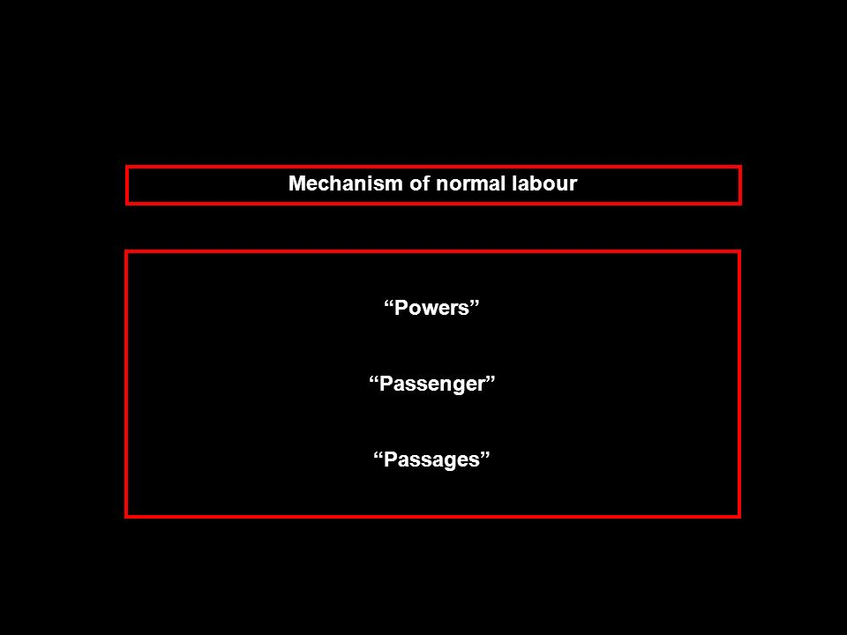

Slide 4
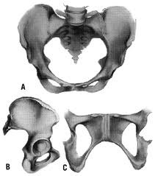
The Passage

Slide 5
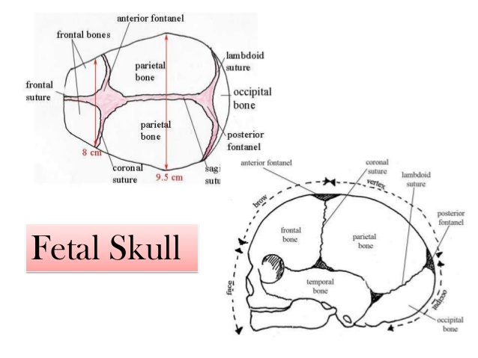
The Passenger

Slide 6
Description of terms
The lie
The relation which the fetus bears to the longitudinal axis of the uterus
May be Longitudinal, Oblique or Transverse
Presenting part
The part of the fetus which is in or over the pelvic brim and in relation to the cervix

Slide 7
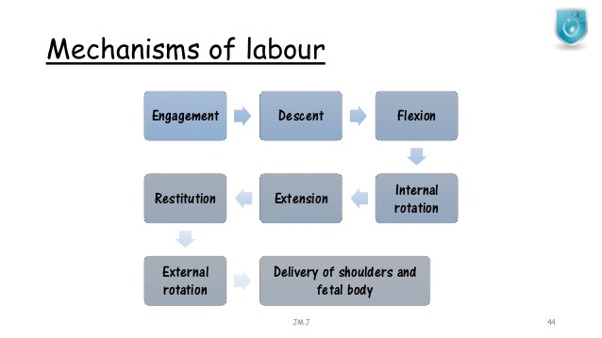

Slide 8
Engagement
The widest diameter of the presenting part (with a well-flexed head, where the largest transverse diameter of the fetal occiput is the biparietal diameter) enters the maternal pelvis to a level below the plane of the pelvic inlet
On pelvic examination, the presenting part is at 0 station, or at the level of the maternal ischial spines (Or 2/5 abdominally)
Lightening-engagement before labour in PGs

Slide 9
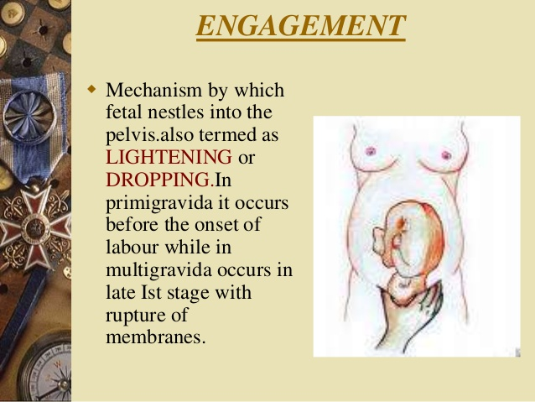

Slide 10
Descent
Downward movement through pelvic inlet through dilated cervix, reaches posterior vaginal wall
Slow in the first stage but pronounced in the second stage
Completed with expulsion of fetus
Due to contraction and retraction of uterine muscles (primary force) plus bearing down efforts (secondary force) in second stage

Slide 11
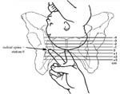
Descent (Cont’d)

Slide 12
Flexion
Flexion is a passive movement in part due to surrounding structure
Achieved either due to the resistance offered by the unfolding cervix, the walls of the pelvis or by the pelvic floor
It is essential for descent as it reduces the shape and size of the plane of the advancing diameter of the head

Slide 13
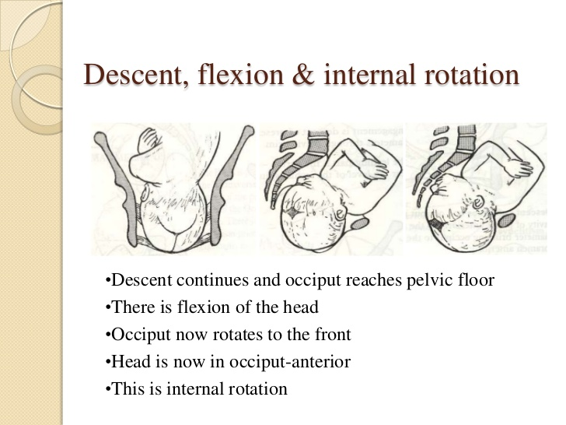
Internal rotation

Slide 14
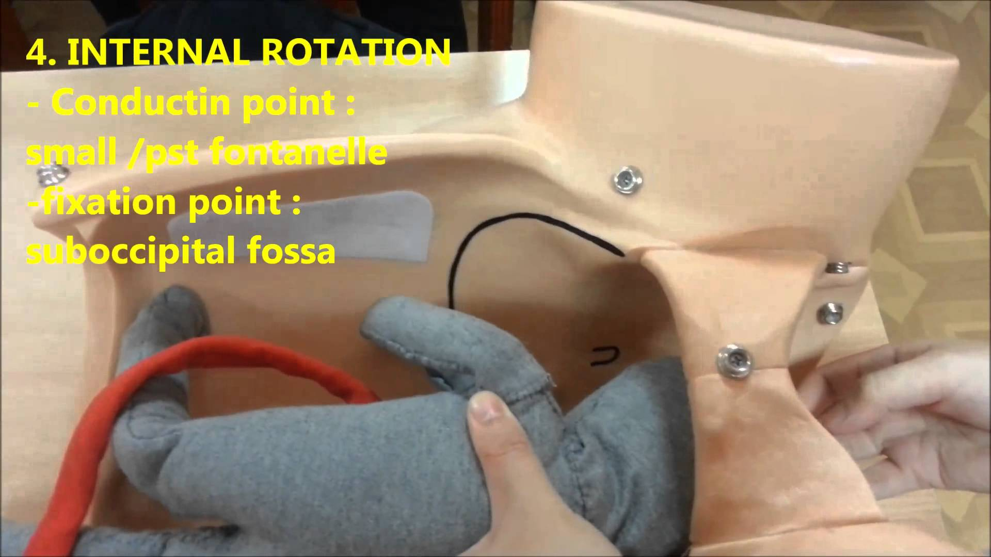
Internal rotation (Cont’d)

Slide 15
Extension
Extension leads to delivery of the head
Occiput escapes from underneath the symphysis pubis and distends the vulva (Crowning of the heard)
Further extension with pubic symphysis acting as fulcrum on the occiput leads to appearance of bregma, face and chin in succession
Minimises soft tissue trauma

Slide 16
Restitution, External Rotation & Delivery
Restitution is the slight rotation of the occiput through one eighth of the circle
Allows aligning of the head with the shoulders which entered pelvis in a slight oblique position
External rotation aligns the shoulders into directly anterior-posterior plane
Rest of body delivers spontaneously

Slide 17
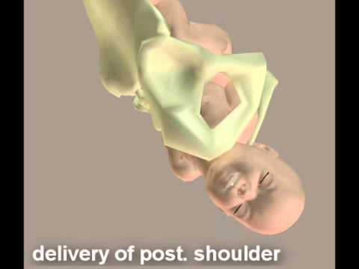
Delivery of the shoulders

Slide 18
Summary
Mechanism of labour involves (EDFIERED)
Engagement
Descent
Flexion
Internal rotation
Extension
Restitution
External rotation
Delivery of shoulders and body

Slide 19
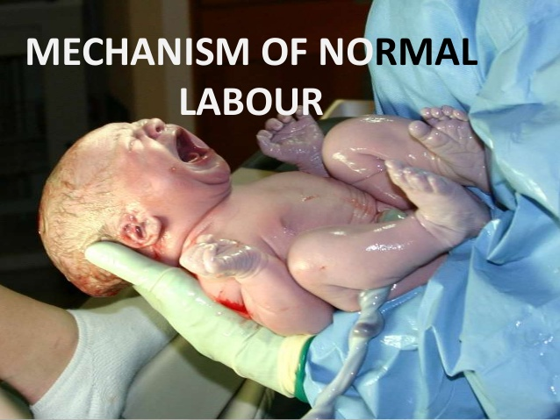

Slide 20
THE END

