Slide 1
Normal Puerperium & Postnatal Care
BSc. Clinical Medicine
Dr Kenneth Chanda
BScHB, MBChB, MMed (MMOG)-[UNZA]
Last updated: 04-02-18
Ecclesiastes 1:18; ‘For in much wisdom is much grief: and he that increaseth knowledge increaseth sorrow’

Slide 2
Definition of Puerperium
Period confined to the time after child birth
Usually includes six subsequent weeks
Changes are a reversal of the physiological changes in pregnancy

Slide 3
Normal Puerperium
Uterine Changes
Just after placenta expulsion, fundus is slightly below the umbilicus
Anterior and posterior walls are in close apposition each measuring about 4-5cm
Uterus begin to shrink after 2 days (Involution)
Descends into pelvis after 2 weeks and regains a non pregnant state after 4 weeks
Weighs 1000g just after delivery

Slide 4
Normal Puerperium
Uterine Changes (Cont’d)
Weighs 500g after 1 week, 300g by 2nd week and to less than 100g there after
Tends to contract tonically in prime paras and contracts vigorous at intervals in multiparas giving rise to the after pains

Slide 5
Normal Puerperium
Uterine Changes (Cont’d)
Calibre of extra uterine vessels decrease to equal to or approximate the none pregnant state
Large vessels within the uterus are obliterated by uterine changes, gradually reabsorbed and replace by small ones
Cervical opening contracts with a few days leaving a parous cervix (see next slide)

Slide 6
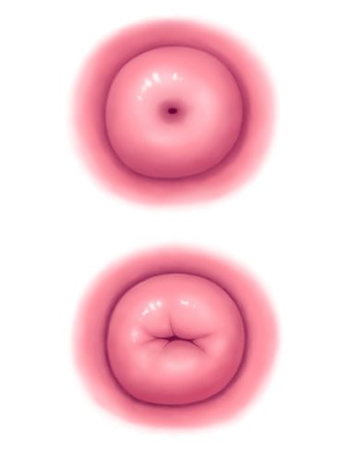
Normal Puerperium
Uterine Changes (Cont’d)

Slide 7
Normal Puerperium
Uterine Changes (Cont’d)
Lochia
Is vaginal discharge of variable quantity originating from sloughing of the decidual
Components of lochia are; Erythrocytes, decidual, epithelial cells, bacteria
Types of lochia
Lochia rubra (0-3 days); red
Lochia serosa (4-10 days); pale
Lochia alba (> 10 days); white

Slide 8
Normal Puerperium
Other Anatomic Changes
Vagina
Rugae appear by the 3rd week
The hymen is represented by several small tags of tissue called myrtiform caruncles
Broad/Round ligaments
Require considerable time to recover from the stretching and the loosening that occurred in pregnancy

Slide 9
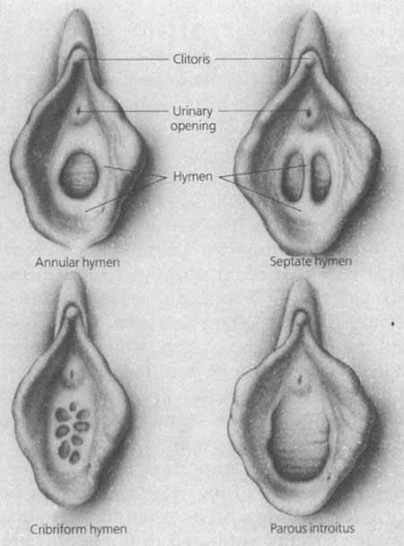
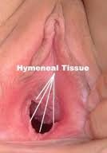
Normal Puerperium
Other Anatomic Changes (Cont’d)

Slide 10
Normal Puerperium
Cardiac output
Remains elevated for at least 48hours after delivery
Contraction of uterus pushes 500-700 of blood into maternal circulation

Slide 11
Normal Puerperium
Renal Changes
Normal pregnancy is associated with associated with an appreciable increase of extracellular water
Diuresis occurs from 2nd to 5th day and corresponds to the loss this water
Puerperal bladder has increased capacity and a relative insensitivity to intravesical fluid pressure
Dilated renal pelvis/ ureters resolve over 2-8 weeks

Slide 12
Normal Puerperium
Haematology
There is marked leukocytosis and thrombocytosis
Leukocyte count may reach as high as 30,000/µL
There is relative lymphopenia and absolute eosinophilia
HB and HCT fluctuate moderately

Slide 13
Normal Puerperium
Weight
Women lose 5-6 kg from uterine evacuation
They lose 2-3 kg from uterine diuresis
Most women approach their self reported prepregnant weight 6 months after delivery but still retain some surplus weight

Slide 14
Normal Puerperium
Breast Changes
Each mature mammary gland contains 15-25 lobes
Each lobe contains several lobules that contain alveoli
Alveoli secretory epithelium synthesises the various components of milk
Colostrum is deep lemon-yellow coloured liquid secreted by the breast after delivery and can be expressed from nipple by 2nd day

Slide 15
Normal Puerperium
Breast Changes (Cont’d)
Mature milk contains more minerals and protein much of which is globulin and less of fat
Colostrum secretion persists for about 5days with gradual conversion to mature milk during the ensuing 4 weeks
Host resistance factors found in colostrum and milk include: IgA, complement, Macrophages, lymphocytes, lactoferin, lysosomes etc

Slide 16
Normal Puerperium
Breast Changes (Cont’d)
Human milk is a suspension of fat and protein in a carbohydrate mineral solution
A nursing mother can produce up to 600cc of milk/day
Milk is isotonic with plasma with lactose accounting for half of the osmotic pressure
Other nutrients present include; Major proteins including α lactoalbumin, β lactoalbumin and casein
All vitamins except vitamin K are found in human milk

Slide 17
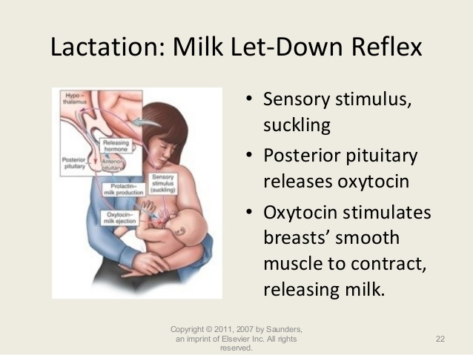
Normal Puerperium
Milk let down reflex

Slide 18
Normal Puerperium
Exercise & Diet
Exercise to restore abdominal wall tone may be started anytime after vaginal delivery and as soon as abdominal sore diminishes in caesarean section (6-8 weeks)
No dietary restrictions for women who delivery vaginally
Women may be allowed to eat 2 hours after delivery

Slide 19
Puerperal Infection/ Pyrexia
Puerperal sepsis; A general term used to describe any bacteria infection of the genital tract after delivery
Puerperal Pyrexia; A temperature of 38.0 ⁰ C or higher which occurs on any two of the first 10 days postpartum, exclusive of the first 24 hours and which is taken orally by the standard technique at least 4 times daily

Slide 20
Puerperal Infection/ Pyrexia (Cont’d)
Differential diagnosis pyrexia
UTI
RTI
Malaria
Breast abscess
CNS infection
DVT
etc

Slide 21
THE END

