Slide 1
ACUTE PANCREATITIS
Presenter: Dr. Patricia Chipalabwe
Supervisor: Dr. Sihem
Moderator: Dr. Mbambiko

Slide 2
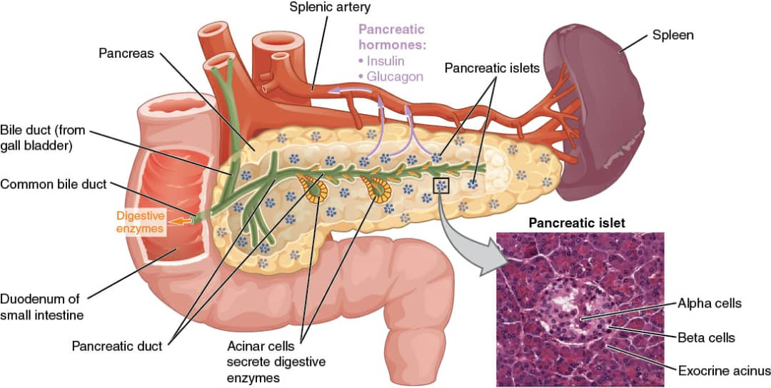

Slide 3
Functions
Islets of langerhans
Endocrine
  Alpha cells-glucagon 20%
  Beta cells- insulin 75%
  Delta cells- somatostatin
Exocrine
Pancreatic juice
  Amylase
  Lipase
  Trypsin
  Chymotrypsin
  Carboxypeptidase

Slide 4
Definition
Acute pancreatitis is a reversible condition in which activated pancreatic enzymes leak into the substance of the pancreas and initiate the auto-digestion of the gland.
It varies from mild edema to severe hemorrhagic necrosis.

Slide 5
EPIDEMIOLOGY
Gender predilection
  Generally – M>F
  In males-more often related to alcohol
  In females-more often related to biliary tract disease
  Idiopathic pancreatitis has no clear gender predilection

Slide 6
ETIOLOGY
OTHERS
I GET SMASHED
I-Idiopathic
G-Gallstones
E-Ethanol
T-Trauma (Blunt / Penetrating trauma)
S-Steroids
M- Mumps ; EBV, CMV
A-Autoimmune : Hereditary pancreatitis
S-Scorpions and Snakes
H- Hyperlipidemia, hypercalcemia
E- ERCP (Back pressure of contrast)
D- Drugs (Steroids, Furosemide, Thiazide, Estrogen, Metronidazole)
Congenital: Pancreatic Divisum, Annular Pancreas
Vascular: Ischemia, vasculitis

Slide 7
Pathophysiology
The underlying mechanism of injury in pancreatitis is thought to be due to premature activation of pancreatic enzymes within the pancreas leading to autodigestion.
Anything that injures the acinar cells and impairs the secretion of zymogen granules or damages the duct epithelium and thus delays enzyme secretion can trigger acute pancreatitis.
Once cellular injury has been initiated, the inflammatory process can lead to pancreatic edema, hemorrhage and eventually necrosis.

Slide 8
As inflammatory mediators are released into the circulation, the systemic complications can arise such as hemodynamic instability, bacteremia
(due to translocation of gut flora), ARDS, pleural effusion, GI
hemorrhage, renal failure and DIC.
The pathophysiologic involvement of acute pancreatitis ranges from edematous pancreatitis (which is self limiting) to necrotizing pancreatitis.

Slide 9
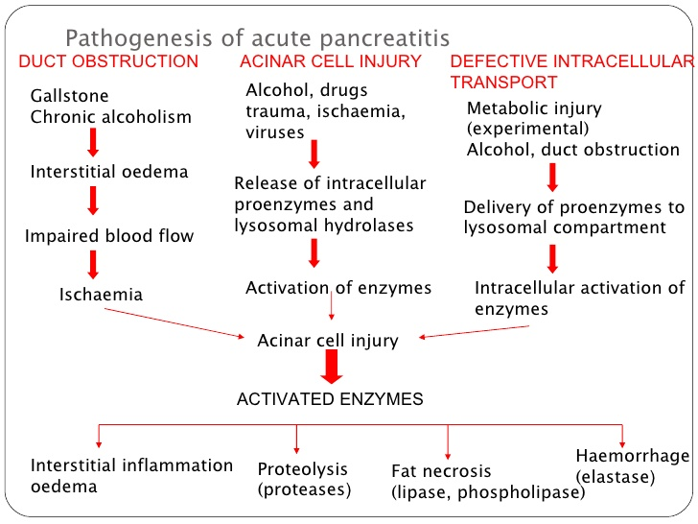

Slide 10
Classification of Acute Pancreatitis
The Revised Atlanta Classification
The Two Phases
Early Phase (<1 week)
  Characterized by SIRS +/- organ failure
  Severity assessed by functional/clinical severity scoring system (Ranson/Glasgow etc)
Late Phase (> 1week)
  Characterized by local complications
  Severity assessed by morphological scoring system (Balthazar scoring)

Slide 11
Severity of Acute Pancreatitis
1. Mild: No organ failure, no local complications
2. Moderate: Organ failure less than 48hrs, +/- local complications
3. Severe: Severe organ failure longer than 48hrs and/or death

Slide 12
Morphological classification of Acute Pancreatitis
1. Interstitial edematous Pancreatitis
2. Necrotizing Pancreatitis
  Parenchymal
  Peripancreatic necrosis
  Combined type

Slide 13
INTERSTITIAL EDEMATOUS PANCREATITIS
NECROTIZING PANCREATITIS
Pancreatic enlargement due to edema.
On CT, pancreatic parenchyma shows negatively homogeneous enhancement and peripancreatic fat standing.
Outcome: Symptoms usually resolve within first week.
Inflammation associated with pancreatic parenchymal necrosis or peripancreatic necrosis
Cause impairment of pancreatic perfusion
Impairment evolve over several days.
Early CT may underestimate the extent of the disease.

Slide 14
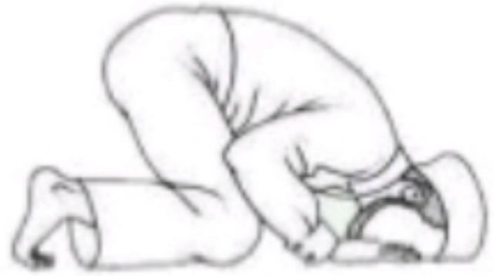
CLINICAL PRESENTATION
Symptoms
Pain (SOCRATES)
  Site: usually epigastrium but it may be in Upper quadrants or whole abdomen
  Onset: sudden and the pain has no upper limit
  Character: dull, boring and steady
  Radiation: to the back in 50%
  Associated with: nausea, vomiting, retching, anorexia, hiccups
  Time duration: persist for hours to days
  Exacerbate in the supine position, refractory to the usual analgesics and may be relieved by sitting and leaning forward (Muhammedan Prayer sign)

Slide 15
Nausea, non projectile vomiting, retching
Anorexia
Fever
Weakness
Tachycardia, Tachypnea
Pale, diaphoretic
Shallow breathing
Abdominal distension (ileus, ascites)

Slide 16
Inspection- Grey Turner’s sign, Cullen’s sign, Fox’s sign, Panniculitis
( subcutaneous nodular fat necrosis, tender red nodules usually over the extremities).
Palpation-Rebound tenderness, Rigidity
  Korte’s sign: pain and resistance in the zone where the head of the pancreas is located (in Epigastrium 6-7cm above the umbilicus)
  Mayo-Robson’s sign: tenderness at the Mayo-Robson point
Percussion-Shifting dullness
Auscultation-Absence of bowel sounds due to ileus
Other- Purtscher retinopathy (on Fundoscopy)
Activation of compliment and agglutination of blood cells within
retinal vessels causing ischemic injury to retina.

Slide 17
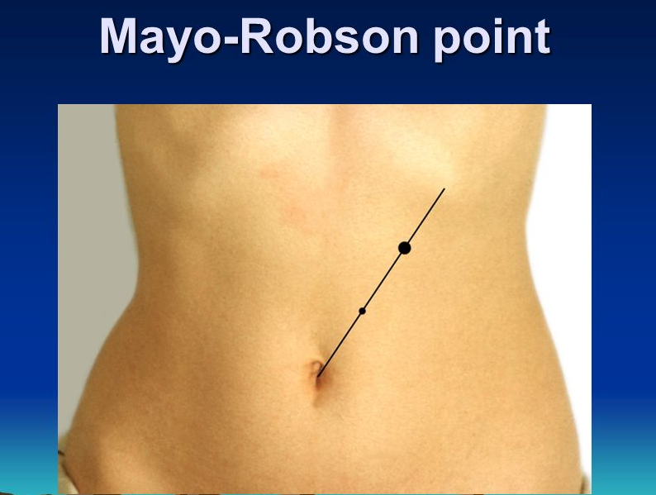
At this point, the tail of the pancreas is projected on the abdominal wall

Slide 18
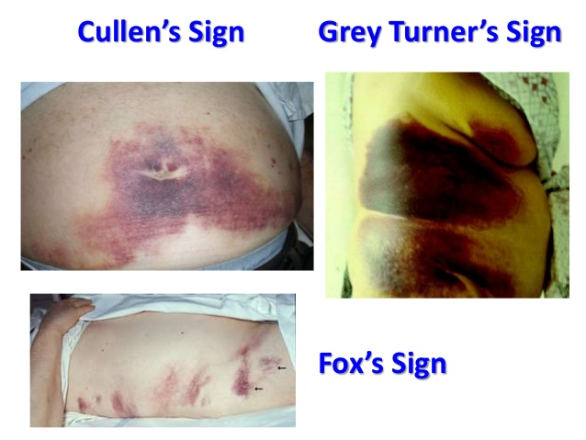

Slide 19
INVESTIGATIONS
BLOOD TESTS
FBC
Serum Amylase and Lipase
C-reactive Protein
Serum electrolytes
Blood glucose
Renal Function tests
Liver Function tests
LDH
Coagulation profile
Arterial Blood Gas Analysis

Slide 20
Serum Amylase
Sensitivity is about 72%
Release within 6 to 12 hours of the onset and remains elevated for 3-5 days.
Elevation > 3X normal is significant
High Amylase levels are also seen in I.O, perforated ulcer, ruptured ectopic pregnancy, salpingitis, renal failure, salivary gland disorders and diabetic ketoacidosis.

Slide 21
Serum Lipase
More pancreatic-specific than S.Amylase
Sensitivity is about 100%
Remains elevated longer than Amylase ( Usefuel in patients presenting late to the physicians).
NB: S.Amylase tends to be higher in gallstone pancreatitis while S.lipase tend to be higher in alcoholic pancreatitis.

Slide 22
IMAGING INVESTIGATIONS
Plain X-Ray
Helps to exclude other causes of abdominal pain such as obstruction and bowel perforation.
It may show show gallstones, "sentinel loop sign,"colon cut off sign" in severe Pancreatitis , features of paralytic ileus, left pleural effusion or collapsing lung.
A ground glass appearance may indicate ascitis.
CT Scan And MRI
Useful in detecting large pancreas, pseudocyst, abscess, hemorrhagic pancreas.

Slide 23
Ultrasound
A diffusely enlarged, hypoechoic pancreas is the classic ultrasonographic image of acute pancreatitis.
Useful to detect gallstone and biliary obstruction and serial assessment of psudocysts, although in the earlier stages the gland may not be grossly enlarged and may be missed on US.
MRCP
Detection of the choledocholithiasis and assessment of pancreatic parenchyma.
ERCP
Detection of the choledocholithiasis and stones removal.

Slide 24
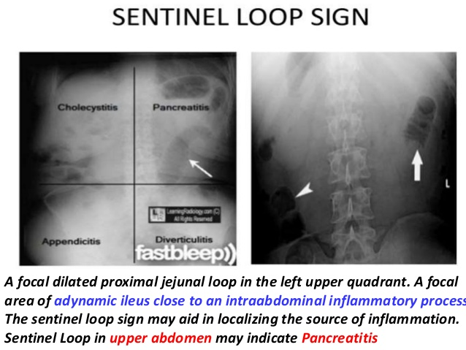
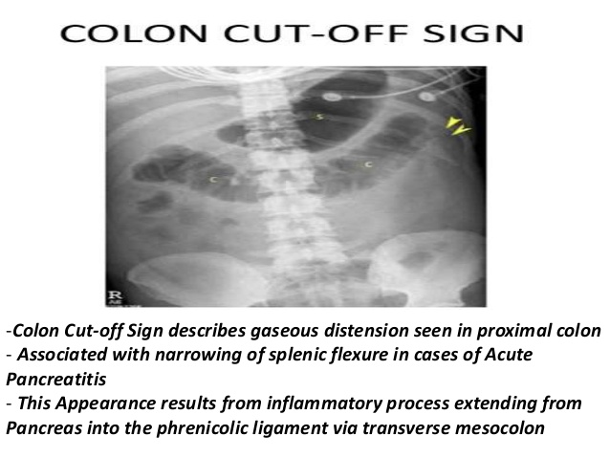

Slide 25
Assessement of Severity of Acute Pancreatitis
Ranson Score
Glasgow Scale
APACHE II Score
BISAP Score
Baltazar score

Slide 26
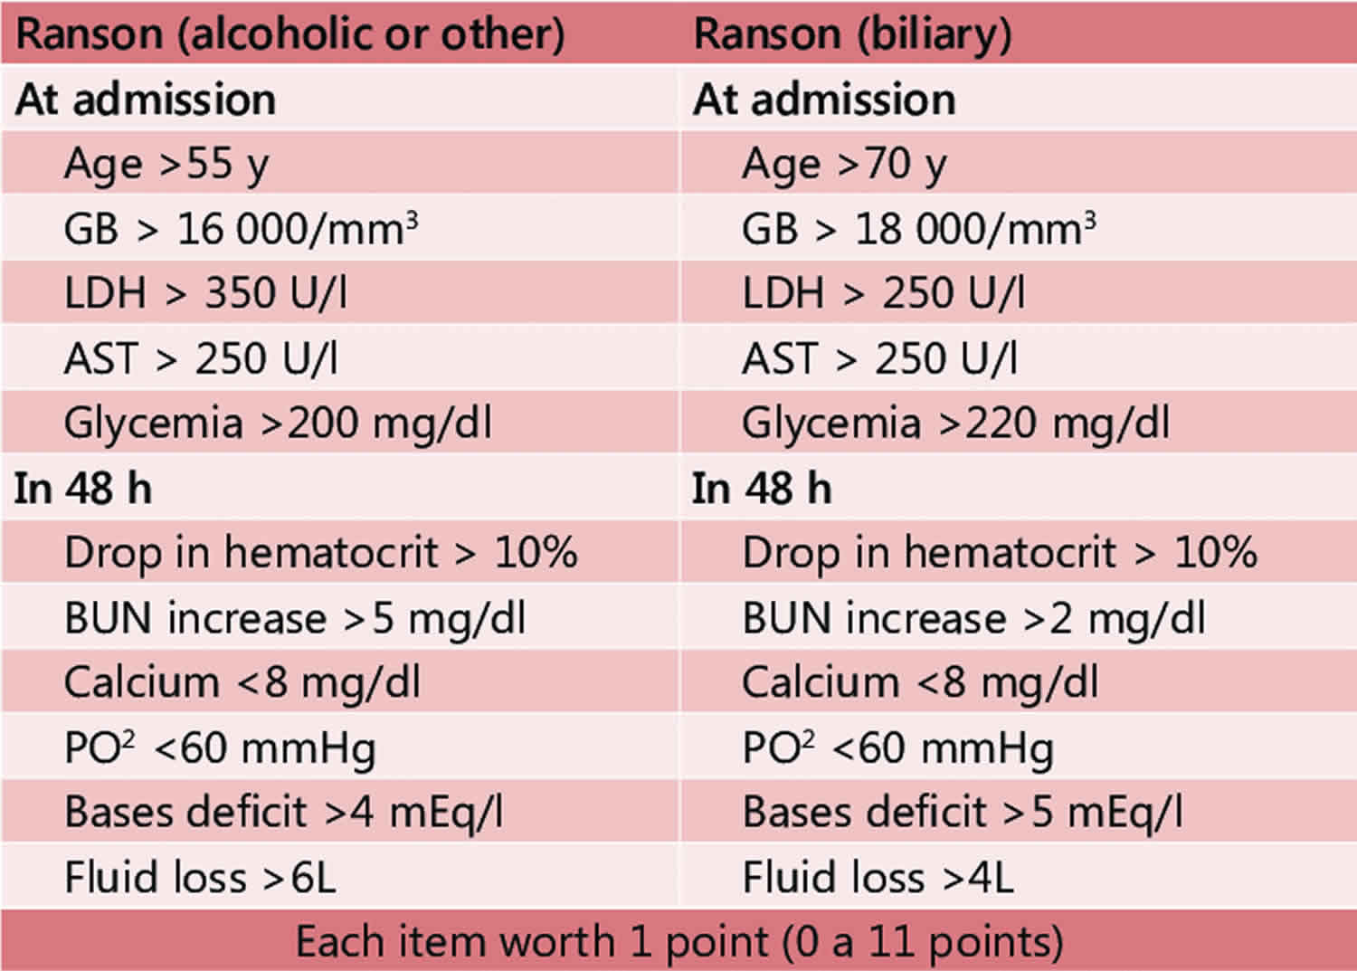

Slide 27
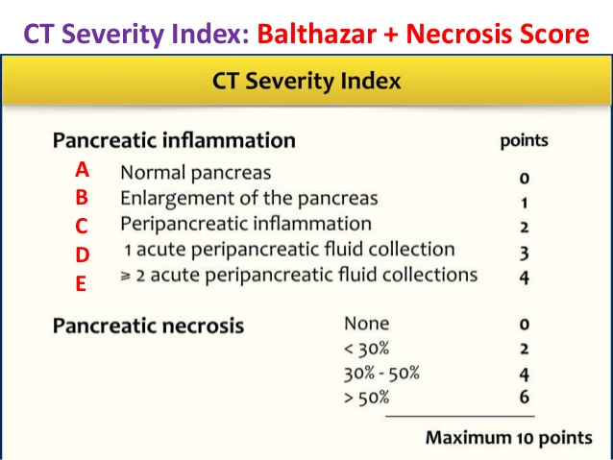

Slide 28
COMPLICATIONS
Systemic complications:
Renal : Pancreatic failure is associated with leakage of fluid in the pancreatic bed causing ileus with fluid filled loops of bowel leading to pre-renal Azotemia and then acute tubular necrosis and therefore renal failure.
Pulmonary : ARDS due to micro thrombi in pulmonary vessels, Basal atelectasis, pleural effusion.
Cardiovascular : Shock, Arrthymia, Pericardial effusion.
Hematological : DIC

Slide 29
Metabolic : Hypoglycemia (due to disruption of pancreatic islets), Hypocalcaemia (due to sequestration of calcium in fat necrosis) and Hypoalbuminemia due to the increase capillary permeability.
GIT : Ileus, Upper GI bleeding (due to gastric or duodenal erosion), Duodenal obstruction (Compression by pancreatic mass), Hemosuccus Pancreaticus, Obstructive jaundice (due to compression of the CBD).
Neurological : Confusion, irritability, encephalopathy
Miscellaneous : Subcutaneous fat necrosis, Arthralgia

Slide 30
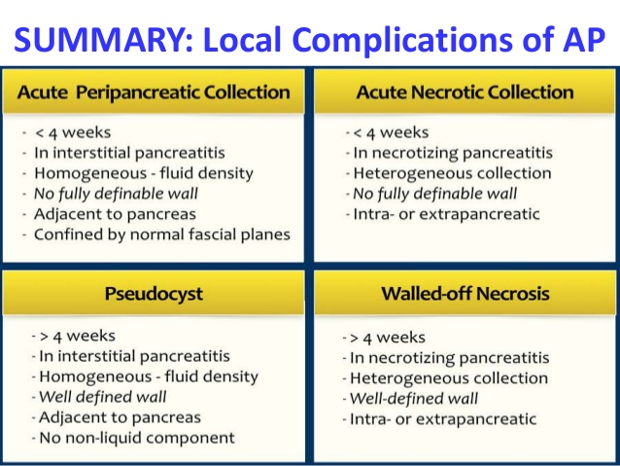
Classification of local complications of AP
(fluid collection: Revised Atlanta 2012)

Slide 31
MANAGEMENT
1- NON SURGICAL
Bed rest NPO
IV Fluids and electrolytes replacement
NGT : If severe nausea, vomiting or development of paralytic ileus.
Pethidine 3 to 4 hourly to control the pain, avoid Morphine
Oxygen for hypoxia, ventilator may be required for ARDS
Dopamine for shock non responsive to fluid
Calcium Gluconate IV only if hypocalcemia is associated with tetany

Slide 32
Somatostatin or Octreotide (Pancreatic secretions inhibitors)
Antispasmodics : To decrease the vagal stimulation, motility and pancreatic outflow.
Omeprazole 40mg IV BD
FFP for coagulopathy
Serum Albumin for hypoalbuminemia
Insulin for hyperglycemia
TPN for severe cases
Antibiotics : Prophylactic broad spectrum antibiotic is given even in sterile pancreatitis to prevent infection.
ERCP : When severe pancreatitis results from stone in the biliary tract, particularly if there is jaundice or cholangitis ERCP with endoscopic sphincterotomy and stone extraction is indicated.

Slide 33
2- SURGICAL
Cholecystectomy should be undertaken within 2 weeks of resolution of pancreatitis.
Necrosectomy to debride all cavities in case of infected necrosis.
Drainage of pancreatic pseudocysts: Percutaneous drainage, Cystogastrostomy, Cystodudenostomy, Roux-en-Y Cystojeunostomy.
Drainage in case of Pancreatic abscess (Percutaneous or open).

Slide 34
References
Bailey and Love, (2013) Short practice of surgery, 26th edition. Tailor and Francis group, LLC.
F. Charles Brunicardi, (2015) Schwartz’s Principles of Surgery, 10th edition. Mc Graw-Hill Education.

