Slide 1
Surgical Hypertension
Presenter: Dr. Edward N. Nyimbili
Date: 13-03-2020
UTH

Slide 2
Background
HTN affects approx. 60 m people in U.S .
Long-term sequelae include:
cardiac arterial disease,
congestive heart failure
left ventricular hypertrophy,
renal disease,
cerebral vascular accidents
retinopathy.

Slide 3
Background
The vast majority of people with hypertension have primary or essential hypertension
HTN that develops as a result of an identifiable cause, it is termed “secondary” hypertension
Suspect 2°HTN in
Pt. with medically refractory HTN
An Acute Raise in BP over a Short Period of time.
<30yrs at onset of HTN & with no family Hx.
Severe HTN

Slide 4
Secondary HTN
Secondary hypertension can be divided into surgical and nonsurgical causes.
Surgical Causes
Renal Renovascular Disease
Coarctation of the Aorta
Primary Hyperaldosteronism
Phoechromocytoma
Hyperthyroidism
Hyperparathyroidism
ACTH secreting Tumour
Non Surgical Causes
Polycythemia vera
Chronic Sleep Aponea
Renal Parenchymal Disease
Medications

Slide 5
Renal Renovascular Disease
Present in 1% of general population
Suspect in PT. with Hypertension and upper Abd. Bruit.
Caused by Renal Artery Stenosis
Two main causes
Atherosclerosis, 75% of cases, affects men over the age of 45yrs mostly
Fibromuscular dysplasia, 25% of cases, affects more women than men.

Slide 6
Renal Renovascular Disease
3 anatomical types described
Unilateral Art. Stenosis
Bilateral renal Art. Stenosis
Stenosis in solitary Kidney
Determining the type may be important for therapy.
ACE inhibitors are useful in patient with unilateral Stenosis but contraindicated in the other 2 types.

Slide 7
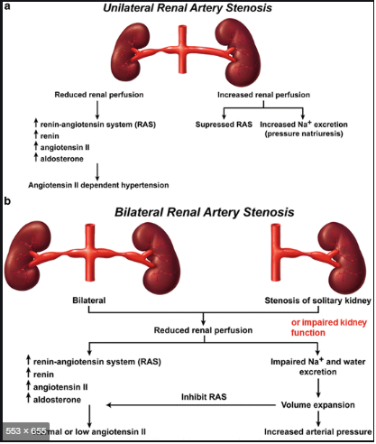
Renal Renovascular Disease

Slide 8
Renal Renovascular Disease
Work up.
Duplex Doppler U/S
CT angiography
MRI
Arteriography; necessary to delineate subtle anomalies.
Still considered a gold standard.

Slide 9
Renal Renovascular Disease
Treatment
Angioplasty
Endarterectomy
Bypass

Slide 10
Coarctation of the Aorta
Narrowing of the medial layer of the vessel.
Aetiology:
Commonly congenital
Acquired- 2°to
Takayasu arteritis
Severe atherosclerosis
May affect neonates, infants, children & adults
Commonly affects Aorta distal subclavian artery.

Slide 11
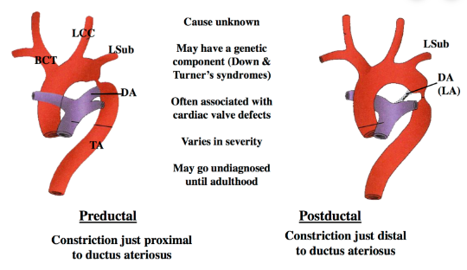
Coarctation of the Aorta

Slide 12
Coarctation of the Aorta
Physical Findings
BP differences between Rt. & Lt. Arms or between Arms & legs.
ECG-LV hypertrophy(voltage & ST&T wave changes)
CXR- Normal or enlarged Heart.
-notching of the posterior 1/3 of the 3rd to 8th ribs.

Slide 13
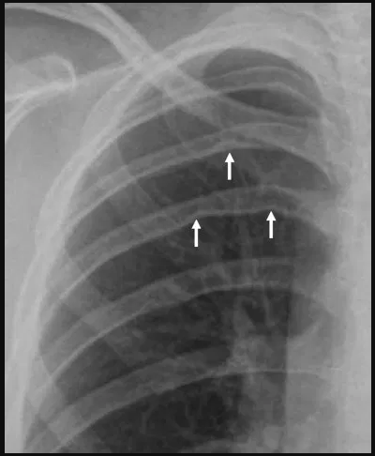
Coarctation of the Aorta
rRib Notching

Slide 14
Coarctation of the Aorta
Diagnosis
Transthoracic echo with suprasternal notch view.
CT
MRI
CT & MRI help delineate anatomy.

Slide 15
Coarctation of the Aorta
Definitive Management
Percutaneous catheterization Repair (Angioplasty & Stent)
Surgical Repair.
Indications
Significant Coarctation or collateral flow
Peak to Peak coarctation Gradient of > 20mmHg.

Slide 16
Primary Hyperaldosteronism
Dfn. Pathologic secretion of aldosterone, independent of renin plasma levels, from unilateral or bilateral adrenal glands.
Causes
Conn’s syndrome-unilateral or bilateral adenomas
Bilateral adrenal hyperplasia
Adrenal Ca.
Ectopic Aldosterone producing tumours
Notes:
Secondary hyperaldosteronism is due to increase renin in CCF, Cirrhosis, Ascites or renin secreting tumours.

Slide 17
Primary Hyperaldosteronism
Primary aldosteronism is the most common cause of surgically correctable HTN.
Suspect P° Hyperaldosteronism in patient with HTN;
family Hx. of early onset HTN
Hyperaldosteronism, concurrent HypoK⁺, HyperN⁺
adrenal incidentaloma
Pt. with drug resistant hypertension

Slide 18
Primary Hyperaldosteronism
Work up.
Plasma aldo./renin ratio if elevated >50 times.
Aldosterone suppression test(oral or IV) & measure urine excretion / plasma levels of aldosterone .
CT to localise lesion
Bilateral adrenal vein sampling

Slide 19
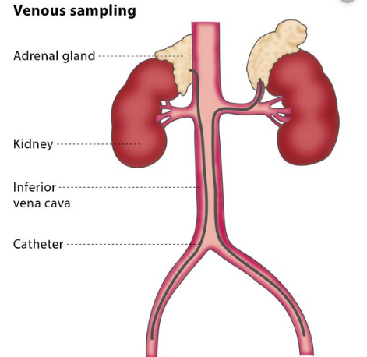
Primary Hyperaldosteronism

Slide 20
Primary Hyperaldosteronism
Goals of treatment
Normalise HTN & hypoK⁺
Unilateral disease – surgical resection
Bilateral benign disease – medical Treatment

Slide 21
Pheochromocytoma
Dfn: catecholamine secreting tumour of the neural crest origin.
90% arise in the adrenal medulla
Most are benign
10% are malignant
Seen commonly in young to mid adult life
Screen all Pt. for MEN type 2.
Secretion of catecholamines maybe precipitated by anxiety, trauma, drugs, food, surgery & anaesthesia.

Slide 22
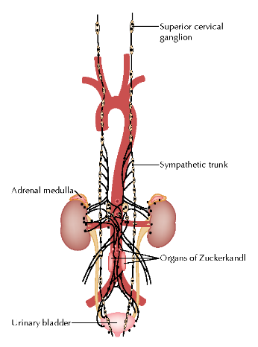
Pheochromocytoma
Potential sites for Pheochromocytoma

Slide 23
Pheochromocytoma
Symptoms
Paroxysmal HTN
Chronic Hypertension resistant to anti-HTN
Heart palpitation
Headache
Sweating
50 % diagnosed with Pheo. are asymptom.
Other Symptoms
Visual blurring
Weight loss
Polyuria
Polydipsia
Constipation
diarrhoea

Slide 24
Pheochromocytoma
Work up
24 hrs measurement of urine normetanephrines/metanephrines & urinary vanillyl-mendilic acid.
Plasma catecholamine levels
CT/MRI can localise tumour
123-I- metaiodobenylguanidine(MIBG) scintigraphy if CT/MRI –ve but biochemically proven disease

Slide 25
Pheochromocytoma
Treatment
Preoperative control of BP is necessary with Pheoxybenzamine
-B-blockers maybe used for tachycardia & HTN
Pt. with MEN 2 & evidence of bilateral disease on imagine undergo bilateral adrenalectomy.

Slide 26
Miscellaneous Surgical Disease that Contribute to HTN
Pt. with HTN and concurrent;
Hyperthyroidism
Hyperparathyroidism
ACTH secreting tumours
May have their HTN lessened after surgical cure.
However most of these patient have primary HTN with these secondary disease.

Slide 27
Summary
One should have a high index of suspicion for secondary hypertension in patients with;
Resistant or severe hypertension
Onset in younger (< 30 years)
Abrupt onset
Rapid worsening of pressure after initially good control
Those with renal bruits
Absent or delayed femoral pulses

Slide 28
end

