Slide 1
COLOSTOMY
7TH Year Tutorial
Dr Mukonka ( Paeds Surgery Senior Registrar)

Slide 2
Layout
History
Definitions
Types of Stomas
Colostomy
Indications for colostomy
Types of colostomies
Complications

Slide 3
HISTORY
Alexis Littre (1658-1726): Anatomist.
Pillorie of Rouen :1776 performed the first colostomy in ca rectum pt.
Debois: 1783 ,first paediatric colostomy

Slide 4
Definitions
Stoma: from the Greek word ”stomoun”
to provide with an opening or mouth .
Deliberate creation of an opening that communicates between the GIT and the exterior.

Slide 5
Purpose of Stomas
Feeding,
Drug administration,
Bowel decompression,
Protecting distal anastomosis or other gut lesions,
Controlling faecal effluent in some cases of incontinence,
A combination of these indications.

Slide 6
Types Of Stomas
Gastrostomy
Enterostomy
-Duodonostomy, Jejunostomy, ileostomy
Caecostomy
Appendicostomy
Sigmoidostomy
Colostomy

Slide 7
Types of Stomas
Gastrostomy
creation of an opening between the stomach and the skin.
feeding
drug administration
Proximal decompression of the GIT.
Oesophageal obstruction due to corrosive oesophageal stricture
severe maxillofacial trauma,
Achalasia of the cardia
oesophageal carcinoma (in adults).

Slide 8
Types of Stomas
Jejunostomy/Ileostomy
Commonly used for feeding
bowel decompression,or diversion of distal disease.
Specific indications include
• Bypass of gastric outlet obstruction;
• Protection of distal anastomosis.
Obstructive distal bowel lesions.
• To rest and/or decompress distal bowel in cases of perforation

Slide 9
colostomies

Slide 10
Colostomy
Defn:
stoma of the colon with the aim of diverting faeces and flatus.
Iatrogenic Colocutaneous fistula

Slide 11
Indications For Colostomy
CONGENITAL OR ACQUIRED
Congenital indications :common
High anorectal anomalies –ARM
(imperforate anus)
Rectovesical/rectovaginal fistula, cloacal exstrophy, and severe spina bifida with incontinence.
Hirschsprung’s disease.
Colonic Atresia
For faecal diversion prior to resection of large congenital intrapelvic masses.

Slide 12
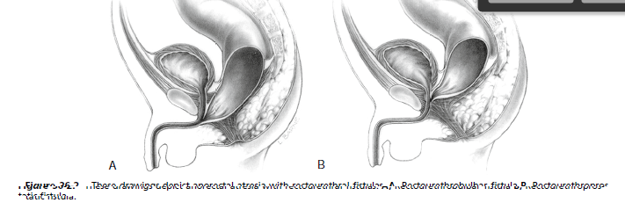

Slide 13
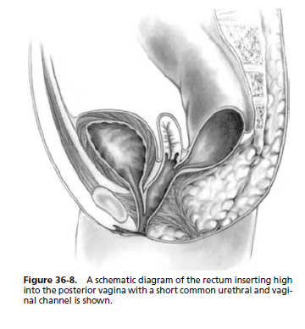
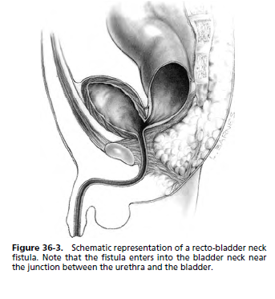

Slide 14
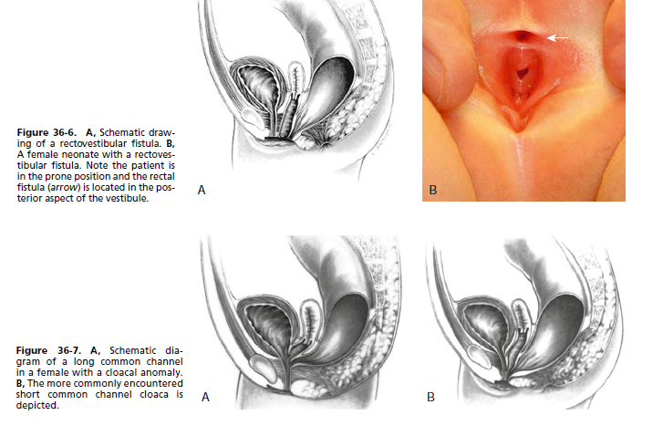

Slide 15
Indications For Colostomy
ACQUIRED INDICATIONS
Intestinal obstruction e.g. sigmoid volvulus
Gangrenous bowel due to strangulation
Ischaemic bowel disease
Penetrating trauma to the bowel
Rectovaginal fistula prior to repair
Tumors :Anal ca, Rectal ca
Protecting an anastomosis of gut resection
Stenosis or stricture
i. Early complications
- RXN to anastesis
- Hemorrhage
- Stomal diarrhea- water
- Electrolyte imbalance
- Skin excoriation
- Ischemic gangrene- necrosis
ii. Late

Slide 16
Indication for colostomy
Decompression
Diversion
- Urinary
Protect distal bowel anastomosis

Slide 17
Classification of Colostomies
Base on temporal, anatomical, or constructional criteria.

Slide 18
Temporal Classification
Temporal classification is based on the anticipated duration of the stoma and is either temporary or permanent.

Slide 19
Anatomical Classification
Anatomical classification is based on the anatomical portion of the colon in which the stoma is sited.
Sigmoid colostomy,
Transverse colostomy,
right-transverse,
mid-transverse,
left-transverse colostomy;
Caecostomy,

Slide 20
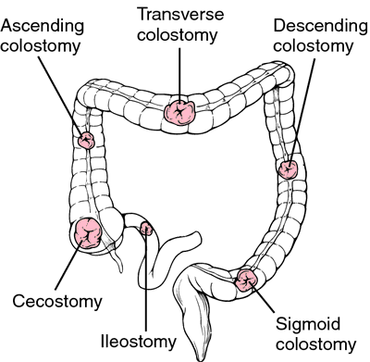

Slide 21
Constructional Classification
Constructional classification is based on how the stoma is constructed,
Two major types: loop colostomy and divided colostomy

Slide 22
Divided colostomy
Divided colostomy
the bowel is completely divided and the bowel Continuity interrupted.
Intestinal content does not enter the distal bowel,
Divided stomas are also called defunctioning stomas.
The most common variations are
the double-barrel, Devine, and end stomas’,

Slide 23
Double-barrel stoma
Both the proximal and distal limbs may or may not be plicated together but are brought out side-by-side through the same wound like a doublebarrel gun

Slide 24
Devine stoma
In a Devine stoma, both proximal and distal limbs are brought out separately, sometimes through different incisions, and are separated by a skin bridge.

Slide 25
End stoma
Here the proximal limb is brought out to evacuate faeces and flatus,
The distal limb is closed or oversewn and returned to the peritoneal cavity.

Slide 26
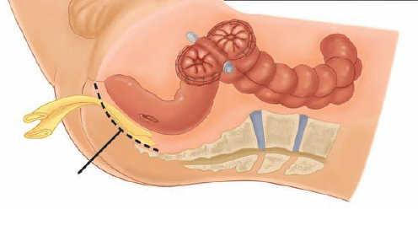
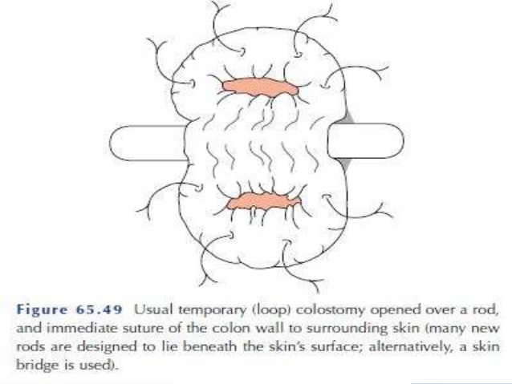
Loop colostomy

Slide 27
Complications of Colostomies
Can be Early or Late complications

Slide 28
Early complications
Anaesthetic related
Hemorrhage
Stomal diarrhea
Electrolyte imbalance
Skin excoriation
Ischemic gangrene- necrosis

Slide 29
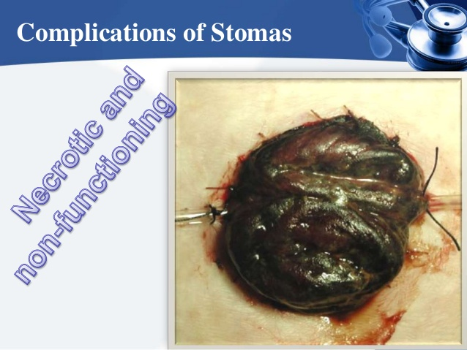

Slide 30
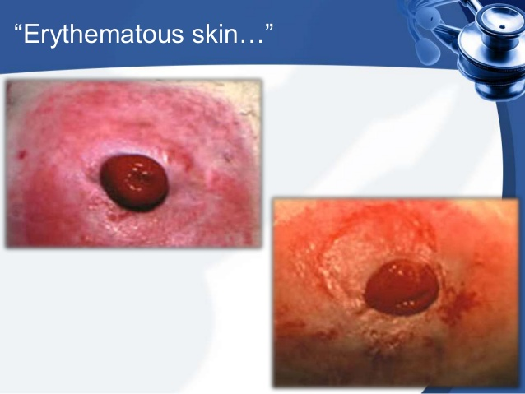

Slide 31
Late Complications
Prolapsed
Stenosis
Retraction---- peritonitis at site
Fistula
Parastomal hernia
Incisional hernia later
Nutritional disorders

Slide 32
Late complications ….
Residual disease
Parastoma fistula
Psychosocial problems
Impotence in men
Loss of libido

Slide 33
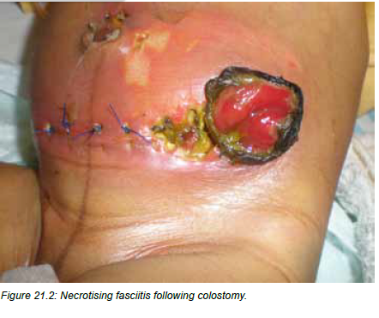

Slide 34
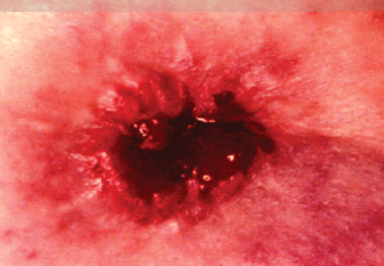
Stomal Retraction

Slide 35
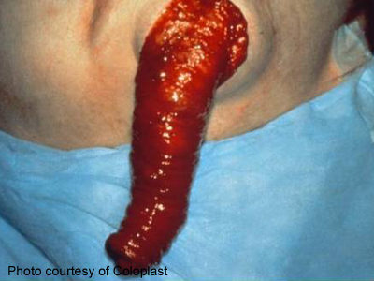
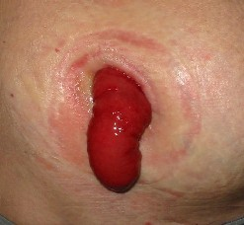
Stomal Prolapse

Slide 36
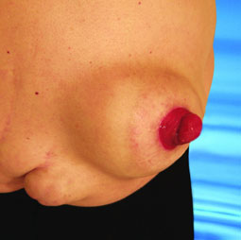
Parastomal Hernia

