Slide 1
Antigens and Immunogens
Dr Samuel Munjita

Slide 2
Introduction
Whenever we refer to a pathogen, most often we may think the entire microbe is responsible for the inducing the immune system.
However, these organisms possess numerous sites that are recognised by antibodies or receptors on the cells such as B and T cells.
In this lecture, we shall discuss antigens, immunogens, epitopes and the factors that influence immunogenicity

Slide 3
Definitions: antigens and immunogens
Antigen is any agent that is recognised by specific components of immune responses such as lymphocytes or antibodies and is capable of binding specifically to these components.
Remember: T cell receptors only recognise antigens complexed with MHC molecules.
Antigenicity is the ability of antibody or lymphocytes to bind specifically to antigens.

Slide 4
Definitions: antigens and immunogens
Although all antigens are recognised by specific lymphocytes or by antibodies, only some antigens are capable of activating immune responses.
Antigens that are able to induce humoral or cell mediated immune responses or both are known as immunogens. Immunogenicity is the ability to induce humoral and cellular immune responses.
All immunogens are also antigens. But, not all antigens are immunogens (not every antigen is able to trigger an immune response).

Slide 5
Types of Antigens
Antigens can be classified on the basis of their origin or on the basis of immune responses
On the basis of their Origin
1. Exogenous antigens
These antigens enters the body or system and start circulating in the body fluids and trapped by the APCs (Antigen presenting cells such as macrophages, dendritic cells, and activated B lymphocytes.)
The uptakes of these exogenous antigens by APCs are mainly mediated by the phagocytosis.
Some antigens start out as exogenous antigens, and later become endogenous (for example, intracellular viruses e.g. HIV)

Slide 6
Types of Antigens
2. Endogenous antigens
These are body’s own cells or sub fragments or compounds or the antigenic products that are produced. Examples: Blood group antigens.
3. Autoantigens
An autoantigen is usually a normal protein or complex of proteins (and sometimes DNA or RNA) that is recognised by the immune system of patients suffering from a specific autoimmune disease
These antigens should not be, under normal conditions, the target of the immune system, but, due mainly to genetic and environmental factors, the normal immunological tolerance for such an antigen has been lost in these patients.

Slide 7
Types of Antigens
On the basis of immune response
1. Complete Antigen or Immunogen
These antigens are able to generate an immune response by themselves.
High molecular weight (more than 10,000 Da)
May be proteins or polysaccharides

Slide 8
Types of antigens
2. Incomplete antigens
Incomplete antigens are incapable of inducing immune responses by themselves but can induce immune responses upon binding to larger molecules called carriers.
Incomplete antigens are referred to as Haptens.
Haptens are low molecular weight (Less than 10,000 Da) compounds that can combine with antibody but cannot initiate an immune response unless it is coupled to a larger carrier molecule.

Slide 9
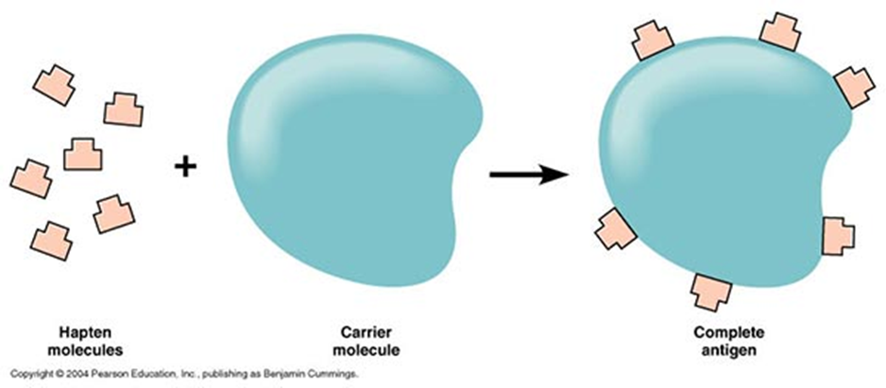
Types of Antigens
Incomplete antigens continued

Slide 10
Types of Antigens
Incomplete antigens continued
The carrier molecule is a non-antigenic component and helps in provoking the immune response.
Example of carrier molecules: Serum Protein such as Albumin or Globulin.
Examples of Haptens include nickel. Nickel is a substance of small molecular weight which is incapable of provoking an immune response in its own right. Nickel allergy, however, is a common cause of contact dermatitis.
This results when nickel combines with protein in the patient’s skin. The nickel-protein complex is recognised as foreign and an immune response is mounted.
Penicillins, capsular polysaccharide of pneumococcus, polysaccharide “C” of beta haemolytic streptococci, and cardiolipin antigens are other examples of Haptens.

Slide 11
Factors affect the immunogenicity (ability to induce immune responses:

Slide 12
Factors affect the immunogenicity (ability to induce immune responses:
Foreignness
Immune system usually differentiate self and non self (Remember positive and negative selection).
Therefore, the more foreignness of substances toward host, thee more immunogenic.
2. Molecular Size
Immunogens with molecular mass of 100,000 daltons (Da) are more immunogenic.
Substances with a molecular mass less than 5000–10,000 Da are poor immunogens.

Slide 13
Factors affect the immunogenicity (ability to induce immune responses:
3. Chemical composition and heterogeneity
Proteins are more immunogenic compared to other macromolecules. Nucleic acids and lipids are not immunogenic. Antibodies still can bind to them when they bind with proteins in form of nucleoproteins and lipoproteins. Thus, nucleic acids and lipids are antigenic but not immunogenic.
4. Degradability/capacity to be phagocytosed
Humoral and cell mediated immunity normally involve the interaction of T cells and antigens where the antigens must be processed and complexed by MHC of antigen presenting cells (APCs).
Large and insoluble substances are more immunogenic than smaller and soluble because the large substances are more likely to be phagocytosed and processed by APCs.
Thus, they are more likely to be expressed at MHC complex.
Substances that are difficult to phagocytose are poor immunogens.

Slide 14
Factors affect the immunogenicity (ability to induce immune responses:
5. Genetics (or genotype) of recipient
Differences in our genetic makeup means that we respond differently to immunogens
6. Immunogens dosage
Different of immunogen dosage affects the immunogenicity.
In the case of vaccines, specific dosages must be administered to elicit the required immune responses.
Repeated administrations, or boosters, increase the immunogenicity by increasing the clonal proliferation of antigen-specific T cells or B cells.

Slide 15
Factors affect the immunogenicity (ability to induce immune responses:
7. Route of administration
Administration route also affect the immunogenicity.
The common administration routes are: intravenous (into vein), intradermal (into skin), subcutaneous (beneath skin), intramuscular (into muscle) and intraperitoneal (into peritoneal cavity).
8. Adjuvants
Adjuvants are substances that, when mixed with an antigen and injected with it, enhance the immunogenicity of that antigen.
Adjuvants are often used to boost the immune response when an antigen has low or poor immunogenicity or when only small amounts of an antigen are available.
Examples of adjuvants: Freund’s adjuvants and alum precipitate

Slide 16
Adjuvant name | Composition | Mechanism of action
Incomplete Freund’s adjuvants | Oil in water emulsion | Delayed release of antigen; enhanced uptake by macrophage
Complete Freund’s adjuvants | Oil in water emulsion with dead mycobacteria | Delayed release of antigen; enhanced uptake and induction of co-stimulators in macrophages
Alum precipitate | A suspension of aluminum hydroxide on which the antigen is absorbed | This adjuvant causes aggregation of a soluble antigen and allows continuous slow release of antigen. In addition, it has a slight irritant effect that enhances the ingestion and processing of an antigen by macrophages which present the antigen to T cells, leading to T-cell activation.

Slide 17
Factors affect the immunogenicity (ability to induce immune responses:
Note
It is important to distinguish between a carrier for a Hapten and an adjuvant.
A Hapten will become immunogenic when conjugated covalently to a carrier; it will not become immunogenic if mixed with an adjuvant. Thus, an adjuvant enhances the immune response to immunogens but does not confer immunogenicity to Haptens.
9. Age: Age can also influence immunogenicity. Usually the very young and the very old have a diminished ability to elicit and immune response in response to an immunogen.

Slide 18
End of Lecture

