Slide 1
Lymphocyte Development
Dr Samuel Munjita

Slide 2
Lecture objectives
At the end of this lecture, you should be able to
Provide an overview of B and T cell development
List the markers for specific stages of B and T cell development
Explain the role of specific molecules in T and B-cell growth and development
Compare and contrast the development of T and B lymphocytes and phagocytic cells

Slide 3
Introduction
Hematopoietic stem cell (HSC) HSCs give rise to two cell populations:
  The common myeloid progenitor (CMP)
  The common lymphocyte progenitor (CLP).
CMP differentiation results in the production of: neutrophils, basophils, eosinophils, monocyte, macrophages, erythrocytes and dendritic cells.
The CLP is responsible for the production of B lymphocytes, T lymphocytes, and natural killer cells

Slide 4
Introduction
In this lecture, we shall carefully study the development of B and T lymphocytes
B and T lymphocytes are the major cells of the adaptive immune responses
When activated, B lymphocytes differentiate into plasma cells to produce antibodies. B cells are a key component of the humoral immune responses.
T lymphocytes are part of the cell mediated immune system

Slide 5
Development of B cells
B cells develop in the bone marrow with the help of stromal cells and achieve maturity in secondary lymphoid organs, in this case, the spleen
B-cell development is dependent on the non-lymphoid stromal cells of the bone marrow
Stem cells isolated from the bone marrow and grown in culture fail to differentiate into B cells unless bone marrow stromal cells are also present.
The stroma, whose name derives from the Greek word for a mattress, provides a necessary support for B-cell development.

Slide 6
Development of B cells
The contribution of the stromal cells to B cell development is twofold:
  First, they form specific adhesive contacts with the developing B-lineage cells through interactions between cell-adhesion molecules and their ligands.
  Second, they provide growth factors that stimulate B cell lymphocyte differentiation and proliferation (Fig. 1).

Slide 7
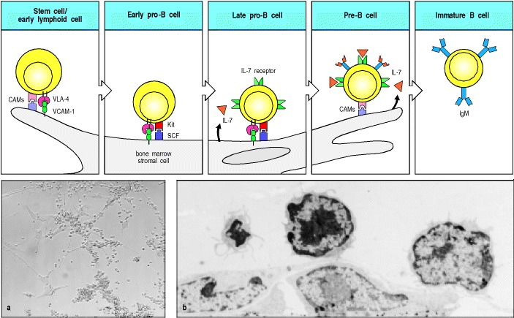
Development of B cells
Figure 1: The early stages of B-cell development are dependent on bone marrow stromal cells
Lymphoid progenitor cells and early pro-B cells bind to the adhesion molecule VCAM-1 on stromal cells through the integrin VLA-4 and also interact through other cell-adhesion molecules (CAMs).
These adhesive interactions promote the binding of the receptor tyrosine kinase (Kit) found on the surface of the pro-B cell to stem-cell factor (SCF) on the stromal cell, resulting in activation of the kinase and induction of the growth/proliferation of the B-cell progenitors.
Late pro-B cell and Pre-B cell require interleukin-7 (IL-7) for proliferation and further development.

Slide 8
Development of B cells
As B-lineage cells mature, they migrate within the marrow, remaining in contact with the stromal cells.
The earliest stem cells ( early pro-B cells) lie in a region called the sub-endosteum, which is adjacent to the inner bone surface.
Pro-B stage is marked by cells expressing an enzyme called terminal deoxynucleotidyl transferase (TdT)
As maturation proceeds, B-lineage cells move toward the central axis of the marrow cavity ready for export.

Slide 9
Development of B cells
Later stages of maturation become less dependent on contact with stromal cells, and the final stages of development of immature B cells into mature B cells occur in peripheral lymphoid organs, in this case, its the spleen.

Slide 10
Stages in B-cell development
Stages in B-cell development are distinguished by the expression of immunoglobulin chains and particular cell-surface proteins
The stages in B-cell development are defined by the sequential rearrangement and expression of heavy- and light-chain immunoglobulin genes (Fig. 2).
However, the stem cells in the germline configuration are not linked to rearrangement of their immunoglobulin (Ig) gene segments

Slide 11
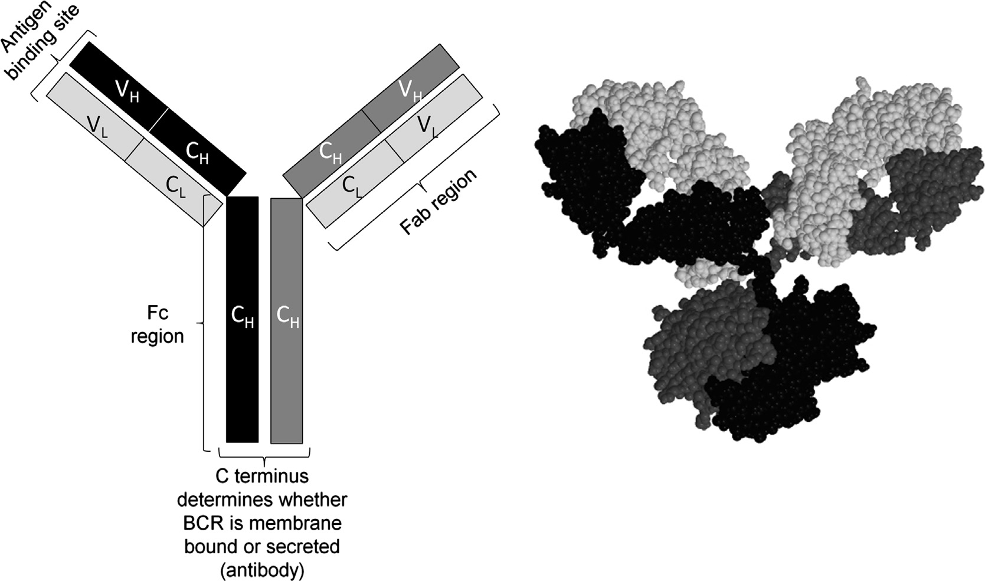
Stages in B-cell development
Antibody structure: The left-hand image shows a schematic of a B-cell receptor/antibody. VL-variable region of light chain; VH-variable region of heavy chain; CL-constant region of light chain; CH-constant region of heavy chain. The right-hand image is a 3D structure of an IgG antibody (Lauren M.F. Merlo, Laura Mandik-Nayak, 2013)

Slide 12
Stages in B-cell Development
GENE REARANGEMENT
The portion of the B-cell receptor (BCR) that recognizes antigens is made up of three disparate genetic regions, termed V, D, and J, that are spliced and recombined at the genetic level in a combinatorial process unique to the immune system.
Multiple genes encoding each of these regions exist in the genome and can be joined in different ways to produce a diverse repertoire of receptor molecules.
The generation of this diversity is critical; because the body may encounter many more antigens than there are available genes, this process provides a way to produce millions of different combinations of antigen-recognizing receptor molecules.

Slide 13
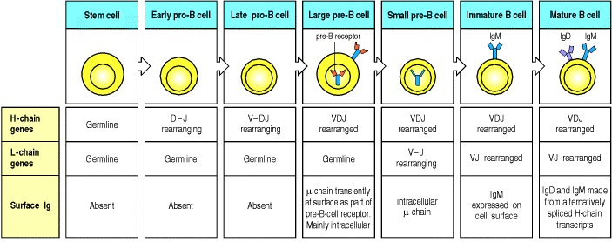
Stages in B-cell development
Figure 2: The development of a B-lineage cell proceeds through several stages marked by the rearrangement and expression of the immunoglobulin genes (Variable (V); D (diversity), J (joining) and C(Constant) gene segments). A successful VDJ_{H} rearrangement leads to the expression of a complete immunoglobulin heavy chain as part of the pre-B-cell receptor, which is found mainly in the cytoplasm and to some degree on the surface of the cell. Once the VDJ_{H} rearrangement is complete, the cell is stimulated to become a large pre-B cell which actively divides.

Slide 14
Stages in B-cell development
The μ-chain in large pre-B cells is expressed intracellularly and possibly in small amounts at the cell surface, in combination with a surrogate light chain, to form the pre-B-cell receptor.
When Large pre-B cells cease to divide, they enter into the resting phase
Resting non-dividing Large pre-B cells become small resting pre-B cells, at which point they cease expression of the surrogate light chains and express the μ-heavy chain alone in the cytoplasm.
Small resting pre-B cells express the RAG proteins and start to rearrange the light-chain (L-chain) genes (figure 2).

Slide 15
Stages in B-cell development
Once a light-chain gene is assembled and a complete IgM molecule is expressed on the cell surface, the cell is defined as an immature B cell.
At this stage, immature B cells are expressing the immunoglobulin heavy and light chains.
NB: All development up to this point has taken place in the bone marrow/foetal liver and is independent of antigen.

Slide 16
Stages in B-cell development
The immature B cells that successfully make it through this process (only about 10%) enter into the bloodstream and migrate to the spleen.
The immature B cells have both IgM and IgG (B cell receptors-BCRs) expressed on their surface at this point and once they enter into the spleen are called transitional type 1 (T1) B cells
They are also marked by the additional appearance of IgD on the cell surface.

Slide 17
Stages in B-cell development
At this point, the T1 B cells are exposed to more self cells and circulating proteins and if they respond strongly it would indicate autoreactivity and the cells are typically induced to become T3 B cells, which are anergic and will undergo apoptosis.
If the T1 B cells survive through this they can then migrate into the follicle of the lymphoid tissue and become T2 B cells.
At this point they will be responsive to antigen, and become naive follicular B cells, which are fully mature B cells that can participate in immune responses.

Slide 18
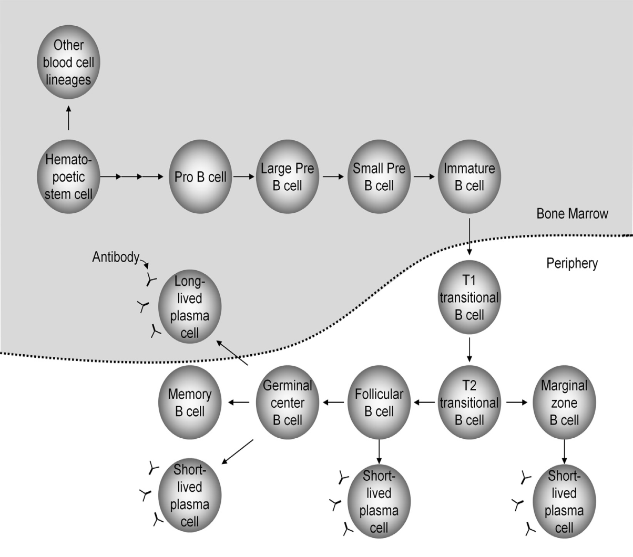
Stages in B cell Development
Fig 3: B-cell Development.
B cells are derived from hematopoietic stem cells.
In the bone marrow VDJ recombination of the heavy chain and VJ recombination of the light chain occur to produce a B-cell receptor.
The IgM-expressing immature B-cell can leave the bone marrow and enter the periphery, where it can become activated upon encounter with antigen, generating an initial, short-lived immune response or forming a germinal center where affinity maturation further refines the specificity of the BCR and differentiation of both short- and long-lived plasma cells as well as memory B cells occurs.
Plasma cells secrete antibodies that allow for the elimination of pathogens.

Slide 19
Useful markers for B-lineage cells at different developmental stages
As B cells develop from pro-B cells to mature B cells, they express proteins other than immunoglobulin receptors that are characteristic of each stage.
Many of these proteins are expressed on the cell surface and are useful markers for B-lineage cells at different developmental stages.

Slide 20
Useful markers for B-lineage cells at different developmental stages
One of the first identifiable proteins expressed on the surface of B-lineage cells is CD45R
CD45R is a protein tyrosine phosphatase that functions in B-cell receptor signaling.
It is expressed throughout B-cell development from pro-B cells right up to the antibody-secreting plasma cells,

Slide 21
Useful markers for B-lineage cells at different developmental stages.
Another protein that is expressed throughout B-cell development is CD19, which also participates in B-cell receptor signaling.
The earliest B-cell precursors also express the receptor for IL-7, which is an essential growth factor for both developing B cells and T cells.
Blocking signaling by infusion of an anti-IL-7 antibody will halt B-cell development, as will mutations that inactivate either IL-7 or its receptor.

Slide 22
Useful markers for B-lineage cells at different developmental stages
Another cell-surface protein first detected at the pro-B cell stage is CD43 (the mucin leukosialin), but this is lost as cells progress to become immature B cells.
CD43 functions both as an adhesion molecule that may guide cell-cell interactions: for example those of B-cell precursors with stromal cells—and also as a signaling molecule.
Exactly why CD43 is expressed at these early stages of B-cell development, but not later, is not yet known.

Slide 23
Useful markers for B-lineage cells at different developmental stages
Other cell-surface molecules expressed during early stages of B-cell development include the heat-stable antigen (HSA, CD24) and the aminopeptidase BP-1.
The functions of these molecules in B-cell development are unknown, although B cells apparently develop normally in mice lacking BP-1.
At the late pro-B cell stage, Kit, the receptor for Stem cell factor-2 (SCF-1) mutates. Signaling through Kit, in concert with IL-7 and other stromal-derived signals, promotes pro- and pre-B cell proliferation.
After Kit turns off, at the large pre-B cell stage, the low affinity IL-2 receptor, CD25, is expressed.

Slide 24
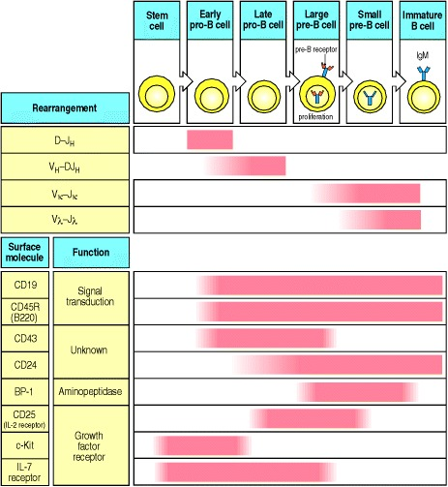
Useful markers for B-lineage cells at different developmental stages

Slide 25
Conclusion
The terminal differentiation of a B cell is becoming a plasma cell which is essentially a cell devoted to secreting antibodies.
From the germinal centre or the memory B cell population, antigen specific B cells will proliferate (in the presence of the antigen) and become plasmablasts and then plasma cells.

Slide 26
Development of T-Lymphocytes
Dr Samuel Munjita

Slide 27
Development of T lymphocytes
T lymphocytes develop from a common lymphoid progenitor in the bone marrow.
They leave the bone marrow and migrate to the thymus.
This is the reason they are called thymus-dependent lymphocytes or T cells.
The thymus consists of numerous lobules, each clearly differentiated into an outer cortical region called the thymic cortex and an inner medulla (Fig. 1).

Slide 28
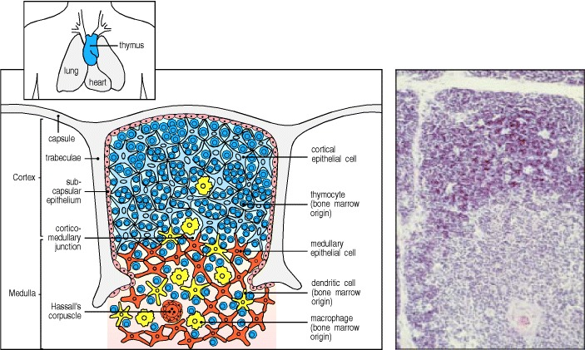
The cellular organization of the human thymus
Figure 1: The thymus, is made up of several lobules, each of which contains cortical (outer) and medullary (central) regions.
The cortex consists of immature thymocytes (dark blue), branched cortical epithelial cells (pale blue), and scattered macrophages (yellow), which are involved in clearing apoptotic thymocytes.
The medulla consists of mature thymocytes (dark blue), and medullary epithelial cells (orange), along with macrophages (yellow) and dendritic cells (yellow) of bone marrow origin.

Slide 29
Development of T lymphocytes
Most developing T cells die in the thymus
T-cell precursors arriving in the thymus from the bone marrow spend up to a week differentiating there before they enter a phase of intense proliferation.
Approximately 98% of the thymocytes that develop in the thymus die within the thymus. No widespread damage is seen, indicating that death is occurring by apoptosis rather than by necrosis
This apparently waste of thymocytes is a crucial part of T-cell development as it reflects the intensive screening that each new thymocyte undergoes for the ability to recognise self antigens and for self tolerance

Slide 30
Stages in the development of T Lymphocytes
Developing thymocytes pass through a series of distinct phases that are marked by:
  Changes in the status of T-cell receptor genes (gene rearrangement) and in the expression of the T-cell receptor
  Changes in expression of cell-surface proteins such as the CD3 complex and the co-receptor proteins CD4 and CD8.
These surface changes reflect the state of functional maturation of the cell.

Slide 31
Stages in T Lymphocytes Development
Progenitor T cells from the bone marrow enter the thymus in the outer cortex.
When progenitor cells first enter the thymus from the bone marrow, they lack most of the surface molecules characteristic of mature T cells and their receptor genes are unrearranged
Thus, throughout the early stages of development the T cell precursor is referred as a 'double negative' cell (CD4-/CD8-).

Slide 32
Stages in T Lymphocytes Development
However, double negative cells do express other markers that allow their identification:
  For example Thy-1 (in mice), c-kit (the receptor for stem cell growth factor), CD44 (an adhesion receptor) and CD25 (the α chain of the IL-2 receptor).
NB: Loss of expression of c-kit and CD44 precedes T cell receptor (TCR) gene rearrangement.
These cells ('double negative' cells (CD4-/CD8-) give rise to the major population of α:β T cells and the minor population of γ:δ T cells.

Slide 33
Stages in the development of T Lymphocytes
Interactions with the thymic stroma trigger:
  1. An initial phase of differentiation along the T-cell lineage pathway
  2. Followed by cell proliferation,
  3. And then expression of the first cell-surface molecules specific for T cells, for example CD2 and Thy-1 (in mice).
At the end of this phase, which can last about a week, the thymocytes bear distinctive markers of the T-cell lineage, but they do not express any of the three cell-surface markers that define mature T cells.
Changes in cell-surface molecules that allow thymocyte populations at different stages of maturation to be distinguished are outlined in Fig. 2.

Slide 34
Stages in the development of T Lymphocytes
Two distinct lineages of T cells—α:β and γ:δ, which have different types of T-cell receptor—are produced early in T-cell development.
Later, α:β T cells develop into two distinct functional subsets, CD4 and CD8 T cells.

Slide 35
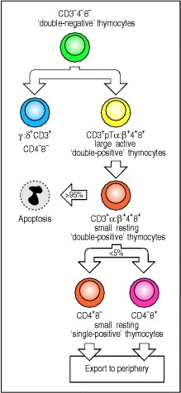
Stages in the development of T lymphocytes
Figure 2. Changes in cell-surface molecules allow thymocyte populations at different stages of maturation to be distinguished
The most important cell-surface molecules for identifying thymocyte subpopulations have been CD4, CD8, and T-cell receptor complex molecules (CD3, and the T-cell receptor α and β chains). The earliest cell population in the thymus does not express any of these. As these cells do not express CD4 or CD8, they are called ‘double-negative’ thymocytes.
These precursor cells give rise to two T-cell lineages, the minority population of γ:δ T cells (which lack CD4 or CD8 even when mature), and the majority α:β T-cell lineage.
Development of prospective α:β T cells proceeds through stages where both CD4 and CD8 are expressed by the same cell; these are known as ‘double-positive’ thymocytes.

Slide 36
Stages in the development of T lymphocytes
Figure 2 continued:
At first, large double-positive cells express the pre-T-cell receptor (pTα:β). These cells enlarge and divide.
Later, they become small resting double-positive cells in which low levels of the T-cell receptor (α:β) itself are expressed.
Most thymocytes (~97%) die within the thymus after becoming small double-positive cells.

Slide 37
Stages in the development of T lymphocytes
Figure 2 continued
Those cells whose receptors can interact with self MHC molecules lose expression of either CD4 or CD8 and increase the level of expression of the T-cell receptor.
The outcome of this process are the ‘single-positive’ thymocytes, which, after maturation, are exported from the thymus as mature single-positive CD4 or CD8 T cells.

Slide 39
Distinguishing T cell at different stages of development
The double-negative stage can be subdivided on the basis of expression of the adhesion molecule CD44 (an adhesion receptor) , CD25 (the α chain of the IL-2 receptor), and c-Kit, the receptor for the hematopoietic cytokine, stem cell growth factor.
At first, double-negative thymocytes express c-Kit and CD44 but not CD25.
In these cells, the genes encoding both chains of the T-cell receptor are in the germline configuration.

Slide 40
Distinguishing T cell at different stages of development
As the thymocytes mature further, they begin to express CD25 on their surface and expression of CD44 and c-Kit is reduced.
In these latter cells, which are known as CD44^{low} CD25⁺ cells, rearrangement of the T-cell receptor β-chain locus occurs.
Cells that fail to make a successful rearrangement of the β locus remain in the CD44^{low} CD25⁺ stage and soon die,
Whereas cells that make productive β-chain gene rearrangements and express the β chain lose expression of CD25 once again (Remember this statement).

Slide 41
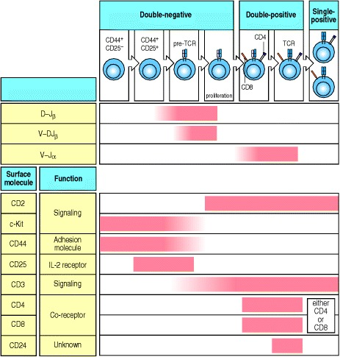
Distinguishing T cells at different stages of development
Figure 3. The correlation of stages of α:β T-cell development with T-cell receptor gene rearrangement and expression of cell-surface proteins

Slide 42
Distinguishing T cells at different stages of development
The in-frame β chain expressed by CD44^{low} CD25⁺ thymocytes then pairs with the surrogate pTα chain and is expressed on the cell surface, which triggers entry into the cell cycle.
Expression of pTα:β on the cell surface is associated with small amounts of CD3, and causes the loss of CD25, cessation of β-chain gene rearrangement, cell proliferation, and the expression of CD4 and CD8 (Remember that statement?).
After the cells cease proliferating and revert to small CD4⁺ CD8⁺ double-positive cells, they begin rearrangement at the α-chain locus.

Slide 43
Distinguishing T cells at different stages of development
The assembly of the CD3:pre-T-cell receptor complex leads to cell proliferation, the arrest of further β-chain gene rearrangements, and the expression of CD8 and CD4. These double-positive thymocytes comprise the vast majority of thymocytes.
Once the large double-positive thymocytes cease to proliferate and become small double-positive cells, the α-chain locus begins to rearrange.

Slide 44
Distinguishing T cells at different stages of development
The structure of the α locus allows multiple successive rearrangement attempts, so that a successful rearrangement at the α-chain locus is achieved in most developing thymocytes. Thus most double-positive cells produce an α:β T-cell receptor.
Small double-positive thymocytes initially express low levels of the T-cell receptor. Most of these cells bear receptors that cannot recognize self MHC molecules; they are destined to fail positive selection and die.

Slide 45
Positive and negative selection of T cells
Double-positive cells that recognise self MHC and can therefore undergo positive selection, go on to mature and express high levels of the T-cell receptor.
Concurrently, they cease to express one or other of the two co-receptor molecules, becoming either CD4 or CD8 single-positive thymocytes.
Thymocytes also undergo negative selection during and after the double-positive stage in development, which eliminates those cells capable of responding to self antigens.

Slide 46
Positive and negative selection of T cells
Approximately 2% of the double positives survive this dual screening and mature as single-positive T cells that are gradually exported from the thymus to form the peripheral T-cell repertoire.
The time between the entry of a T-cell progenitor into the thymus and the export of its mature progeny is estimated to be around 3 weeks in the mouse.
Positive selection "selects for" T cells capable of interacting with MHC.
Double-positive thymocytes (CD4⁺/CD8⁺) move deep into the thymic cortex, where they are presented with self-antigens.

Slide 47
Positive and negative selection of T cells
These self-antigens are expressed by thymic cortical epithelial cells on MHC molecules on the surface of cortical epithelial cells.
Only those thymocytes that interact with MHC-I or MHC-II appropriately (i.e., not too strongly or too weakly) will receive a vital "survival signal".
This process ensures that the selected T-cells will have an MHC affinity that can serve useful functions in the body (i.e., the cells must be able to interact with MHC and peptide complexes to effect immune responses).

Slide 48
Positive and negative selection of T cells
Negative selection removes thymocytes that are capable of strongly binding with "self" MHC peptides.

Slide 49
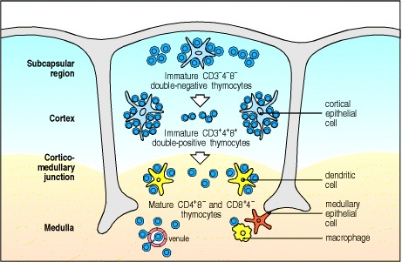
Location of thymocytes at different developmental stages in the thymus
The earliest cells (double-negative thymocytes) to enter the thymus are found in the subcapsular region of the cortex.
As these cells proliferate and mature into double-positive thymocytes, they migrate deeper into the thymic cortex.
Finally, the medulla contains only mature single-positive T cells, which eventually leave the thymus and enter the bloodstream.

Slide 50
End of lecture

