Slide 1
Major Histocompatibility molecules
Dr Samuel Munjita

Slide 2
Lecture objectives
At the conclusion of this activity, participants will be able to:
Explain the meaning of the origin, mechanisms of action and functions of MHC class I and II molecules
Differentiate MHC class I molecules from MHC class II molecules

Slide 3
Introduction
The major histocompatibility complex (MHC), is so named because of its participation in tissue compatibility or graft rejection.
Individuals identical for this region (MHC region) can exchange grafts more successfully than those with different MHC combinations.
A major role of the MHC is to bind small peptides and to present them to the cell surface where the antigen can be recognised by T cell receptors

Slide 4
Introduction
MHC proteins have the capacity to bind to several different peptides, which is necessary as there are a vast number of potential peptide targets, and only a limited number of MHC proteins.
Furthermore, the different peptides that an MHC protein can bind are often structurally different from one another.
This is an unusual property for a protein, and makes MHC molecules very different from other immune system proteins such as antibodies and T cell receptors, both of which show much greater specificity for their targets.

Slide 5
Introduction
MHC molecules are able to bind to such diverse peptides, because both the MHC binding pocket and the peptides are relatively flexible, the latter because of their small size.
In addition, water molecules can fill in the gaps between the MHC molecule and its peptide to improve its fit.

Slide 6
MHC molecules: a means of Antigen Processing
In humans, the MHC genes encode the human leukocyte antigens (HLAs) on the cell surface.
Proteins inside the cell are broken down into short fragments that can be displayed as peptide antigens by MHC molecules on the surface of the cell.
MHC molecules display both ‘self’ peptides derived from their own proteins, and foreign peptides derived from invading pathogens.

Slide 7
MHC molecules: a means of Antigen Processing
The immune system is constantly monitoring the surfaces of cells, and the MHC-presented peptides help immune cells to discriminate between normal antigens on the surface of all cells, and those that are foreign and potentially dangerous.
The immune system also monitors the amount of MHC-presented antigens, which helps them to target and destroy cancerous cells that often display increased amounts of self-antigens.
Defects in certain MHC genes lead to autoimmune disorders in which the body fails to recognize self-antigens, such as occurs in diseases like multiple sclerosis, inflammatory bowel disease, and in some forms of arthritis and diabetes.

Slide 8
Review: Activation of T cells
APCs ( e.g. Interdigitating DCs) capture Ag and migrate to the lymphoid tissue where they express higher MHC class II and co-stimulatory molecules such as B7.1 and B7.2.
T cell receptor binds MHC-peptide complex
B7-CD28 co-stimulation
cytokine release
NB: CD28 is a T cell receptor which binds B7 and stimulate release of cytokines

Slide 9
Classes of MHC molecules
There are two major classes of MHC molecules, both of which consist of an α and a β chain, but from different sources.
MHC class I molecules (MHC I) consist of one membrane-spanning α chain (heavy chain) produced by MHC genes, and one β chain (light chain or β2-microglobulin) produced by the b2-microglobulin gene.
MHC class II molecules (MHC II) consist of two membrane-spanning chains, α and β, of similar size and both produced by MHC genes.

Slide 10
Classes of MHC molecules
In each case, the MHC molecule has a groove that binds a peptide, which it can then present at the cell surface to a T cell to elicit an immune response.
Remember: T cells only recognise antigens as complexes with MHC molecules.
The two classes of MHC proteins differ not only in their structure, but more importantly in their functional roles within the immune system: the two types of MHC molecules are specialised to present different types of antigens, thereby eliciting different responses.

Slide 11
MHC class I
MHC I glycoproteins are present on almost every cell in the body, acting to present endogenous antigens that originate from the cytoplasm.
These antigens include not only self-proteins, but also foreign proteins produced within the cell, such as viral proteins that take over the cell’s machinery in order to replicate the virus.
When these proteins become degraded, the peptide fragments can be transported to the endoplasmic reticulum, where they can bind to MHC I proteins, before being transported via the Golgi apparatus to the cell surface.
Once at the cell surface, the membrane-bound MHC I protein displays the antigen for recognition by special immune cells known as cytotoxic T cell lymphocytes.

Slide 12
MHC class I
MHC I proteins work to present the types of proteins being synthesised within a cell, which can then be monitored by killer T cells as part of a surveillance system that identifies and destroys any cell with over-abundant or unfamiliar peptide antigens, such as malignant cells or those harbouring viruses.

Slide 13
MHC class II
MHC II glycoproteins are only present on specialised antigen-presenting immune cells, including macrophages that engulf foreign particles such as bacteria, dendritic cells that present antigen to T cells, and B cells that produce antibodies.
MHC II proteins present exogenous antigens that originate extracellularly from foreign bodies such as bacteria.
Upon encountering a pathogenic organism, proteins from the pathogen can be degraded into peptide fragments by the antigen-presenting cell, which then sequesters these fragments into the endosome so they can bind to MHC II proteins, before being transported to the cell surface.

Slide 14
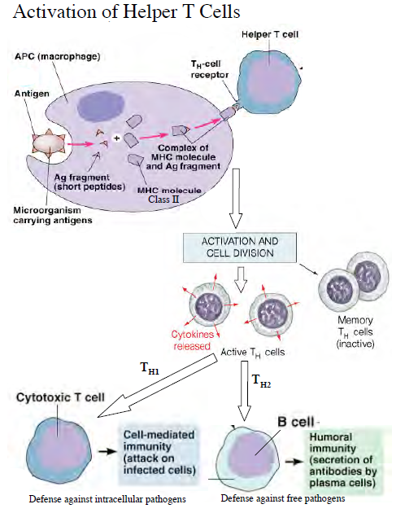

Slide 15
MHC class II
Once at the cell surface, the membrane-bound MHC II protein displays the antigen for recognition by a different type of T cell, namely the helper T cell lymphocyte.
These helper T cells are activated upon binding to macrophage or dendritic cell MHC II-antigen, causing the release of lymphokines that attract other cells to the area of infection in an attempt to confine and destroy the antigenic material.
In addition, the binding of helper T cells to B cell MHC II-antigen stimulates the development of a clone of antibody-producing cells against the antigenic material.

Slide 16
MHC I and MHC II: Comparison
MHC class I | MHC class II
Comprised of an MHC-encoded α chain and a β2-microglobulin chain | Comprised of MHC-encoded α and β chains
Present on most cells | Present only on antigen-presenting cells
Bind endogenous antigens synthesized in a cell | Binds exogenous antigens
Present antigen to cytotoxic T cell lymphocytes | Present antigen to helper T cell lymphocytes
Bind CD8 adhesion molecules on cytotoxic T cells | Bind CD4 adhesion molecules on helper T cells
Presence of foreign or over-abundant antigens targets cell for destruction | Presence of foreign antigens induces antibody production, and attracts immune cells to area of infection

Slide 17
End of Lecture

