Slide 1
The Adaptive Immune system
Features of adaptive immunity
Made up of the humoral immunity and cell mediated immunity
Response is slow(1-2 weeks) but this varies from one person to another
It is very specific
Not always present unless it is a second exposure to the same pathogen
Has memory - upon re-exposure to a pathogen, memory cells mount a much faster and more potent second response

Slide 3
Cells of the adaptive immune system
Lymphocytes and Lymphocyte Subpopulations. Several subpopulations of lymphocytes have been defined:
a. B lymphocytes : precursors of antibody-producing cells, known as plasma
cells.
b. T lymphocytes, or T-cells, which are further divided into several
subpopulations:
i. Helper T lymphocytes (TH) : play a very significant amplification role
in the immune responses. Two functionally distinct subpopulations of T helper
lymphocytes have been well defined :

Slide 4
a. TH1 lymphocytes: assist the differentiation of cytotoxic cells and also
activate macrophages. Activated macrophages play a role as
effectors of the immune response.
b. TH2 lymphocytes: involved in the amplification of B lymphocyte
responses. These amplifying effects of helper T lymphocytes are
mediated in part by soluble mediators interleukins—and in part
by signals delivered as a consequence of cell-cell contact.
ii. Cytotoxic T lymphocytes : which are the main immunological effector
mechanisms involved in the elimination of non-self or infected cells.
NB: T cells are more numerous in paracortical areas of lymph nodes. B cells are more numerous in germinal centers of lymph nodes

Slide 5
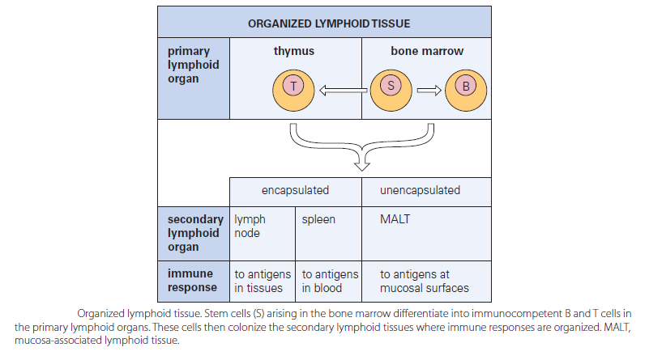

Slide 6
Lymphocytes and Lymphocyte Subpopulations Contd’
Lymphocytes:
-Originate from hematopoietic stem cells in red bone marrow. Immature
lymphocytes are identical when released from bone marrow
-Determination of which lymphocyte (B or T) depends on where in the body it
becomes immunocompetent (able to recognize a specific antigen by binding to it)
-T cells formed in the thymus (2-3 days) where the T cells are selected for their ability
to identify foreign antigens. There are two types of selections:
a. Negative selection – lymphocytes that strongly attack self-antigens are destroyed in
the thymic medulla
b. Positive selection – weakly anti-self lymphocytes continue to develop and the ones that can
best recognize self when attached to antigens are identified. This occurs in the thymic
cortex.

Slide 7
Cells of the adaptive immune system Contd’
2. Antigen-presenting cells(APCs)
Major types are: i. Dendritic cells (interstitial cells of connective tissues and
Langerhans’ cells of the skin epidermis),
ii. Macrophages, and activated B lymphocytes
Engulf particles and presents fragments of these antigens on their own surfaces where they can be recognized by T cells
APCs secrete proteins that activate T cells. In turn, activated T cells secrete chemicals (cytokines) that activate macrophages and increase DC maturation.
APCs and lymphocytes are found throughout the lymphatic system.
DCs are more numerous in germinal centers of lymph nodes

Slide 8
Other cells that play a role in adaptive immune system
Phagocytic and cytotoxic cells
-Such as monocytes, macrophages, and granulocytes, also play significant roles as effectors of the immune response.
-Once antibody has been secreted by plasma cells and is bound by the microbes, cells, or compounds that triggered the immune response, it is able to induce their ingestion by phagocytic cells. If bound to live cells, antibody may induce the attachment of cytotoxic T cells and NK cells that cause the death of the antibody-coated cell (antibody-dependent cellular cytotoxicity; ADCC).
-The ingestion of microorganisms or particles coated with antibody is enhanced when an amplification effector system known as complement is activated.
Natural killer (NK) cells
-play a dual role in the elimination of infected and malignant cells.
-They can participate in the elimination of antibody-coated cells by ADCC.

Slide 9
Branches of adaptive immunity
Humoral immunity or antibody-mediated immunity
-consists of antibodies circulating in the fluids of the body
- The antibodies are produced by B lymphocytes (B-cells)
- Works best against bacteria, toxins, and virus that are free in body fluids
Cellular or cell-mediated immunity
-Involves T cells that target infected tissue cells directly by lysing foreign cells
(cytotoxicity) or indirectly by releasing chemicals (cytokines) that enhance
the inflammatory response or activate other lymphocytes or macrophages.
-Works best on bacteria- or virus-infected cells, fungi, protozoa, tissue grafts
and cancer cells

Slide 10
Humoral immunity or antibody-mediated immunity
B cells produce antibodies = humoral /antibody-mediated immunity
Antibody (Ab) are special proteins produced by plasma cells (B cells) that will recognize and bind to its specific epitope of an antigen via its antigen binding sites
B cells arise from stem cells in bone marrow (primary lymphoid tissue). When mature, they migrate to secondary lymphoid tissue
They wait to recognize and bind to antigen in order to be stimulated to produce antibodies
Each B cells produces only one antibody against one antigen/epitope. It recognizes antigen/epitope via IgD receptor on its cell surface
when activated it will divide to produce clones (Clonal selection)

Slide 11
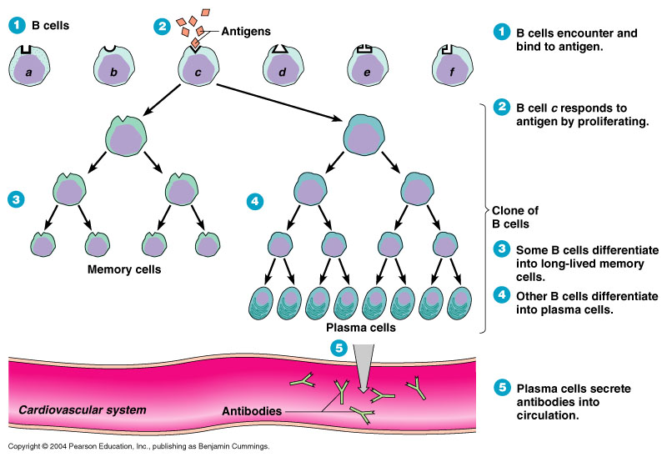
Activation and clonal selection of B cells

Slide 12
Summary of activation and clonal selection of B cells
IgD antibody receptor on B cell binds its specific antigen/epitope.
B cell is activated and undergoes clonal selection: the B cell proliferates and differentiate into two types of cell populations: Memory B cells and Plasma Cells
Plasma cells secrete antibodies specific for the original epitope (2000 antibody molecules
per second) for 3-5 days [Time from initial antigen binding to antibodies appearing in the
blood is 7-10 days] Antibodies bind to free antigens.
Upon second exposure to the same antigen/epitope, memory cells bind antigen and are
triggered to differentiate into plasma cells and secrete antibodies. [Time from initial
antigen binding to antibodies appearing in the blood is 2-5 days]
Memory cells = long term immunity

Slide 13
Primary response and secondary memory response
Primary Response:
Initial exposure to antigen results in IgM production. Peak titre of Abs is reached in 8-12 days but it is still low
Secondary/Memory Response:
Second and subsequent exposure results in IgG production. Peak titre is reached in 2-7 days. Much higher peak titre of antibodies

Slide 14
Results of Ag-Ab binding

Slide 15
Cellular or cell-mediated immunity
Requires coordinated activity of specialised cells (T-Cells or T lymphocytes) that must communicate through cytokines
T cells originate from stem cells in bone marrow but mature in thymus, travel to blood & lymph
T cells do not bind free antigen: the Ag must be on cell surface in association with molecules of the major histocompatibility complex (MHC)
Class I MHC is found on all cell types and displays all antigens that are present in a cell, both
self and non-self.
Class II MHC is found only on APCs and only displays antigens that have been endocytosed ( phagocytosed)

Slide 16
MHC class I molecules incorporate abnormal peptides within the cell (APCs). Then MHC class I proteins are transported to the cell membrane and abnormal pathogen peptides are displayed by MHC I on cell membrane
In the case of MHC class II proteins, the antigenic fragment of the phagocytised pathogen is displayed on the cell membrane

Slide 17
General activation of T cells (T-Lymphocytes)
Naïve T cells are activated in secondary lymphoid organs and involves 2 signals:
a. Specific recognition of Ags bound to MHC molecules
on surface of APCs such as DCs
b. Higher expression of co-stimulatory molecules and
MHC class II( remember, APCs are phagocytes) or MHC class I
NB: absence of co-stimulation leads to a state of non-responsiveness
in the cell termed, anergy

Slide 18
General activation of T-cells
APCs ( e.g. Interdigitating DCs) capture Ag and migrate to the lymphoid tissue where they express higher MHC class II and co-stimulatory molecules such as B7.1 and B7.2.
1. T cell receptoer binds MHC-peptide complex
2. B7-CD28 co-stimulation
3. cytokine release
NB: CD28 is a T cell receptor which binds B7 and stimulate release of cytokines

Slide 19
Expansion of T cells (T-lymphocytes)
-Each T-cell only recognizes one antigen. When it binds to antigen,
it undergoes clonal selection (expansion) to produce effector and
memory cells. Effector cells attack foreign cells or stimulate other
defence cells via cytokines such as Il-2.
-Synthesis of the cytokine, IL-2, activated by T cells, leads to
completion of the cycle and T-cell proliferation
Contraction (of T cells numbers)
-Occurs when no more Ag is presented to specific T cells.
-This stage is due to apoptosis. Cells that survive apoptosis form the
long lasting pool of memory cells.
-Memory cells exert a rapid and efficient response upon re-
exposure

Slide 20
Examples of Cytokines (factors)

Slide 21
Types of T cells (T-lymphocytes)
1. T_{H} (Helper T cells)/ CD4 T cells
-activated by antigen in Class II MHC
-respond by secreting cytokines to influence other immune cells
There are two subsets of T helper cells or CD4 T cells:
TH1: activate cells related to cell mediated immunity (cytotoxic T
cells and Macrophages)
B. TH2: activate B cells to make antibodies(T-dependent antigens)

Slide 22
Subsets of CD4 T cells
T Helper Cells 1 (T_{H1})
T Helper cells 2 (T_{H2})
Activate cells related to cell mediated immunity (cytotoxic T cells and Macrophages)
Produces cytokines such as TNF and IL-2
They are an important source of IFN-γ
Activation of IFN-γ requires T_{H1} cells expressing a surface molecule called CD40 ligand to bind macrophage receptor CD40
IFN-γ promotes T_{H1} production & in turn secrete more IFN-γ
Activate B cells to make Abs (T-dependent antigens)
Produces cytokines such as IL-4, IL10, IL13, & IL5
Helps with immunity against extracellular pathogens including helminths
TH2 cytokines promote defences including eosinophilia (IL-5), fibrosis (IL-13, IL-10), mucus secretion and smooth muscle contraction.

Slide 23
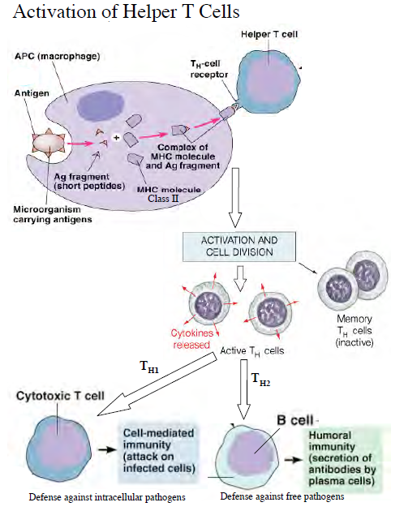

Slide 24
T_{C} (Cytotoxic T cells) / CD8 Cells
Activated by antigen in Class I MHC
respond by secreting perforin, granzymes (caspases) and lysing the target cell: this usually requires pre-activation of the T_{C} by cytokines produced by a T_{H1} cells
CD8 cells express a Fas ligand which binds a Fas receptor on the target cell membrane and activates caspases, which induce apoptosis
Vital in clearing viral infection
Play a role in controlling tumour cells
From the thymus, naïve cytotoxic cells can not lyse cells, they need activation
Can secrete IFN-γ, which promotes antiviral environment by activating macrophages
Also secrete TNF, which promotes inflammation

Slide 25
Activation of cytotoxic T cells (CD8 T cells)

