Slide 1
DNA Replication and Fidelity of Replication
Dr. Samuel Munjita
Department of Biomedical Sciences
School of Health Sciences
The University of Zambia

Slide 2
Objectives
At the end of this lecture, the student should be able to:
  1. Explain the structure of DNA
  2. Define Replication, Replication fork, and Replisome
  3. Explain the general process of DNA replication
  4. Describe the process and principle of Meselson-Stahl experiment
  5. Explain the functions of enzymes involved in replication

Slide 3
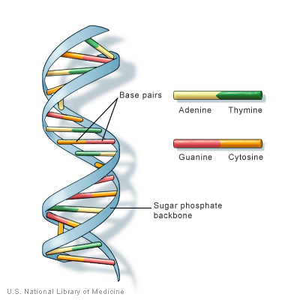
Review: DNA Structure
DNA bases pair up with each other, A with T and C with G, to form units called base pairs.
Each base is also attached to a sugar molecule and a phosphate molecule.
Together, a base, sugar, and phosphate are called a nucleotide.
Nucleotides are arranged in two long strands that form a spiral called a double helix.

Slide 4
Review: DNA Structure
The phosphodiester bonds (one of which is shaded in the DNA) link successive nucleotide units.
The 5’-phosphate group of one nucleotide is joined to the 3’-hydroxyl group of the next nucleating creating a phosphodiester linkage

Slide 5
What is DNA Replication
DNA replication is the synthesis of a DNA strand complementary to the original template strand. In other words, it is the copying of a cell's DNA.
The process of replication involves multiple enzymes.
To synthesize DNA, the double-stranded DNA is unwound/separated by DNA helicases forming a replication fork region.T his is so named Because of its Y-shaped structure
DNA polymerases are responsible for adding new nucleotides to form new DNA strands. They use each separated single strand as a template for the synthesis of a new double strand.
The basic mechanisms of DNA replication are similar across organisms.

Slide 6
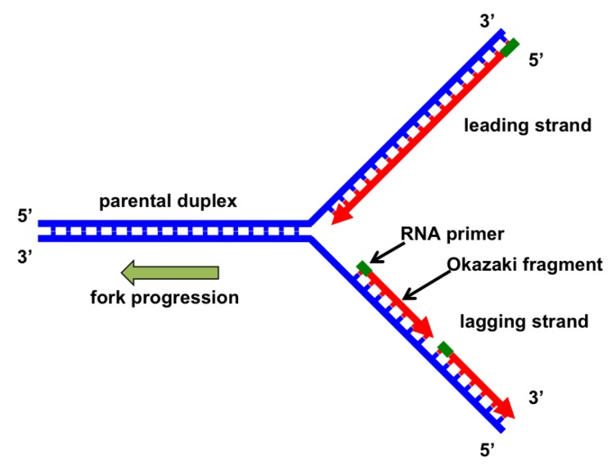
What is DNA Replication: Replication fork
To synthesize DNA, the double-stranded DNA is unwound by DNA helicases ahead of polymerases, forming a replication fork containing two single-stranded templates.
This fork-like DNA structure, where the DNA helix is open or unwound, exposes unpaired DNA nucleotides for recognition and base pairing for the incorporation of free nucleotides into double-stranded DNA
Replication occurs in the 5’ to 3’ direction

Slide 7
What is DNA Replication
The major enzymatic functions carried out at the replication fork are well conserved from prokaryotes to eukaryotes.
The replication machinery is a massive complex coordinating many proteins all working at the site of replication, forming the “replisome”. The replisome is responsible for copying the entirety of genomic DNA in each proliferative cell.
This process allows for the high-fidelity passage of hereditary/genetic information from parental cell to daughter cell and is thus essential to all organisms.
Much of the cell cycle is built around ensuring that DNA replication occurs without errors.

Slide 8
The Semi-conservative nurture of DNA Replication
DNA replication is semi-conservative because two strands of DNA unwind from each other, and each acts as a template for synthesis of a new, complementary strand.
This results in two DNA molecules with one original strand and one new, meaning that each strand in the DNA double helix acts as a template for the synthesis of a new, complementary strand.
Other methods of replication such as conservative and dispersive replication have not been proven and were ruled out. But how was it done?

Slide 9
The Semi-conservative nurture of DNA Replication
The Meselson-Stahl experiment
Meselson and Stahl conducted their experiments on DNA replication using E. coli bacteria as a model system. They grew E. coli in medium, or nutrient broth, containing a "heavy" isotope of nitrogen (¹⁵N), the bacteria took up the nitrogen and used it to synthesize new biological molecules, including DNA.
After many generations growing in the ¹⁵N medium, the nitrogenous bases of the bacteria's DNA were all labeled with heavy ¹⁵N. Then, the bacteria were switched to medium containing a "light" ¹⁴N isotope and allowed to grow for several generations.
Meselson and Stahl knew how often E. coli cells divided, so they were able to collect small samples in each generation and extract and purify the DNA. They then measured the density of the DNA (and, indirectly, its ¹⁵N and ¹⁴N content) using density gradient centrifugation.

Slide 10
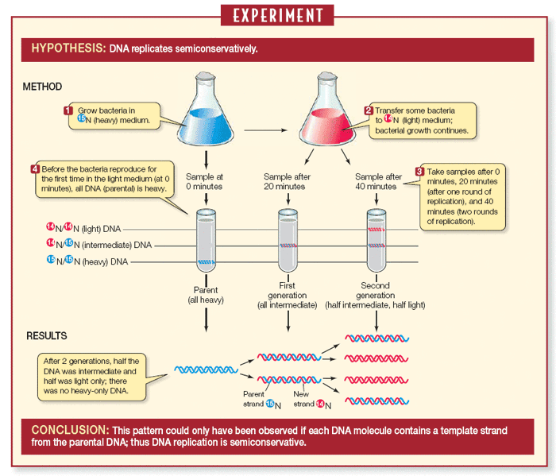
The Semi-conservative nurture of DNA Replication
The Meselson-Stahl experiment
Adapted from: David Savada/www.nature.com

Slide 11
The Semi-conservative nurture of DNA Replication
The Meselson-Stahl experiment
A centrifuge was used to separate DNA molecules labeled with isotopes of different densities.
This experiment revealed a pattern that supports the semi-conservative model of DNA replication.
FURTHER RESEARCH: If you continued this experiment for two more generations (as Meselson and Stahl actually did), what would be the composition (in terms of low- and intermediate-density) of the fourth generation DNA?

Slide 12
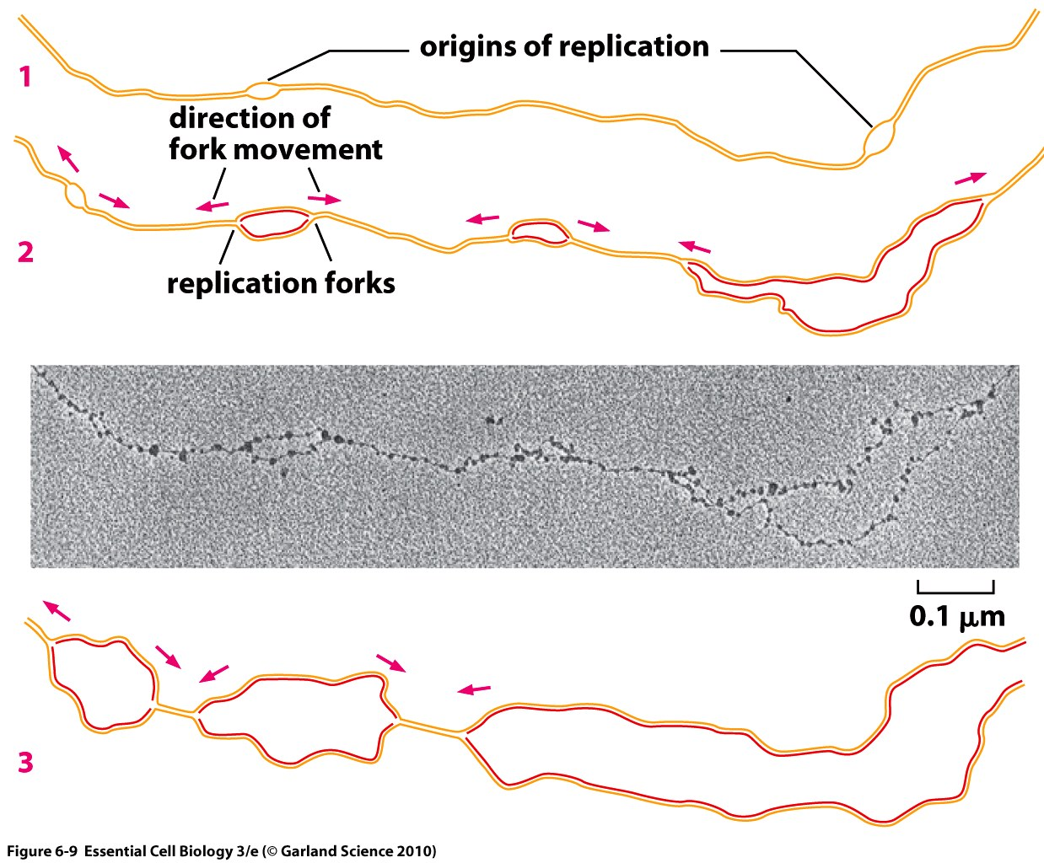
Molecular Mechanisms of DNA Replication in prokaryotes
Replication begins at specific location (s) on the DNA.
This location (s) is referred to as origin of replication and can be recognised by their sequence.
E. coli, a prokaryotic organism, like most bacteria, has a single origin of replication on its “chromosome”.
The origin is about 245 base pairs long and has mostly A/T base pairs

Slide 13
Molecular Mechanisms of DNA Replication in prokaryotes
Helicase is the first replication enzyme to load on at the origin of replication.
Helicase's job is to move the replication forks forward by "unwinding" the DNA.
As the DNA opens, two Y-shaped structures called replication forks are formed, together making up what's called a replication bubble. The replication forks will move in opposite directions as replication proceeds.
Proteins called single-strand binding proteins coat the separated strands of DNA near the replication fork, keeping them from coming back together into a double helix or preventing other transactions at the exposed ssDNA.

Slide 14
Molecular Mechanisms of DNA Replication in prokaryotes
The base pairing and chain formation reactions, which form the daughter helix, are catalyzed by DNA polymerases.
Owing to the anti-parallel nature of duplex DNA, DNA replication occurs in opposite directions between the two new strands at the replication fork in the 5' to 3' direction.
DNA polymerase III can only add nucleotides to the 3' end of an existing DNA strand. They use the free -OH group found at the 3' end.
In this reaction, a pyrophosphate is released from the free dNTP, generating energy for the polymerization reaction and exposing the 5' monophosphate, which is then covalently bonded to the 3' oxygen

Slide 15
Molecular Mechanisms of DNA Replication in prokaryotes
Where do the nucleotides come from? Activated free deoxyribonucleotides or nucleobases exist in the cell as deoxyribonucleotide triphosphates (dNTPs).
How, then, does DNA polymerase III add the first nucleotide at a new replication fork?
DNA polymerase does not do it alone, it needs the help of an enzyme called primase. Primase makes an RNA primer, or short stretch of nucleic acid complementary to the template, that provides a 3' end for DNA polymerase to work on. A typical primer is about five to ten nucleotides long.
Once the RNA primer is in place, DNA polymerase "extends" it, adding nucleotides one by one to make a new DNA strand that's complementary to the template strand

Slide 16
Molecular Mechanisms of DNA Replication in prokaryotes
RNA primers are removed and replaced with DNA by DNA polymerase I.

Slide 17
Molecular Mechanisms of DNA Replication in prokaryotes
Leading and Lagging strands, how does it happen
In E. coli, the DNA polymerase III handles most of the synthesis is DNA polymerase III.
There are two molecules of DNA polymerase III at a replication fork, each of them hard at work on one of the two new DNA strands.
DNA polymerases can only make DNA in the 5' to 3' direction, and this poses a problem during replication.
A DNA double helix is always anti-parallel; in other words, one strand runs in the 5' to 3' direction, while the other runs in the 3' to 5' direction.
This makes it necessary for the two new strands, which are also antiparallel to their templates, to be made in slightly different ways.

Slide 18
Molecular Mechanisms of DNA Replication in prokaryotes
Leading and Lagging strands, how does it happen
The new strand, which runs 5' to 3' towards the replication fork, is the easy one. This strand is made continuously, because the DNA polymerase is moving in the same direction as the replication fork. This continuously synthesized strand is called the leading strand.
The other new strand, which runs 5' to 3' away from the fork, is trickier. This strand is made in fragments because, as the fork moves forward, the DNA polymerase (which is moving away from the fork) must come off and reattach on the newly exposed DNA. This tricky strand, which is made in fragments, is called the lagging strand.
The small fragments are called Okazaki fragments, named for the Japanese scientist who discovered them. The leading strand can be extended from one primer alone, whereas the lagging strand needs a new primer for each of the short Okazaki fragments.

Slide 19
Molecular Mechanisms of DNA Replication in prokaryotes
Other proteins involved in DNA replication
Sliding clamp: holds DNA polymerase III molecules in place as they synthesize DNA. The sliding clamp is a ring-shaped protein and keeps the DNA polymerase of the lagging strand from floating off when it re-starts at a new Okazaki fragment.
Topoisomerase I and II: plays an important maintenance role during DNA replication. This enzyme prevents the DNA double helix ahead of the replication fork from getting too tightly wound as the DNA is opened up. It acts by making temporary nicks in the helix to release the tension, then sealing the nicks to avoid permanent damage.
The nicks that remain after the primers are replaced get sealed by the enzyme DNA ligase.

Slide 20
Molecular Mechanisms of DNA Replication in Eukaryotes
In eukaryotes, the vast majority of DNA synthesis occurs during S phase of the cell cycle, and the entire genome must be unwound and duplicated to form two daughter copies.
During G₂, any damaged DNA or replication errors are corrected.
Finally, one copy of the genomes is segregated to each daughter cell at Mitosis or M phase. These daughter copies each contain one strand from the parental duplex DNA and one nascent antiparallel strand.

Slide 21
Molecular Mechanisms of DNA Replication in Eukaryotes
The basics of DNA replication are similar between bacteria and eukaryotes but some differences exist.
The similarities between prokaryotic and eukaryotic replication:
  Both are bi-directional processes
  DNA polymerases work 5’ to 3’
  Leading and lagging strands
  Primers are required

Slide 22
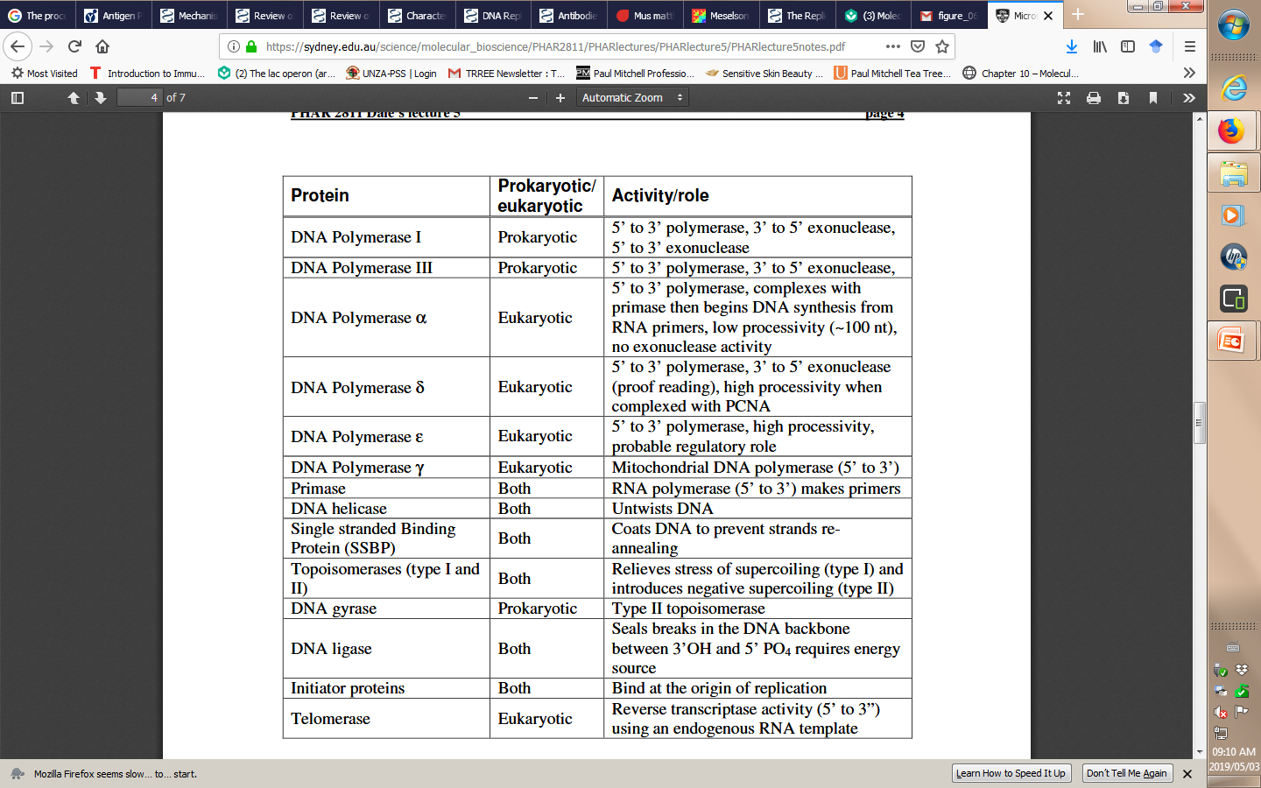
Molecular Mechanisms of DNA Replication in Eukaryotes
Summary of Proteins associated with DNA Replication in both Prokaryotes and Eukaryotes

