Slide 1
Gene Expression
Samuel Munjita

Slide 2
Lecture aims
At the end of this lecture, each student should be able to:
Explain gene expression and list the steps involved
Define and explain the mechanisms/processes of Transcription in prokaryotes and eukaryotes
Define and explain the mechanisms/processes of Translation in prokaryotes and eukaryotes

Slide 3
Gene expression
Gene expression is the phenotypic manifestation of a gene or genes by the processes of genetic transcription and genetic translation.
When genes are expressed, the genetic information (base sequence) on DNA is first copied to a molecule of mRNA (transcription). The mRNA molecules then leave the cell nucleus and enter the cytoplasm, where they participate in protein synthesis by specifying the particular amino acids that make up individual proteins (translation).
Information flow in gene expression is one way - from genes to proteins. This is the Central Dogma of Molecular Biology

Slide 4
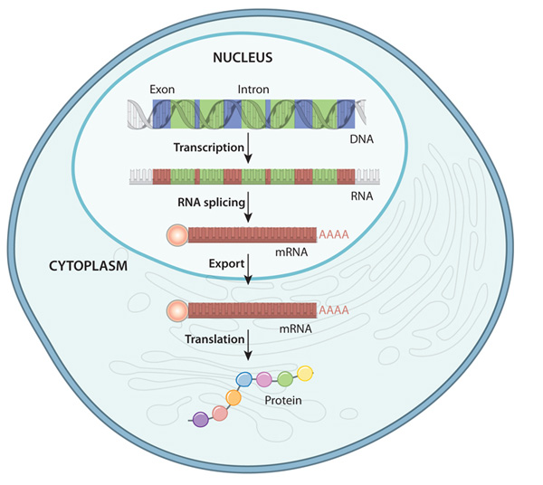
Gene expression
First, both coding and noncoding regions of DNA are transcribed into mRNA.
Some regions are removed (introns) during initial mRNA processing.
The remaining exons are then spliced together, and the spliced mRNA molecule (red) is prepared for export out of the nucleus through addition of an endcap (sphere) and a polyA tail. This for stability and translation
Once in the cytoplasm, the mRNA can be used to construct a protein.
NB: mRNA splicing only occurs in Eukaryotes

Slide 5
Transcription
Transcription is the first step in gene expression
The goal of transcription is to use information from a gene to make a RNA copy of a gene's DNA sequence.
For a protein-coding gene, the RNA copy, or transcript, carries the information needed to build a polypeptide (protein or protein subunit).
The main enzyme involved in transcription is RNA polymerase, which uses a single-stranded DNA template to synthesise a complementary strand of RNA.
Specifically, RNA polymerase builds an RNA strand in the 5' to 3' direction, adding each new nucleotide to the 3' end of the strand.

Slide 6
Stages of Transcription
Transcription has three stages: initiation, elongation, and termination
Initiation: RNA polymerase binds to a sequence of DNA called the promoter, found near the beginning of a gene. Each gene has its own promoter. Once bound, RNA polymerase separates the DNA strands, providing the single-stranded template needed to synthesise a strand of RNA
Elongation: One strand of DNA, the template strand, acts as a template for RNA polymerase. The polymerase builds an RNA molecule out of complementary nucleotides, making a chain that grows from 5' to 3'. The RNA transcript carries the same information as the non-template (coding) strand of DNA, but it contains the base uracil (U) instead of thymine (T).

Slide 7
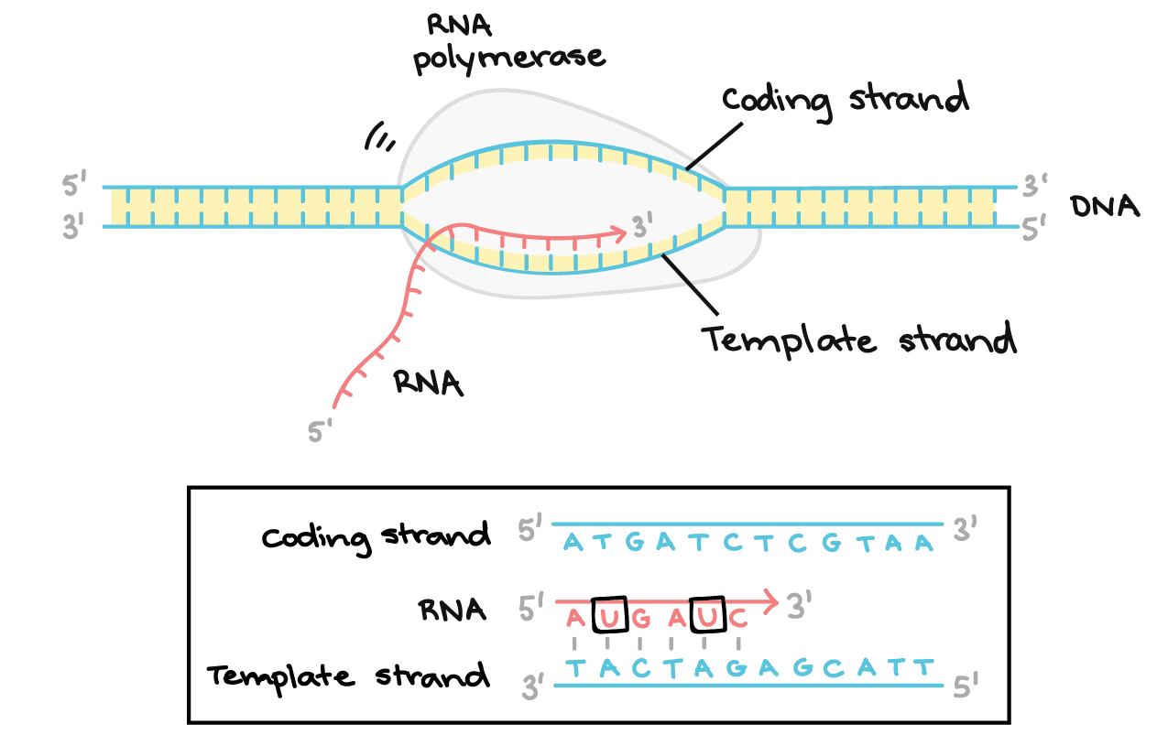
Stages of Transcription
Elongation

Slide 8
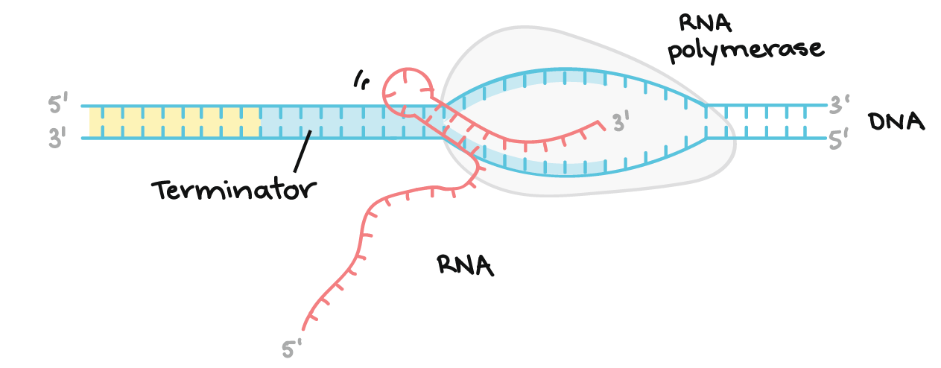
Stages of Transcription
Termination. Sequences called terminators signal that the RNA transcript is complete. Once they are transcribed, they cause the transcript to be released from the RNA polymerase. An example of a termination mechanism involving formation of a hairpin

Slide 9
Stages of Transcription
In bacteria, RNA transcripts can act as messenger RNAs (mRNAs) right away.
In eukaryotes, the transcript of a protein-coding gene is called a pre-mRNA and must go through extra processing before it can direct translation.
Eukaryotic pre-mRNAs must have their ends modified, by addition of a 5' cap (at the beginning) and 3' poly-A tail (at the end).
Many eukaryotic pre-mRNAs undergo splicing. In this process, parts of the pre-mRNA (called introns) are chopped out, and the remaining pieces (called exons) are stuck back together.

Slide 10
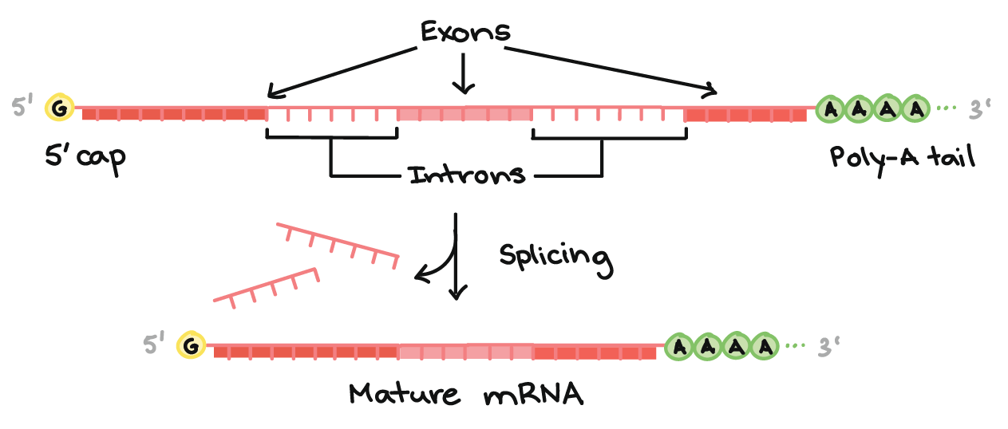
Stages of Transcription
Modification of the mRNA transcript in eukaryotes

Slide 11
Translation
In this stage, the mRNA is "decoded" to build a protein that contains a specific series of amino acids.
During translation, a cell “reads” the information in a messenger RNA (mRNA) and uses it to build a protein.
In an mRNA, the instructions for building a polypeptide are RNA nucleotides (A, U, C, and G) read in groups of three. These groups of three are called codons.
There are 61 codons for amino acids, and each of them is "read" to specify a certain amino acid out of the 20 commonly found in proteins.
One codon, AUG, specifies the amino acid methionine and also acts as a start codon to signal the start of protein construction.

Slide 12
Translation
There are three more codons that do not specify amino acids. These stop codons, UAA, UAG, and UGA, tell the cell when a polypeptide is complete.
All together, this collection of codon-amino acid relationships is called the genetic code, because it lets cells “decode” an mRNA into a chain of amino acids.

Slide 13
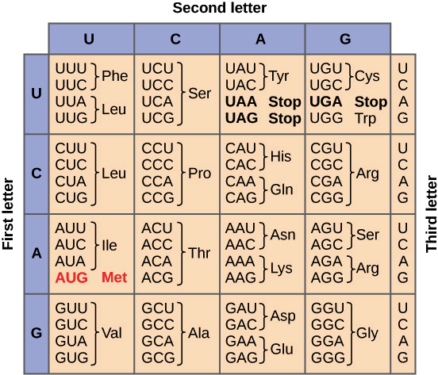
Translation

Slide 14
Stages of Translation
In translation, the codons of an mRNA are read in order (from the 5' end to the 3' end) by molecules called transfer RNAs, or tRNAs.
Each tRNA has an anticodon, a set of three nucleotides that binds to a matching mRNA codon through base pairing. The other end of the tRNA carries the amino acid that's specified by the codon.
tRNAs bind to mRNAs inside of a protein-and-RNA structure called the ribosome. As tRNAs enter slots in the ribosome and bind to codons, their amino acids are linked to the growing polypeptide chain in a chemical reaction. The end result is a polypeptide whose amino acid sequence mirrors the sequence of codons in the mRNA.

Slide 15
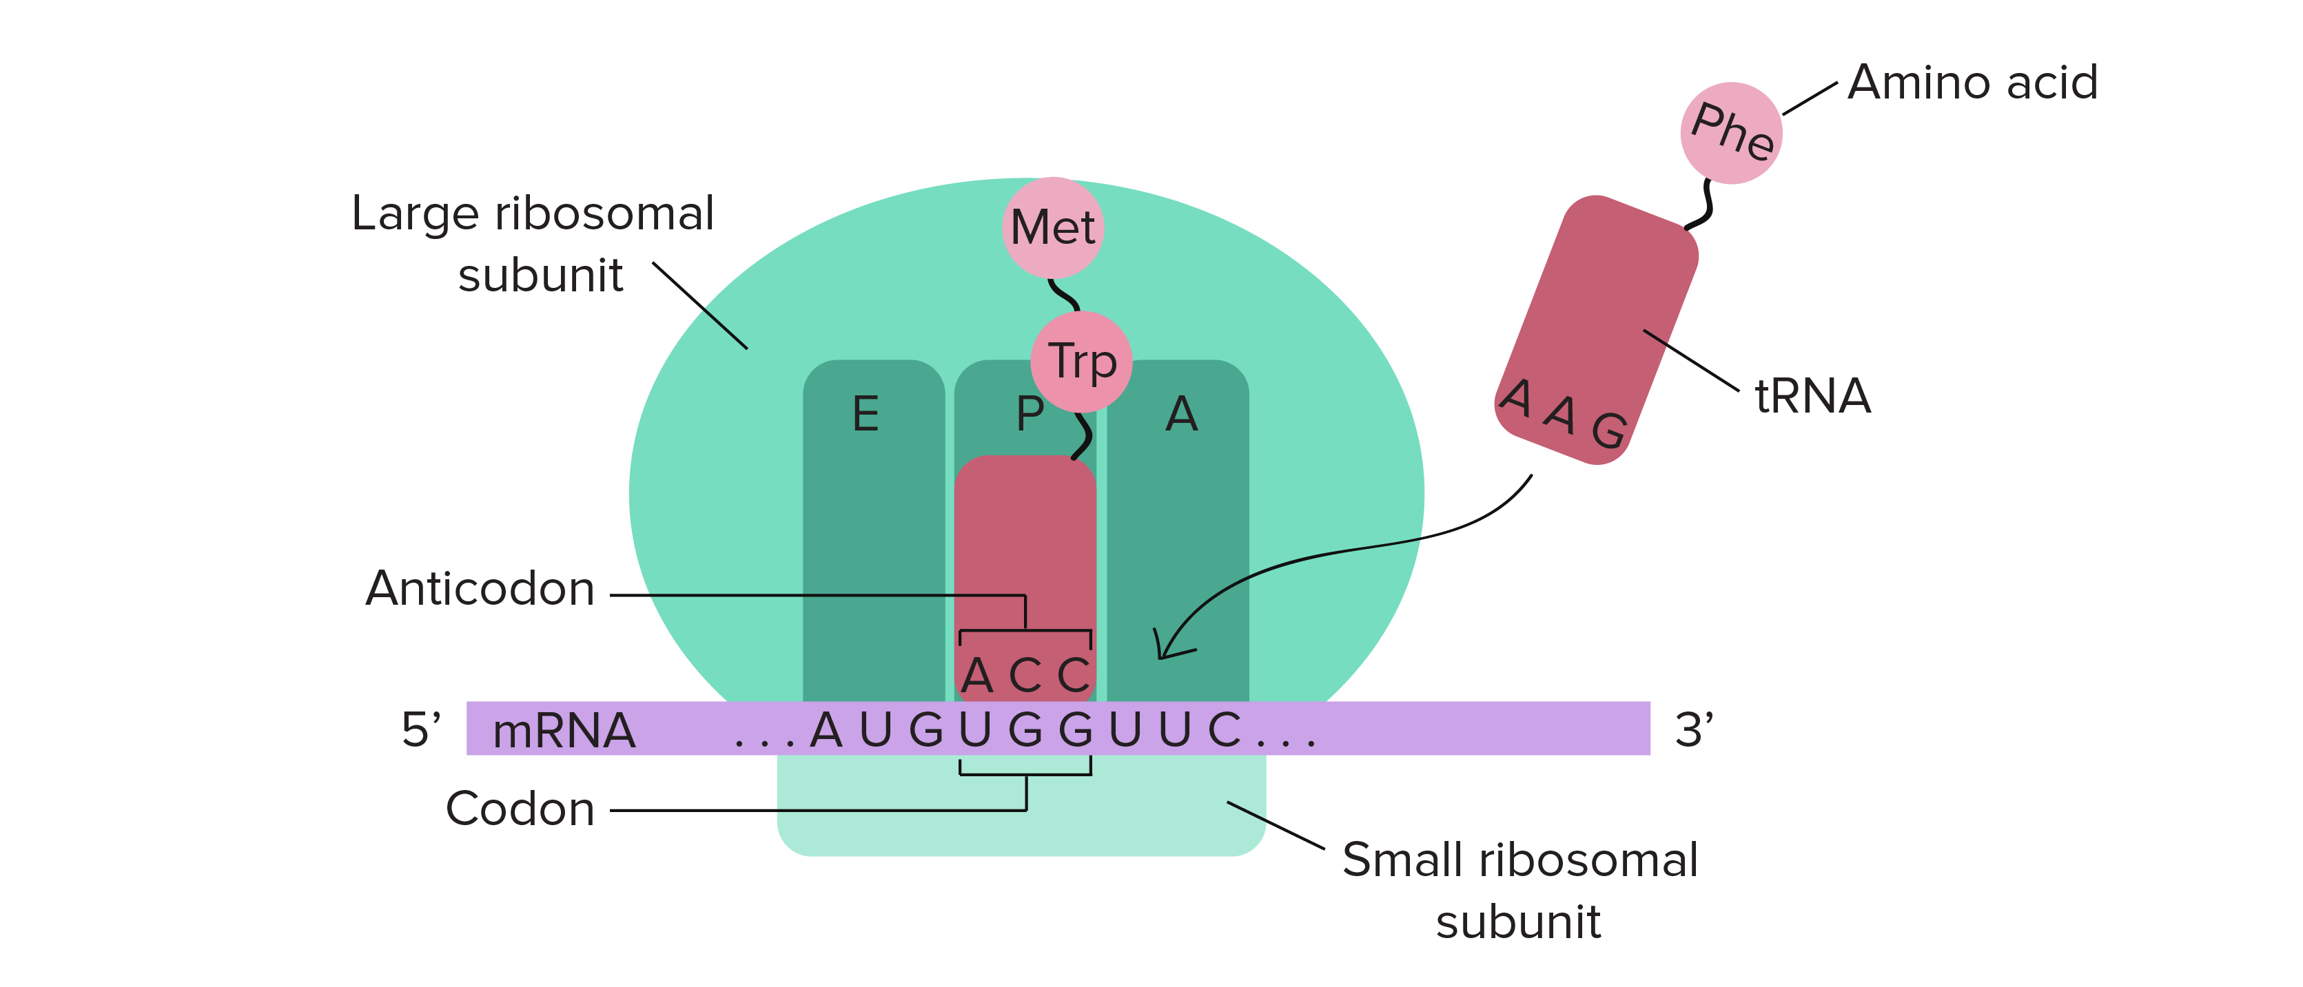
Stages of Translation

Slide 16
Stages of Translation
Initiation
Elongation
Termination

Slide 17
Stages of Translation: Initiation
In order for translation to start, we need a few key ingredients. These include:
A ribosome (which comes in two pieces, large and small)
An mRNA with instructions for the protein we'll build
An "initiator" tRNA carrying the first amino acid in the protein, which is almost always methionine (Met)
During initiation, these pieces must come together in just the right way. Together, they form the initiation complex, the molecular setup needed to start making a new protein.

Slide 18
Stages of Translation: Initiation
Inside your cells (and the cells of other eukaryotes), translation initiation goes like this:
First, the tRNA carrying methionine attaches to the small ribosomal subunit.
Together, they bind to the 5' end of the mRNA by recognizing the 5' GTP cap (added during processing in the nucleus).
Then, they "walk" along the mRNA in the 3' direction, stopping when they reach the start codon (often, but not always, the first AUG).

Slide 19
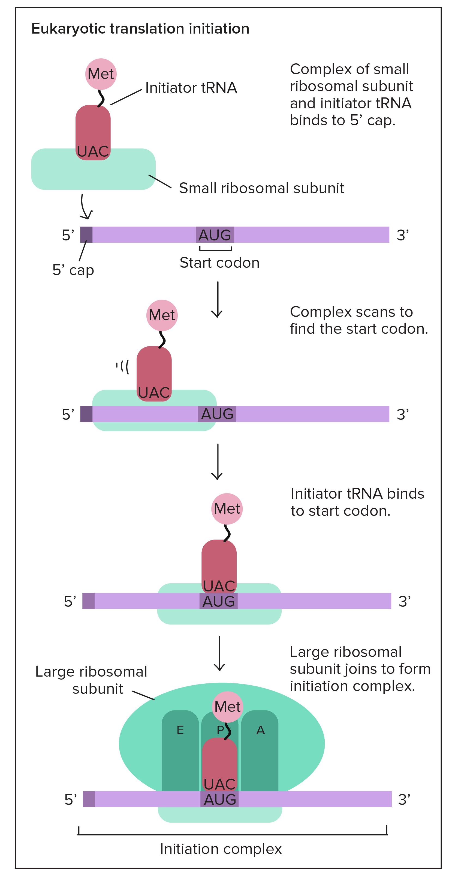

Slide 20
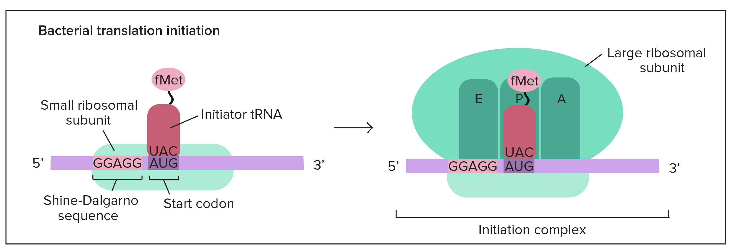
Stages of Translation: Initiation
In bacteria, the situation is a little different.
Here, the small ribosomal subunit doesn't start at the 5' end of the mRNA and travel toward the 3' end.
Instead, it attaches directly to certain sequences in the mRNA. These Shine-Dalgarno sequences come just before start codons and "point them out" to the ribosome.

Slide 21
Stages of Translation: Initiation
Why use Shine-Dalgarno sequences?
Bacterial genes are often transcribed in groups (called operons), so one bacterial mRNA can contain the coding sequences for several genes.
A Shine-Dalgarno sequence marks the start of each coding sequence, letting the ribosome find the right start codon for each gene.

Slide 22
Stages of Translation: Elongation
Our first, methionine-carrying tRNA starts out in the middle slot of the ribosome, called the P site.
Next to it, a fresh codon is exposed in another slot, called the A site.
The A site will be the "landing site" for the next tRNA, one whose anticodon is a perfect (complementary) match for the exposed codon.

Slide 23
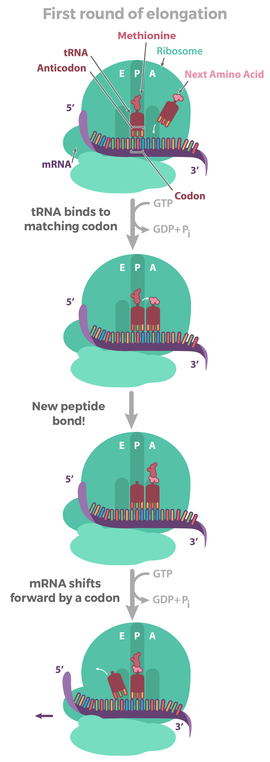
Stages of Translation: Elongation

Slide 24
Stages of Translation: Elongation
Once the matching tRNA has landed in the A site, it's time for the action:
that is, the formation of the peptide bond that connects one amino acid to another. This step transfers the methionine from the first tRNA onto the amino acid of the second tRNA in the A site.
We now have two amino acids, a (very tiny) polypeptide! The methionine forms the N-terminus of the polypeptide, and the other amino acid is the C-terminus.

Slide 25
Stages of Translation: Elongation
Once the peptide bond is formed, the mRNA is pulled onward through the ribosome by exactly one codon.
This shift allows the first, empty tRNA to drift out via the E ("exit") site. It also exposes a new codon in the A site, so the whole cycle can repeat.

Slide 26
Stages of Translation: Termination
Polypeptides, like all good things, must eventually come to an end. Translation ends in a process called termination. Termination happens when a stop codon in the mRNA (UAA, UAG, or UGA) enters the A site.
Stop codons are recognized by proteins called release factors, which fit neatly into the P site (though they aren't tRNAs). Release factors mess with the enzyme that normally forms peptide bonds: they make it add a water molecule to the last amino acid of the chain. This reaction separates the chain from the tRNA, and the newly made protein is released.

