Slide 1
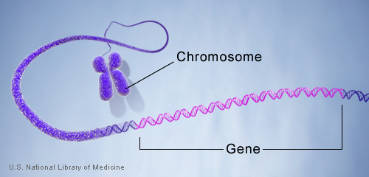
Introduction to Molecular Biology
Dr Samuel Munjita

Slide 2
Introduction and Lesson Objectives
Welcome to the second component of the 3rd year course Molecular Biology and Genetics. In this component, we shall focus on the field of Molecular Biology.
Some of you already know some aspects of this course and others will be meeting this type of science for the first time. Do not worry, take a chill pill, we shall soon be on the same page of knowledge.
At the end of this lecture, it is expected that you will be able to do the following:
Define the terms Molecular Biology
Explain the applications of molecular biology in today’s world
Identify the molecules at the centre of Molecular Biology
Explain the basic pathway involving genes all the way to protein formation

Slide 3
What is Molecular biology?
We need to understand what this specialised field is all about. Here is the definition modified from the journal Nature:
“Molecular Biology is the field of biology that studies the composition, structure and interactions of molecules  such as nucleic acids and proteins, and the biochemical process involved within a cell”
Some consider molecular biology as a specialised component of biochemistry. What do you think?
Molecular biology is separated from the field of cell biology, which concentrates on cellular structures (organelles and other cell structures), molecular pathways within cells, and cell life cycles.

Slide 4
Applications of Molecular Biology
Now that you know the definition of Molecular Biology, you must now think about the application of this field of science to life today.
Hmmm. If someone wanted to prove their paternity of their children, What technique would they use? Is that technique a component of Molecular Biology? How about investigating a crime scene, would some aspects of Molecular Biology be applied?
Take some moment to think. Thereafter, write down your answers or discuss your thoughts with your fellow students.
Lets now compare your answers to what the notes say.

Slide 5
Applications of Molecular Biology
Cellular Analysis: this is useful for Investigating cellular activities such as protein expression (production, modification and regulation) and protein functional interactions using assays such as Yeast Hybrid screens.
Recombinant DNA technology: this involves the joining together of DNA molecules from different organisms and inserting it into a host organism to produce new genetic combinations that are of value to science, medicine, agriculture, and industry. At the core of Recombinant DNA technology is Cloning. We shall discuss cloning in future lectures.
DNA Amplification: this involves the copying and amplification of genes or genetic regions of interest using a variety of molecular biology techniques such as the polymerise chain reaction (PCR) and isothermal amplification.

Slide 6
Applications of Molecular Biology
Epigenetics: this is the study of changes in an organism caused by modification of gene expression (Remember gene expression?) rather than alteration of the underlying gene sequences. Confused? Well, we are talking about changes in the phenotype without changes to the genotype.
Genome Editing: this is enabled by tools that make precise, targeted changes to the genome (remember to review what a genome is) of living cells to manipulate gene function. Some genetic material can be removed or added.
Sequencing: determining the nucleotide sequences of a gene of an organism. It can be partial or complete determination of the sequences and their order of arrangement

Slide 7
Applications of Molecular Biology
Molecular biology is also applied in the following fields
Agricultural systems: to produce high yielding plants or plant resistant to diseases or droughts
Paternity testing : to determine relations (who is the father or mother?)
Biomedical Sciences: to detect pathogens, confirmatory diagnosis of infectious agents through PCR and other related techniques
Forensic investigations: All of today's forensic genetic methods used to investigate people involved in a crime are based on PCR. Read more about crime scene genetics here :https://academic.oup.com/bioscience/article/58/6/484/235866

Slide 8
The Core of Molecular Biology
The field of molecular biology is based on the following molecules:
  Chromosomes
  DNA
  RNA
  Genes
  Alleles
We shall learn about each of these molecules in the next few slides.
Take time to fully understand these molecules, their relationship, and roles in cellular activities at a molecular level.

Slide 9
The Core of Molecular Biology
Genes
Lets talk about a gene. In the genetics component, you learnt more about genes. Now, take a few minutes to recall the definition of a gene…………... Alright here is the definition.
A gene is the basic physical and functional unit of heredity. It consists of a specific sequence of nucleotides at a given position on a given chromosome ( consist of tightly coiled DNA) that that carries the instructions (codes) needed to assemble a specific protein(or, in some cases, an RNA molecule).
A gene has 'start‘ (beginning point) and 'stop‘ (ending point) codons and other regulatory elements that specifies a sequence of amino acids that are linked together to form a protein.

Slide 10
The Core of Molecular Biology
Genes
In us humans, genes vary in size from a few hundred DNA bases to more than 2 million bases.
The Human Genome Project has estimated that humans have between 20,000 and 25,000 genes located on 46 chromosomes (23 pairs). These genes are known, collectively, as the human genome.
Every person, including you, has two copies of each gene, one inherited from each parent.
Most genes are the same in us humans, but a small number of genes (less than 1 percent of the total) are slightly different between people.

Slide 11
The Core of Molecular Biology
An allele is a variant form of a gene.
Some genes have a variety of different forms, which are located at the same position, or genetic locus, on a chromosome.
Humans are called diploid organisms because they have two alleles at each genetic locus, with one allele inherited from each parent.
Each pair of alleles represents the genotype of a specific gene.
Genotypes are described as homozygous if there are two identical alleles at a particular locus and as heterozygous if the two alleles differ.
Alleles contribute to the organism's phenotype, which is the outward appearance of the organism.
Some alleles are dominant or recessive. When an organism is heterozygous at a specific locus and carries one dominant and one recessive allele, the organism will express the dominant phenotype.
Alleles can also refer to minor DNA sequence variations between alleles that do not necessarily influence the gene's phenotype.

Slide 12
The Core of Molecular Biology

Slide 13
The Core of Molecular Biology
Deoxyribonucleic acid (DNA)
This is the molecule that carries the genetic information in all cellular forms of life and some viruses. Name any virus that has DNA as its genetic material.
It belongs to a class of molecules called the nucleic acids, which are polynucleotides - that is, long chains of nucleotides.
What are nucleotides? Take a moment to think and write down your answer
Nucleotides are building blocks of nucleic acids. They consists of three components:
  Four nitrogenous bases: cytosine (C), guanine (G), adenine (A) or thymine (T)
  A five-carbon sugar molecule (deoxyribose in the case of DNA)
  A phosphate molecule

Slide 14
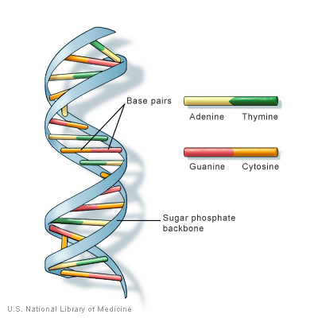
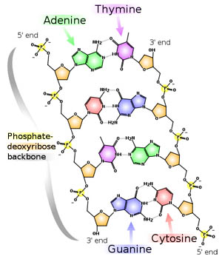
DNA is a double helix formed by base pairs attached to a sugar-phosphate backbone.
Can you see the nitrogenous bases and their pairing? Look out for the phosphate backbone too. Pairing of bases: A with T and C with G, to form units called base pairs

Slide 15
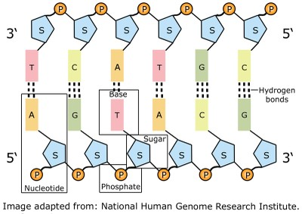
The Core of Molecular Biology
DNA
Can you see the five carbon sugar (painted blue)? Pause and count the carbons.
Look at he Base pairing and hydrogen bonding
As mentioned in the previous slide, the phosphate (P), five carbon sugar (S), and the nitrogenous base (A,T,G,C) form a nucleotide

Slide 16
The Core of Molecular Biology
Deoxyribonucleic acid (DNA)
As you observed in the previous two slides, the backbone of the polynucleotide is a chain of sugar and phosphate molecules. Each of the sugar groups in this sugar-phosphate backbone is linked to one of the four nitrogenous bases (Mention the four nitrogenous bases). Together, a base, sugar, and phosphate are called a nucleotide.
You may wish to know that most DNA is located in the cell nucleus (where it is called nuclear DNA), but a small amount of DNA can also be found in the mitochondria (where it is called mitochondrial DNA or mtDNA).
Human DNA consists of about 3 billion nitrogenous bases, and more than 99 percent of those bases are the same in all people.

Slide 17

The Core of Molecular Biology
DNA
The nucleotides in DNA are arranged in two long strands that form a spiral called a double helix.
The structure of the double helix is somewhat like a ladder, with the base pairs forming the ladder’s rungs and the sugar and phosphate molecules forming the vertical sidepieces of the ladder.
I am confident that you have seen a ladder before
An important property of DNA is that it can replicate, or make copies of itself.

Slide 18
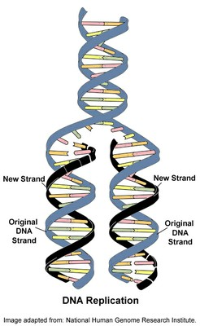
The Core of Molecular Biology
DNA
Do you know that each strand (one chain) of DNA in the double helix can serve as a pattern for making another DNA molecule?
The ability of the two DNA strands is the basis of a technique called Polymerase Chain reaction. In this technique, heat is used to break down the hydrogen bonds (shown in the previous pictures) in order for the strands to separate
This is also important when cells divide because each new cell needs to have an exact copy of the DNA present in the old cell

Slide 19
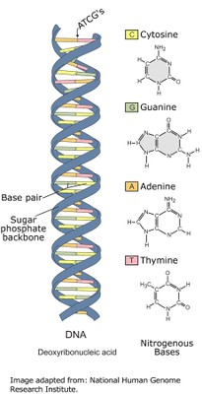
Double helix structure of DNA
In reality, the double helix of the complete DNA molecule resembles a spiral staircase , with two sugar phosphate backbones and the paired bases in the centre of the helix.
This structure explains two of the most important properties of the molecule:
First, it can be copied or 'replicated', as each strand can act as a template for the generation of the complementary strand.
Second, it can store information in the linear sequence of the nucleotides along each strand.

Slide 20
The Core of Molecular Biology
Mitochondrial DNA
The mitochondria has its own DNA independent of what is found in cells
Mitochondrial DNA contains 37 genes, all of which are essential for normal mitochondrial function.
Thirteen (13) of these genes provide instructions for making enzymes involved in oxidative phosphorylation.
The remaining genes provide instructions for making molecules called transfer RNAs (tRNAs) and ribosomal RNAs (rRNAs).
These types of RNA help assemble protein building blocks (amino acids) into functioning proteins.

Slide 21
The Core of Molecular Biology
Chromosomes
Now that we know what genes and DNA are all about, let us now discuss chromosomes.
In the nucleus of each cell, the DNA molecule is packaged into thread-like structures called chromosomes.
Each chromosome is made up of DNA tightly coiled many times around proteins called histones that support its structure.
Chromosomes are not visible in the cell’s nucleus—not even under a microscope—when the cell is not dividing.
The DNA that makes up chromosomes becomes more tightly packed during cell division and is then visible under a microscope.

Slide 22
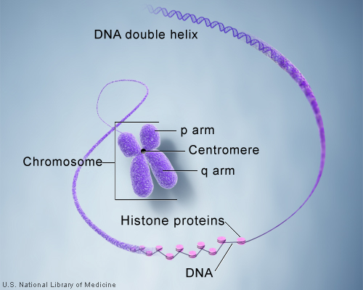
The Core of Molecular Biology
Chromosomes
Each chromosome has a constriction point called the centromere, which divides the chromosome into two sections, or “arms.”
The short arm of the chromosome is labeled the “p arm.” The long arm of the chromosome is labeled the “q arm.”
The location of the centromere on each chromosome gives the chromosome its characteristic shape, and can be used to help describe the location of specific genes.

Slide 23
The Core of Molecular Biology
Ribonucleic acid (RNA)
Ribonucleic acid is a nucleic acid present in all living cells. Its bases pair up like this, A with U and C with G, to form units called base pairs. Compare with pairing with what we found in DNA.
Its principal role is to act as a messenger carrying instructions from DNA for controlling the synthesis of proteins, although in some viruses, RNA rather than DNA carries the genetic information.
Did you All RNA molecules except the RNA genomes of certain viruses are derived from information permanently stored in DNA.
During transcription, an enzyme, RNA polymerase, converts the genetic information in a segment of double-stranded DNA into an RNA strand with a base sequence complementary to one of the DNA strands.

Slide 24
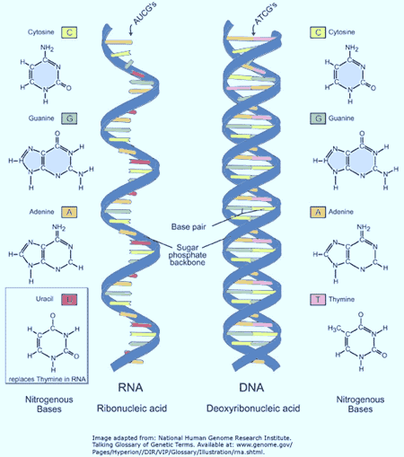
The Core of Molecular Biology
Ribonucleic acid (RNA)
In RNA, Cytosine (C) pairs with Guanine (G), and Adenine (A) with Uracil (U).
RNA is single stranded compared to the double helix structure of DNA.
Both nucleic acids have a phosphate backbone and a five carbon sugar. DNA has deoxyribose whereas RNA contains ribose

Slide 25
The Core of Molecular Biology
Ribonucleic acid (RNA)
There are three major kinds of RNA that are produced mainly from DNA. These are:
Messenger RNA (mRNA)
Is a single-stranded RNA molecule that is complementary to one of the DNA strands of a gene.
It carries coded information about a specific protein that is earmarked for production.
It is formed when the enzyme, RNA polymerase, reads (transcribes) the information on a particular gene turning that information into nucleotide sequences we call mRNA.
mRNA leaves the cell nucleus and moves to the cytoplasm where proteins are made.
During protein synthesis, an organelle called a ribosome moves along the mRNA, reads its base sequence, and uses the genetic code to translate each three-base triplet, or codon, into its corresponding amino acid.

Slide 26
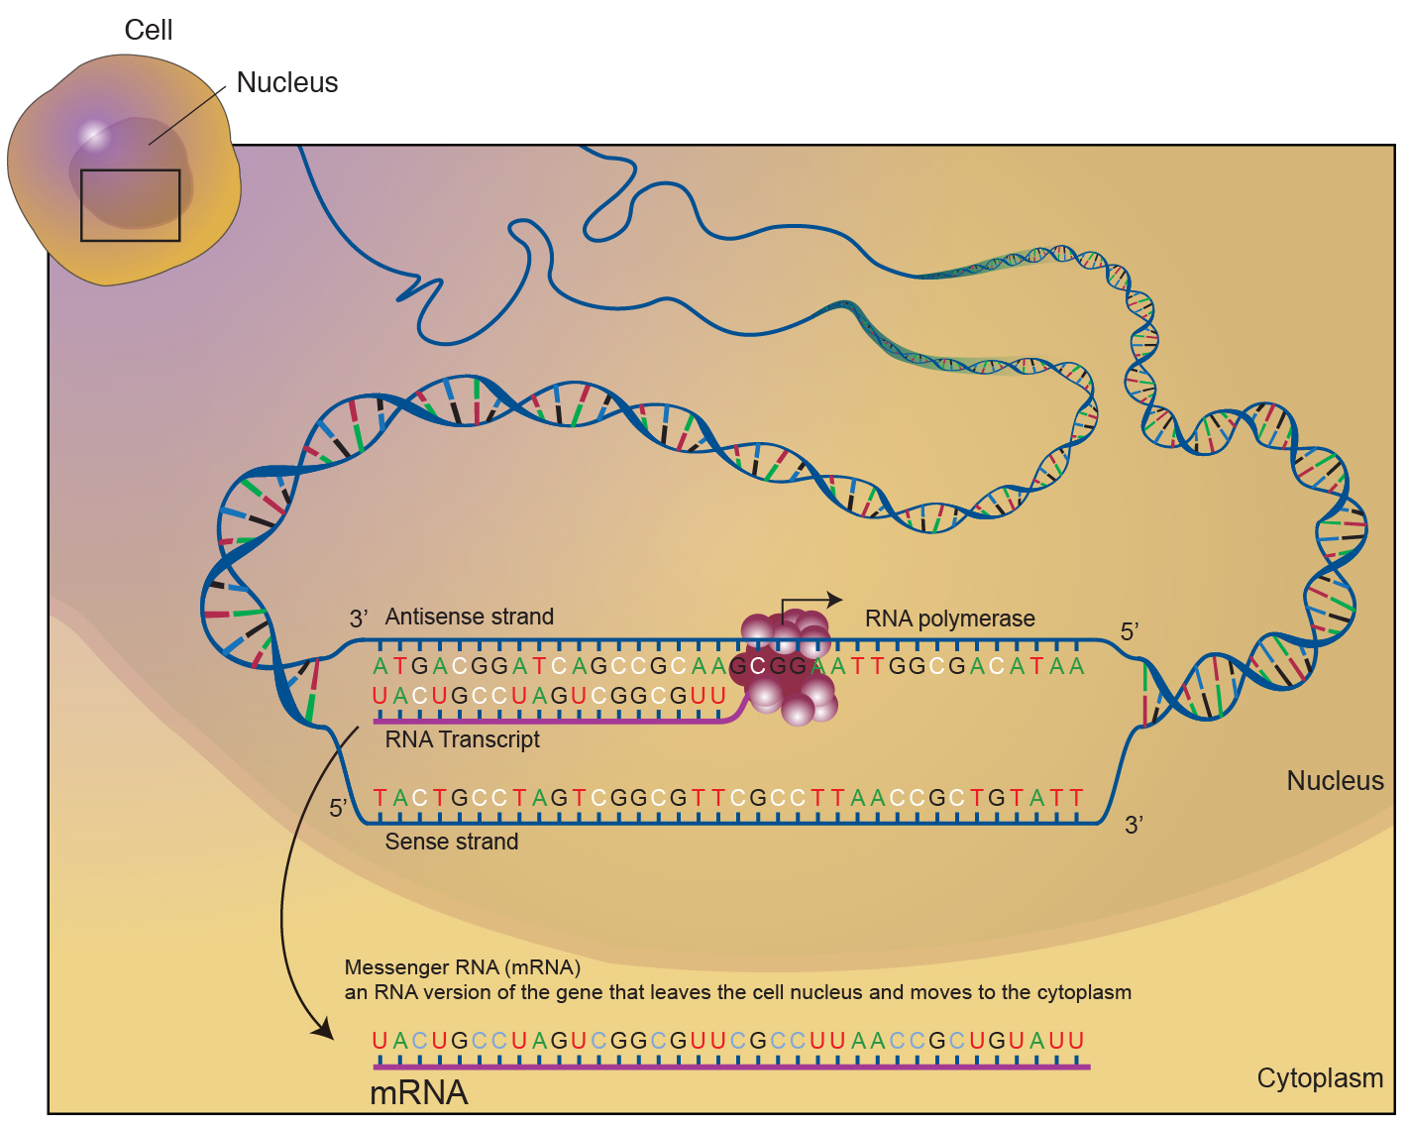
The Core of Molecular Biology
Messenger RNA (mRNA)
Note that mRNA here is complementary to the antisense
DNA strand

Slide 27
The Core of Molecular Biology
Transfer RNA (tRNA)
It is a small RNA molecule that participates in protein synthesis. It reads information carried in the mRNA and transfers the appropriate amino acid to a growing polypeptide chain during protein synthesis.
Each tRNA molecule has two important areas: a trinucleotide region called the anticodon (This is complementary to the three base nucleotide sequence (codon) carrying information about a specific amino acid on mRNA) and a region for attaching a specific amino acid.
During translation, each time an amino acid is added to the growing chain, a tRNA molecule through the anticodon region forms base pairs with its complementary sequence on the messenger RNA (mRNA) molecule, ensuring that the appropriate amino acid is inserted into the protein.

Slide 28
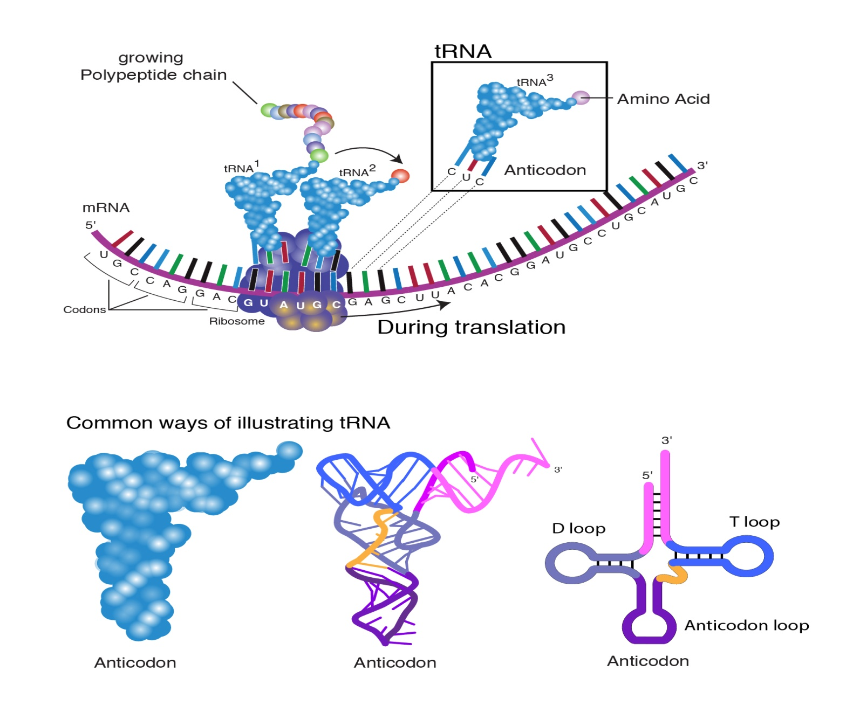
The Core of Molecular Biology
Transfer RNA (tRNA)

Slide 29
The Core of Molecular Biology
Ribosomal RNAs (rRNAs)
These are constituents of ribosomes, they are intricate cellular machines that synthesise proteins.
Something to think about
Define the term complimentary?
What is codon?
What are anticodons?
Describe the relationship between mRNA, tRNA, and rRNA?
Here is a leakage: A codon is a sequence of three adjacent nucleotides, which encode for a specific amino acid during protein synthesis or translation

Slide 30
The genetic code
Now that we know about the different types of RNAs, it is time we talked about how the type of amino acid to be formed during translation is determined. The secret is in what is known as the Genetic code.
The genetic code is a set of rules defining how the four-letter code ( A, C, G and T) of DNA is translated into the 20-letter code of amino acids, which are the building blocks of proteins.
The genetic code is a set of three-letter combinations of nucleotides called codons, each of which corresponds to a specific amino acid or stop codon.
There are 64 possible permutations, or combinations, of three-letter nucleotide sequences that can be made from the four nucleotides.
Of these 64 codons, 61 represent amino acids, and three are stop signals or codons. How is this possible, you ask. Discuss with your friends

Slide 31
The Genetic Code
Although each codon is specific for only one amino acid (or one stop signal), the genetic code is described as degenerate, or redundant, because a single amino acid may be coded for by more than one codon.
Furthermore, the genetic code is nearly universal, with only rare variations reported. For instance, mitochondria have an alternative genetic code with slight variations.
NB: It is the order of the bases along a single strand of DNA that constitutes the genetic code.

Slide 32
The genetic Code
There are a two points to note about the genetic code:
It is universal. All life on Earth uses the same code (with a few minor exceptions).
It is degenerate. Each amino acid can be coded for by more than one codon. For example, AGC and ACC both code for the amino acid serine.

Slide 33
The Central Dogma of Molecular Biology
The central dogma of molecular biology describes the flow of genetic information in cells from DNA to messenger RNA (mRNA) to protein.
It states that genes specify the sequence of mRNA molecules, which in turn specify the sequence of proteins

Slide 34
Introduction to Gene expression
Gene expression
Gene expression is the process by which the genetic code - the nucleotide sequence - of a gene is used to direct protein synthesis and produce the structures of the cell. Together, transcription and translation, are usually referred to as, Gene expression
Some genes are expressed continuously, as they produce proteins involved in basic metabolic functions; some genes are expressed as part of the process of cell differentiation; and some genes are expressed as a result of cell differentiation.
The process of gene expression involves two main stages:
Transcription: the production of messenger RNA (mRNA) by the enzyme RNA polymerase, and the processing of the resulting mRNA molecule.
Translation: the use of mRNA to direct protein synthesis, and the subsequent post-translational processing of the protein molecule.

Slide 36

Introduction to gene expression
Genes that code for amino acid sequences are known as 'structural genes'.
A structural gene consist of three types of nucleotide sequence:
Coding regions, called exons: Exons code for amino acids and collectively determine the amino acid sequence of the protein product. It is these portions of the gene that are represented in final mature mRNA molecule
Non-coding regions, called introns: Introns are portions of the gene that do not code for amino acids, and are removed (spliced) from the mRNA molecule before translation
Regulatory sequences: which play a role in determining when and where the protein is made (and how much is made)

Slide 37
Introduction to Gene expression
Regulatory regions in structural genes
Start site: A start site for transcription.
A promoter: A region a few hundred nucleotides 'upstream' of the gene (toward the 5' end). It is not transcribed into mRNA, but plays a role in controlling the transcription of the gene. Transcription factors bind to specific nucleotide sequences in the promoter region and assist in the binding of RNA polymerases.
3. Enhancers. Some transcription factors (called activators) bind to
regions called 'enhancers' that increase the rate of transcription.
Some enhancers are conditional and only work in the presence of
other factors as well as transcription factors
4. Silencers. Some transcription factors (called repressors) bind to regions called 'silencers' that depress the rate of transcription

Slide 38
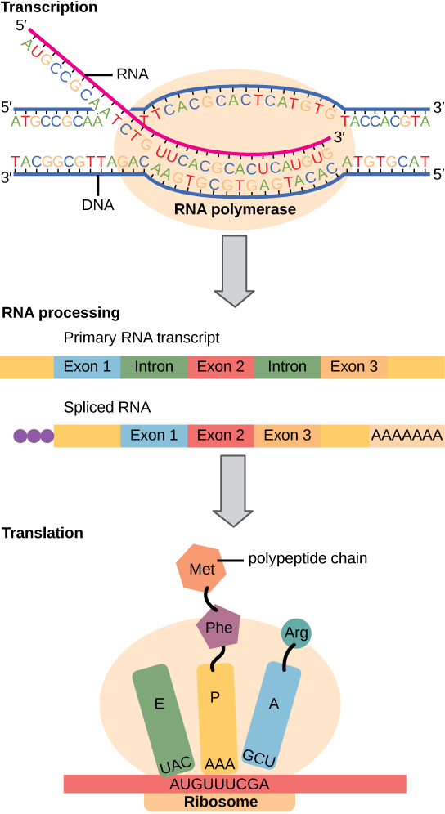
Transcription and Translation
Analyse this diagram. Discuss with your friends what happens during the processes of Transcription and Translation . Mention the function of each feature during these two processes. Does a mature mRNA still have introns? Where do these two processes take place within the cell? See the next slide

Slide 39
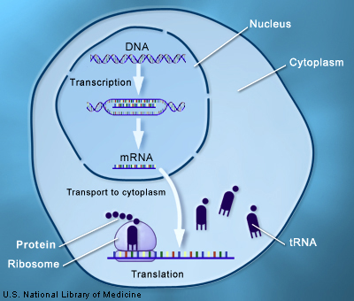
Transcription and Translation

Slide 40
Common techniques in Molecular Biology
As we come to the end of the lecture, I want you to list any techniques that you think fall under the field of molecular Biology
I will begin by mentioning the Polymerase Chain Reaction, Next generation sequencing (NGS)……………………..complete the list and share with your colleagues.
For any questions, use the chat option in moodle to send your questions. I will respond to each question. Do not send it as a private message but use the group questions for the sake of your class mates
…………………………………………………………………………………………….
Have a blessed day

