Slide 1
Introduction to RNA Interference
Dr Munjita

Slide 2
Review: Transcription and translation ( eukaryotes)
Chromosomes are located in the nucleus. Transcription occurs in the nucleus.
Result of transcription is a primary mRNA transcript (that still has exons and introns).
Primary mRNA splicing leads to mature mRNA.
Mature mRNA is exported to the cytoplasm where translation takes place.
It is during translation that some small RNA molecules have their silencing effects

Slide 3
Historical perspectives
The first evidence that dsRNA could achieve efficient gene silencing through RNAi came from studies on the nematode Caenorhabditis elegans.
Further analyses in the fruit fly Drosophila melanogaster have contributed greatly toward understanding the biochemical nature of the RNAi pathway
The importance of this technology is reflected by the fact that the 2006 Nobel prize for medicine was awarded for the discovery of RNA interference by Craig Mello and Andrew Fire.

Slide 4
What is RNA Interference?
RNA interference (RNAi) is a post-transcriptional process triggered by the introduction of double-stranded RNA (dsRNA) which leads to silencing of protein encoding genes in a sequence-specific manner. Consequently, the respective protein is no longer synthesised.
In nature, this mechanism is used for the regulation of specific genes and is also applied as a defence against viruses.
In research, this technique can be used for loss-of-function studies where a gene is specifically silenced and the impact of this loss is analysed in cells or whole organisms. This can be performed under normal conditions or in the context of a disease i.e.:
  RNAi is now routinely utilized across multiple biological disciplines to determine gene function. RNAi is also being utilized for therapeutic interventions to downregulate the expression of genes involved in disease pathogenesis.

Slide 5
Types of small RNA molecules
There are two types of small RNA molecules:
microRNAs (abbreviated: miRNAs)
Small interfering RNAs ( abbreviated: siRNAs)

Slide 6
Micro ribonucleic acids (miRNAs)
A microRNA (miRNA) is a small non-coding RNA molecule (22-25 nucleotides) found in plants, animals and some viruses.
miRNAs function are involved in RNA silencing and post-transcriptional regulation of gene expression.
miRNAs (micro RNAs) are products of dsRNAs encoded in genes of our genome (see diagram below).
They do not require full complementarity to bind with target mRNA, e.g. one type of miRNA may regulate many genes, as well as one gene can be regulated by several miRNAs.
miRNAs are encoded by eukaryotic nuclear DNA in plants and animals and by viral DNA in certain viruses whose genome is based on DNA.

Slide 7
Micro ribonucleic acids (miRNAs)
miRNAs function through base-pairing with complementary sequences within mRNA molecules. As a result, these mRNA molecules are silenced, by one or more of the following processes:
Cleavage of the mRNA strand
Destabilization of the mRNA through shortening of its poly(A) tail (miRNA molecules with full sequence complementarity can induce mRNA degradation).
The poly-A tail is a long chain of adenine nucleotides that is added to a messenger RNA (mRNA) molecule during RNA processing to increase the stability of the molecule
Inefficient translation of the mRNA into proteins by ribosomes (miRNAs often exhibit imperfect sequence complementarity to target mRNA (usually in the 3’ untranslated region) and lead to the inhibition of translation as their mechanism of gene silencing)

Slide 8
Formation of miRNAs
Endogenous micro RNA (miRNA) molecules have been identified in mammals as well as in Drosophila, C. elegans and many other organisms.
miRNA molecules are derived from pri-miRNA, which is cleaved by the RNase III enzyme Drosha into precursor miRNA (pre-miRNA) in the nucleus.
These hairpin structures are then exported to the cytoplasm in an Exportin-5/RAN-GTPase-dependent manner. Double stranded miRNA are excised from pre-miRNA by Dicer. Thus, the resultant products have 2-3 nucleotide 3’ overhangs and 5’ phosphate and 3’ hydroxyl groups.

Slide 9
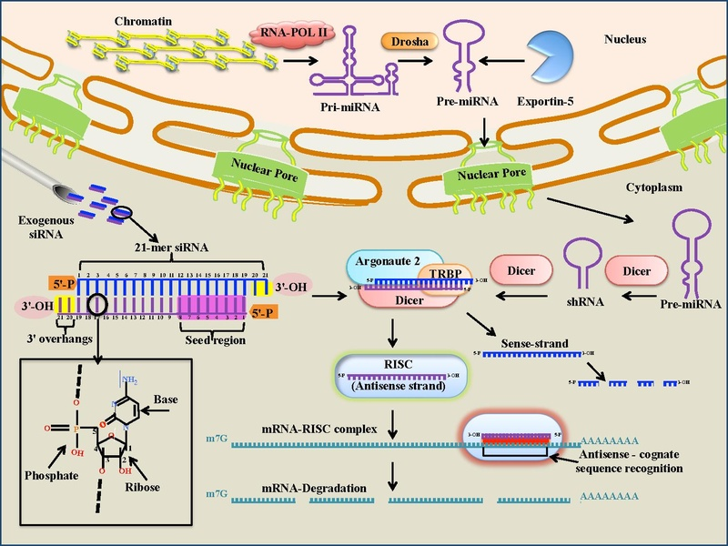
How RNA Interference works?

Slide 10
Where does mRNA degradation by miRNAs occur?
Classically, it was thought that mRNA was broken down in the cytoplasm following translation; it is now known that mRNA degradation occurs in processing bodies (P-bodies/GW bodies/ Dcp bodies)
Moreover, mRNAs subject to miRNA-mediated silencing accumulate in P-bodies thereby sequestering the mRNA away from the translational machinery.

Slide 11
Small interfering RNAs
Small interfering RNA (siRNA), sometimes known as short interfering RNA or silencing RNA, is a class of double-stranded RNA molecules, 19-23 base pairs in length.
Endogenous siRNAs have not been found in mammalian systems.
The structure of siRNA is highly specific to prevent erroneous gene silencing. siRNA molecules are 19-23 nucleotide double stranded RNA (dsRNA) duplexes with symmetric 2-3 nucleotide 3’ overhangs and 5’ phosphate and 3’ hydroxyl groups

Slide 12
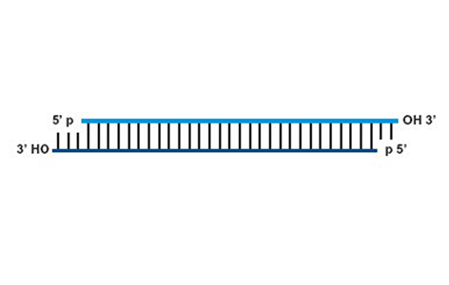
Small interfering RNAs
siRNAs are double stranded RNA (dsRNA) duplexes with symmetric 2-3 nucleotide 3’ overhangs and 5’ phosphate and 3’ hydroxyl groups

Slide 13
Where does mRNA degradation by siRNAs occur?
Like miRNAs, siRNA-induced cleavage of mRNA molecules is thought to take place in P-bodies since Argonaute proteins concentrate in these sub-cellular structures

Slide 14
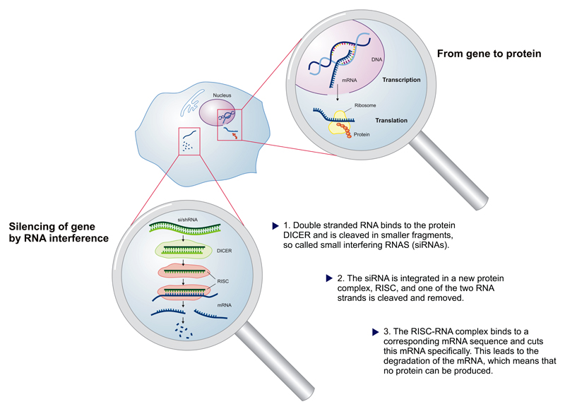
How RNA Interference works?

Slide 15
How RNA Interference works?
The term RNA interference (RNAi) was coined to describe a cellular mechanism that use the gene's own DNA sequence of nucleotides to turn it off, a process that researchers call silencing.
In a wide variety of organisms, including animals, plants, and fungi, RNAi is triggered by double-stranded RNA (dsRNA).
During RNAi, long dsRNA is cut or "diced" into small fragments 19-23 nucleotides long by an enzyme called "Dicer“ belonging to the RNase III family. The fragments have 5’ phosphorylated ends and 2-nt unpaired and unphosphorylated 3’ ends.
These small (fragments) dsRNAs are called small interfering RNAs (siRNAs). Each siRNA duplex is formed by a guide strand and a passenger strand.

Slide 16
How RNA Interference works?

Slide 17
How RNA Interference works?
These siRNAs bind to proteins from a special family: the Argonaute proteins.
The endonuclease Argonaute 2 (Ago 2) catalyses the unwinding of the siRNA duplex. Argonaute proteins are found in plants, fungi, animals and some bacteria
After binding to an Argonaute protein, the passenger strand of the dsRNA is removed, leaving the guide strand.
Combination of the siRNA guide strand and Argonaute proteins along with other proteins forms a multiprotein complex called RNA induced silencing complex (RISC). RISC incorporates one strand of a small interfering RNA (siRNA) or micro RNA (miRNA).

Slide 18
How RNA Interference works?
RISC uses the guide strand (antisense strand) of siRNA or miRNA as a template for recognising and binding to complementary mRNA target sequences according to the rules of base pairing: A binds U, G binds C, and vice .
When it finds a complementary strand, RISC activates RNase to either endonucleolytically cleave the mRNA, destroying it or recruit accessory factors to regulate the target sequence in other ways.
In the case of miRNA, only part of the of the miRNA known as the seed pairs with the target mRNA. This inprecise matching allows miRNAs to target hundrends of endogenous mRNAs. Targeting by miRNA can lead to mRNA being degraded or translation being inhibited.

Slide 19
RNAi Animation link
http://highered.mheducation.com/sites/dl/free/0072835125/126997/animation31.html

Slide 20
Argonaute family of proteins
The Argonaute family of proteins, specifically Argonaute 2 (also known as Ago2, eIF2C2 or Slicer) are essential components of RISC, which are involved in mRNA cleavage.
The Argonaute family are highly basic proteins that are characterized by a central PAZ domain and a C-terminal PIWI domain

Slide 21
Members of the Dicer family
Members of the Dicer family are multi-domain proteins that comprise RNase III domains, a PAZ domain (named after the proteins PIWI, Argonaute and Zwille), a dsRNA-binding domain, a domain of unknown function in addition to a helicase domain that is presumably involved in unwinding of the double stranded siRNA precursor.

Slide 22
Uses of RNAi
RNAi is widely used by researchers to silence genes in order to learn something about their function. siRNAs can be designed to match any gene, can be manufactured cheaply, and can be readily administered to cells.
One can now order commercially synthesized siRNAs to silence virtually any gene in a human or other organism's cell, dramatically accelerating the pace of biomedical research.
Furthermore, the ability to turn off expression of a single gene makes RNAi an appealing therapeutic approach to treat infectious diseases or genetic disorders, such as those that result from the inappropriate and undesirable activity of a gene, as in many cancers and neurodegenerative diseases. There are currently several clinical trials testing the safety and effectiveness of siRNA drugs.

Slide 23
Uses of RNAi
RNAi is much more than a research tool. RNAi encompasses an array of ancient and sophisticated cellular mechanisms that regulate a variety of biological functions.
Argonaute proteins bind many naturally occurring small RNAs to defend against transposable elements, maintain chromosome structure and stability, and regulate developmental timing and differentiation.
For example, microRNAs represent a natural form of developmentally-important siRNAs. Like siRNAs, microRNAs are made by Dicer, but microRNA derive from single-stranded RNAs that fold back on themselves to generate small regions of double-stranded RNA—so called "stem-loops"— instead of the long double-stranded RNA that produces siRNAs.

Slide 24
Uses of RNAi
microRNAs can guide Argonaute proteins to repress messenger RNAs that match the miRNA incompletely, allowing one microRNA to regulate hundreds of genes.
Humans make more than 500 distinct microRNAs, and the inappropriate production of specific microRNAs has been linked to several diseases.
Drugs to inhibit disease-causing microRNAs are now being tested as therapies for several human diseases.

