Slide 1
Structure & Function of DNA & RNA
Dr Samuel Munjita

Slide 2
Introduction
Nucleic acids play an important role in the storage and expression of genetic information.
They are divided into two major classes:
  Deoxyribonucleic acid (DNA) functions solely in information storage
  Ribonucleic acids (RNAs) are involved in most steps of gene expression and protein biosynthesis.

Slide 3
Introduction
Nucleic acids are polymers(polynucleotides) made up of monomers called nucleotides.
DNA is a double stranded nucleic acid whereas RNA is single stranded.
Each nucleotide consists of three components:
  Nitrogenous bases: cytosine (C), guanine (G), adenine (A), thymine (T) in DNA and Uracil in RNA
  A five-carbon sugar molecule (deoxyribose in the case of DNA and Ribose in RNA)
  A phosphate molecule
A nucleotide is a combination of a nitrogen base, a 5-carbon sugar, and phosphoric acid.
A sugar and a nitrogenous base without the phosphate group is known as a nucleoside.

Slide 4
Some functions of nucleotides and nucleosides
Nucleoside triphosphate (especially ATP) provides chemical energy to drive a wide variety of cellular reactions.
They serve as precursor for nucleic acid synthesis (phosphodiester linkage).
Adenine nucleotides are components of major enzyme cofactors.
Some nucleotides are regulatory molecules like cyclic AMP.

Slide 5
Basic Functions of DNA and RNA
DNA has two direct purposes: storage of information and generation new DNA (replication) and RNA (ribonucleic acid).
RNA is involved in the direct synthesis of proteins (translation): mRNA carries genetic information from one or few genes to a ribosome where corresponding proteins are synthesised; Transfer RNAs (tRNA) are adaptor molecules that faithfully translate the information in mRNA into a specific sequence of amino acids; Ribosomal RNAs (rRNA) are components of ribosomes that carry out synthesis of proteins.

Slide 6
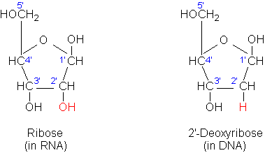
Ribose and Deoxyribose sugars
Both ribose and deoxyribose are five-carbon sugars
Both RNA and DNA are built from nucleobases linked to a phosphate-sugar backbone.
In DNA, the phosphate-sugar backbone contains deoxyribose, and in RNA it contains ribose.
Ribose has an OH group on position 2', whereas deoxyribose does not (hence, deoxy).

Slide 7
Ribose and Deoxyribose sugars
Deoxyribonucleic acid contains 2’deoxy-D-ribose where as ribonucleic acid contains D-ribose
Both 2’deoxy-D-ribose and D-ribose are in their β-furanose form( closed five-carbon membered ring)
Sugars define the identity of a nucleic acid. If a nucleic acid contains 2’deoxy-D-ribose, it is a DNA by definition even though it may contain some Uracil
If the nucleic acid contains D-ribose, it is RNA regardless of its base composition

Slide 8
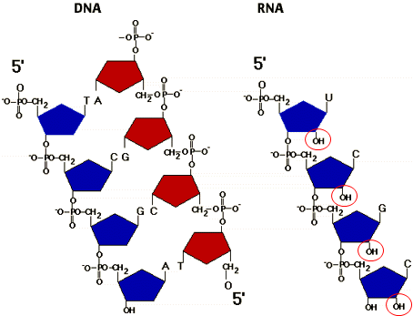
Ribose and Deoxyribose sugars
The 3' and 5' OHs bond to the phosphate group and the 1' OH bonds to the nucleobase
Therefore, DNA has no free OH groups
RNA has a free and exposed OH group on each sugar (circled)
NB: As OH groups are often the target of chemical attack, this makes DNA more stable than RNA.

Slide 9
Nitrogenous bases
DNA is made up of four nitrogenous bases: Cytosine, Guanine, Thymine and Adenine
RNA is also made up of four bases except that it has Uracil in place of Thymine
The nitrogen bases are divided into purines (adenine and guanine) and pyrimidines (cytosine, thymine, and uracil).
Adenine (A), guanine (G), and cytosine (C) occur in both DNA and RNA.
Thymine (T) is only found in DNA, whereas uracil (U) only occurs in RNA.
Only in rare cases is Uracil found in DNA and Thymine in RNA

Slide 10
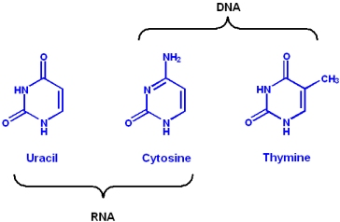
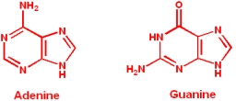
Nitrogenous Bases( Purines vs Pyrimidines)
Pyrimidines are composed of a single ring with two nitrogen atoms in the ring structure
Purines are composed of two fused rings incorporating two nitrogen atoms in each ring

Slide 11
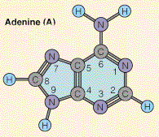
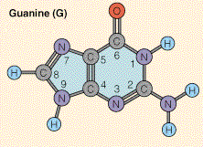
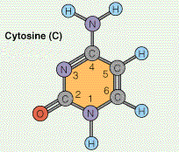
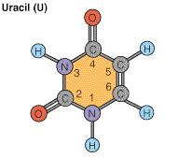
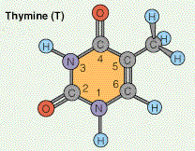
Nitrogenous Bases of DNA and RNA
Purines:
Pyrimidines:
RNA only
DNA only
Notes:
NOTE: deamination of cytosine= Uracil
Deamination of methyl-cytosine =thymine
Demethylation of thymine= uracil

Slide 12
Base pairing in DNA and RNA
In DNA, Adenine pairs with Thymine, and Cytosine with Guanine
In RNA, Adenine pairs with Uracil, and Cytosine with Guanine

Slide 13
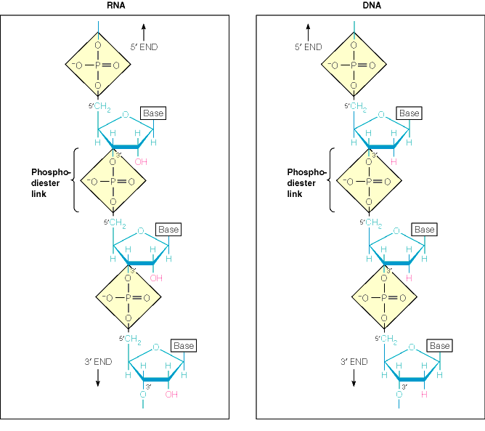
Chemical Structure of DNA and RNA
The C is
named 1’-5’
4’
1’
2’
Nucleotide
Nucleoside
RNA
DNA

Slide 14
Nucleotides are joined by phosphodiester linkages
The phosphodiester bonds (one of which is shaded in the DNA) link successive nucleotide units.
The 5’-phosphate group of one nucleotide is joined to the 3’-hydroxyl group of the next nucleating creating a phosphodiester linkage

Slide 15
The antiparallel DNA structure, complementarity and hydrogen bonding
The DNA strands are held together(stabilised) by hydrogen bonds, complementary base pairs, non-specific base stacking interactions
In DNA every Adenine (A) is complementary to a Thymine (T), and every Guanine (G) is complementary to a Cytosine (C) in base pairing: A=T; G ≡ C
The covalent backbones of DNA consist of alternating phosphate and pentose residues. Phosphate and pentose residues are hydrophilic and the less polar nitrogen bases located on the inside are hydrophobic.
The antiparallel structure of DNA means that the 5' end of one strand connects to the 3' end of its complementary strand. DNA is negatively charged

Slide 16
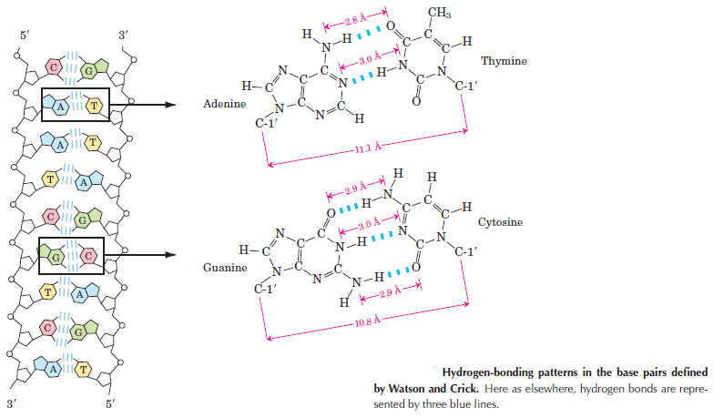
The antiparallel DNA structure, complementarity and hydrogen bonding

Slide 17
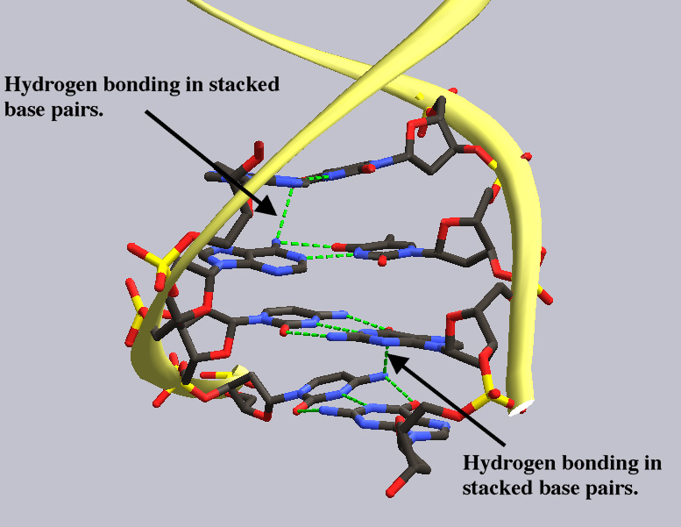
Hydrogen bonding and base stacking in DNA
Hydrogen bonding between DNA base pair stacks. Hydrogen bonding is indicated by the green dotted line.
Hydrogen bonds occur not only between complimentary base pairs, but adjacent nucleotide pairs as well.
The hydrogen bonds indicated by the black arrows are between stacked base pairs.
Hydrogen bonding between base pair stacks could be responsible for the tight base pair stacking observed in DNA molecules.
Stability---protects bases from attack by H₂O soluble compounds and H₂O itself.
Provides easy mechanism for replication

Slide 18
Primary structure of DNA
Primary structure consists of a linear sequence of nucleotides that are linked together by phosphodiester bonds.
It is this linear sequence of nucleotides that make up the Primary structure of DNA or RNA
It is usually written as the sequence of bases they contain

Slide 19
The double Helical Structure of DNA ( secondary structure.
Schematic model of the double helix:
One turn of the helix (34 Å or 3.4 nm) spans approx. 10.5 base pairs.
The sugar and phosphate residues in each strand form the backbone, which are traced by the yellow, grey, and red circles, show the helical twist of the overall molecule.
The bases project inward but are accessible through major and minor grooves

Slide 20
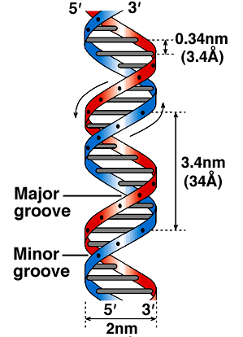
The Helical Structure of DNA cont’d
Each strand of DNA has a “direction” at one end, the terminal carbon atom in the backbone is the 5’ carbon atom of the terminal sugar at the other end, the terminal carbon atom is the 3’ carbon atom of the terminal sugar
Therefore we can talk about the 5’ and the 3’ ends of a DNA strand in a double helix, the strands are antiparallel (arrows drawn from the 5’ end to the 3’ end go in opposite directions)
Chains are anti-parallel (i.e. in opposite directions)
Diameter and periodicity are consistent 2.0 nm, 10.5 bases/ turn, 3.4 nm/ turn
Width consistent because of pyrimidine/purine pairing

Slide 21
The Helical Structure of DNA cont’d
The sugar phosphate backbones are not equally spaced along the helical axis and the grooves that form between the backbones are not of equal size, i.e. we see a major and minor groove
These grooves provide a topography and allow recognition by proteins
The structure of DNA is such that the bases are protected (backbone, complementary H-bonds, base-stacking), but also accessible.
Why are there a minor groove and a major
groove?
It is a simple consequence of the geometry of the base pair.

Slide 22
DNA Is Usually a Right-Handed Double Helix
Applying the handedness rule from physics, we can see that each of the polynucleotide chains in the double helix is right-handed.

Slide 23
The Double Helix Exists in Multiple Conformations
Early X-ray diffraction studies of DNA, which were carried out using concentrated solutions of DNA that had been drawn out into thin fibres, revealed two kinds of structures, the B and the A forms of DNA
The B form, which is observed at high humidity, most closely corresponds to the average structure of DNA under physiological conditions.
It has 10 base pairs per turn, and a wide major groove and a narrow minor groove.
The A form, which is observed under conditions of low humidity, has 11 base pairs per turn.
Its major groove is narrower and much deeper than that of the B form, and its minor groove is broader and shallower.
The vast majority of the DNA in the cell is in the B form, but DNA does adopt the A structure in certain DNA-protein complexes.
The A form is similar to the structure that RNA adopts when double helical.

Slide 24
Multiple conformations of DNA helix
Models of the B, A, and Z Forms of DNA. The sugar-phosphate backbone of each chain is on the outside in all structures (one red and one blue) with the bases (silver) oriented inward.
(a) The B form of DNA, the usual form found in cells, is characterized by a helical turn every 10 base pairs (3.4 nm); adjacent stacked base pairs are 0.34 nm apart. The major and minor grooves are also visible.
(b) The more compact A form of DNA has 11 base pairs per turn and exhibits a large tilt of the base pairs with respect to the helix axis.
(c) Z DNA is a left-handed helix and has a zig zag (hence “Z”) appearance.
a
b
c

Slide 25
Multiple forms of DNA helix
The A-DNA conformation (left) is favored when DNA is dehydrated.
B-DNA (center) is the conformation normally found inside cells.
The Z-DNA conformation (right) is favored in certain GC-rich sequences.
Notes---The base pairs in Z-DNA are clearly perpendicular to the axis of the helix and show very little propeller twist. This conformation relieves some steric hindrances found in certain GC-rich sequences.

Slide 26
Tertiary structure of DNA:
Refers to how DNA is stored in a confined space to form the chromosomes.
Varies depending on whether the organisms are prokaryotes and eukaryotes:
In prokaryotes the DNA is folded like a super-helix, usually in circular shape and associated with a small amount of protein.
The same happens in cellular organelles such as mitochondria and the chloroplasts.
In eukaryotes, since the amount of DNA from each chromosome is very large, the packing must be more complex and compact, this requires the presence of proteins such as histones and other proteins of non-histone nature

Slide 27
Structure of RNA
Recap:
The backbone of RNA contains ribose rather than 2-deoxyribose.
Ribose has a hydroxyl group at the carbon 2 position.
RNA contains uracil in place of thymine. Uracil has the same single-ringed structure as thymine, except that it lacks the 5 methyl group.
RNA is usually found as a single polynucleotide chain.

Slide 28
RNA Chains Fold Back on themselves to form local regions of double helix similar to A-form DNA
Despite being single-stranded, RNA molecules often exhibit a great deal of double-helical character.
This is because RNA chains frequently fold back on themselves to form base-paired segments between short stretches of complementary sequences.
If the two stretches of complementary sequence are near each other, the RNA may adopt one of various stem-loop structures in which the intervening RNA is looped out from the end of the double-helical segment as in a hairpin, a bulge, or a simple loop.

Slide 29
Double Helical Characteristics of RNA
In an RNA molecule having regions of complementary sequences, the intervening (non-complementary) stretches of RNA may become “looped out” to form one of the structures illustrated on the left:
(a) Hairpin (b) Bulge (c) Loop

Slide 30
Functions of RNA
Except for the case of certain viruses, RNA is not the genetic material and does not need to be capable of serving as a template for its own replication.
Rather, RNA functions as the intermediate, the mRNA, between the gene and the protein-synthesizing machinery.
Another function of RNA is as an adaptor, the tRNA, between the codons in the mRNA and amino acids.
RNA can also play a structural role as in the case of the RNA components of
the ribosome.
Another role for RNA is as a regulatory molecule, which through sequence complementarity binds to, and interferes with the translation of, certain mRNAs.
Finally, some RNAs (including one of the structural RNAs of the ribosome) are enzymes that catalyse essential reactions in the cell.

