Slide 1
The Structure of Eukaryotic Genomes
Dr Samuel Munjita

Slide 2
Review: Eukaryotes
Eukaryotic cells contain membrane-bound compartments, including a nucleus and organelles such as mitochondria and, in the case of plant cells, chloroplasts.
Eukaryotes include animals, plants, fungi and protozoa.
Eukaryotes may be either single-celled or multicellular.
Eukaryotes are differentiated from prokaryotes by way of the presence of internal membranes that separate parts of the eukaryotic cell from the rest of the cytoplasm.
These membrane-bound structures are called organelles.

Slide 3
Review: Eukaryotes
In eukaryotes, the cell's genetic material, or DNA, is contained within an organelle called the nucleus, where it is organised in long molecules called chromosomes.
Eukaryotic cells also contain other organelles:
Mitochondria, which generate energy;
The endoplasmic reticulum, which plays a role in the transport of proteins;
The Golgi apparatus, which sorts and packages proteins and lipids for transport throughout the cell.

Slide 4
Review: Eukaryotes
Plant cells additionally contain organelles called chloroplasts, which are used to collect energy from sunlight.
Each eukaryotic chromosome is composed of DNA coiled and condensed around nuclear proteins called histones.
Humans inherit one set of chromosomes from their mother and a second set from their father.
In total, most human cells contain 46 chromosomes with 22 pairs of autosomes, or non-sex chromosomes, and two sex-determining chromosomes.
The sex chromosomes in humans are called X and Y.

Slide 5
Genomes of eukaryotes
Humans are fairly typical eukaryotes and the human genome is in many respects a good model for eukaryotic genomes in general.
Eukaryotic nuclear genomes are divided into two or more linear DNA molecules, each contained in a different chromosome;
All eukaryotes also possess smaller, usually circular, mitochondrial genomes.
The only general eukaryotic feature not illustrated by the human genome is the presence in plants and other photosynthetic organisms of a third genome, located in the chloroplasts.

Slide 6
Genomes of eukaryotes
The size of eukaryotic genomes vary across organism
The smallest eukaryotic genomes are less than 10 Mb in length, and the largest over 100 000 Mb.
The genome size range coincides to a certain extent with the complexity of the organism, the simplest eukaryotes such as fungi having the smallest genomes, and higher eukaryotes such as vertebrates and flowering plants having the largest ones. However, the correlation is far from precise.
If it was, then the nuclear genome of the yeast S. cerevisiae, which at 12 Mb is 0.004 times the size of the human nuclear genome, would be expected to contain 0.004 × 25 000 genes, which is just 100. In fact the S. cerevisiae genome contains about 5800 genes.

Slide 7
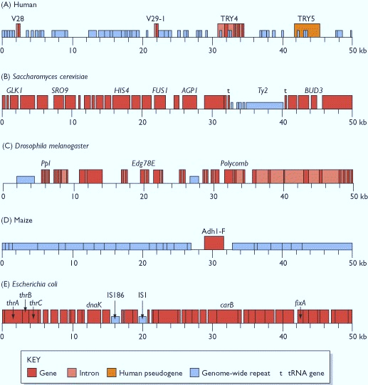
Genes of less complex eukaryotes are more compact
Comparison of the 50-kb genomes of humans, yeast, fruit flies, maize and E. coli.
Genes of less complex organisms are more compact than complex organisms.
For example: the S. cerevisiae genome segment (50-kb), which comes from chromosome III has the following distinctive features:
    It contains more genes than the human segment
    None of the genes in this segment are discontinuous
    The segment has fewer genome-wide repeats compared to the human segment

Slide 8
Genes of less complex eukaryotes are more compact
Yeasts have relatively fewer discontinuous genes. In the entire yeast genome there are only 239 introns, compared with over 300 000 in the human genome.
There are fewer genome-wide repeats in yeasts than humans. When all 16 yeasts chromosomes are considered, the total amount of sequence taken up by genome-wide repeats is only 3.4% of the total. In humans, the genome-wide repeats make up 44% of the genome
The genes in yeast are more compact, having fewer introns, and the spaces between the genes are relatively short, with much less space taken up by genome-wide repeats and other non-coding sequences.

Slide 9
Compactness of the yeast, fruit-fly and human genomes
Feature | Yeast | Fruit fly | Human
Gene density (average number per Mb) | 479 | 76 | 11
Introns per gene (average) | 0.04 | 3 | 9
Amount of the genome that is taken up by genome-wide repeats | 3.4% | 12% | 44%

Slide 10
The Anatomy of the Eukaryotic Genome
We have already learnt that the human genome is split into two components: the nuclear genome and the mitochondrial genome
This is the typical pattern for most eukaryotes, the bulk of the genome being contained in the chromosomes in the cell nucleus and a much smaller part located in the mitochondria and, in the case of photosynthetic organisms, in the chloroplasts
The nuclear genome is split into a set of linear DNA molecules, each contained in a chromosome.
No exceptions to this pattern are known: all eukaryotes that have been studied have at least two chromosomes and the DNA molecules are always linear.

Slide 11
The Anatomy of the Eukaryotic Genome
The only variability at this level of eukaryotic genome structure lies with chromosome number, which appears to be unrelated to the biological features of the organism.
For example, yeast has 16 chromosomes, four times as many as the fruit fly.
Some salamanders have genomes 30 times bigger than the human version but split into half the number of chromosomes.

Slide 12
Packaging of DNA into Eukaryotic chromosomes
Chromosomes are much shorter than the DNA molecules that they contain
A highly organised packaging system is therefore needed to fit a DNA molecule into its chromosome.
The important breakthroughs in understanding DNA packaging were made in the early 1970s by a combination of biochemical analysis and electron microscopy.

Slide 13
Packaging of DNA into Eukaryotic chromosomes
It was already known that nuclear DNA is associated with DNA-binding proteins called histones but the exact nature of the association had not been delineated.
Using nuclease protection experiments on chromatin (DNA-histone complexes) that had been gently extracted from nuclei, researchers found that histones are regularly spaced along the DNA molecule.
In 1974 these biochemical results were supplemented by electron micrographs of purified chromatin, which enabled the regular spacing inferred by the protection experiments to be visualised as beads (nucleosomes) of protein on the string of DNA

Slide 14
Packaging of DNA into Eukaryotic chromosomes
The nucleosome is the fundamental subunit of chromatin.
Each nucleosome is composed of a little less than two turns of DNA wrapped around a set of eight proteins called histones, which are known as a histone octamer.
Each histone octamer is composed of two copies each of the histone proteins H2A, H2B, H3, and H4.
Chromatin is a complex of DNA and proteins that forms chromosomes within the nucleus of eukaryotic cells.

Slide 15
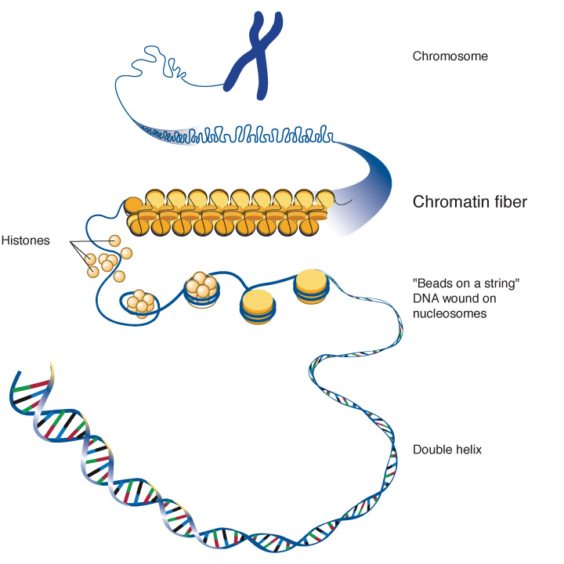
Packaging of DNA into Eukaryotic chromosomes

Slide 16
Packaging of DNA into Eukaryotic chromosomes
As well as the proteins of the core octamer, there is a group of additional histones, all closely related to one another and collectively called linker histones
A single linker histone is attached to each nucleosome, to form the chromatosome
Function: the linker histone acts as a clamp, preventing the coiled DNA from detaching from the nucleosome

Slide 17
Unusual chromosome types
The karyograms of some organisms display unusual features not displayed by the human version. These include the following:
Minichromosomes are relatively short in length but rich in genes. The chicken genome, for example, is split into 39 chromosomes: six macrochromosomes containing 66% of the DNA but only 25% of the genes, and 33 minichromosomes containing the remaining one-third of the genome and 75% of the genes. The gene density in the minichromosomes is therefore some six times greater than that in the macrochromosomes
B chromosomes are additional chromosomes possessed by some individuals in a population, but not all. They are common in plants and also known in fungi, insects and animals. B chromosomes appear to be fragmentary versions of normal chromosomes that result from unusual events during nuclear division. Some contain genes, often for rRNAs, but it is not clear if these genes are active.

Slide 18
Unusual chromosome types
B chromosomes continued: the presence of B chromosomes can affect the biological characteristics of the organism, particularly in plants where they are associated with reduced viability. It is presumed that B chromosomes are gradually lost from cell lineages as a result of irregularities in their inheritance pattern.
Holocentric chromosomes do not have a single centromere but instead have multiple centromeres spread along their length. Caenorhabditis elegans has holocentric chromosomes

Slide 19
Where are the genes in a eukaryotic genome?
Genes are not arranged evenly along the length of a chromosome.
In most organisms, genes appear to be distributed more at less at random, with substantial variations in gene density at different positions within a chromosome.
The same is true for human chromosomes, where the density ranges from 0 to 64 genes per 100 kb.

