Slide 1
Structure of Prokaryotic Genomes
Dr Samuel Munjita

Slide 2
Prokaryotic cells: a review
A prokaryote is an organism whose cells lack a distinct nucleus and lack extensive internal compartments.
There are two very different groups of prokaryotes, distinguished from one another by characteristic genetic and biochemical features:
The bacteria, which include most of the commonly encountered prokaryotes such as the gram-negatives (e.g. E. coli), the gram-positives (e.g. Bacillus subtilis), the cyanobacteria (e.g. Anabaena) and many more.

Slide 3
Prokaryotic cells: a review
The archaea, which are less well-studied, and have mostly been found in extreme environments such as hot springs, brine pools and anaerobic lake bottoms. Examples of archaea:
  Halophiles: live in extremely salty environments
  Acidophiles: live under pH as low as 0
  Thermophiles: live under very high temperature
NB:
Archaea is closer to eukaryotes in how genetic information is handled, i.e. replication, transcription, and translation.
Bacteria is closer to eukaryotes in metabolism and energy conversion

Slide 4
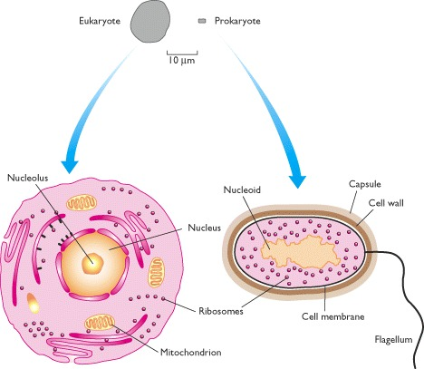
Prokaryotic cell vs a Eukaryotic cell
Eukaryotic cells are characterised by their membrane-bound compartments, which are absent from prokaryotes.

Slide 5
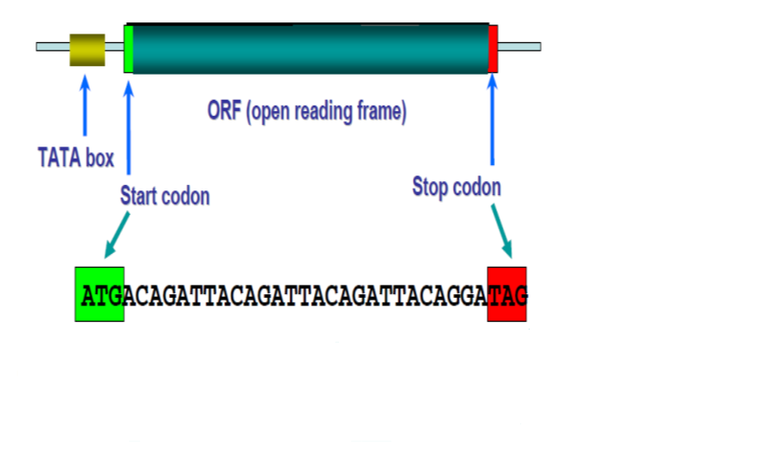
Overview of prokaryotic genome
They have a simple gene structure
Their genomes are small (0.5 to 10 million base pairs)
The genome is uninterrupted. It has no introns
Some genes in prokaryotes are quite short (<60 bp)
They have high coding density (>90%): they have relatively little non-coding sequences in their genome. Thus, their genes are generally referred to as Open Reading Frames (ORF) which include start & stop codon.
An open reading frame (ORF) is the part of a reading frame that has the potential to be translated. It is a continuous stretch of codons

Slide 6
Overview of prokaryotic genomes
Prokaryotic genomes are much smaller than eukaryotic genomes. For example, the E. coli K12 genome is just 4639 kilobases (kb), and has only 4405 genes.
The traditional view has been that an entire prokaryotic genome is contained in a single circular DNA molecule.
Prokaryotes may also have additional genes on independent smaller, circular or linear DNA molecules called plasmids.
Plasmids are small circular DNA molecules that are found inside some prokaryotic cells

Slide 7
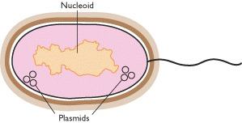
Overview of prokaryotic genomes
Genes carried by plasmids are useful, coding for properties such as antibiotic resistance or the ability to utilise complex compounds such as toluene as a carbon source, but plasmids appear to be dispensable ( they can be done away with) - A prokaryote can exist quite effectively without them.

Slide 8
Overview of prokaryotic genomes
The traditional view of the prokaryotic genome has been biased by the extensive research on E. coli, which has been accompanied by the mistaken assumption that E. coli is a typical prokaryote.
In fact, prokaryotes display a considerable diversity in genome organisation, some having a unipartite (have only a single undivided chromosome) genome, like E. coli, but others being more complex.
Borrelia burgdorferi B31, for example, has a linear chromosome of 911 kb, carrying 853 genes, accompanied by 17 or 18 linear and circular molecules, which together contribute another 533 kb and at least 430 genes.

Slide 9
Overview of prokaryotic genomes
Multipartite genomes (carry a genome divided among several chromosomes of different uneven sizes) are now known in many other bacteria (Vibrio cholerea and Brucella abortis) and archaea.
In general, most chromosomes in multipartite genomes are circular, but in some cases such as in Agrobacterium, one of the two chromosomes is linear.

Slide 10
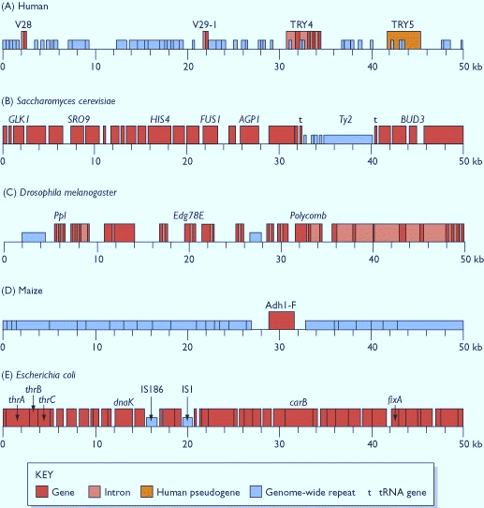
Characteristics of Prokaryotic genomes
Compact genomes: In one respect, E. coli is fairly typical of other prokaryotes. Prokaryotic genomes are even more compact than those of yeast and other lower eukaryotes

Slide 11
Characteristics of Prokaryotic genomes
Length of prokaryotic genome: in general, prokaryotic genes are shorter than their eukaryotic counterparts, the average length of a bacterial gene being about two-thirds that of a eukaryotic gene, even after the introns have been removed from the latter. Bacterial genes appear to be slightly longer than archaeal ones.
Lack of introns: There are no introns in the genes present in the E. coli genome. In fact E. coli has no discontinuous genes at all. It is generally believed that this type of gene structure (discontinuous gene structure), is virtually absent in prokaryotes, the few exceptions occurring mainly among the archaea.

Slide 12
Characteristics of Prokaryotic genomes
4. Infrequency occurrence of repetitive sequences
Repeated sequences or repetitive elements or repeats are patterns (sequence of nucleotides) of nucleic acids (DNA or RNA) that occur in multiple copies throughout the genome.
Most prokaryotic genomes do not have anything equivalent to the high-copy-number genome-wide repeat families found in eukaryotic genomes (Repetitive sequences will be discussed in the next lecture).
They do, however, possess certain sequences that might be repeated elsewhere in the genome, examples being the insertion sequences IS1 and IS186 that can be seen in the 50-kb segment of E. coli (See slide number 10).

Slide 13
Characteristics of Prokaryotic genomes
4. Infrequency occurrence of repetitive sequences
Insertion sequences are examples of transposable elements (a type of a repetitive sequence), sequences that have the ability to move around the genome and, in the case of insertion elements, to transfer from one organism to another, even sometimes between two different species.
As usual, there are some exceptions, notably the meningitis bacterium Neisseria meningitidis Z2491, which has over 3700 copies of 15 different types of repeat sequence, collectively making up almost 11% of the 2.18 Mb genome.

Slide 14
Characteristics of Prokaryotic genomes
5. Presence of operon (We shall discuss operons later in today’s lecture

Slide 15
The packaging systems for prokaryotic genomes
As with eukaryotic chromosomes, a prokaryotic genome has to squeeze into a relatively tiny space (the circular E. coli chromosome has a circumference of 1.6 mm whereas an E. coli cell is just 1.0 × 2.0 μm).
This is achieved with the help of DNA-binding proteins that package the genome in an organised fashion.
The resulting structure has no substantial similarities with a eukaryotic chromosome, but we still use ‘bacterial chromosome’ as a convenient term to describe it.
The first feature to be recognised was that the circular E. coli genome is supercoiled.

Slide 16
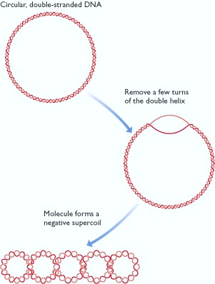
The packaging systems for prokaryotic genomes
Supercoiling occurs when additional turns are introduced into the DNA double helix (positive supercoiling) or if turns are removed (negative supercoiling).
With a linear molecule, the torsional stress introduced by over- or under-winding is immediately released by rotation of the ends of the DNA molecule, but a circular molecule, having no ends, cannot reduce the strain in this way.
Instead the circular molecule responds by winding around itself to form a more compact structure
Negative supercoiling: The diagram shows how underwinding a circular double-stranded DNA molecule results in negative supercoiling.

Slide 17
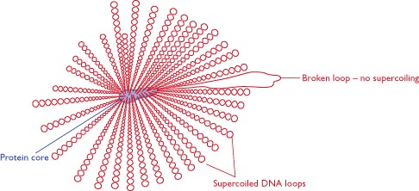
The packaging systems for prokaryotic genomes
Supercoiling is an ideal way to package a circular molecule into a small space.
Evidence that supercoiling is involved in packaging the circular E. coli genome was first obtained in the 1970s from examination of isolated nucleoids, and subsequently confirmed as a feature of DNA in living cells in 1981.
In E. coli, the supercoiling is thought to be generated and controlled by two enzymes, DNA gyrase and DNA topoisomerase I.
A model for the structure of the Escherichia coli nucleoid. Between 40 and 50 supercoiled loops of DNA radiate from the central protein core. One of the loops is shown in circular form, indicating that a break has occurred in this segment of DNA, resulting in a loss of the supercoiling.

Slide 18
The packaging systems for Prokaryotic genomes
Apart from DNA gyrase and DNA topoisomerase I, the two enzymes that are primarily responsible for maintaining the supercoiled state, there are atleast four proteins believed to have a more specific role in packaging the bacterial DNA.
The most abundant of these packaging proteins is HU ( H stands for Histone and U stands for the U93 E. coli strain used at that time to isolate the E. coli nucleoid) , which is structurally very different to eukaryotic histones but acts in a similar way, forming a tetramer around which approximately 60 bp of DNA becomes wound.

Slide 19
The packaging systems for prokaryotic genomes
There are differences between the packaging systems for bacterial and archaeal DNA molecules.
One reason why the archaea are looked upon as a distinct group of organisms, different from the bacteria, is that archaea do not possess packaging proteins such as HU but instead have proteins that are much more similar to histones
Remember that DNA is tightly coiled together with histone proteins on chromosomes in eukaryotes

Slide 20
Plasmids in prokaryotic organism
A plasmid is a small piece of DNA, often, but not always circular, that coexists with the main chromosome in a bacterial cell.
Some types of plasmid are able to integrate into the main genome, but others are thought to be permanently independent.
Plasmids carry genes that are not usually present in the main chromosome, but in many cases these genes are non-essential to the bacterium, coding for characteristics such as antibiotic resistance, which the bacterium does not need if the environmental conditions are amenable.

Slide 21
Plasmids in prokaryotic organism
As well as this apparent dispensability, many plasmids are able to transfer from one cell to another, and the same plasmids are sometimes found in bacteria that belong to different species.
These various features of plasmids suggest that they are independent entities and that in most cases the plasmid content of a prokaryotic cell should not be included in the definition of its genome.

Slide 22
Examples of plasmids
Type of plasmid | Gene functions | Examples
Resistance | Antibiotic resistance | Rbk of Escherichia coli and other bacteria
Fertility | Conjugation and DNA transfer between bacteria | F of E. coli
Killer | Synthesis of toxins that kill other bacteria | Col of E. coli, for colicin production
Degradative | Enzymes for metabolism of unusual molecules | TOL of Pseudomonas putida, for toluene metabolism
Virulence | Pathogenicity | Ti of Agrobacterium tumefaciens, conferring the ability to cause crown gall disease on dicotyledonous plants

Slide 23
Plasmids in prokaryotic organism
With a bacterium such as E. coli K12, which has a 4.6-Mb chromosome and can harbour various combinations of plasmids, none of which is more than a few kb in size and all of which are dispensable (can be done away with in certain circumstances), it is acceptable to define the main chromosome as the ‘genome’ and the rest as plasmids. With other prokaryotes it is not so easy.
Here is a look at some complex prokaryotes that have highly multipartite genomes:
Vibrio cholerae, the pathogenic bacterium that causes cholera, has two circular DNA molecules, one of 2.96 Mb and the other of 1.07 Mb, with 71% of the organism's 3885 genes on the larger of these.

Slide 24
Plasmids in prokaryotic organism
Vibrio cholerae
It would appear obvious that these two DNA molecules together constitute the Vibrio genome, but closer examination reveals that most of the genes for the central cellular activities such as genome expression and energy generation, as well as the genes that confer pathogenicity, are located on the larger molecule.
The smaller molecule contains many essential genes but also has certain features that are considered characteristic of plasmids, notably, an integron, a set of genes and other DNA sequences that enable plasmids to capture genes from bacteriophages (bacterial viruses) and other plasmids.
It therefore appears possible that the smaller genome is a ‘megaplasmid’ that was acquired by the ancestor to Vibrio at some period in the bacterium's evolutionary past.

Slide 25
Plasmids in prokaryotic organism
2. Deinococcus radiodurans R1: whose genome is of particular interest because it contains many genes that help this bacterium resist the harmful effects of radiation, is constructed on similar lines, with essential genes distributed among two circular chromosomes and two plasmids.
3. Borrelia burgdorferi B31: has a linear chromosome of 911 kb, carrying 853 genes, is accompanied by 17 or 18 linear and circular plasmids which together contribute another 533 kb and at least 430 genes.
Although the functions of most of these genes are unknown, those that have been identified include several that would not normally be considered dispensable, such as genes for membrane proteins and purine biosynthesis.
The implication is that at least some of the Borrelia plasmids are essential components of the genome, leading to the possibility that some prokaryotes have highly multipartite genomes, comprising a number of separate DNA molecules, more akin to what we see in the eukaryotic nucleus rather than the ‘typical’ prokaryotic arrangement.

Slide 26

Characteristics and functions of Operons
One characteristic feature of prokaryotic genomes illustrated by E. coli is the presence of operons.
An operon is a group of genes that are located adjacent to one another in the genome, with perhaps just one or two nucleotides between the end of one gene and the start of the next.
An operon can also be described as a unit made up of linked genes which is thought to regulate other genes responsible for protein synthesis.
A typical operon

Slide 27
Characteristics and functions of Operons
In most cases the genes in an operon are functionally related, coding for a set of proteins that are involved in a single biochemical activity such as utilisation of a sugar as an energy source or synthesis of an amino acid.
All the genes in an operon are expressed as a single unit. This type of arrangement is common in prokaryotic genomes.
A typical E. coli example is the lactose operon ( it has three genes: lacZ, lacY and lacA), the first operon to be discovered, which contains three genes that are expressed (Remember the process of gene expression? ) to synthesise the enzymes (enzymes are proteins) that break down lactose (disaccharide sugar found in milk) into its monosaccharide units - glucose and galactose.

Slide 28
Characteristics and functions of Operons
Lactose is not a common component of E. coli's natural environment, so most of the time the operon is not expressed.
When lactose becomes available, it switches on the operon; all three genes are expressed together, resulting in coordinated synthesis of the lactose-utilizing enzymes.

Slide 29
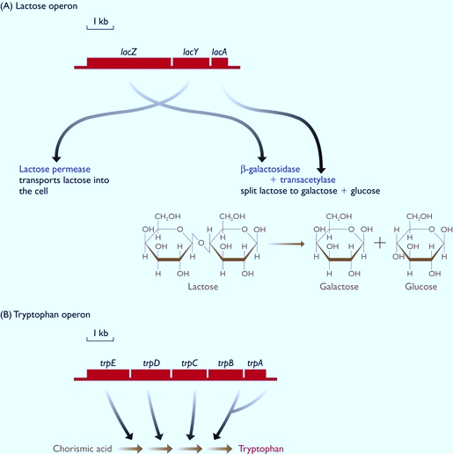
The two operons of Escherichia coli.
A)The lactose operon: the three genes are called lacZ, lacY and lacA, the first two separated by 52 bp and the second two by 64 bp. All three genes are expressed together, lacY coding for the lactose permease which transports lactose into the cell, and lacZ and lacA coding for enzymes that split lactose into its component sugars - galactose and glucose.
(B) The tryptophan operon: which contains five genes coding for enzymes involved in the multistep biochemical pathway that converts chorismic acid into the amino acid tryptophan. The genes in the tryptophan operon are closer together than those in the lactose operon: trpE and trpD overlap by 1 bp, as do trpB and trpA; trpD and trpC are separated by 4 bp, and trpC and trpB by 12 bp.

Slide 30
How an Operon Controls Transcription in a Prokaryotic cell ( example of a lactose operon: Video)
Search for the video: How an Operon controls transcription in a prokaryotic cell

Slide 31
End of lecture
Thank you.

