Slide 1
1.9 Energy Balance and weight maintanance

Slide 2
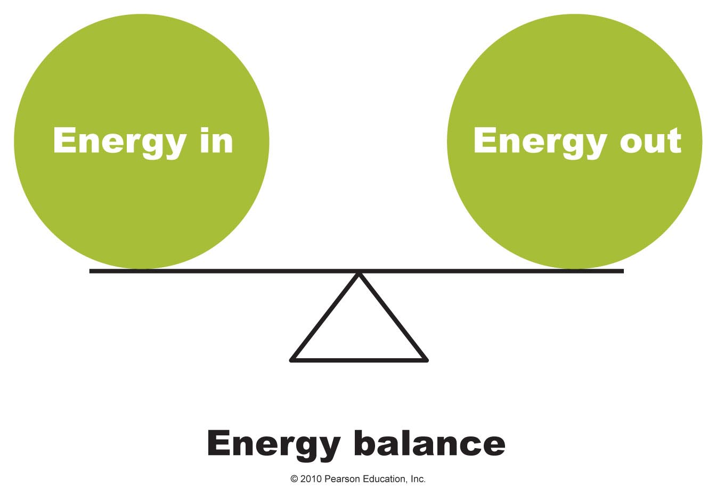
What Is Energy Balance and Why Is It Important?
Energy balance is achieved when the kilocalories consumed equal the kilocalories expended
Fig. 1

Slide 3
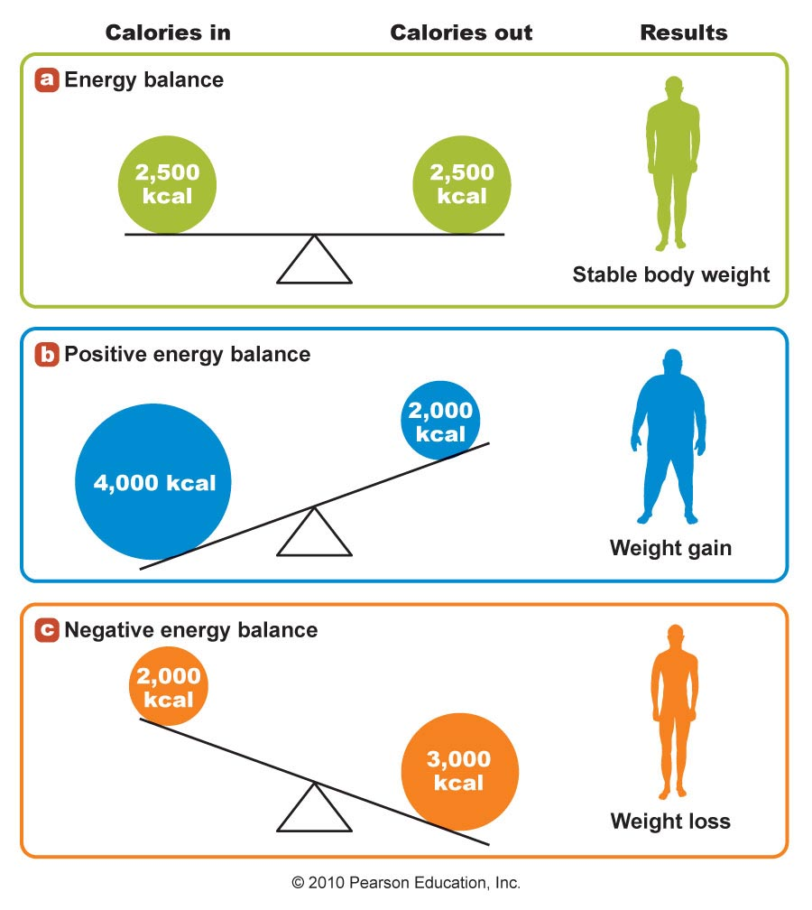
The Concept of Energy Balance
Fig. 2
Figure 14.1

Slide 4
Energy Balance (Fig 2) is a balance of energy intake
and output that results in little or no change in
weight over time
Positive energy balance energy intake exceeds
energy expenditure, resulting in an increase in
body energy stores and weight gain
Negative energy balance energy intake is lower
than energy expenditure, resulting in a depletion
of body stores and weight loss.

Slide 5
Weight maintenance
Weight management is a body condition achieved when the balance of energy intake and output is the same,
Normally the result is that of a ‘normal’ BMI ranging from 18.5 to 24.5
A positive enegy balance will tilt towards weight gain
A negative energy balance will tilt toward under nutrition

Slide 6
The Basal Metabolic Rate
Basal metabolic rate is the number of calories your body needs to accomplish its most basic (basal) life-sustaining functions.
Keeping your Basal Metabolic Rate (BMR) as high as possible is vital when it comes to weight loss and maintaining healthy body fat levels

Slide 7
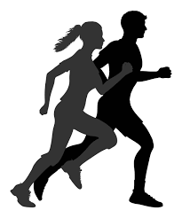
Factors that Affect Basal Metabolic Rate
Exercise: This is one of the biggest factors that influence BMR.
BMR is higher in people who exercise regularly

Slide 8
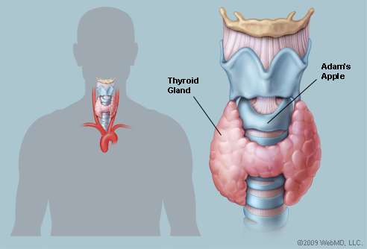
Hormones: an increase in thyroid hormones increases BMR, decreased levels of the hormone lower BMR
Body Temperature: Excessive heat or cold raise BMR

Slide 9

Gender: Males tend to have higher basal metabolism than females due to an abundance of hormones such as testosterone ad elevated levels of muscle mass compared to females
Age: as we get older basal metabolic rate becomes increasingly slower.

Slide 10
Surface Area: Taller individuals have a higher BMR compared to shorter individuals. More surface area means more heat lost from the body, which causes the metabolism to speed up in order to maintain body temperature.

Slide 11

Stress and Illness: increase in hormone activity due to physical or physiological stress increase BMR.
Starvation: Fasting for more than 48 hrs. will lead to a decrease of 50% of Basal Metabolic Rate.

Slide 12
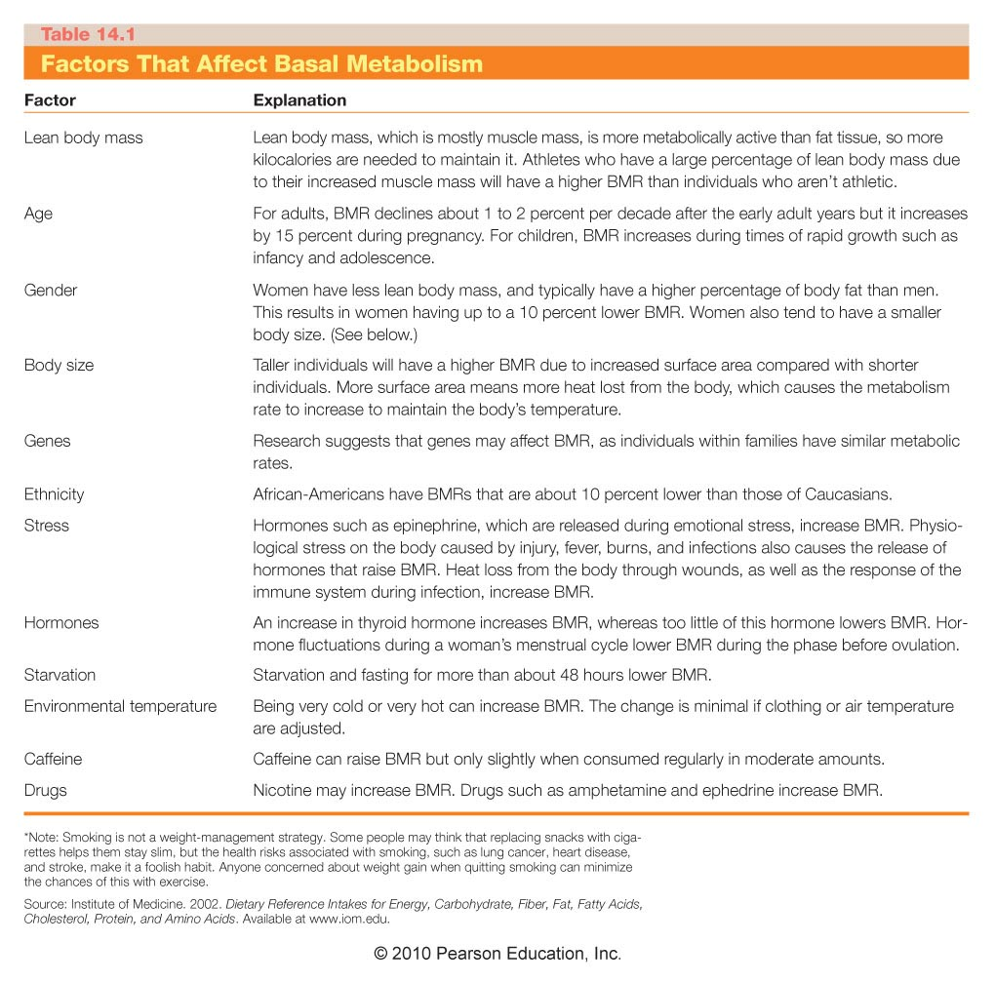

Slide 13
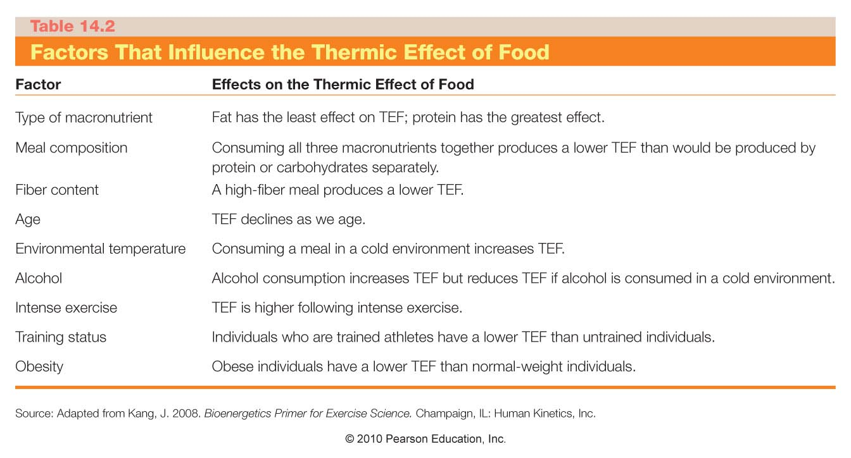

Slide 14
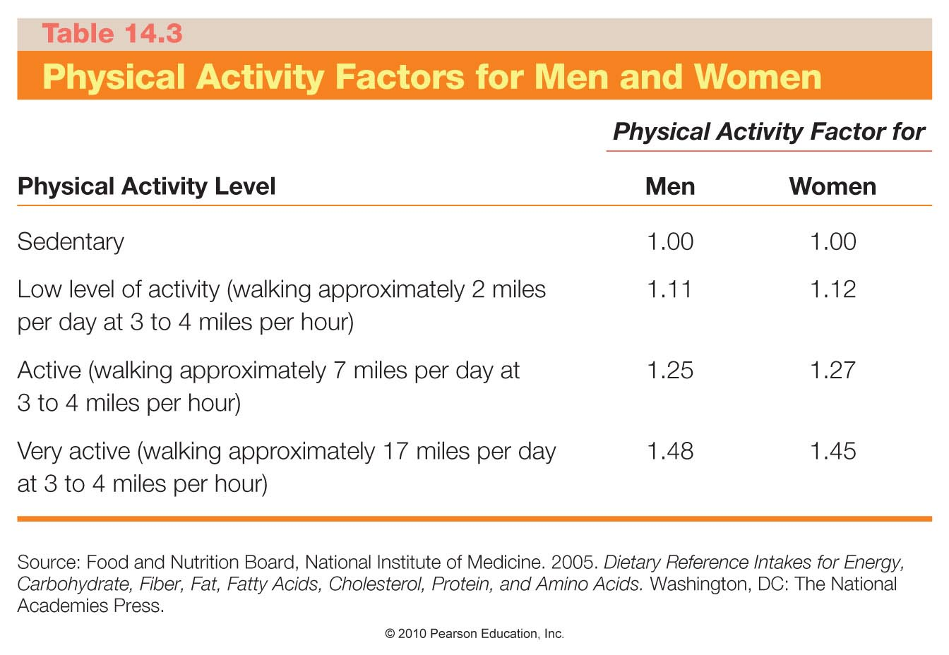

Slide 15
What Is Body Composition?
The ratio of fat tissue to lean body mass (muscle, bone, and organs)
  Usually expressed as percent body fat
  Important for measuring health risks associated with too much body fat

Slide 16
Most Body Fat Is Stored in Adipose Tissue
Two types of fat make up total body fat
  Essential fat
    Found in bone marrow, heart, lungs, liver, spleen, kidneys, intestines, muscles, and central nervous system
    Women have 4 times more essential fat than men
  Stored fat
    Found in adipose tissue
    Subcutaneous fat – located under the skin
    Visceral fat – stored around the organs in the abdominal area

Slide 17
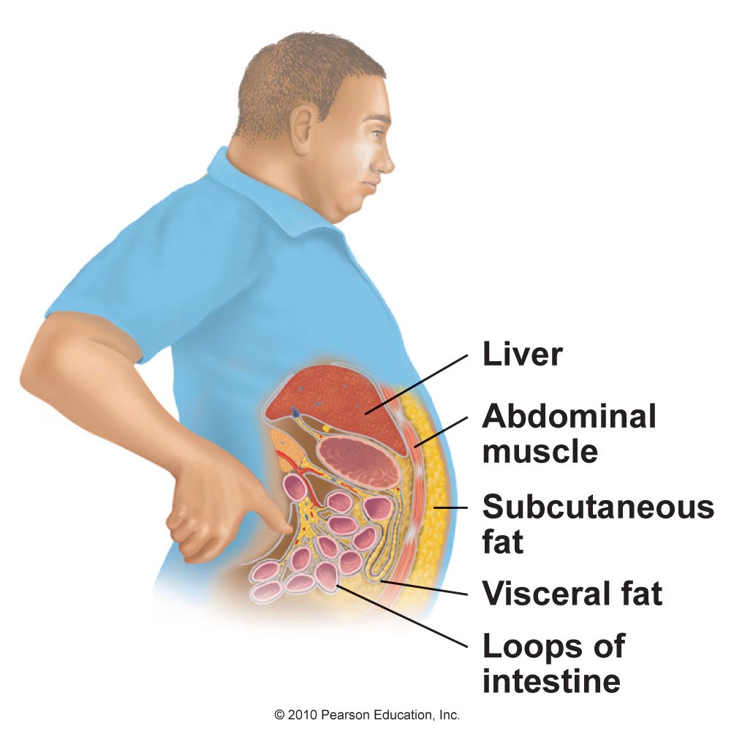
Visceral and Subcutaneous Fat Storage in the Body
Figure 14.6

Slide 18
Most Body Fat Is Stored in Adipose Tissue
In negative energy balance, fatty acids are released from adipose cells
  Used as fuel and cells shrink
In positive energy balance, fat accumulates and adipose cells expand
Brown adipose tissue (BAT) is another type of fat tissue made up of specialized fat cells
  Contain more mitochondria and rich in blood
  Function is to generate heat
  Found primarily in infants

Slide 19
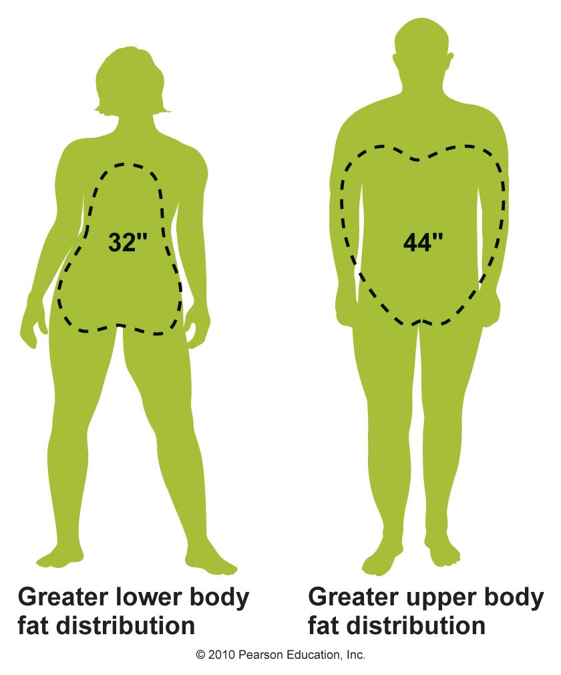
Distribution of Subcutaneous Body Fat
Figure 14.8

Slide 20
Body Fat Distribution Affects Health
Storing excess fat around the waist versus the hips and thighs increases risk of heart disease, diabetes, and hypertension
Central obesity (android obesity) – from storing too much visceral fat in the abdomen
Gynoid obesity – from excess fat around the thighs and buttocks
Visceral fat releases fatty acids which travel to the liver causing insulin resistance, increased LDL, decreased HDL, and increased cholesterol

Slide 21
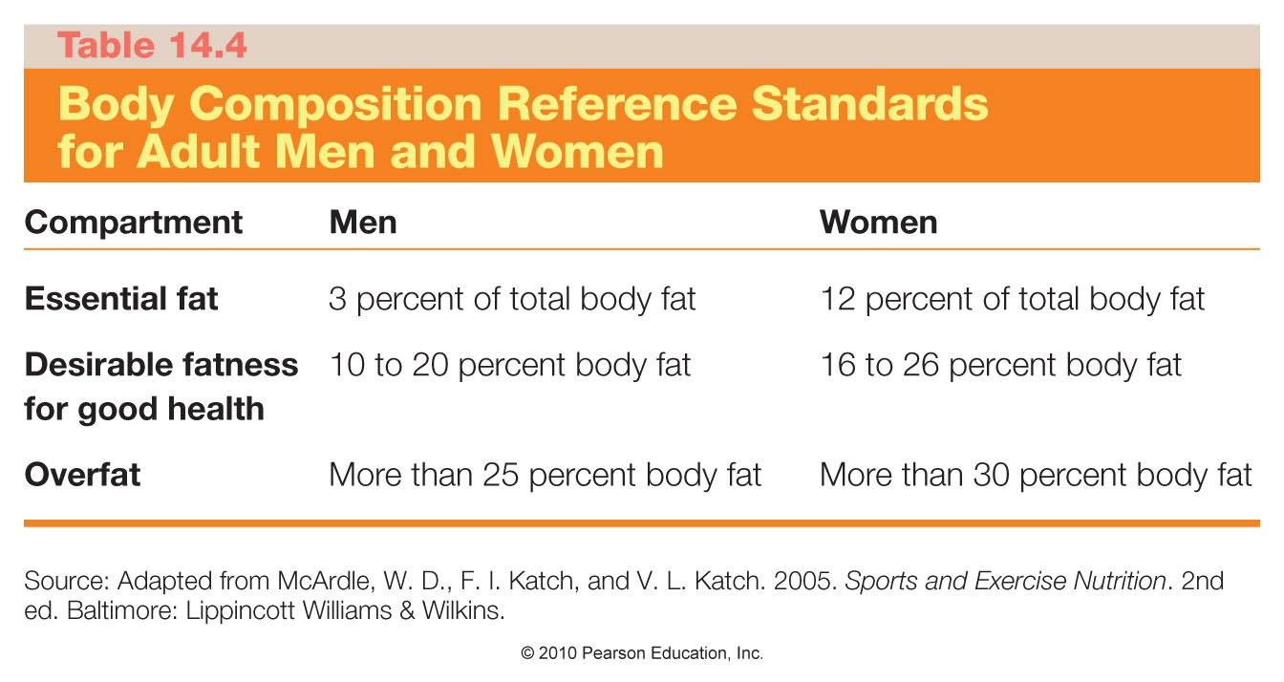

Slide 22
How Do We Estimate a Healthy Body Weight?
Body mass index is a useful indicator of healthy weight for most people
  Body mass index (BMI) calculates body weight in relation to height
  BMI = body weight (in kilograms) / height2 (in meters)
  BMI = body weight (in pounds) × 703 / height2 (in inches)

Slide 23
Body Mass Index
Healthy weight BMI 18.5–24.9
Overweight BMI 25–29.9
Obese BMI ≥ 30
Obese individuals have a 50–100% higher risk of dying prematurely than those at a healthy weight

Slide 24
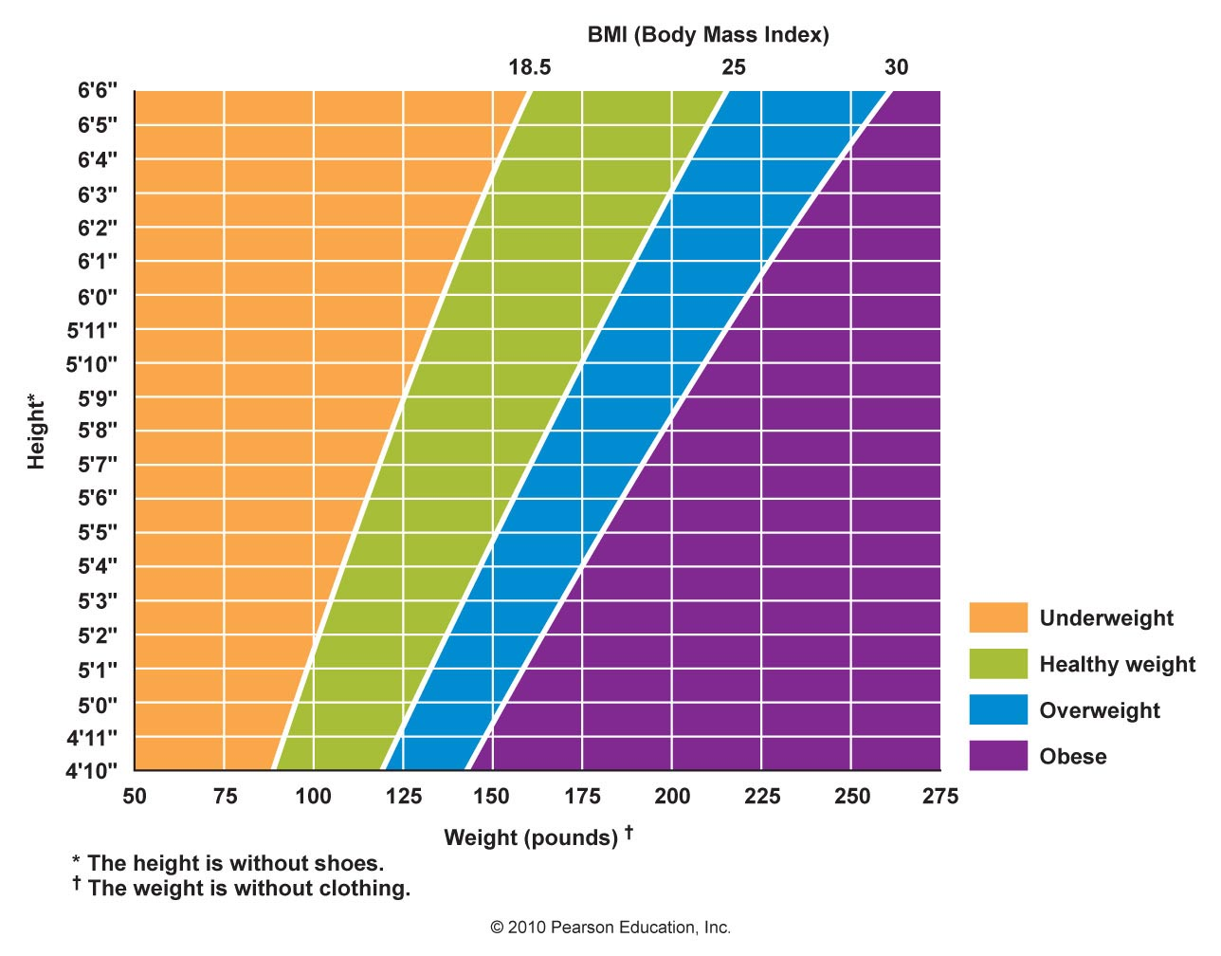
What’s Your BMI?
Figure 14.9

Slide 25
Body Mass Index
BMI may not be accurate for everyone
  Is not a direct measure of percent body fat and doesn't assess if weight is predominantly muscle or fat
  Athletes and individuals with high muscle mass may have a BMI over 25, yet a low percentage of body fat
  Chronic weight loss in older adults signals loss of muscle mass and depletion of nutrients stores even though BMI may be within the healthy range
  Individuals less than 5 ft in height may have a high BMI, but not be unhealthy

Slide 26
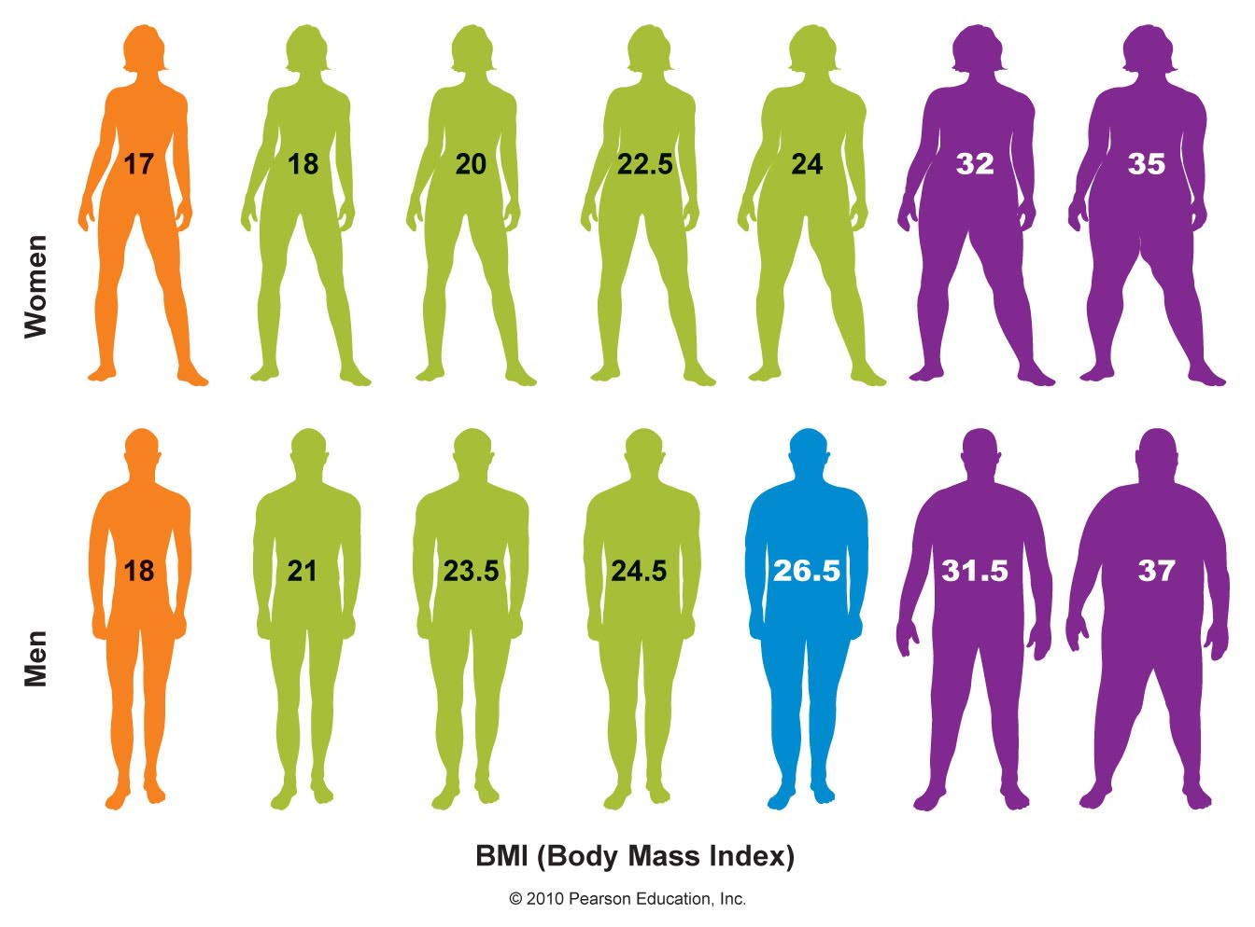
Waist Circumference Will Indicate Abdominal Fat
Waist circumference – a quick indicator of health risk
  Greater than 35 inches in women and 40 inches in men is associated with increased health risk even if BMI is normal
Figure 14.10

Slide 27
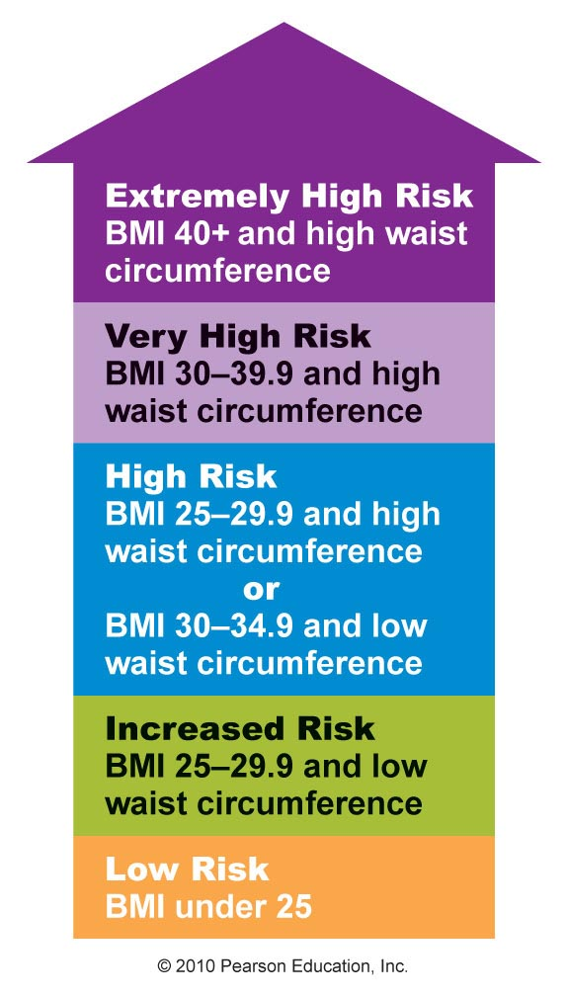
Using BMI and Waist Circumference to Determine Health Risks
Figure 14.12

Slide 28
Health Risks Associated with Body Weight and Body Composition
Being overweight increases health risks
  Overweight and obesity associated with increased risk of heart disease, hypertension, stroke, hyperlipidemia, gallstones, sleep apnea, and reproductive problems
  Increases risk of certain cancers including colon, breast, endometrial, and gallbladder cancer
  More than 80% of people with type 2 diabetes are overweight
  Metabolic syndrome is associated with central obesity

Slide 29
Health Risks Associated with Body Weight and Body Composition
Being underweight also increases health risks
  Symptomatic of malnutrition, substance abuse, or disease
  Higher risk of anemia, osteoporosis and bone fractures, heart irregularities, and amenorrhea
  Correlated with depression and anxiety, inability to fight infection, trouble regulating body temperature, decreased muscle strength, and risk of premature death
  May be unintentional and due to malabsorption associated with diseases such as cancer, inflammatory bowel disease, or celiac disease

Slide 30
Summary
Energy balance is the relationship between energy consumed as kilocalories and energy expended, and includes basal metabolism, physical activity, adaptive thermogenesis, and the thermic effect of food
Energy expenditure can be measured through direct or indirect calorimetry or estimated with reference equations.
Body composition describes the ratio of fat tissue to lean body mass; it is determined by hydrostatic weighing, air displacement, DEXA, bioelectrical impedance, or using skinfold calipers

Slide 31
Summary cont’d
Excess body fat and central obesity are associated with increased health risks including heart disease, type 2 diabetes, certain cancers, and other chronic diseases
Being underweight is also associated with health risks and increased risk of premature death

