Slide 1

NUTRITION & DIETETICS
COURSE CODE: BMS 3160
MUGODE L, Ph.D.

Slide 2
COURSE OBJECTIVE
At the end of the lesson the student should be able to
Understand principles of nutrition and nutritional requirements of human beings.

Slide 3
Unit 1.Nutrients: (sources, digestion and metabolism) Macro and Micronutrients
1.1 Carbohydrates: sugars, starches and fibre
1.2 Proteins and protein requirements
1.3 Lipids
1.4 Water-soluble vitamins
1.5 Fat-soluble vitamins
1.6 Vitamin requirements
1.7 Major minerals and trace elements
1.8 Glycaemic index
1.9 Energy balance and weight maintenance

Slide 4
Definitions
Nutrient, is a chemical substance in food that helps maintain the body.) Some provide energy, body building and other protective. All help build cells and tissues, regulate bodily processes such as breathing. No single food supplies all the nutrients the body needs to function.
A macromolecule is a very large molecule, such as protein, commonly created by the polymerization of smaller subunits (monomers).
Common macromolecules in biochemistry are carbohydrates, proteins, and lipids) and large non-polymeric nucleic acids
A micromolecule is a very small molecule, such vitamins and minerals
Recommended read, Contemporary Nutrition, A functional approach book by Gordon M. Wardlaw et al., 2012

Slide 5
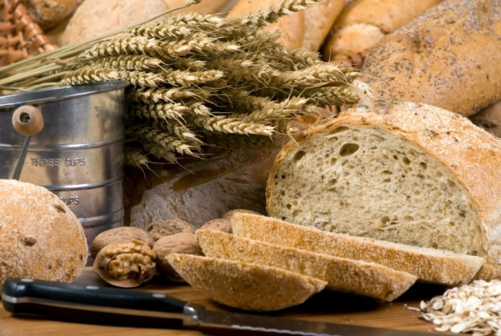
Unit 1.Nutrients: (sources, digestion and metabolism) Macro and Micronutrients

Slide 6
  Carbohydrates
  Carbohydrates are organic compounds containing Carbon, Hydrogen and Oxygen, and may be simple or complex molecules.
  Historically, carbohydrate has been used to classify all compounds with the general formula C_{n} (H₂O)_{n}
Read, Part Two . Macronutrients, types and sources, of (Carbohydrate, Proteins and Lipids), pp 123 -209
Recommended, Contemporary Nutrition, A functional approach book by Gordon M. Wardlaw et al., 2012

Slide 7
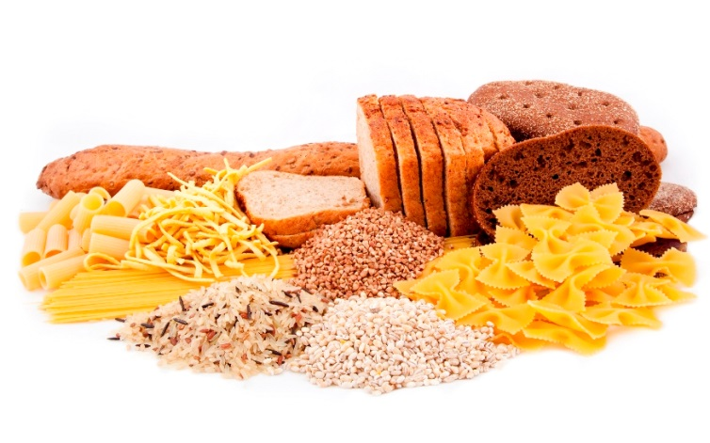

Carbohydrates
There are two types of carbohydrate which provide the body with energy – (Sugars and Starches).
Dietary fibre is also a form of carbohydrate and is important for digestive health, however this is not digested to provide the body with energy.
Starchy carbohydrate is an important source of energy.
1g of carbohydrate provides 4 kcal (17kJ).
© Livestock & Meat Commission for Northern Ireland 2015

Slide 8
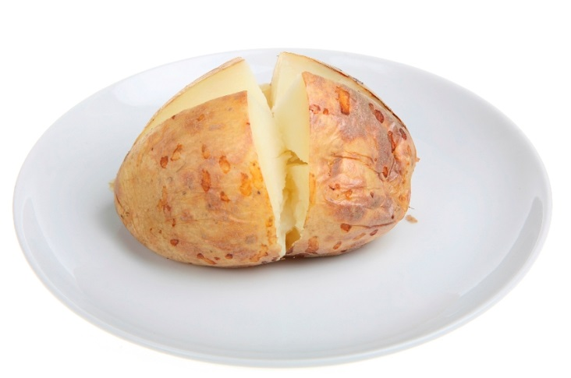
Classification of carbohydrates
Monosaccharides are the simplest carbohydrate molecule. Examples include:
Glucose
Fructose
Galactose
Disaccharides are formed when two monosaccharides join together, with the removal of one molecule of water. Examples include:
Sucrose (glucose + fructose)
Lactose (glucose + galactose)
Maltose (glucose + glucose)
Monosaccharides and disaccharides are collectively termed as ‘sugars’.
© Livestock & Meat Commission for Northern Ireland 2015

Slide 9
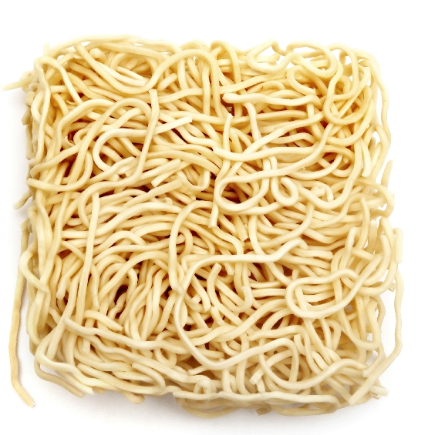
Functions of carbohydrate
Carbohydrate is the only dietary source of glucose, and provides the body with 4kcal/17kJ per gram.
Dietary fibre provides a small amount of energy as it is digested in the large bowel by the resident bacteria into short chain fatty acids.
This provides the body with 2kcal/8kJ per gram.
© Livestock & Meat Commission for Northern Ireland 2015

Slide 10
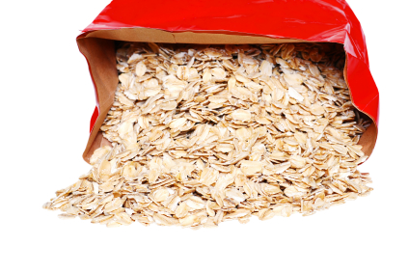
Recommendations on carbohydrate
It is recommended that meals are based on starchy foods.
Carbohydrates should provide around 50% of dietary energy (starch and sugars combined).
In general, for adults, it is recommended to consume10–35% of calories from protein, 45–65% from carbohydrates, and 25–35% of calories from fat.

Slide 11
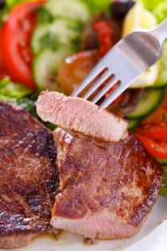
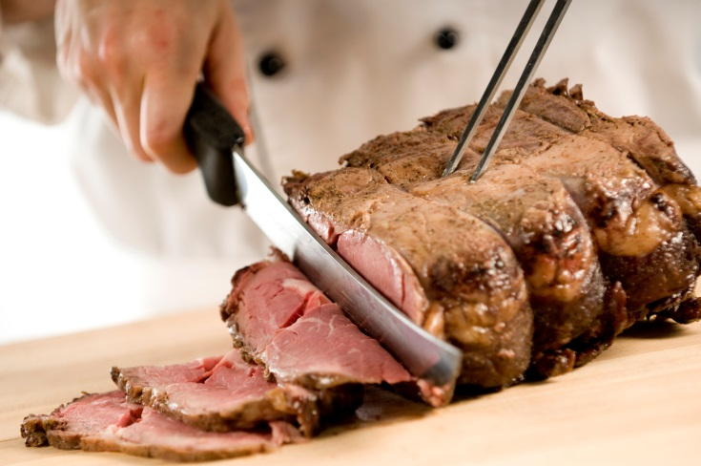
PROTEIN
Proteins are large macromolecules, made up of a series of amino acids.
Amino acids are the building blocks of proteins.
There are about 20 different amino acids commonly found in plant and animal proteins.

Slide 12
Protein cont’d
The amount of essential amino acids that are present determines the biological value of the protein.
Proteins derived from an animal source provide good amounts of the essential amino acids, and therefore have a higher biological value than proteins derived from a plant source.
For adults, 8 of the Amino Acids have to be provided by foods in the diet, and are therefore defined as ‘essential’ or ‘indispensable’ amino acids.
These are leucine, isoleucine, valine, threonine, methionine, phenylalanine, tryptophan, lysine.
© Livestock & Meat Commission for Northern Ireland 2015

Slide 13
Sources of protein
Animal sources:
meat;
poultry;
fish;
eggs;
milk;
dairy foods.
Plant sources:
soya;
nuts;
seeds;
pulses, e.g. beans, lentils;
mycoprotein.
© Livestock & Meat Commission for Northern Ireland 2015

Slide 14

Protein complementation
If vegetarians and vegans eat a variety of vegetable proteins in combination, there is no reason why the quality of protein cannot be as good as in a diet consuming animal proteins.
QS, Can you think some of some examples of protein complementation?
rice and peas;
beans on toast;
hummus and pitta bread;
bean chilli served with rice.
© Livestock & Meat Commission for Northern Ireland 2015

Slide 15
Protein function
Protein is required for growth and repair of the body and to maintain good health.
Protein forms structural and functional elements of body cells, and is needed for growth in muscle mass and the maintenance of muscle mass and normal bones.
Protein is involved in various metabolic reactions, including signalling functions.
Read, Part Two . Macronutrients, types and sources, of ( Proteins pp 209
Recommended, Contemporary Nutrition, A functional approach book by Gordon M. Wardlaw et al., 2012
© Livestock & Meat Commission for Northern Ireland 2015

Slide 16

Fat /Lipids
Fat is made up of different types of fatty acids attached to a glycerol molecule backbone. This is called a triglyceride.
Depending on their chemical structure, fatty acids are often classified as:
saturated fatty acids (also known as ‘saturated fat’ or ‘saturates’);
monounsaturated fatty acids;
polyunsaturated fatty acids (omega-3, omega-6 and omega-9);
trans fatty acids.
© Livestock & Meat Commission for Northern Ireland 2015

Slide 17
FATTY ACIDS
The basic components of lipids are fatty acids.
They form chains that vary in length from 4 to 26 carbon atoms.
The fatty acids are not linked in a long chain (as amino acids in proteins) but are bound to an alcohol, Glycerol, to form triglycerides

Slide 18
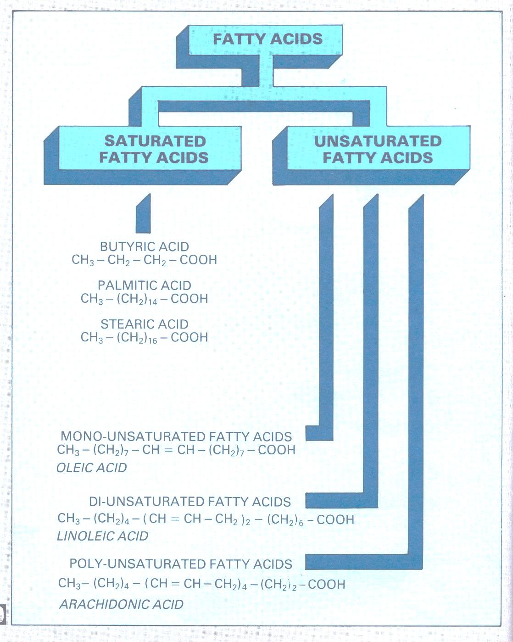

Slide 19
FATTY ACIDS
Saturated fatty acids – are characterised by single bonds between the carbon atoms e.g. butyric acid, palmitic acid and stearic acid.
Unsaturated fatty acids – are characterised by one or more double bonds. The double bonds can “open” and take up a single molecule, thus becoming saturated. Some unsaturated fatty acids contain only one double bond. These are called mono-unsaturated fatty acids e.g. Oleic acid.

Slide 20

Saturated fat
Eating too many foods high in fat, especially saturated fat, can have adverse effects on health.
This is associated with raised blood cholesterol level, which is one of the risk factors for coronary heart disease.
Diets high in saturated fatty acids are associated with the development of insulin resistance and abnormal blood fat levels, which are associated with increased risk of type 2 diabetes.

Slide 21
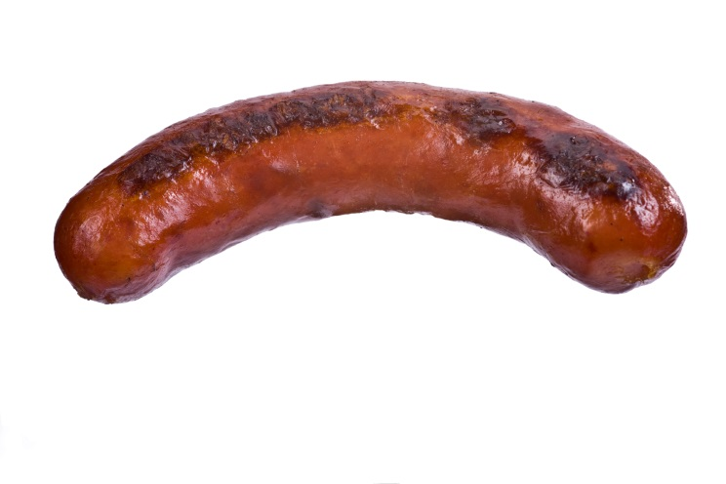
Sources of saturated fat
Meat and meat products – 26%
Cereal and cereal products – 20%
Milk and milk products – 19%
Eggs and egg dishes – 3%
Fat spreads – 13%
Vegetables and potatoes – 6%
Fish and fish dishes – 2%
Vegetables and potatoes – 6%
Savoury snacks – 2%
Nuts and seeds – 1%
Sugars, preserves and confectionary – 5%
Miscellaneous – 3%
Notes:
Meat and meat products – 26%
Of which:
Bacon and ham – 3%
Beef, veal and dishes - 5%
Lamb and dishes – 1%
Pork and dishes – 2%
Coated chicken and turkey – 1%
Chicken, turkey and dishes – 3%
Burgers and kebabs – 2%
Sausages – 5%
Meat pies and pastries – 3%
Other meat, meat products and dishes – 1%

Slide 22
Functions of fat
Fat is a concentrated source of energy. 1 gram of fat provides 9kcal (37kJ).
Fat is the carrier for fat-soluble vitamins A,D, E and K.
Fat is a component of hormones which control biochemical reactions within cells.
Fat provides cushioning for the major organs in the body.
© Livestock & Meat Commission for Northern Ireland 2015

Slide 23
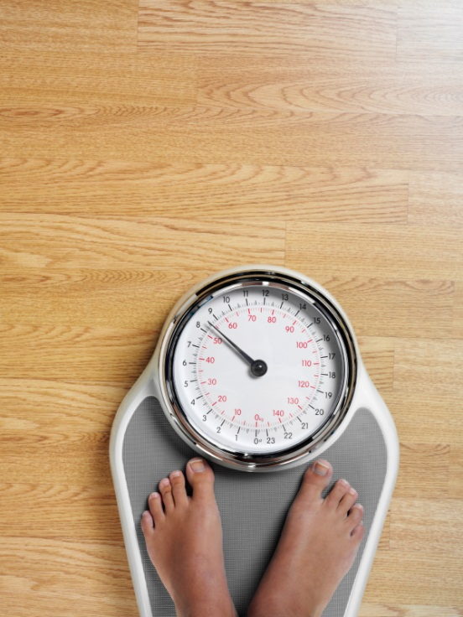
Health effects of macronutrients
Obesity
Cardiovascular disease
Diabetes
© Livestock & Meat Commission for Northern Ireland 2015

Slide 24
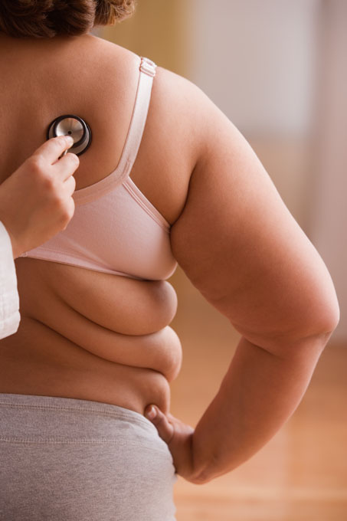
Obesity
Obesity is a condition in which abnormal or excessive fat accumulation in adipose tissue impairs health.
It is often the result of energy intake exceeding energy expenditure over a long period of time.
It is defined in adults as a body mass index (BMI) above 30.
Overweight and obesity are associated with an increased risk of developing some cancers, cardiovascular disease and type 2 diabetes.

Slide 25

Cardiovascular disease
Cardiovascular disease includes coronary heart disease (CHD) and stroke, is a common cause of death and ill-health.
The two main events that lead to CVD are atherosclerosis and thrombosis.
Atherosclerosis causes narrowing of the blood vessels, which can result in reduced flow of blood to the heart and may cause chest pain, which is known as angina.
© Livestock & Meat Commission for Northern Ireland 2015

Slide 26

Diabetes
Diabetes has become a major threat to public health.
It is one of the major causes of premature illness and death in most countries.
There are two main types – type 1 and type 2.
© Livestock & Meat Commission for Northern Ireland 2015

Slide 27

Summary
Carbohydrate, protein and fat are known as the macronutrients.
Macronutrients provide energy in varying amounts.
All of the macronutrients are important for different functions.
Government recommendations on the quantities we require for each individual vary according Food based dietary based guidelines
for each region or country .

Slide 28
WATER AND MINERAL SALTS
Quantitatively, water is the most important component of the human body. It represents, on average, 66% of body weight in adults and almost 75% in the newborn.
Water is essential for all life processes. The body can go without food for several weeks but it cannot do without water
Body water is divided into two compartments:
  Intracellular; approx. 50% of body weight and 2/3 of total body water
  Extracellular

Slide 29
Role and Sources of Water
Role
  It helps build and renew
  It acts as a solvent and carrier of nutrients and waste products in solution
  It is required for all biological reactions in the body
Sources
  The fluids we drink
  The food we eat
  As a by-products of fat, carbohydrates and proteins metabolism

Slide 30
MINERAL SALTS
Mineral refers to a group inorganic ions in their elemental form.
The essential minerals for nutrition, which must be supplied in the diet, may be classified as:
  Macroelements – essential for the normal development & functioning of the body at levels of 100mg or more per day.
  Microelements – essential to the body at level of 0.01mg to a few mg per day

Slide 31
CLASSIFICATION OF MINERALS
MINERALS
MACROELEMENT
Calcium
Phosphorus
Magnesium
Sodium
Potassium
Chloride
MICROELEMENT
Iron Manganese
Iodine Molybdenum
Zinc Selenium
Copper Fluoride
Chromium

Slide 32
ROLE OF MINERALS
They form part of the tissues and skeleton
They are essential for growth
Some act as catalysts or carriers and regulates the metabolism of several enzymes
Minerals also maintain nerve and muscular excitability
They are important in maintaining the acid – base balance

