Slide 1
Unit 1.6 and 1.7:
Vitamins & Minerals requirements
Objective: At the end of the lesson, the student should be able to understand principles of nutrition and nutritional requirements of human beings.

Slide 2
Recommendation
The information contained in this PowerPoint is presented to encourage healthy eating.
It is not meant to diagnose or prescribe a person’s health needs.
Before making changes in one’s diet, one should seek the guidance of a Nutrition-dietician professional

Slide 3
Introduction
By definition, Vitamins are organic compounds made by plants and animals which can be broken down by heat, acid or air.
On the other hand, minerals are inorganic compounds, exist in soil or water and cannot be broken down.
The micronutrient content of each food is different, so it’s best to eat a variety of foods to get enough vitamins and minerals.
A recommended intake of micronutrients (vitamins & minerals) is key for optimal health, as each vitamin and mineral has a specific role in your body.
Depending on their function, certain micronutrients also play a role in preventing and fighting disease

Slide 4
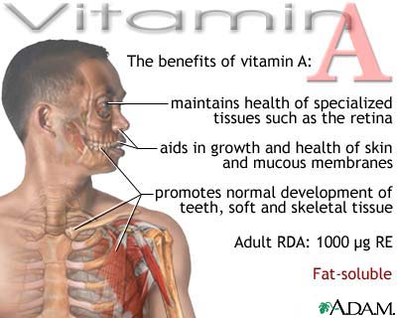

Slide 5
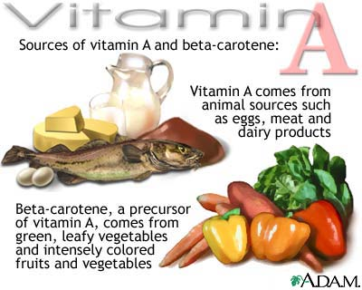

Slide 6
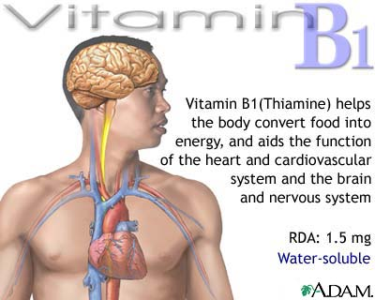

Slide 7
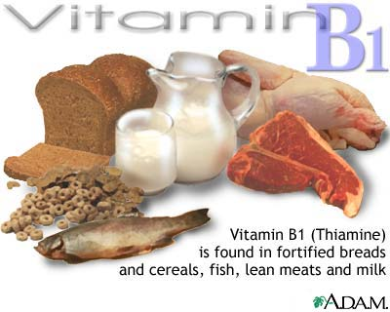

Slide 8
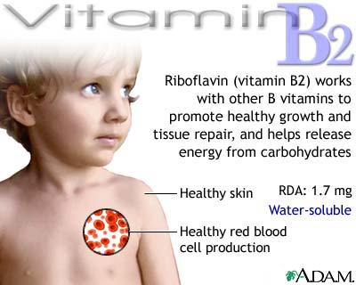

Slide 9
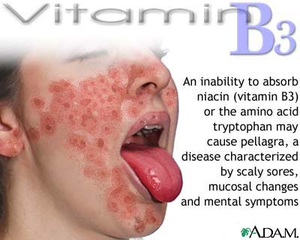

Slide 10
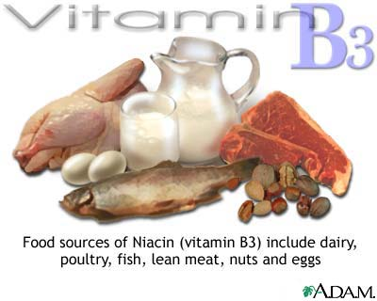

Slide 11
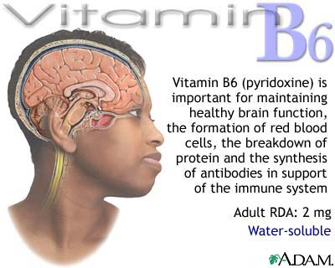

Slide 12
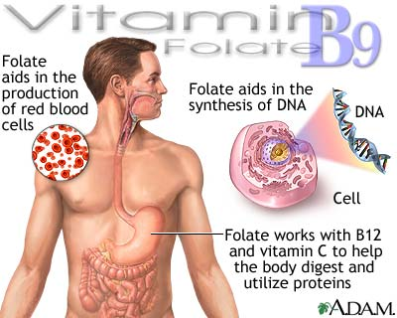

Slide 13
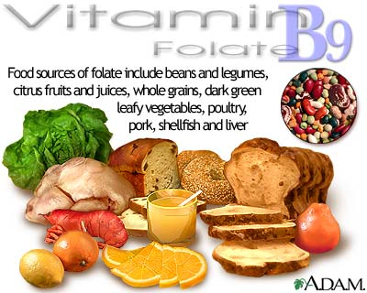

Slide 14
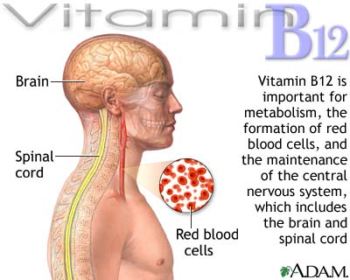

Slide 15
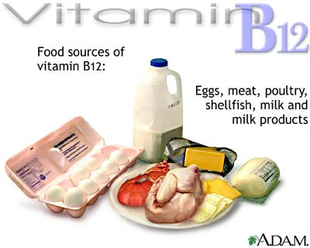

Slide 16
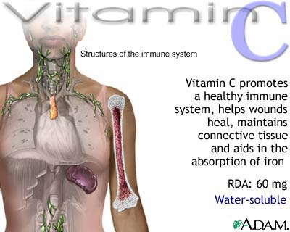

Slide 17
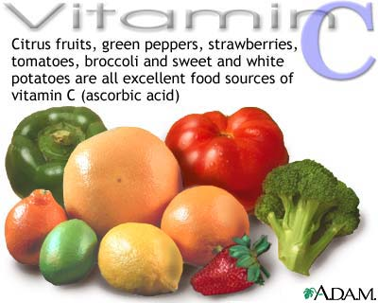

Slide 18
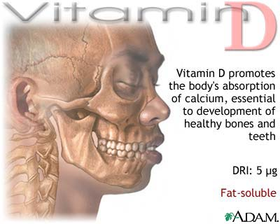

Slide 19
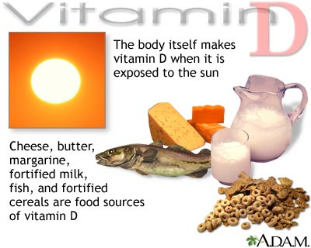

Slide 20
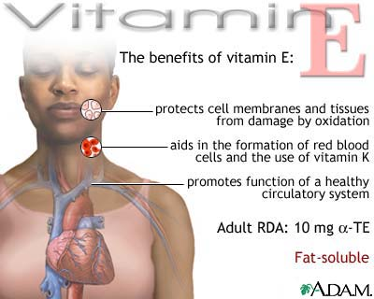

Slide 21
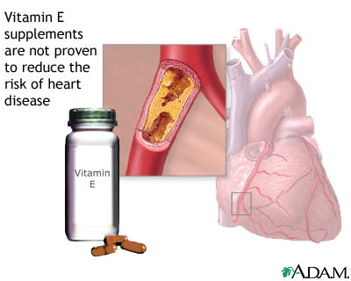

Slide 22
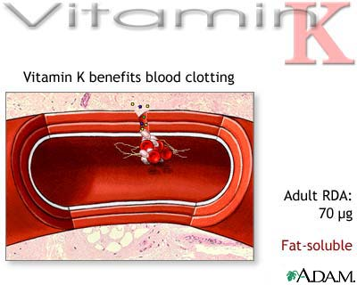

Slide 23
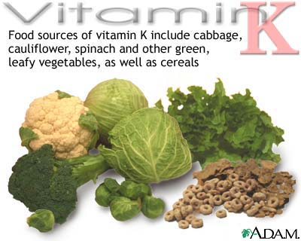

Slide 24
1.7 Minerals, functions and sources

Slide 25
Calcium
Calcium and bone health
Human bones are living tissues and continue to change throughout life.
When calcium intake is low or calcium is poorly absorbed, bone breakdown occurs because the body must use the calcium stored in bones to maintain normal biological functions such as nerve and muscle function. Bone loss also occurs as a part of the aging process.

Slide 26
Sources of Calcium
Foods such as Chinese cabbage, kale and broccoli are other alternative calcium sources, particularly for those who are lactose intolerant.

Slide 27
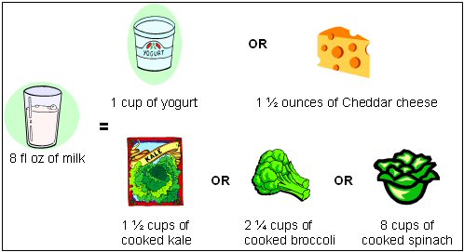
Calcium Content of 236 ml of Milk Compared to Other Food Sources of Calcium

Slide 28
Chromium
Chromium deficiency impairs the body's ability to use glucose to meet its energy needs and raises insulin requirements.
It has been suggested that chromium supplements might help to control type 2 diabetes or the glucose and insulin responses in persons at high risk of developing the disease.

Slide 29
Sources of Chromium
Chromium is widely distributed in the food supply, but most foods provide only small amounts (less than 2 micrograms [mcg] per serving).
Meat and whole-grain products, as well as some fruits, vegetables, and spices are relatively good sources.
In contrast, foods high in simple sugars (like sucrose and fructose) are low in chromium.

Slide 30
Food | Chromium (mcg)
Broccoli, ½ cup | 11
Grape juice, 1 cup | 8
English muffin, whole wheat, 1 | 4
Potatoes, mashed, 1 cup | 3
Garlic, dried, 1 teaspoon | 3
Basil, dried, 1 tablespoon | 2
Beef cubes, 3 ounces | 2
Orange juice, 1 cup | 2
Turkey breast, 3 ounces | 2
Whole wheat bread, 2 slices | 2
Red wine, 5 ounces | 1-13
Apple, unpeeled, 1 medium | 1
Banana, 1 medium | 1
Green beans, ½ cup | 1

Slide 31
Iron
Iron, one of the most abundant metals on Earth, is essential to most life forms and to normal human physiology.
Iron is an integral part of many proteins and enzymes that maintain good health.
In humans, iron is an essential component of proteins involved in oxygen transport.
It is also essential for the regulation of cell growth and differentiation

Slide 32
Sources of Iron
Beef, turkey, chicken, tuna, pork, oysters, and clams provide heme iron (more readily absorbed form).
Spinach, oatmeal, soybeans, lentils, beans, tofu, raisins, and whole wheat bread provide nonheme iron (less easily absorbed form).

Slide 33
Magnesium
Magnesium is the fourth most abundant mineral in the body and is essential to good health.
Approximately 50% of total body magnesium is found in bone.
The other half is found predominantly inside cells of body tissues and organs.
Only 1% of magnesium is found in blood, but the body works very hard to keep blood levels of magnesium constant.

Slide 34
Sources of Magnesium
Green vegetables such as spinach are good sources of magnesium because the center of the chlorophyll molecule (which gives green vegetables their color) contains magnesium.
Some legumes (beans and peas), nuts and seeds, and whole, unrefined grains are also good sources of magnesium.

Slide 35
Selenium
Selenium is a trace mineral that is essential to good health but required only in small amounts.
Selenium is incorporated into proteins to make selenoproteins, which are important antioxidant enzymes.
The antioxidant properties of selenoproteins help prevent cellular damage from free radicals.

Slide 36
Sources of Selenium
Plant foods are the major dietary sources of selenium in most countries throughout the world.
The content of selenium in food depends on the selenium content of the soil where plants are grown or animals are raised.

Slide 37
Zinc
Zinc is an essential mineral that is found in almost every cell.
It stimulates the activity of approximately 100 enzymes, which are substances that promote biochemical reactions in your body.
Zinc supports a healthy immune system, is needed for wound healing, helps maintain your sense of taste and smell, and is needed for DNA synthesis.

Slide 38
Sources of Zinc
Zinc is found in a wide variety of foods.
Oysters contain more zinc per serving than any other food, but red meat and poultry provide the majority of zinc in the American diet.
Other good food sources include beans, nuts, certain seafood, whole grains, fortified breakfast cereals, and dairy products.

