Slide 1
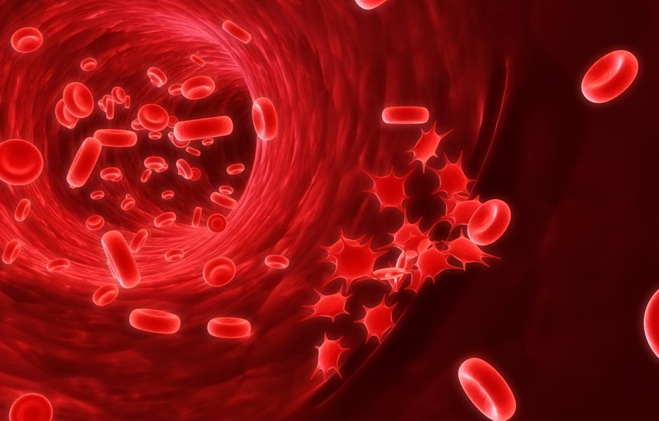
DRUGS USED FOR BLOOD COAGULATION DISORDERS
Margaret M.Silwimba ,B- Pharm, Msc Clin. pharmacy

Slide 2
Learning Objectives:
At the end of this session, YOU should be able to:
Describe the physiological role of blood coagulation;
Outline the blood clotting cascade;
Describe the classes of drugs used for blood coagulation disorders;
Describe the pharmacology of drugs used for blood coagulation disorders.

Slide 3
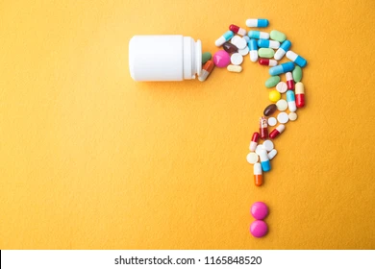

Slide 4
Hemostasis, essential mechanism that protects the body from ext. & int. injury
Without efficient hemostasis, bleeding from wounds or internal injuries would lead to shock and death.
Too much clotting, however, can also be dangerous
Physiological processes of hemostasis must maintain a delicate balance between blood fluidity and coagulation.
Many common diseases affect hemostasis, including myocardial infarction (MI), stroke, venous or arterial thrombosis, valvular heart disease, and indwelling catheters.
Above conditions are so prevalent in clinical practice, biomedical scientist will have frequent occasions to monitor parameters of hemostasis.

Slide 5
The process of hemostasis
Complex process involving a number of clotting factors that are activated in a series of sequential steps.
Injured blood vessel initiates the clotting process
Coagulation cascade series of complex reactions initiated when collagen is exposed at the site of injury.
Two separate pathways, along with numerous biochemical processes, lead to coagulation. Intrinsic & extrinsic →→→ Common pathway.

Slide 6
Near the end of the cascade, prothrombin activator or prothrombinase is formed. Prothrombin activator converts the clotting factor prothrombin to an enzyme called thrombin. Thrombin then converts fibrinogen, a plasma protein, to long strands of fibrin.
Clotting factors, including fibrinogen, are proteins made by the liver.

Slide 7
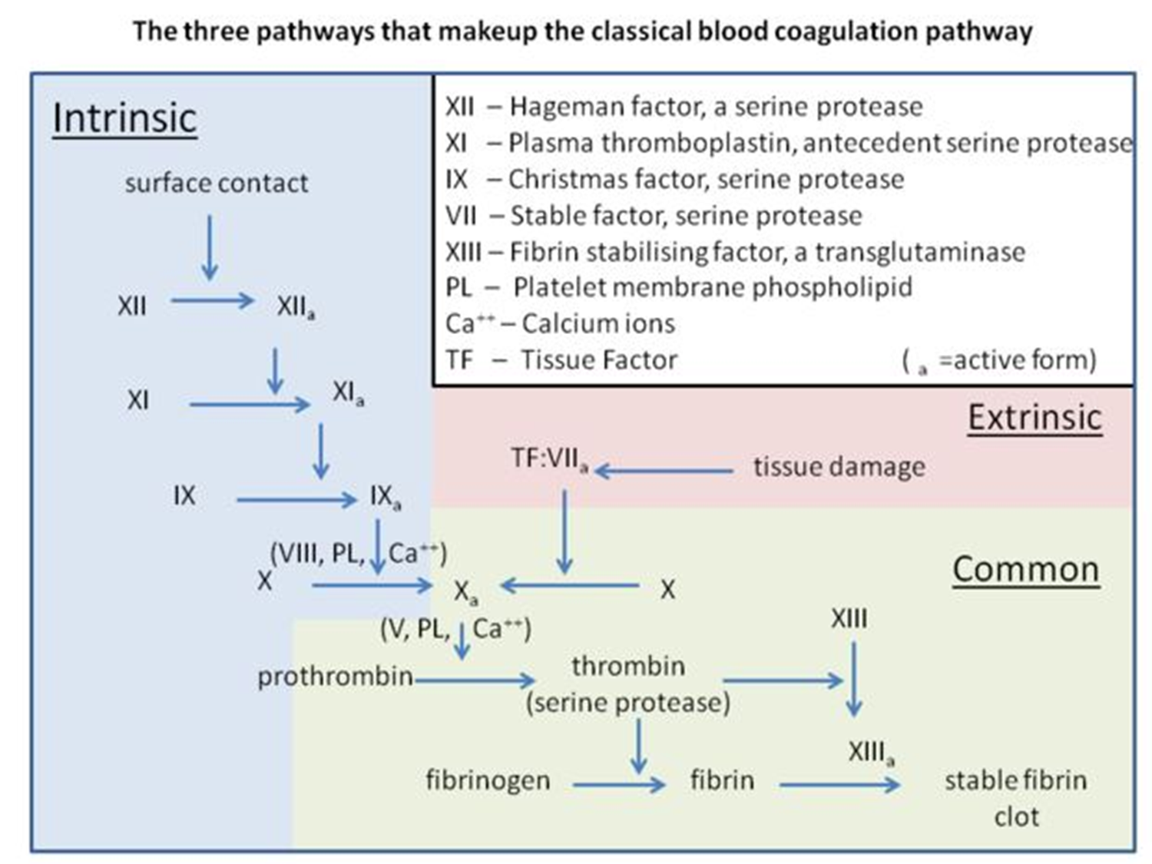
Blood Clotting Cascade
Luellmann, 2005

Slide 8
Fibrinolysis
The process of clot removal
Initiated within 24 to 48 hours of clot formation and continues until the clot is dissolved
Involves several sequential steps:
When the fibrin clot is formed, nearby blood vessel cells secrete the enzyme tissue plasminogen activator (TPA).
TPA converts the inactive protein plasminogen, present in the fibrin clot, to its active enzymatic form, plasmin.
Plasmin then digests the fibrin strands to remove the clot.
The body normally regulates fibrinolysis such that unwanted fibrin clots are removed, whereas fibrin present in wounds is left to maintain hemostasis.

Slide 9
Thromboembolic disorders
Conditions in which the body forms undesirable clots
May arise in both arteries and veins
Arterial thrombi deprive an area of adequate blood flow, causing tissue ischemia →Cessation of blood flow →infarction or tissue death. (MI,Stroke)
Venous thrombi usually form in the veins of the legs in susceptible patients due to sluggish blood flow(DVT)
Embolus from right atrium→pulmonary emboli
Embolus from left atrium →stroke or arterial infarction elsewhere in body.

Slide 10
Arterial thrombi and emboli can also occur in:
Surgical procedures
Following arterial punctures such as angiography.
Patients with indwelling catheters and mechanical heart valves (susceptible to thrombi formation and frequently receive prophylactic anticoagulant therapy)
***Thromboembolic disorders are the most common indications for pharmacotherapy with coagulation modifiers

Slide 11
Bleeding disorders
Characterized by abnormal clot formation
Thrombocytopenia - deficiency of platelets (Counts below 150,000 mm3)
Result of either decreased platelet production or increased platelet destruction. (bone marrow suppression, immunosuppressant drugs, most meds for cancer chemotherapy)
Hemophilias - bleeding disorders caused by genetic deficiencies in specific clotting factors.
400 thousand people worldwide are living with hemophilia.
Hemophilia A - clotting Factor VIII.

Slide 12
Hemophilia B - Factor IX
Hemophilia C – Factor XI
Von Willebrand’s disease (vWD) - most common inherited coagulation disorder. Decrease in quantity or quality of von Willebrand factor (vWF)

Slide 13
Drug classes used for therapy of coagulation disorders include:
Anticoagulants: - Drugs which interfere with blood clot formation.
Antiplatelets (Anti-thrombotics): - Drugs which interfere with platelet aggregation.
Fibrinolytics (Thrombolytics): - Drugs which lead to lysis of fibrin (clot).

Slide 14
ANTICOAGULANT DRUGS

Slide 15
Medicines that help prevent blood clots. AKA “blood thinning” medicines.
Reduce chances of developing serious conditions such as strokes, heart attack, deep vein thrombosis and pulmonary embolism .
Work by interrupting the process involved in formation of blood clots.

Slide 16
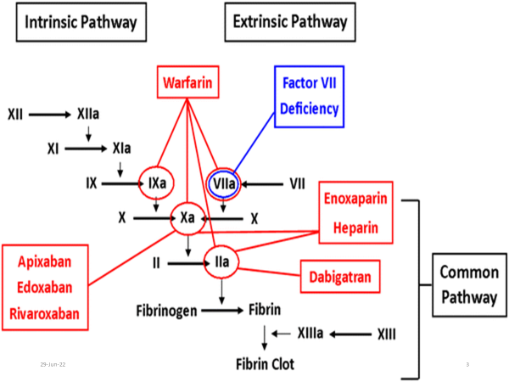
Targets for anticoagulant drugs

Slide 17
Anticoagulant drug classes include:
Antithrombin-dependent Anticoagulants e.g. Heparin (and its congeners): interfere with critical steps of clot formation
Direct Thrombin Inhibitors e.g. Hirudin derivatives: interfere with thrombin directly
Oral Anticoagulants: e.g. Coumarins - interfere with synthesis of coagulation factors

Slide 18
Antithrombin-dependent Anticoagulants

Slide 19
Heparin
Unfractionated heparin (UFH)
Low-molecular-weight heparin (LMWH),
Fondaparinux (a pentasaccharide with indirect factor Xa-inhibiting effects)
Mechanism of Action:
Binds to Antithrombin to from antithrombin-heparin complex that accelerates & enhances antithrombin activity of inactivation of clotting factor proteases, especially thrombin (IIa), IXa, Xa, XIa and XIIa.
Notes:
Antithrombin inhibits clotting factor proteases, especially thrombin (IIa), IXa, and Xa, by forming equimolar stable complexes with them. In the absence of heparin, these reactions are slow; in the presence of heparin, they are accelerated 1000-fold.

Slide 20
Pharmacological Effects of Heparin
Inhibits Thrombin (IIa) and activated factors IX, X, XI and XII → anticoagulant effect
Large dose of Heparin activates Cofactor-II (Thrombin inhibitor)
Stimulates lipoprotein lipase enzyme → plasma clearing effect
Slight vasodilator effect → canalization of thrombus

Slide 21
Pharmacokinetics of Heparin
Rapid onset of action after I.V Inj. but it has short duration of action (4-6 hrs)
80% metabolized in liver by heparinase enzyme.
20% excreted unchanged via the kidney
Heparin does not cross the placenta and is not excreted in milk. (Therefore, Heparin can be given during pregnancy and lactation)

Slide 22
UFH vs. LMWH
 | Unfractionated Heparin | Low Molecular Weight Heparin
Types: | Heparin sodium | Enoxaparin, Dalteparin, Tinzaparin, Nadroparin, Danaparoid, Ardaparin, etc
Mechanism: | Inhibit all three factors (Factor IIa, IXa, Xa), especially thrombin (IIa) and factor Xa | Inhibit mainly factor Xa but have less effect on thrombin (IIa)
Efficacy: | Equal | Equal
Administration: | IV infusion | SC/IV
Dosing: | Metered Infusion | OD or BD dose
Safety & Monitoring | Monitor aPTT closely Monitor Platelet count | Do not require close monitoring of aPTT

Slide 23
Clinical Monitoring of Heparin Effects
UFH therapy controlled by the Activated Partial Thromboplastin Time (aPTT) - which should be kept at twice the normal value (normal value: 30-35 seconds);
Close monitoring of aPTT is necessary in patients receiving UFH;
Target aPTT level corresponds to an anti-factor Xa level of 0.35–0.70 units/ml
Notes:
LMWH levels are not generally measured except in cases of renal insufficiency, obesity, and pregnancy.

Slide 24
Indications for Heparin therapy
Prevention & treatment of Deep Venous Thrombosis and pulmonary embolism
Acute arterial occlusion (e.g. Pulmonary, cerebral or retinal embolism)
Myocardial infarction and coronary thrombosis
Cardiac and vascular surgery
Haemodialysis (Heparin)

Slide 25
Adverse Effects of Heparin
Bleeding.
Heparin-induced Thrombocytopenia (HIT)
Alopecia
Osteoporosis and spontaneous fractures (on prolonged use)
Haematoma (after IM injection)
Long-term use associated with mineralocorticoid deficiency
Antidote for Heparin toxicity: Protamine sulphate

Slide 26
Direct Thrombin Inhibitors

Slide 27
Direct Thrombin Inhibitors
Exert anticoagulant effect by directly binding to Thrombin active site → inhibiting thrombin's downstream effects.
Hirudin (from Leech saliva), Lepirudin and Bivalirudin: bivalent DTIs that bind at both catalytic site of thrombin & substrate recognition site;
Argatroban, Melagatran (and Ximelagatran): bind only at catalytic site of thrombin

Slide 28
Drug Name | Mode of Action | Clinical Uses
Lepirudin | Inhibits thrombogenic activity of thrombin in 1:1 ratio | HIT; Thromboembolic diseases
Argatroban | Reversible, competitive, direct thrombin inhibitor | HIT; Anticoagulant in Thromboembolic diseases
Ximelagatran | oral prodrug metabolized to active drug Melagatran | Thromboembolism

Slide 29
Oral Anticoagulants

Slide 30
Oral Anticoagulants
Drug types include:
Coumarin derivatives e.g.
Warfarin
Dicoumarol
Indanedione derivatives e.g.
Phenindione
(2-Phenyl-1,3-indanedione)
Diphenadione
Rarely used clinically due to serious toxicity
Notes:
Warfarin = (Wisconsin Alumni Research Foundation, with "arin" from coumarin added)

Slide 31
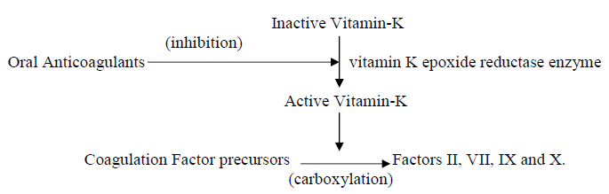
Mechanism of Action
They inhibit the synthesis of Vitamin K-dependent coagulation factors (Factor II, VII, IX and X) by preventing reactivation of Vitamin-K via inhibiting Vitamin-K epoxide reductase enzyme in the liver

Slide 32
Oral Anticoagulants
Have delayed onset of action (2-3 days) - this time is required for depletion of already formed coagulation factors;
Have long duration of action (up to 6 days)

Slide 33
Control of Oral Anticoagulant therapy:
By Prothrombin Time (PT) which should be kept at twice the normal value
(Normal value = 12 seconds)

Slide 34
Pharmacokinetics
Delayed onset of action (2-3 days)
Long duration of action (up to 6 days)
Well absorbed after oral administration
Undergo metabolism in the liver
Excreted via the kidney
They cross the placenta and are secreted in milk (Therefore, contraindicated in pregnancy and during lactation as they can cause bleeding in fetus or newborn)

Slide 35
Adverse effects of Oral Anticoagulants
Bleeding
Hemorrhagic skin necrosis in patients deficient in Protein-C
Alopecia and Allergy
Teratogenicity and fetal hemorrhage (Contraindicated in pregnancy)
Liver toxicity
Phenindione associated with causing exfoliative dermatitis, bloody diarrhea, hepatitis, neuropathy, renal tubular damage

Slide 36
Therapeutic Uses of Oral Anticoagulants
Same indications as Heparin
N.B.
Due to delayed onset of action, oral anticoagulant therapy should be started along with Heparin, concomitantly administer Heparin with oral anticoagulant for 2 days before stopping Heparin.

Slide 37
Antidote for Oral Anticoagulant Effects
Vitamin-K
Fresh Blood transfusion (Fresh frozen plasma)
Prothrombin complex concentrates (e.g. Bebulin, Proplex T)

Slide 38


Slide 39
ANTI-PLATELET DRUGS
(ANTI-THROMBOTICS)

Slide 40
Medications that prevent platelets from sticking together and forming blood clots (↓ platelet aggregation and inhibit thrombus formation)
Common treatment for people at risk of heart attack or stroke

Slide 41
ANTI-PLATELET DRUGS
(Anti-thrombotics)
Aspirin (Low dose: 75-300mg): prevents formation of Thromboxane-A₂ → irreversible inhibition of platelets and endothelial cells.
Other agents: Sulphinpyrazone, Clopidogrel, Dazoxiban, Ticlopidine, Tirofiban, Pentoxifylline, Dipyridamole

Slide 42
Clinical Uses of Antiplatelet Drugs
Cardiac surgery.
Prevention and management of myocardial infarction.
Prophylaxis and treatment of deep venous thrombosis and transient cerebral ischemic attacks.

Slide 43
Anti-platelet drugs
Drug Name | M.o.A | Adverse Effects
Clopidogrel | directly inhibits ADP binding to receptor sites | Diarrhoea, rash, GI bleeding, GI ulcers, thrombotic thrombocytopenia purpura, etc
Ticlopidine | Blocks ADP receptors inhibiting expression of GPIIb-IIIa receptors | Diarrhoea, rash, neutropenia, minor bleeding, etc
Tirofiban | Blocks fibrinogen receptors | Bleeding, thrombocytopenia, etc
Sulphinpyrazone | Reversible competitive inhibitor of platelet COX | Rash, N/V, GI pain, Blood dyscrasias, Bronchospasm, etc

Slide 44
Anti-platelet drugs
Drug Name | M.o.A | Adverse Effects
Dipyridamole | Inhibits PDE → increased platelet cAMP → inhibition of platelet aggregation | Bleeding, liver failure, arrhythmia, anaphylaxis, arthralgia, etc
Dazoxiben | selectively inhibits platelet thromboxane synthetase enzyme | Bleeding
Pentoxifylline | stimulates Prostacycline synthesis | Blood dyscrasias, hypotension, blurred vision, angina, CNS side effects, etc
Abciximab | Irreversibly inhibits platelet gpIIb/IIIa receptor | Bleeding, thrombocytopenia

Slide 45
FIBRINOLYTIC DRUGS
(Thrombolytics)

Slide 46
Fibrinolysis process prevents blood clots from growing and becoming problematic
Enzymatic breakdown of fibrin
Prevents uncontrolled thrombosis and embolism
Primary fibrinolysis; normal body process
Secondary fibrinolysis ; breakdown of clots due to medicine, a medical disorder or some other cause.

Slide 47
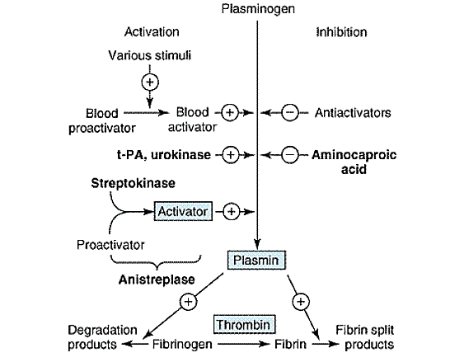
FIBRINOLYSIS
Katzung B.G. 10th ed.

Slide 48
FIBRINOLYTICS
(Thrombolytics)
Drugs that cause lysis of fibrin (dissolves blood clot)
Fibrinolytics are plasminogen activators (i.e. they catalyze the formation and activation of Plasmin from its precursor Plasminogen)
Plasmin is a serine protease that causes lysis of fibrin, fibrinogen, factors II, V, and VIII, complement, and kallikreinogen.

Slide 49
Classification of Fibrinolytics
Fibrin non-specific (e.g. Streptokinase and Urokinase)
Relative fibrin specific (e.g. Acylated Plasminogen-Streptokinase activator complex)
Fibrin-specific (e.g. Tissue plasminogen activator, Alteplase)
***Fibrin specific - Produce limited plasminogen conversion in the absence of fibrin.
Fibrin non- specific – Indiscriminate in their ability to cause both fibrinolysis and fibrinogenolysis.Catalyze systemic fibrinolysis

Slide 50
The ideal fibrinolytic agent:
Should only activate plasminogen bound to fibrin (fibrin specific);
Should NOT activate free plasminogen in plasma;
Its effect should be localized to the clot hence reducing the risk of bleeding

Slide 51
Clinical Uses of Fibrinolytics
Acute myocardial infarction (effective if given in first 6hrs post-MI)
Massive pulmonary embolism
Acute peripheral arterial occlusion
Deep venous thrombosis (DVT)
Obstructed arterio-venous shunts and occluded I.V. catheter

Slide 52
Fibrinolytic Drugs
Drug Name | M.o.A | Adverse Effects
Streptokinase | Forms streptokinase–plasminogen activator complex that activates & converts plasminogen to Plasmin | Bleeding, hypersensitivity reactions, hypotension, etc
Alteplase (rt-PA) | Directly activates fibrin-bound plasminogen | Bleeding
Anistreplase (anisoylated plasminogen-streptokinase activator complex) | Deacylated to streptokinase–plasminogen complex that activates & converts plasminogen to plasmin | Bleeding, hypersensitivity reactions
Urokinase | Enzymatically converts plasminogen to plasmin | Similar to Streptokinase except less allergenic
Notes:
Streptokinase is a bacterial protein derived from group C β-hemolytic streptococci.

Slide 53
Drugs used for management of Bleeding Disorders

Slide 54
Vitamin-K (Phytonadione)
Cofactor essential for hepatic carboxylation of glutamyl residues in precursor proteins to γ-carboxyglutamyl residues;
Essential for hepatic synthesis of coagulation factors II, VII, IX and X, anticoagulation proteins C & S, bone (osteocalin), plasma protein Z, and other proteins of several organs (kidney, lung, and testicular tissue)

Slide 55
Clinical Uses of Vitamin K:
Overdose of Anticoagulants and Salicylates
Bleeding disorders in the newborn
Vitamin-K deficiency (e.g. in Obstructive jaundice and Malabsorption syndrome).

Slide 56
Fibrinolytic inhibitors (Antiplasmin)
e.g. Aminocaproic acid, Tranexamic Acid
Competitive inhibitors of plasminogen activators (ie bind to distinct sites)
Clinical Uses:
Bleeding due to fibrinolytics
Adjuvant therapy in haemophilia
Bleeding states resulting from damage of tissues rich in plasminogen activators (e.g. after prostatic surgery and tonsillectomy).

Slide 57
Plasma fractions
Given when there is deficiency of one of the coagulation factors;
Types include:
Factor VIII (given in haemophilia)
Factor IX
Fibrinogen
Cryoprecipitate (plasma protein rich in Factor VIII, Von-Willebrand factor and Fibrinogen)

Slide 58
Laboratory Testing for Coagulation Disorders
Test | Description | Normal Values* | Significance
Activated clotting time | Used to monitor high-dose heparin pharmacotherapy; also used before, during, and after surgery or medical procedures | 70–180 seconds; 400–500 seconds during coronary bypass surgery | High values indicate a risk for bleeding and that heparin dose may need to be reduced
Activated partial thromboplastin time (aPTT) | Used to monitor heparin pharmacotherapy | 25–35 seconds; 1.5–2 times higher than the pretreatment value | High values indicate a risk for bleeding and that heparin dose may need to be reduced
Bleeding time | Used for general diagnosis of coagulation disorders | 2–9 minutes (forearm) | Long bleeding time may indicate a low platelet count or anticoagulant therapy
Heparin anti-Xa | Used to monitor heparin or low-molecularweight heparin (LMWH) pharmacotherapy in patients with heparin resistance | 0.3–0.7 international units/mL for heparin; 0.4–1.1 international units/mL for LMWH | High values indicate a risk for bleeding and that heparin or LMWH dose may need to be reduced
Platelet count | Part of a complete blood count | 150,000–350,000 | Values below 20,000 indicate thrombocytopenia
Prothrombin time (PT) | Used to monitor warfarin therapy | INR should be 2–3 to prevent DVT; 2.5–3.5 to prevent arterial thrombosis | High values indicate a risk for bleeding and that anticoagulant dose may need to be reduced
Thrombin time pharmacotherapy | Used to assess for fibrinogen deficiency; may be used to monitor effectiveness of heparin | 13–15 seconds | Prolonged values may occur with heparin pharmacotherapy

Slide 59

Further Reading:
Rang H.P., Dale M.M., Ritter J.M., et al. Rang & Dale’s Pharmacology, 7th ed. Churchill-Livingstone.
Katzung B.G., Basic & Clinical Pharmacology, 10th ed. McGraw-Hill.

