Slide 1
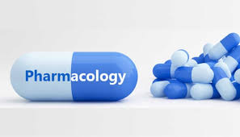
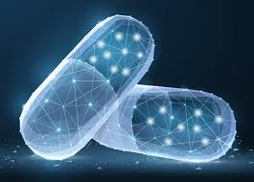
BMS 3140
With Margaret Mswema Silwimba
B-Pharm, Msc. Clin. Pharmacy

Slide 2
CENTRAL NERVOUS SYSTEM
PHARMACOLOGY

Slide 3
Learning Objectives:
At the end of the lessons, YOU should be able to:
Demonstrate basic fundamental knowledge of neurotransmission in the CNS.
Describe the principle classes of drugs used for CNS disorders.
Describe the actions and effects of drugs acting on the CNS
Outline the rationale for pharmacologic intervention for clinical management of common CNS disorders

Slide 4
Goal of biomedical science in neuropharmacology
Primary goal is to enhance understanding of CNS function in health and disease.
Goal of biomedical research is to translate basic research findings into useful medical advances in the field of neuropharmacology.
Understanding disease mechanisms as well as the effects of drugs and other compounds on neuronal function.
Information will result in new or improved treatment for CNS disease through discovery of new drugs and their clinical development for CNS disorders.
Need for new approaches in CNS drug discovery: Why drugs have failed, and what can be done to improve outcomes??

Slide 5

The CNS……

Slide 6
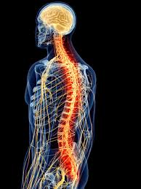
CENTRAL NERVOUS
SYSTEM
Brain
Spinal Cord
Neurons (nerve cells)

Slide 7
CNS - Receives and processes information, initiates action
Brain
Controls many functions of the body ie movement, thought, learning & awareness
Receives & processes sensory information, initiates responses, stores memories, generates thoughts and emotions
Spinal cord
Conducts signals to & from the brain, controls reflex activities)
Neurons (Nerve cells)
Cells that make up the CNS
Responsible for communicating information throughout the body

Slide 8
CNS NEUROTRANSMITTERS
Substances neurons use to communicate with one another and with their target tissues in the process of synaptic transmission (neurotransmission).
Synthetized in and released from nerve endings into the synaptic cleft. Bind to receptor proteins in the cellular membrane of the target tissue. The target tissue gets excited, inhibited, or functionally modified in some other way.
More than 40 NT in the human nervous system

Slide 9
CNS Neurotransmitters
Acetylcholine
Catecholamines (i.e. Dopamine, Norepinephrine and Epinephrine).
Serotonin (5-Hydroxytryptamine)
Gamma aminobutyric acid (GABA)
Glycine
Aspartate
Glutamate
Endogenous peptides (e.g. Opioid peptides, Substance-P,endorphins,enkephalins ,dynorphins etc)
Histamine
Purines (e.g. Adenosine, ATP)

Slide 10
Excitatory neurotransmitters | Glutamate (Glu) Acetylcholine (ACh) Histamine Dopamine (DA) Norepinephrine (NE); also known as noradrenaline (NAd) Epinephrine (Epi); also known as adrenaline (Ad)
Inhibitory neurotransmitters | gamma-Aminobutyric acid (GABA) Serotonin (5-HT) Dopamine (DA)
Neuromodulators | Dopamine (DA) Serotonin (5-HT) Acetylcholine (ACh) Histamine Norepinephrine (NE) Endogenous peptides (e.g. Opioid peptides, Substance-P,endorphins,enkephalins ,dynorphins etc)
Neurohormones | Releasing hormones from hypothalamus Oxytocin (Oxt) Vasopressin; also known as antidiuretic hormone (ADH)

Slide 11
CNS DRUGS
Exert their actions on one of four types of target proteins:
G-protein coupled receptors
Ligand-gated Ion channels
Enzymes
Membrane transport proteins

Slide 12
Psychotropic Drugs
Affect psychosomatic disposition, mood and behaviour;
Types include:
Sedative-Hypnotic drugs (e.g. Benzodiazepines, Barbiturates);
Antidepressant drugs (e.g. MAOIs, SSRIs, SNRIs, etc);
Antipsychotic drugs (e.g. Haloperidol, Chlopromazine, etc)
Antiepileptic drugs (e.g. Carbamazepine, Phenytoin, etc)
Anaesthetic drugs (e.g. Halothane, Ketamine, etc)
CNS stimulants (e.g. Amphetamines, Caffeine, Doxapram, etc)

Slide 13


Slide 14
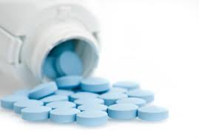
SEDATIVE-HYPNOTIC DRUGS

Slide 15
Sedative: drug that produces a relaxing & calming effect, cause sleep and reduces anxiety (anxiolytic);
Hypnotic: drug that produces drowsiness, promotes or induces onset and maintenance of sleep.
Hypnotics produce more pronounced depression of CNS than Sedatives

Slide 16
Anxiety - feelings of apprehension and worry
Normal reaction to stress, inappropriate or excessive → anxiety disorder.
AD a component of broader conditions - psychosis & depression
Symptoms palpitations, sweating, nausea, headache ,sleep disturbances
Physiological anxiety, ie experienced during bereavement.
Key to successful drug treatment of anxiety disorder is to use the smallest dose for the shortest possible time.

Slide 17
Types of anxiety disorders
Situational anxiety
Experienced by people faced with a stressful environment
Can be beneficial,motivates people to accomplish tasks in a prompt manner.
Can be intense
Patients often learn coping mechanisms to deal with it without conventional medical intervention.
Generalized anxiety disorder (GAD)
difficult-to control, excessive anxiety that lasts 6 months or more
Among the most common types of stress disorders and most frequently encountered in clinical practice.

Slide 18
Symptoms : restlessness, fatigue, muscle tension, nervousness, inability to focus or concentrate, overwhelming sense of dread, and sleep disturbances.
Autonomic signs of sympathetic nervous system activation anxiety: BP elevation, heart palpitations, varying degrees of respiratory change, and dry mouth.
Parasympathetic responses : abdominal cramping, diarrhoea, fatigue, and urinary urgency.
Women are slightly more likely to experience GAD than men, and its prevalence is highest in the 20–35 age group

Slide 19
Panic disorder
Second category of intense anxiety,
Characterized by intense feelings of immediate apprehension, fearfulness, terror, or impending doom accompanied by increased autonomic nervous system activity
Although panic attacks usually last less than 10 minutes, patients may describe them as seemingly endless.

Slide 20
Other categories : Phobias, obsessive–compulsive disorder, and post-traumatic stress disorder.
Phobias are fearful feelings attached to situations or objects. Common phobias include fear of snakes, spiders, crowds, or heights.
A fear of crowds is termed social anxiety disorder, or social phobia

Slide 21
Sedative-Hypnotic drugs
Benzodiazepines
Barbiturates
Anxiolytics
(e.g. Diazepam, Lorazepam, Clonazepam)
Hypnotics
(e.g. Midazolam, Flurazepam, Triazolam, etc)
Other Anxiolytic Agents
(e.g. Buspirone, Zolpidem, Hydoxyzine, etc )
Ultra-short Acting
(e.g. Thiopental)
Intermediate-Acting
(e.g. Pentobarbital)
Long Acting
(e.g. Phenobarbital)

Slide 22
Benzodiazepines
Include : diazepam, alprazolam, chlordiazepoxide, flurazepam, lorazepam, oxazepam, nitrazepam, temazepam
Mechanism of action
Benzodiazepines potentiate inhibitory neurotransmission in the brain by increasing ℽ-aminobutyric acid (GABA) binding to the GABA-A receptor via interaction with an allosteric site.

Slide 23
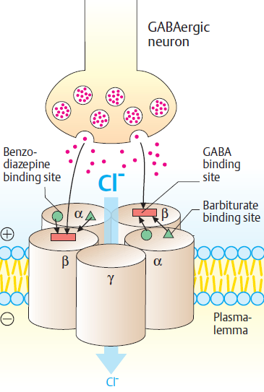
Mechanism of action
They bind with affinity to allosteric sites of GABA receptor → potentiate GABA receptor activity & trigger opening of Cl⁻ ion channels:
→ hyperpolarization of postsynaptic potentials
→ inhibit firing of AP
Luellmann, 2005

Slide 24
Benzodiazepines: Pharmacological effects
Anxiolytic (at low doses)
Sedation & Hypnosis (at high doses)
Anticonvulsant
Skeletal muscle relaxation
Anaesthetic action

Slide 25
Benzodiazepines: Therapeutic Uses
Anxiety (Diazepam, Clonazepam and Alprazolam);
Panic attacks (Clonazepam, Alprazolam);
Alcohol Withdrawal (Diazepam);
Insomnia (Triazolam, Diazepam);
Sleep walking and Night terrors (Diazepam);
Facilitating Endoscopy (Midazolam IV, Diazepam IV);
Pre-anaesthetic medication (Midazolam IV, Diazepam IV);
Adjuvant to anaesthesia (Midazolam IV, Diazepam IV).

Slide 26
Adverse effects of Benzodiazepine drugs
Drowsiness, Confusion (and lack of learning abilities in children);
Ataxia and decreased motor skills;
Anterograde amnesia (loss of memory for recent events);
Dependence → Abuse
Addictive potentiation of CNS depression with Alcohol (and other CNS depressants);
Excessive daytime sedation (Hangover), decreased REM sleep → Irritability, Emotional distress and rebound insomnia (with hypnotics)
Contraindicated in respiratory depression and hepatic impairment; should not be used for chronic psychosis or alone for treatment of depression.

Slide 27
Benzodiazepine antagonist
Flumazenil is a GABA receptor antagonist; rapidly reverses effects of benzodiazepines;
Available by IV; Rapid onset of action but short duration

Slide 28
Barbiturates - Mechanism of action
Bind to GABA channels, causing them to remain open for a prolonged period of time which in turn creates negative charge making brain cells less responsive to nerve impulses→ sedative & analgesic properties.
→ hyperpolarization of postsynaptic potentials
→ inhibit firing of AP
Luellmann, 2005

Slide 29
BZD VS BARBITURATE BINDING
Both have sedative effects on the body→ calm & relaxation
MOA main difference ,directly influences both how strong and how long their effects will last ,how addictive they can be and their potential to be dangerous.
BZD change the voltage in the brain from positive to negative causing brain cells to be less sensitive.
BZD do not stimulate GABA receptors directly. Make receptors more efficient

Slide 30
Sedative-Hypnotics: Barbiturates
Drug name | Clinical Uses | Common Adverse effects
Phenobarbital | Insomnia; Seizures; Convulsions; Pre-anaesthetic use | Respiratory & CNS depression, Somnolence, Confusion, ataxia, vertigo, nausea, constipation, bradycardia, hypotension
Pentobarbital | Pre-operative sedation, hypnotic | Similar to Phenobarbital
Thiopental | Induction of anaesthesia, Hypnotic, Convulsions, Sedation | Cardiac & Respiratory depression, arrhythmia, rectal bleeding, etc

Slide 31
Sedative-Hypnotics: Other agents
Drug name | Clinical Uses | Common Adverse effects
Zolpidem | Hypnotic | Dysphoria, Drowsiness, Amnesia, Dizziness, Nausea, vomiting, etc
Buspirone | Anxiety disorders | Dizziness, Headache, Chest pain, Insomnia, Thrombocytopenia
Zeleplon | Insomnia | Visual impairment, myalgia, Dizziness, Rebound insomnia & anxiety, headache, etc

Slide 32
Guidelines for therapy with Sedative-hypnotics
Drug therapy of Anxiety should be complimented with psychotherapy and other relaxation techniques (e.g. Deep breathing)
Drug therapy of Insomnia should not be started except after alternative methods fail (e.g. Lifestyle modification, exercise, etc).
To prevent drug dependence, drug therapy of insomnia should be started with small oral doses for short period (<3 weeks).
Termination of therapy should be gradual to avoid withdrawal syndrome.

Slide 33
Ideal hypnotic drug choice should have rapid onset and short duration of action (to avoid excessive daytime sedation next day).
Longer acting drugs are preferred as Anxiolytics.
Dose-adjustment is required for patients with impaired liver function.
Dose reduction necessary in Geriatrics & Paediatrics.

Slide 34
Contraindications
Known hypersensitivity to sedative-hypnotic drugs;
Comatose patients or those with respiratory problems;
Patients with history of recent chronic drug abuse (e.g. alcohol, pyschotropics, etc);
Pregnancy & lactation

Slide 36
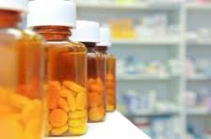
ANTIDEPRESSANT
DRUGS

Slide 37
Depression……

Slide 38
What is Depression?
A heterogeneous disorder of Mood
Ranges from very mild condition (bordering on normality) to severe psychotic depression (accompanied by hallucinations and delusions)
Lifetime prevalence: Approx. 10-12% of population
A major cause of disability and premature death worldwide

Slide 39
Manifestations of Depression
Depression with Typical symptoms:
Sadness, loss of libido, disturbance in appetite, anorexia & weight loss, negative emotions and insomnia;
Suicidal tendencies and Psychotic symptoms (e.g. Hallucinations and Delusions in severe depression).
Depression with Atypical symptoms:
Anxiety, phobias, obsessions, hypochondriasis (multiple body complaints), irritability & over-reacting, increased sleep tendency, etc.

Slide 40
Types of Depression
Unipolar depression: associated with mood swings constantly in same direction (i.e. negative depressive mood);
Most common type; ~75% non-familial, associated with stressful life events; ~25% endogenous, familial
Bipolar affective disorder: depression alternating with mania;
Usually presents in early adult life; strong hereditary tendency/link

Slide 41
Etiology theories
Mono-Amine theory of Depression (Schildkraut, 1965)
Decrease in the activity of brain biogenic amine (NE and 5-HT) neurotransmitters will result in depression;
Whereas, increase in their activity will result in mood elevation.
Neuroplasticity & Trophic effects theory (Duman et al, 2004)
Major depression is associated with neuronal loss in the hippocampus and prefrontal cortex of brain

Slide 42
Antidepressant Drugs: Classification
Inhibitors of monoamine uptake (Amine pump inhibitors): By blocking reuptake,allow the released amines to remain in the cleft and continue to exert their effects
  Non-selective (NE & 5-HT) uptake inhibitors, e.g. Tricyclic Antidepressants (imipramine, amitriptyline, etc), Venlafaxine, Duloxetine, etc
  Selective serotonin (5-HT) reuptake inhibitors (SSRIs) (e.g. fluoxetine, fluvoxamine, paroxetine & sertraline).
  Selective noradrenaline (NE) reuptake inhibitors (e.g. maprotiline, reboxetine).

Slide 43
Mono-amine Oxidase Inhibitors (MAOI) e.g. Tranylcypromine, Moclobemide, Phenylzine:
These drugs inhibit MAO type A enzyme, thus inhibiting metabolism of biogenic amines (NE & 5-HT) stores available for release in neuronal synaptic cleft.
Miscellaneous: Presynaptic adrenergic α₂ receptor blockers e.g. Mianserine, Trazodone
(blockade of these receptors results in increased release of biogenic amines into the synaptic cleft).

Slide 44
Antidepressant Drugs
Drug Name | Clinical Uses | Adverse Effects
Tricyclic Antidepressants (TCAs)
Amitryptyline | Depression; Adjuvant analgesia | Sedation, Orthostatic hypotension, Anticholinergic effects (e.g. Dry mouth, etc), Lethergy, Constipation, etc
Imipramine | Depression | Sedation, Orthostatic hypotension, Anticholinergic effects (e.g. Dry mouth, etc), Lethergy, Constipation, etc
Clomipramine | Obsessive Compulsive Disorder | Similar to Imipramine
Other TCA’s: Desipramine, Doxepine, Nortriptyline, Amoxapine, etc

Slide 45
Antidepressant Drugs
Drug Name | Clinical Uses | Adverse Effects
MAOI’s
Tranylcypromine | Atypical & Neurotic Depression | Orthostatic hypotension, vertigo, constipation, hypertensive crisis, anticholinergic symptoms, etc
Phenylzine | Neurotic & Atypical Depression | Orthostatic hypotension, vertigo, constipation, hypertensive crisis, anticholinergic symptoms, etc
Other MAOI’s: Meclobemide, etc

Slide 46
Antidepressant Drugs
Drug Name | Clinical Uses | Adverse Effects
SSRI’s
Fluoxetine | Depression, OCD, Bulimia nervosa, | Anxiety, nervousness, insomnia, drowsiness, fatigue, asthenia, tremor, sweating, dizziness, sexual dysfunction, anorexia, etc
Fluvoxamine | Depression, OCD | Headache, insomnia, anxiety, tremor, dizziness, sexual dysfunction, anticholinergic symptoms, etc.
Sertraline | Depression, PTSD, OCD, Panic disorders | Insomnia, nervousness, anxiety, fatigue, nausea, visual disturbance, headache, etc
Other SSRI’s: Citaloplam, Paroxetine, etc

Slide 47
Antidepressant Drugs
Drug Name | Clinical Uses | Adverse Effects
SNRI’s
Maprotiline | Depression | Hypotension, Sedation, Anticholinergic symptoms, disturbed concentration, etc
Miscellaneous
Venlafaxine | Depression, Anxiety disorders | Abnormal dreams, Hypertension, weakness, weight loss, parathesia, etc
Trazodone | Depression | Priapism, hypertension, aggression, skin reaction, anaemia, anticholinergic symptoms, etc
Other Antidepressants: Duloxetine, Nefazodone, Mirtazepine, Bupropion, etc

Slide 48
Contraindications & Interactions
TCA’s: Hypersensitivity, Avoid concurrent use with MAOI’s, Myocardial infarction, Pregnancy & Lactation
MAOIs + Sympathomimetics → Hypertensive crisis.
MAOIs + TCA → Hypertensive crisis + Hyperthermia + Convulsions.
MAOIs + SSRIs → Serotonin syndrome leading to Hyperthermia and Convulsions.
***MAO inhibition, excess activity at peripheral sympathetic adrenergic terminals may cause a profound increase in BP. Exacerbated if other drugs that increase sympathetic nervous activity are being taken concurrently.

Slide 49
MAOIs + Opioids → Respiratory depression + Hyperthermia + Convulsions.
Patients on MAOIs should not receive TCA or SSRIs/SNRIs until after 2 weeks from cessation of MAOIs
Patients on MAOIs should avoid Tyramine-rich foods (e.g. Mature cheese, beer, chicken liver, fermented meats, coffee, milk products, etc) → Catecholamine-induced Hypertensive crisis
***Fermented foods contain tyramine, which stimulates the release of endogenous epinephrine and norepinephrine ( cheese effect).

Slide 50
End of lesson one…

Slide 52
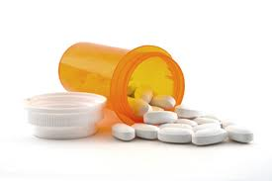
ANTIPSYCHOTIC DRUGS
(Neuroleptics)

Slide 53
Mental health condition. Affects about 1-5% of population
Characterized by
Delusions (firm ideas and beliefs not founded in reality),
Hallucinations (seeing, hearing, or feeling something that is not there),
Illusions (distorted perceptions of actual sensory stimuli),
disorganized behavior, and a difficulty relating to others.
Behavior may range from total inactivity to extreme agitation & combativeness.
Paranoia, extreme suspicion & delusion that they are being followed, or that others are trying to harm them (in some pts)

Slide 54
Often viewed as medically & legally incompetent.
Classified as acute or chronic. Acute episodes occur over hours or days, whereas chronic develop over months or years.
May be attributed to:
brain damage,overdoses of certain medications, extreme depression, chronic alcoholism, and drug addiction, genetic factors .Vast majority of psychoses have no identifiable cause.
Patients require long-term drug therapy.
Family members & social support groups are important sources of help for patients who cannot function without continuous drug therapy.

Slide 55
Schizophrenia
Type of psychosis characterized by :
Abnormal thoughts and thought processes,
Disordered communication,
Withdrawal from other people and the outside environment,
High risk for suicide.
Several subtypes of schizophrenic disorders based on clinical presentation.
Most common psychotic disorder, affecting 1% to 2% of the population.

Slide 56
Positive symptoms (add on to normal behavior) ;
Hallucinations, delusions,& a disorganized thought or speech pattern.
Negative symptoms (subtract from normal behavior).
lack of interest, motivation, responsiveness, or pleasure in daily activities.
Proper diagnosis of + ve and –ve symptoms is important for selection of appropriate antipsychotic drug.

Slide 57
Etiology theories of Psychosis
Actual cause of schizophrenia has not been determined
Several theories have been proposed.
Dopamine theory of Psychosis (by Carlson):
Psychosis is caused by increased dopaminergic hyperactivity & signal transduction in the brain mesolimbic & mesocortical system.
Dopamine is the main neurotrasmitter activating dopaminergic receptors in brain mesolimbic system that controls psychological behaviour.

Slide 58
Genetic & environmental
e.g. Patients suffering from schizophrenia have family members who have been afflicted with the same disorder.
Glutamate
Many conditions can cause bizarre behavior, should be distinguished from schizophrenia.
Chronic use of amphetamines or cocaine can create a paranoid syndrome.
Certain complex partial seizures cause unusual symptoms mistaken for psychoses
Brain neoplasms,
Infections, or hemorrhage can also cause bizarre, psychotic-like symptoms.

Slide 59
Antipsychotic drugs
Antipsychotic drugs also called Neuroleptics or Antischizophrenics
MOA - antagonise/inhibit Dopamine hyperactivity at D receptors in brain centres by occupying D2 receptors, preventing dopamine from stimulating the postsynaptic neuron
Used primarily to treat schizophrenia. (but are also effective in some other psychotic states, e.g. mania and delirium);
Primary therapeutic goal for patients with schizophrenia is to reduce psychotic symptoms to a level that allows the patient to maintain normal social relationships, including self-care and interacting with other people.

Slide 60
Antipsychotic Drug Classification
Antipsychotics
Typical Antipsychotics
e.g. Chlorpromazine,
Haloperidol,
Fluphenazine, etc
Atypical Antipsychotics
e.g. Resperidone,
Clozapine,
Olanzepine, etc

Slide 61
ANTIPSYCHOTICS
TYPICAL (aka traditional, conventional,1st gen)
Strongly block D2 & several types of D receptors.
As effective as Atypical
More side effects (esp. motor)
Effect less predictable
Usually 2nd line meds
ATYPICAL (aka newer agents,2nd gen)
Weaker D2 receptor (basal ganglia)blockade
5HT2 receptor blockade
As effective as typical
Better side effect profile (muscarinic, adrenergic, histamine effects)
More predictable effect
Preferred 1st line meds

Slide 62
Pharmacological Effects of Dopamine receptor antagonism
Blockade of D2 receptors in brain mesolimbic system → Antipsychotic effects;
Blockade of D2 receptors in brain’s chemo-receptor trigger zone (CTZ) → Anti-emetic effect;
Blockade of D2 receptors in hypothalamus and pituitary gland → Gynaecomastia, Galactorrhea, Amenorrhea, Infertility and weight gain (adverse effects)

Slide 63
Blockade of D2 receptors in brain basal ganglia → Extrapyramidal side effects e.g.
Akathisia (motor restlessness)
Tardive Dyskinesia(involuntary and fragmented movements)
Dystonia (Muscle spasm)
Pseudoparkinsonism (motor symptom in Parkinson disease)
Neuroleptic Malignant Syndrome (stupor, rigidity, tremors, & fever)
(N.B. Anticholinergic drugs e.g. Benzhexol or Benztropine given routinely to counteract extrapyramidal side effects)

Slide 64
Antipsychotic drugs (summary)
Drug Name | Clinical Uses | Adverse Effects
Typical Antipsychotics
Chlorpromazine | Psychotic disorders; CNS-induced nausea & vomiting | Hypotension, photosensitivity, extrapyramidal side effects, Drowsiness, etc
Haloperidol | Psychotic disorders; Tourette’s syndrome | Extrapyramidal side effects, Hypotension, Drowsiness, etc
Fluphenazine | Psychotic disorders | Extrapyramidal side effects, drowsiness, hypotension etc

Slide 65
Antipsychotic drugs (summary)
Drug Name | Clinical Uses | Adverse Effects
Atypical Antipsychotics
Resperidone | Psychotic disorders | Nervousness, akathisia, Agitation, dizziness, constipation, weight gain, pyrexia, etc
Clozapine | Refractory schizophrenia | Akathisia, seizures, drowsiness, sedation, tachycardia, hypotension, etc
Olanzapine | Schizophrenia, Manic phase of bipolar disorder | Nervousness, akathisia, drowsiness, dizziness, constipation, weight gain, etc
Other Antipsychotics: Thiothixene, Lithium, Prochlorperazine,
Quetiapine, Ziprasidone, Trifluoperazine, Pimozide, Loxapine, etc

Slide 66
Contraindications of Antipsychotics:
Known hypersensitivity
Unconscious (comatose) patients
Severely depressed patients
Parkinson’s disease
Liver impairment

Slide 67
Coronary artery disease, severe hypotension or hypertension.
Lithium is contraindicated in patients hypersensitive to Tartrazine ; Renal or CVD, Natriuresis , Dehydration, Diuretic therapy, Dehydration.

Slide 68
Drug Interactions with Antipsychotics
Antipsychotic + Alcohol → additive CNS depression.
Clozapine synergistic with other drugs that suppress bone marrow
Drugs that reduce renal clearance increase risk of Lithium toxicity.

Slide 70
ANTI-EPILEPTIC DRUGS

Slide 71
Epilepsy:
A chronic disorder characterized by repeated/recurrent attacks of abnormal electrical discharge of cerebral neurons resulting in EEG, sensory, motor, autonomic and physiological changes;
Each attack is called a seizure or a fit;
Epilepsy affects 0.5 - 1% of population; second most common neurologic disorder after stroke.

Slide 72
Causes of Epilepsy
Primary Epilepsy: - No known cause (idiopathic)
Secondary Epilepsy:
Local causes: - Head trauma, Meningitis, Tumors in the brain;
Systemic causes: - Hypoglycemia, hypocalcemia, fevers;
Drug-induced: - e.g. Insulin, Tricyclic Antidepressants, CNS stimulants and Antipsychotics, etc

Slide 73
Pathophysiology of Epilepsy
Hyper-excitability of cerebral neurons in brain region manifesting an epileptic foci may be due to:
Change in brain neurotransmitters or their signal transduction;
Increased activity of excitatory brain neurotransmitters (e.g. Glutamate);
Decreased activity of inhibitory brain neurotransmitters (e.g. GABA);
Increased membrane permeability to ions (e.g. Ca²⁺, Na⁺).

Slide 74
Classification of Epilepsy
Partial (Focal) Seizures
Generalized Seizures
SimplePartial Epilepsy: - localized motor (convulsions) or sensory disturbances.
ComplexPartial (Psychomotor) Epilepsy:- attacks of confused behavior with disturbances of consciousness and hallucinations.
Tonic-clonic (Grand-mal) Epilepsy: - convulsions involving the whole body with loss of consciousness.
Absence Seizures (Petit-mal Epilepsy): - brief abrupt loss of consciousness (10-15 sec) with blinking of eyelids or staring in children).
Myoclonic Epilepsy: - Sudden brief single or repetitive muscle contractions without loss of consciousness.

Slide 75
ANTIEPILEPTICS

Slide 76
Anti-epileptic drugs: Mode of Action
Anti-epileptic drugs decrease hyperexcitability of cerebral neurons by one of the following mechanisms:
Change in brain neurotransmitter effects:
Facilitation of GABA action (e.g. Barbiturates, Benzodiazepines);
Increasing GABA levels by decreasing its breakdown through inhibition of transaminase enzyme (e.g. Valproate and Vigabatrin);
Decrease neuronal membrane ion permeability:
Block Na⁺ channels (e.g. Phenytoin, Carbamazepine and Valproate);
Block Ca²⁺ channels in the thalamus (e.g. Ethosuximide).

Slide 77
Drug Name | Clinical Use | Adverse Effects
Lamotrigine | Partial seizures | Insomnia, somnolence, ataxia, dizziness, diplopia, etc
Carbamazepine | Tonic-clonic seizures, Mixed seizures, Psychomotor seizures; Neuropathic pain | Aplastic anemia, blood dyscrasias, dizziness, drowsiness, nausea & vomiting, diplopia, hepatotoxicity
Ethosuximide | Absence seizures | Hematologic disturbances, anorexia, urticaria, drowsiness, ataxia, vomiting, etc
Valproate (Valproic acid) | Tonic-clonic; Absence seizures | Nausea, vomiting, rash, sedation, indigestion, nystagmus, diplopia, etc
Phenytoin | Partial seizures, Tonic-clonic seizures | CNS depression, hypotension, rash, nystagmus, ataxia, gingival hyperplasia, blood dyscrasias, etc

Slide 78
Other Anti-epileptic drugs
Trimethadione
Clorazepate
Felbamate
Gabapentin
Magnesium sulfate
Oxcarbazepine
Primidone
Zonisamide
etc

Slide 79
STATUS EPILETICUS: - Continuous successions of acute non-stop seizures (>20 minutes) without any period of recovery.
It is a medical emergency
D.O.C: Diazepam IV, follow up with Phenobarbital IV

Slide 80
Contraindications & Interactions
Known hypersensitivity;
Additive CNS depression with other CNS depressant drugs (e.g. alcohol, narcotic analgesics, and antidepressants);
Phenytoin contraindicated in pregnancy; in patients with sinus bradycardia, SA node and AV node block, respectively;
Carbamazepine and Succinimides (e.g ethosuximide) contraindicated in patients with bone marrow depression or hepatic or renal impairment and during lactation

Slide 81
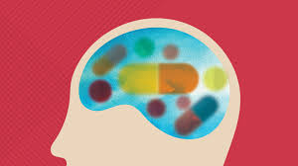
DRUGS USED FOR
PARKINSONISM

Slide 82
Parkinsonism……

Slide 83
Pathophysiology of Parkinsonism
Parkinson’s disease is associated with lesions in nigrostriatal dopaminergic system in basal ganglia;
Basal ganglia controls movements by two balanced systems: (i) Cholinergic system (excitatory) and (ii) Dopaminergic system (inhibitory)
Degeneration of dopaminergic neurons and/or dysfunction of D2 receptors → Parkinsonism

Slide 84
In Parkinsonism, the dopaminergic activity in basal ganglia is so reduced that the cholinergic system is dominant
For this reason, drug therapy for parkinsonism focuses not only on restoring dopamine function but also on blocking the effect of acetylcholine within the basal ganglia.

Slide 85
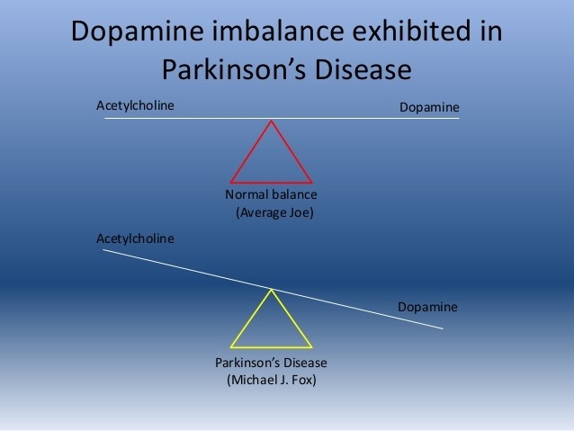

Slide 86
Manifestations of Parkinsonism
Parkinsonism is characterized by:
Rigidity,
Bradykinesia,
Static tremors,
Postural instability and
Mood changes

Slide 87
ETIOLOGY OF PARKINSONISM
Parkinsonism usually idiopathic
Genetic - Some patients with Parkinson’s symptoms family history of the disorder
Environmental toxins- Potentially harmful agents: carbon monoxide, cyanide, manganese,chlorine, & pesticides.
Viral infections, head trauma, and stroke
Drugs e.g antipsychotics

Slide 88
DRUGS USED FOR PARKINSONISM
Treatment aims at :
Restoring Cholinergic / Dopaminergic balance in basal ganglia.
Increasing the ability of patient to perform normal activities of daily living (ADLs) such as eating, walking, dressing, and bathing.
Although pharmacotherapy does not cure this disorder, symptoms may be dramatically reduced in some patients.

Slide 89
Enhancement of Dopaminergic activity by:
Replenishing neuronal dopamine ( e.g. Levodopa)
Releasing dopamine from stores and inhibit its neuronal uptake (e.g. Amantadine)
Inhibiting dopamine metabolism by selective MAO-B inhibitor (e.g. Selegiline)
Dopamine agonists (e.g. Bromocriptine).
Inhibiting cholinergic activity using Anticholinergic drugs e.g. Benzhexol and Benztropine
Relieve rigidity, tremors and sialorrhea of Parkinsonism but they have little effect on bradykinesia.
Effective against drug-induced Parkinsonism.

Slide 90
Dopamine receptor agonists
e.g. bromocriptine, cabergoline
Mechanism of action
■ Stimulation of postsynaptic dopamine D2 receptors in the corpus striatum (part of the basal ganglia).

Slide 91
Adverse effects
■ Nausea and vomiting (particularly with apomorphine).
■ Ergot-derived drugs (bromocriptine, cabergoline, pergolide) associated with pulmonary, retroperitoneal and pericardial fibrosis; patients should be monitored for breathing difficulties, signs of cardiac failure and abdominal pain.
■ Drowsiness with sudden onset of sleep.
■ Hallucinations.
■ Less commonly, psychosis, pathological gambling, increased libido and hypersexuality.

Slide 92
Clinical context
■ Can be used as first line therapy.
■ The weak dopaminergic agonist amantadine can be used in combination therapy to reduce dyskinesia in advanced PD.

Slide 93
Levodopa
■ Replenishing neuronal dopamine
Mechanism of action
■ Precursor of dopamine (and other catecholamines). In PD, it increases the amount of dopamine available for release from surviving dopaminergic neurones in the basal ganglia. Centrally converted to dopamine.
Adverse effects
■ Nausea, vomiting and taste disturbances.
■ Arrhythmias, postural hypotension, fainting,Drowsiness
■ Dementia, psychosis, hallucinations.

Slide 94
■ Euphoria and abnormal dreams, anxiety & depression also possible.
■ Dystonia, dyskinesia & chorea; particular problem in younger patients.
■ Use with caution in patients with severe cardiovascular, pulmonary or psychiatric disease or endocrine disorders affecting autonomic control (e.g. hyperthyroidism).

Slide 95
Clinical context
■ Levodopa most effective of the first-choice drug options.
■ Dose gradually titrated to minimum effective to help avoid large fluctuations in response.
■ Modified-release preparations may be used to reduce motor side-effects in advanced disease.

Slide 96
Monoamine oxidase type B inhibitors
e.g. rasagiline, selegiline
Mechanism of action
■ Preservation of releasable dopamine by inhibiting catabolism in surviving dopaminergic neurones in the basal ganglia.
■ Selective for type B enzyme so no problematic food interactions.
Adverse effects
■ Less marked with rasagiline.
■ Caution necessary with selegiline in gastric or duodenal ulcer patients, cardiovascular disease (particularly postural hypotension) and psychosis.
■ Nausea, gastrointestinal disturbance.

Slide 97
■ Postural hypotension, particularly in combination with levodopa.
■ Vertigo, abnormal dreams and hallucinations.
■ Abrupt withdrawal must be avoided.
Clinical context
■ Used alone in the early stages of PD, rasagiline can delay the need to use levodopa.
■ Used in combination with levodopa/dopa-decarboxylase inhibitor, rasagiline smooths out ‘on–off’ and end-of-treatment fluctuations in response.

Slide 98
Antimuscarinic drugs
e.g. benztropine, orphenadrine, trihexyphenidyl (benzhexol)
Mode of action
■ Reduce the relatively excessive cholinergic tone in the presence of reduced dopaminergic drive.
Adverse effects
■ Antiparasympathetic nervous system effects: dry mouth, urinary retention, constipation, blurred vision.
■ Confusion, memory impairment, hallucinations.
■ Reduced skills in motor task performance (e.g. driving).
■ Caution is required in cardiovascular disease, psychosis and narrow-angle glaucoma.

Slide 99
Clinical context
■ Some positive effects on tremor and rigidity but no relief of bradykinesia.
■ May be useful in drug-induced parkinsonism but not as effective as dopaminergic drugs, so little place in PD therapy, particularly given their negative effects on cognition.

Slide 100
Catechol-O-methyltransferase inhibitors
e.g. entacapone, tolcapone
Mechanism of action
■ COMT is involved in the breakdown of dopamine and inhibitors of this enzyme will also increase levels of dopamine and so enhance dopaminergic function.
■ Levodopa is also a substrate for COMT and its co-administration will prevent peripheral metabolism of L-dopa and so optimise levels of L-dopa for central conversion to dopamine.

Slide 101
Comparison between two major treatments for Parkinsonism
 | Anticholinergic Drugs (e.g. Benzhexol) | Dopaminergic Drugs (e.g. Levodopa)
Bradykinesia | Negligible relief | Marked relief
Rigidity | Some relief | Marked relief
Tremors | Some relief (add β-blocker) | Some relief (add β-blocker)
Preferred For: | Drug-induced Parkinsonism | Idiopathic Parkinsonism and other types
Adverse Effects | Dry mouth, Blurred vision, Confusion, Urine retention, Constipation, Worsen tardive dyskinesia caused by antipsychotic drugs | Nausea, Vomiting, Postural hypotension, Cardiac arrhythmias, Dyskinesia, Psychosis

Slide 102
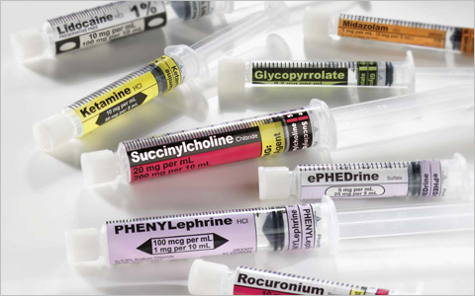
ANAESTHETIC
DRUGS

Slide 103
Anaesthesia……

Slide 104
Anaesthesia - Medical procedure performed by administering drugs that cause loss of sensation.
Local anaesthesia - Occurs when sensation is lost to a limited part of the body without loss of consciousness.
General anaesthesia - Loss of sensation to the entire body, usually resulting in loss of consciousness.
Aim of Anaesthesia: Suppression of CNS functions while maintaining the function of other vital body organs.

Slide 105
LOCAL ANAESTHETICS
Drugs that produce a rapid loss of sensation to a limited part of the body.
Produce their therapeutic effect by blocking the entry of sodium ions into neurons.
Local anaesthetics are classified by their chemical structures; two major classes are amides and esters
A small number of miscellaneous agents are neither amides nor esters.
e.g. Amides - lidocaine, bupivacaine
Esters – Procaine, benzocaine, Cocaine
Applied by injection or surface application to produce local analgesia. Often given with adrenaline to counteract vasodilator effects of LA.

Slide 106
Mechanism of action
■ Inhibit action potential conduction in sensory nerves by blocking voltage operated (‘fast’) sodium channels.
Adverse effects
■ Arise from systemic overdose; inebriation followed by sedation, twitching, convulsions.
**Care needed to avoid accidental iv injection.

Slide 107
Clinical context
■ Injections of lidocaine with adrenaline are used for dental analgesia; infiltration anesthesia, e.g. for minor surgery.
■ LA ointments (lidocaine) are used to relieve pain of haemorrhoids & anal fissure.
■ Eye drops containing oxybuprocaine, tetracaine or proxymetacaine (less initial stinging; good for children) are used for tonometry or minor ophthalmic surgery.

Slide 108
■ Lozenges or ointments containing lidocaine for treating mouth ulcers.
■ Topical preparations for treating pruritus (itching).
■ Lidocaine patches have some benefit in neuropathic pain .

Slide 109
General anaesthetics
Drugs that rapidly produce unconsciousness and total analgesia.
Applied when it is necessary for patients to remain still & without pain for a longer time than could be achieved with local anaesthetics.
Goal of GA is to provide a rapid & complete loss of sensation.
Signs of GA include total analgesia & loss of consciousness, memory,and body movement.

Slide 110
Requirements for general anaesthesia:
Reversible loss of consciousness + analgesia + skeletal muscle relaxation.
Reversible suppression of visceral reflexes with maintenance of physiological stability.

Slide 111
BALANCED ANAESTHESIA
Drug protocols designed to address patient’s needs during each phase of the anaesthetic event from analgesia to sedation and through recovery
Objective : calm the patient, minimize pain and reduce potential adverse effects associated with analgesic and anaesthetic agents.
Allows a lower dose of inhalation anaesthetic, thus making the procedure safer for the patient.

Slide 112
MECHANISM OF ANAESTHTICS
Inhibit the neuronal activity throughout the CNS.
Can decrease activity of neurons in the reticular activating system in the brain (explains their ability to produce unconsciousness and lack of memory (amnesia) during surgery).
Inhibit neuronal function in the spinal cord(explains their ability to produce immobility and inhibit motor responses to painful stimuli)

Slide 113
By binding to specific GABA receptors (the GABA A subtype), GAs increase effects of GABA, thus enhancing CNS inhibition throughout the CNS. This widespread CNS inhibition ultimately leads to a state of GA.
Many GA, also bind to excitatory acetylcholine receptors on CNS neurons, and inhibit the function of these receptors, combination of increased inhibition (through GABA receptors) and decreased excitation (through acetylcholine receptors) explain why they are effective in reducing the level of consciousness and excitability throughout the brain and cord

Slide 114
Opioids decrease transmission in nociceptive pathways by binding to specific presynaptic and postsynaptic opioid receptors in the brain and spinal cord

Slide 115
STAGES OF GENERAL ANESTHESIA
During GA, the patient goes through a series of stages as the anesthetic dosage and amount of anesthesia reaching the brain progressively increase.
Stage I. Analgesia (loss somatic sensation but is still conscious and somewhat aware of what is happening)
Stage II. Excitement (Delirium) (unconscious and amnesiac but appears agitated and restless)
Stage III. Surgical Anesthesia (level desirable for surgical procedure and begins with the onset of regular, deep respiration)

Slide 116
Stage IV. Medullary Paralysis (marked by cessation of spontaneous respiration ,respiratory control centers located in the medulla oblongata are inhibited by excessive anesthesia. The ability of the medullary vasomotor center to regulate BP is also affected, and CV collapse ensues. Respiratory and circulatory support must be provided or the patient will die)
***Consequently, the goal of the anesthetist is to bring the patient to stage III as rapidly as possible and to maintain the patient at that stage for the duration of the surgical procedure.

Slide 117
Classification of General Anaesthetic Drugs
INHALATION ANAESTHETICS:
- Rapidly absorbed from lungs alveoli,
- Cross blood-brain-barrier
- Offer minute to minute control over the depth of anaesthesia.
They include:
Gaseous Anaesthetics e.g. Nitrous Oxide
Volatile liquid anaesthetics:
Halothane, Enflurane, Methoxyflurane, Isoflurane, Desflurane and Sevoflurane.
Diethyl ether and Vinyl ether.

Slide 118
INTRAVENOUS ANAESTHETICS:
Ultra-short acting barbiturates e.g. Thiopental.
Non-barbiturate IV anaesthetics:
Benzodiazepines e.g. Midazolam, Diazepam;
Opiate analgesics e.g. Morphine, Fentanyl;
Ketamine;
Propofol

Slide 119
Pharmacological Effects
Decreased oxygen consumption of the brain
Dose-related depression of respiratory centre
Dose-related myocardial depression and hypotension (due to decreased cardiac output and/or Vasodilatation)
Skeletal muscle relaxation
Decreased renal blood flow and glomerular filtration rate

Slide 120
Adverse Effects of General Anaesthetics
Respiratory depression,
Bronchospasm & lung atelectasis;
Hypotension, Bradycardia, Disarrhythmias;
Nephrotoxicity;
Halothane-induced hepatitis;
Uterine relaxation with uterine bleeding;
Hypersensitivity reactions

Slide 121
IDEAL GA AGENT
Must be able to produce each of the following conditions:
Loss of consciousness and sensation.
Amnesia (i.e., no recollection of what occurred during the surgery).
Skeletal muscle relaxation (currently met with the aid of skeletal muscle blockers used in conjunction with the anesthetic “Neuromuscular Blockers,”).

Slide 122
Inhibition of sensory and autonomic reflexes.
A minimum of toxic side effects (i.e., be relatively safe).
Rapid onset of anesthesia; easy adjustment of the anesthetic dosage during the procedure; and rapid, uneventful recovery after administration is terminated.
***Current general anesthetics meet these criteria quite well

Slide 123
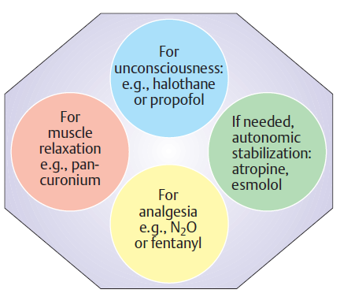
Balanced anaesthesia (Combination therapy)
Luellmann, 2005

Slide 124
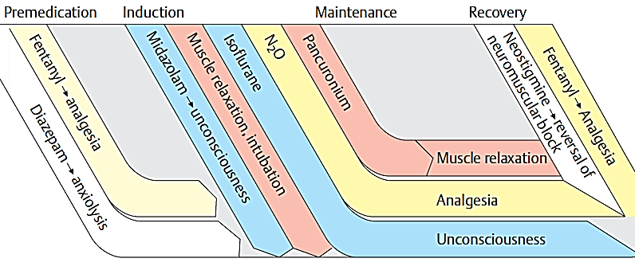
Regimen for Balanced Anaesthesia
Luellmann, 2005

Slide 125

Further Reading and Discussion:
Local anaesthetics (Lignocaine, Benzocaine, Procaine, Bupivacaine, Amethiocaine, etc)
CNS stimulants & Hallucinogens

Slide 126


Slide 127
End of lesson …

