Slide 1
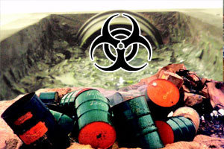
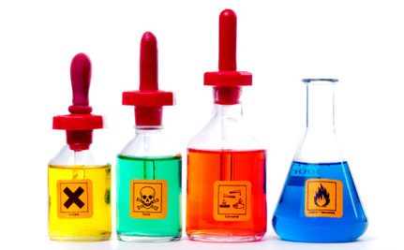
GENERAL PRINCIPLES OF TOXICOLOGY
Absorption, Distribution & Elimination of Toxicants

Slide 2
Outline
Overview of Disposition
Principles of Toxicant Disposition
Cell Membrane Transport of Toxicants
Absorption of Xenobiotics
Distribution of Xenobiotics
Storage of Toxicants in Tissues
Excretion of Toxicants
Reviewing the Key Concepts

Slide 3
Overview
As noted in Lecture 1, the toxicity of a substance depends on the dose; that is, the greater the amount of a chemical taken up by an organism, the greater the toxic response.
However, it is not the dose but the concentration of a toxicant at the site or sites of action that determines toxicity.
The concentration of a chemical at the site of action is proportional to the dose.

Slide 4
Overview
Nonetheless, the same dose of two or more chemicals may lead to vastly different concentrations in a particular target organ of toxicity.
This differential pattern is due to differences in the disposition of chemicals.
Disposition may be conceptualized as consisting of absorption, distribution, biotransformation, and excretion.

Slide 5
Overview
The various factors have a minor or major impact on the concentration and thus the toxicity of a chemical in a target organ.
These include, (1) fraction absorbed (2) the distribution of a toxicant (3) biotransformation of a chemical and (4) efficiency of chemical elimination.
Furthermore, all these processes are interrelated and thus influence each other.

Slide 6
Overview
For example, the rate of excretion of a chemical may depend to a large extent on its distribution and/or biotransformation.
As this brief introduction illustrates, the disposition of xenobiotics is very important in determining the concentration and thus the toxicity of chemicals in organisms.

Slide 7
Toxicant Exposure
Entrance to Body
Absorption & Distribution
Toxicity
Storage
Excretion
Metabolism
Disposition of Toxicants

Slide 8
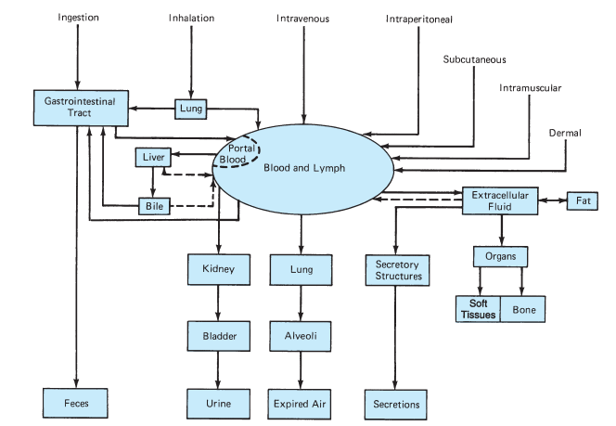
Routes of Absorption, Distribution & Excretion of Toxicants

Slide 9
Principles of Toxicant Disposition
Toxicants have to cross one or several incomplete barriers to exert their deleterious effects at the site(s) in the body.
Exceptions are caustic and corrosive agents (acids, bases, salts, oxidizers), which act topically.
A chemical absorbed into the bloodstream through any of three main barriers is distributed, at least to some extent, throughout the body, including the site where it produces damage.

Slide 10
Principles of Toxicant Disposition
This site is often called the target organ or target tissue.
It is self-evident that to produce a direct toxic effect in an organ, a chemical must reach that organ.
However, indirect toxic responses may be precipitated at distant sites if a toxicant alters regulatory functions.

Slide 11
Principles of Toxicant Disposition
Several factors other than the concentration influence the susceptibility of organs to toxicants.
Therefore, the organ or tissue with the highest concentration of a toxicant is not necessarily the site where toxicity is exerted.
For example, dichlorodiphenyltrichloroethane (DDT) attains its highest concentrations in fat depots of the body but produce no known toxic effect in that tissue.

Slide 12
Principles of Toxicant Disposition
A toxicant may also exert its adverse effect directly on the bloodstream, as with arsine gas, which causes haemolysis.
Toxicants are removed from the systemic circulation by biotransformation, excretion, and storage at various sites in the body.
The relative contribution of these processes to total elimination depends on the physical and chemical properties of the chemical.

Slide 13
Principles of Toxicant Disposition
The kidney plays a major role in the elimination of most toxicants, but other organs may be of critical importance with some toxic agents.
The liver is the most active organ in the biotransformation of toxicants.
Other organs or tissues [enzymes in plasma, kidney, lungs, gastrointestinal (GI) tract, etc.] may also contribute to overall biotransformation.

Slide 14
Principles of Toxicant Disposition
After a toxicant is biotransformed, its metabolites may be excreted preferentially into bile, or may be excreted into urine.
The fourth aspect of disposition—the biotransformation of chemicals—is dealt with in Lecture 3.
Most toxic agents have to pass several membranes before exerting toxicity.

Slide 15
Cell Membrane Transport of Toxicants
Toxicants usually pass through a number of cells, such as the stratified epithelium of the skin, the thin cell layers of the lungs or the gastrointestinal tract, the capillary endothelium, and the cells of the target organ or tissue.
The plasma membranes surrounding all these cells are remarkably similar.
The thickness of the cell membrane is about 7 to 9 nm.

Slide 16
Cell Membrane Transport of Toxicants
A toxicant may pass through a membrane by one of two general processes:
Passive transport, in which the cell expends no energy, and
Specialized transport, in which the cell provides energy to translocate the toxicant across its membrane.

Slide 17
Passive Transport
Most toxicants cross membranes by simple diffusion.
Small hydrophilic molecules permeate membranes through aqueous pores, whereas hydrophobic molecules diffuse across the lipid domain of membranes.
For the majority of toxicants their rate of transport across membranes correlates with their lipid solubility, which is frequently.

Slide 18
Filtration
When water flows in bulk across a porous membrane, any solute small enough to pass through the pores flows with it.
Passage through these channels is called filtration, as it involves bulk flow of water caused by hydrostatic or osmotic force.
One of the main differences between various membranes is the size of these channels.

Slide 19
Active Transport
Substances actively transported across cell membranes presumably form a complex with a membrane-bound macromolecular carrier on one side of the membrane.
The complex subsequently traverses to the other side of the membrane, where the substance is released.
Afterward, the carrier returns to the original surface to repeat the transport cycle.

Slide 20
Active Transport
Some of these transporters include the multidrug-resistant (mdr) proteins and the multi-resistant drug (mrd) proteins.
These transporter also protects the intact animal from chemicals by exuding chemicals out of certain cells.
Other transporters include the following:

Slide 21
Active Transport
The organic-anion transporting peptide (oatp ) family – hepatic
Organic anion transporter (oat) family - renal
Organic cation transporter (oct) family - renal & hepatic
The nucleotide transporter (nt) family, the divalent-metal ion transporter (dmt), and the peptide transporter (pept).

Slide 22
Facilitated Diffusion
Facilitated diffusion applies to carrier mediated transport that exhibits the properties of active transport.
However, the substrate is not moved against an electrochemical or concentration gradient and the transport process does not require the input of energy; that is, metabolic poisons do not interfere with this transport.

Slide 23
ABSORPTION
The process by which toxicants cross body membranes and enter the bloodstream is referred to as absorption.
Xenobiotics penetrate membranes during absorption by the same processes as do biologically essential substances such as oxygen, and other nutrients.
The main sites of absorption are the GI tract, lungs, and skin.

Slide 24
Absorption of Toxicants by the
GIT
Many environmental toxicants enter the food chain and are absorbed together with food from the GI tract.
Unless a noxious agent has caustic or irritating properties, poisons in the GI tract usually do not produce systemic injury to an individual until they are absorbed.
Absorption of toxicants can take place along the entire GI tract, even in the mouth and rectum.

Slide 25
Absorption of Toxicants by the
GIT
If a toxicant is an organic acid or base, it tends to be absorbed by simple diffusion in the part of the GI tract in which it exists in the most lipid-soluble (nonionized) form.
Because gastric juice is acidic and the intestinal contents are nearly neutral, the lipid solubility of weak organic acids or bases can differ markedly in these two areas of the GI tract.

Slide 26
Absorption of Toxicants by the
GIT
One can determine by the Henderson-Hasselbalch equations the fraction of a toxicant that is in the nonionized (lipid-soluble) form and estimate the rate of absorption from the stomach or intestine.
According to this equation, a weak organic acid is present mainly in the nonionized form in the stomach and predominantly in the ionized form in the intestine.
Therefore, one would expect that weak organic acids are absorbed more readily from the stomach.

Slide 27
Absorption of Toxicants by the
GIT
In contrast, absorption of organic bases occurs predominantly in the intestine rather than in the stomach.
However, the Henderson-Hasselbalch equations have to be interpreted with some qualifications because other factors—such as the mass action law, surface area, and blood flow rate—have to be taken into consideration in examining the absorption of weak organic acids or bases.

Slide 28
Absorption of Toxicants by the
GIT
GI tract has specialized transport systems (carrier-mediated) for the absorption of nutrients and electrolytes.
The absorption of some of these substances is complex and depends on a number of factors.
The GI tract also has at least one active transport system that decreases the absorption of xenobiotics.

Slide 29
Absorption of Toxicants by the
GIT
The MDR transporter is localized in enterocytes and exudes toxicants back into the intestinal lumen.
The number of toxicants actively absorbed by the GI tract is low; most enter the body by simple diffusion.
If a compound is very toxic, even small amounts of absorbed material produce serious systemic effects.

Slide 30
Absorption of Toxicants by the
GIT
Furthermore, a toxicant may be hydrolyzed by stomach acid or biotransformed by enzymes of the microflora of the intestine to new compounds.
For example, snake venom is much less toxic when administered orally rather than intravenously because it is broken down by digestive enzymes of the GI tract.
Therefore, amount of a chemical that enters the systemic circulation after oral administration depends on several factors.

Slide 31
Absorption of Toxicants by the
GIT
Further, before a chemical enters the systemic circulation, it can be biotransformed by the cells in the GI tract or extracted by the liver and excreted into bile with or without prior biotransformation.
This phenomenon of the removal of chemicals before entrance into the systemic circulation is referred to as presystemic elimination or first-pass effect.

Slide 32
Absorption of Toxicants by the Lungs
A frequent cause of death from poisoning—carbon monoxide—and an important occupational disease—silicosis—both result from absorption or deposition of airborne poisons in the lungs.
A major group of toxicants that are absorbed by the lungs are gases, vapors of volatile or volatilizable liquids (e.g., benzene and carbon tetrachloride), and aerosols.

Slide 33
Gases and Vapors
The absorption of inhaled gases takes place mainly in the lungs.
However, when inhaled, gases first pass through the nose.
The mucosa of the nose is covered by a film of fluid, thus, gas molecules can be retained by the nose and not reach the lungs if they are very water soluble or react with cell surface components.

Slide 34
Gases and Vapors
Therefore, the nose acts by partially protecting the lungs from potentially injurious insults.
Although these actions may serve to reduce systemic exposure or to protect the lungs, they also increase the risk that the nose could be adversely affected.
Lipid solubility of molecules are less important factors in pulmonary absorption because diffusion through cell membranes is not rate-limiting in this case.

Slide 35
Gases and Vapors
When a gas is inhaled into the lungs, gas molecules diffuse from the alveolar space into the blood and then dissolve.
Except for some gases with a special affinity for certain body components, the uptake of a gas by a tissue usually involves the simple physical process of dissolving.
The amount of gas dissolved in a liquid is proportional to the partial pressure of the gas in the gas phase at any given concentration before or at saturation.

Slide 36
Absorption of Toxicants Through the Skin
Skin is the largest body organ and provides a relatively good barrier for separating organisms from their environment.
Some chemicals can be absorbed by the skin in sufficient quantities to produce systemic effects.
Specifically, the stratum corneum represents the major barrier to prevent the absorption of xenobiotics into the body.

Slide 37
Absorption of Toxicants Through the Skin
Compounds may also be absorbed through dermal appendages, including sweat and sebaceous glands and hair follicles found in the dermis.
In general, passage through these areas is much more rapid than passage through the stratum corneum.
Nonpolar toxicants diffuse through the skin in a manner that is proportional to their lipid solubility and inversely related to molecular weight.

Slide 38
Absorption of Toxicants Through the Skin
There are several factors that can influence the absorption of toxicants through the skin, including:
The integrity of the stratum corneum,
The hydration state of the stratum corneum,
Temperature,
Solvent as carriers, and
Molecular size.
The most frequently encountered penetration-enhancing damage to the skin results from burns and various skin diseases.

Slide 39
DISTRIBUTION
After entering the blood a toxicant is distributed to tissues throughout the body.
The rate of distribution to organs or tissues is determined primarily by blood flow and the rate of diffusion out of the capillary bed into the cells of a particular organ or tissue.
The final distribution depends largely on the affinity of a xenobiotic for various tissues, with penetration of toxicants into cells occuring by transport processes, as was discussed previously.

Slide 40
Volume of Distribution
The concentration of a toxicant in blood depends largely on its volume of distribution.
The volume of distribution (Vd) is used to quantify the distribution of a xenobiotic throughout the body.
It is defined as the volume in which the amount of drug would need to be uniformly dissolved in order to produce the observed blood concentration.

Slide 41
Volume of Distribution
The distribution of toxicants is complex and under most circumstances cannot be equated with distribution into one of the water compartments of the body.
Binding to and/or dissolution in various storage sites of the body, such as fat, liver, and bone, are usually more important factors in determining the distribution of chemicals.

Slide 42
Volume of Distribution
Some toxicants do not readily cross cell membranes and therefore have restricted distribution.
Some toxicants selectively accumulate in certain parts of the body as a result of protein binding, active transport, or high solubility in fat.
The target organ for toxicity may be the site of accumulation, but this is not always the case.

Slide 43
Storage of Toxicants in Tissues
Because only the free fraction of a chemical is in equilibrium throughout the body, binding to or dissolving in certain body constituents greatly alters the distribution of a xenobiotic.
Some xenobiotics attain their highest concentrations at the site of toxic action.
Other chemicals concentrate at sites other than the target organ. For example, lead is stored in bone, but manifestations of lead poisoning appear in soft tissues.

Slide 44
Storage of Toxicants in Tissues
The compartment where a toxicant is concentrated is described as a storage depot.
Toxicants in these depots are always in equilibrium with the free fraction in plasma, so that as a chemical is biotransformed or excreted from the body, more is released from the storage site.
As a result, the biological half-life of stored compounds can be very long.

Slide 45
Plasma Proteins as Storage Depot
Binding to plasma proteins is the major site of protein binding, and several different plasma proteins bind xenobiotics and some endogenous constituents of the body.
Albumin is the major protein in plasma and it binds many different compounds.
Other major plasma binding protein include α1-acid glycoprotein, lipoproteins, transferrin, a beta globulin and ceruloplasmin.

Slide 46
Plasma Proteins as Storage Depot
Albumin, serves as both a depot and multivalent transport protein for many endogenous and exogenous compounds.
Furthermore, the fraction of a toxicant bound to plasma proteins is not immediately available for distribution or filtration by the kidneys.
Xenobiotics can also compete with and displace endogenous compounds that are bound to plasma proteins.

Slide 47
Liver and Kidney as Storage Depots
The liver and kidney have a high capacity for binding many chemicals.
These two organs probably concentrate more toxicants than do all the other organs combined, and in most cases, active transport or binding to tissue components are likely to be involved.
In addition, some proteins serve to sequester xenobiotics in the liver or kidney.

Slide 48
Fat as Storage Depot
Many organic compounds that are highly stable and lipophilic can rapidly penetrate cell membranes and taken up by tissues.
These toxicants are distributed and concentrated in body fat.
Fat storage lowers the concentration of the toxicant in the target organ such that toxicity is likely to be less severe in an obese person than in a lean individual.

Slide 49
Bone as Storage Depot
Compounds such as fluoride, lead, and strontium may be incorporated and stored in the bone matrix, but they are not sequestered irreversibly.
Toxicants can be released from the bone by ionic exchange at the crystal surface and dissolution of bone crystals through osteoclastic activity.
Ultimately, deposition and storage of toxicants in bone may or may not be detrimental.

Slide 50
Blood–Brain Barrier
Access to the brain is restricted by the presence of two barriers: the blood–brain barrier (BBB) and the blood–cerebral spinal fluid barrier (BCSFB).
Many toxicants do not enter the brain in appreciable quantities because of these barriers.
Also, diffusion of more lipophilic compounds through endothelial cell membranes is counteracted by xenobiotic efflux transporters.

Slide 51
Blood–Brain Barrier
Furthermore, the protein concentration in CSF is much lower than that in other body fluids.
The low protein content of the CSF also limits the movement of water-insoluble compounds.
The BCSFB is more of an anatomical entity than a true barrier, but it does provide some protection against the distribution of toxicants to the CNS, thereby affording some protection against toxicity.

Slide 52
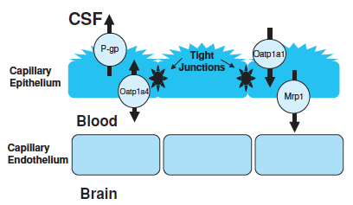
Important Xenobiotic Transport System Found in BCSFB

Slide 53
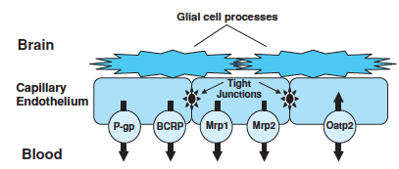
Important Xenobiotic Transport System Found in BBB

Slide 54
Redistribution of Toxicants
The most critical factors that affect the distribution of xenobiotics are the organ blood flow and its affinity for a xenobiotic.
The initial phase of distribution is determined primarily by blood flow to the various parts of the body.
Therefore, a well-perfused organ such as the liver may attain high initial concentrations of a xenobiotic.

Slide 55
Redistribution of Toxicants
However, chemicals may have a high affinity for a binding site (e.g., intracellular protein or bone matrix) or to a cellular constituent (e.g., fat), and with time, will redistribute to these high affinity sites.
For example, although 50% of a dose of lead is found in the liver 2 hours after administration, 1 month later, 90% of the lead remaining in the body is associated with the crystal lattice of bone.

Slide 56
EXCRETION
Toxicants are eliminated from the body by several routes.
The kidney is perhaps the most important organ for the excretion of xenobiotics because more chemicals are eliminated from the body by this route than by any other.
Biotransformation to more water-soluble products is usually a prerequisite to the excretion of xenobiotics through urine (Lecture 3).

Slide 57
EXCRETION
The second important route of elimination of many xenobiotics is through biliary excretion, and the third, primarily for gases, is through the lungs.
All body secretions appear to have the ability to excrete chemicals; toxicants have been found in sweat, saliva, tears, and milk.

Slide 58
Urinary Excretion
Toxic compounds are excreted in urine by the same mechanisms the kidney uses to remove the end products of intermediary metabolism from the body including glomerular filtration, tubular excretion by passive diffusion, and active tubular secretion.
The degree of plasma protein binding affects the rate of filtration because protein-xenobiotic complexes.

Slide 59
Urinary Excretion
A toxicant filtered at the glomerulus may remain in the tubular lumen and be excreted with urine.
Depending on the physicochemical properties of a compound, it may be reabsorbed across the tubular cells of the nephron back into the bloodstream by passive diffusion.
In this case, urinary excretion (i.e., not reabsorbed) of the ionized moiety is favored.

Slide 60
Urinary Excretion
Toxic agents can also be excreted from plasma into urine by passive diffusion through the tubule.
Xenobiotics can also be excreted into urine by active secretion.
Various transporters serve to transport xenobiotics to and from the circulation and the renal tubular cells.

Slide 61
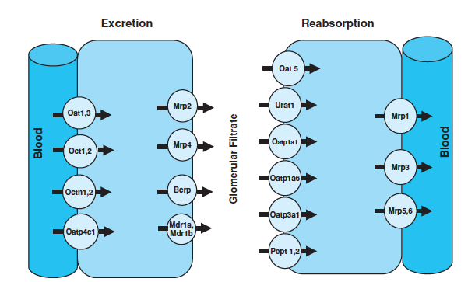
Important Xenobiotic Transport System Found in Kidney

Slide 62
Biliary Excretion
The biliary route of elimination is perhaps the most significant source contributing to the fecal excretion of xenobiotics and is even more important for the excretion of metabolites.
The liver plays an important role in removing toxic chemicals from blood after absorption from the GIT.
A compound can be extracted by the liver, thereby preventing its distribution to other parts of the body.

Slide 63
Biliary Excretion
The liver is also the main site for biotransformation of toxicants, and metabolites may be excreted directly into bile.
Biliary excretion is regulated predominantly by xenobiotic transporters present on the canalicular and sinusoidal membrane.

Slide 64
Biliary Excretion
There are four known transporters expressed on the canalicular membrane that are directly involved in biliary excretion.
These include P-gp, Mrp2, BCRp, and BSEP.
An Mrp2−/− null mouse has been developed, which, show marked reductions in bile flow, biliary glutathione concentrations, and reduced ability to eliminate xenobiotics.

Slide 65
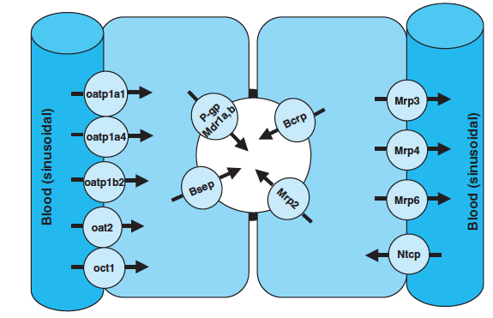
Important Xenobiotic Transport System Found in Liver

Slide 66
Exhalation
Substances that exist predominantly in the gas phase at body temperature are eliminated mainly by the lungs.
Because volatile liquids are in equilibrium with their gas phase in the alveoli, they may also be excreted via the lungs.
The amount of a liquid eliminated via the lungs is proportional to its vapor pressure.

Slide 67
Exhalation
Highly volatile liquids such as diethyl ether and certain volatile anesthetics (nitrous oxide) are excreted almost exclusively by the lungs.
No specialized transport systems have been described for the excretion of toxic substances by the lungs.
Some xenobiotic transporters, including Mrp1 and P-gp, have been identified in the lung, but overall, compounds excreted via exhalation in the lung are most likely to be eliminated by simple diffusion.

Slide 68
Reviewing Key Concepts
Depending on their physical and chemical properties, toxic chemicals may be absorbed by the GI tract, the lungs, and/or the skin.
Fortunately, the body has the ability to biotransform and excrete these compounds into urine, feces, and air.
However, when the rate of absorption exceeds the rate of elimination, toxic compounds may accumulate and reach a critical concentration at a certain target site, and toxicity may ensue.

Slide 69
Reviewing Key Concepts
Whether a chemical elicits toxicity depends not only on its inherent potency and site specificity but also on whether, and if so how, it is absorbed, distributed, and eliminated.
Knowledge of the disposition of chemicals is of great importance in judging the toxicity of xenobiotics.
Many chemicals have very low inherent toxicity but can be metabolically activated into toxic metabolites, and toxicity may be determined by the rate of formation of toxic metabolites.

Slide 70
Reviewing Key Concepts
Alternatively, a very potent toxicant may be detoxified rapidly by biotransformation.
The fundamental and overarching concept is that adverse effects are related to the unbound concentration of the “toxic chemical” at the site of action (in the target organ), whether a chemical is administered or generated by biotransformation in the target tissue or at a distant site.
Accordingly, the toxic response exerted by chemicals is critically influenced by the rates of absorption, distribution, biotransformation, and excretion.

Slide 71
End

