Slide 1
TOXICOLOGY OF THE LIVER

Slide 2
Background
The liver constitutes about 5% of the body mass of a human.
Blood supply is about 20% arterial-80% venous.
May contain 10-15% of blood volume
The liver is the most common site of damage in laboratory animals administered drugs and other chemicals.
There are many reasons including the fact that the liver is the first major organ to be exposed to ingested chemicals due to its portal blood supply.
Although chemicals are delivered to the liver to be metabolized and excreted, this can frequently lead to activation and liver injury.

Slide 3
Normal Liver
Liver is divided histologically into lobules
The center of the lobule is the central vein
At the periphery of the lobule are portal triads

Slide 4
Normal Liver
  Functionally, the liver can be divided into three zones, based upon oxygen supply Zone 1 encircles the portal tracts where the oxygenated blood from hepatic arteries enters and mixes with portal blood
  Zone 3 is located around central veins where blood exits; oxygenation is low
  Zone 2 is the area in between Zones 1 and 3

Slide 5
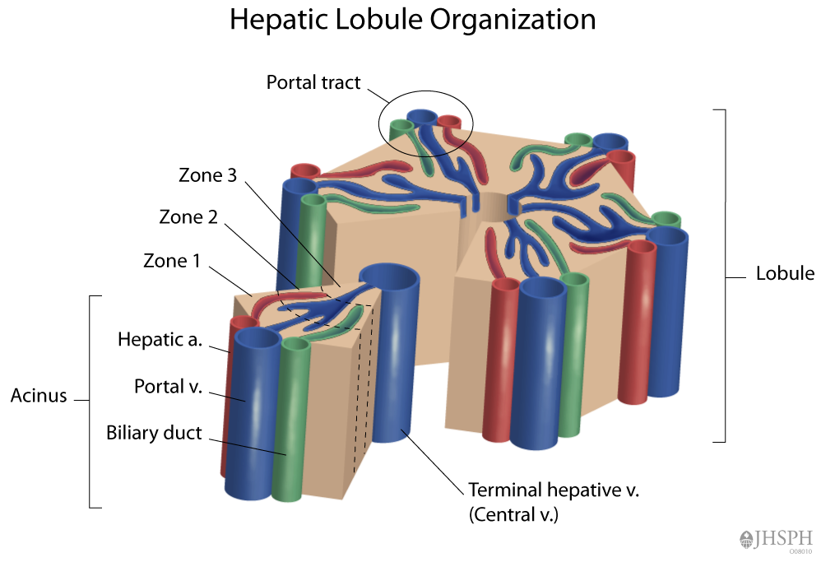

Slide 6
TYPES OF LIVER CELLS
Hepatocytes
Zone I Higher in respiratory enzymes (periportal)
Zone III Higher in cytochrome P450 (centrilobular)
Endothelial cells
Bile duct cells
Oval cells- Possibly stem cells
Kupffer cells- Phagocytic cells Important role in inflammation
Ito cells- Fat storing or stellate cells

Slide 7
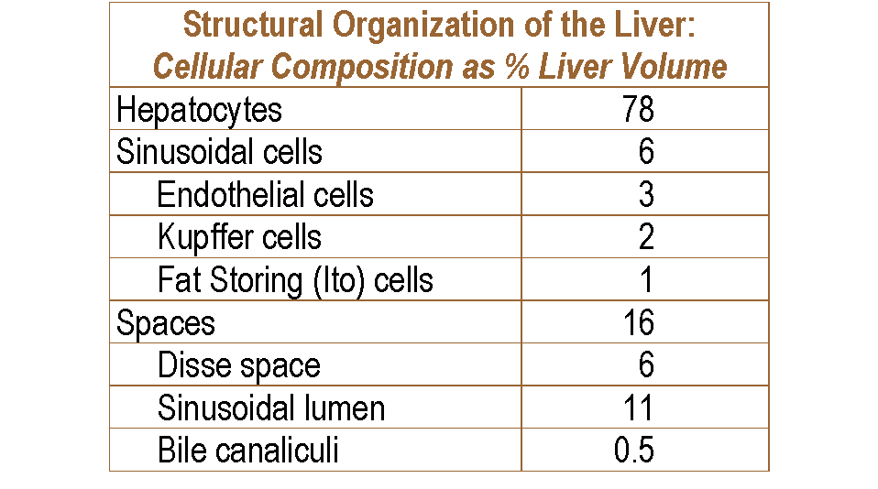

Slide 8
Liver Functions
Biotransformation of xenobiotics, endogenous compounds, including hormones
Carbohydrate metabolism and storage
Synthesis of blood proteins (albumin, lipoproteins, fibrinogen)
Urea formation from amino acids
Fat metabolism
Bile formation

Slide 9
Role of the Liver
Acute Phase Response
  Transient increase or decrease in plasma proteins
  Systemic response to local injury
Phagocytosis of particulates
  Critical location with blood flow from GI tract
Central role in cholesterol homeostasis
Critical for iron, zinc and copper metabolism

Slide 10
Zonal Localization of Metabolic Processes
Predominantly Acinar Zone 1 (Periportal) | Predominantly Acinar Zone 3 (Centrilobular) | Distributed Equally
Oxidative energy metabolism | Glucose uptake | Metabolism of Ethanol Acetaldehyde
Fatty acid oxidation | Glycolysis
Respiratory chain | Glycogen synthesis from glucose
Glucose release | Glycogen degradation to lactate
Glucose synthesis from lactate | Ketogenesis
Amino acid utilization | Lipogenesis including bile acid synthesis
Amino acid conversion to glucose | Biotransformation
Amino acid degradation
Urea formation
Secretion Bile acids Bilirubin

Slide 11
Drugs and the Liver
Liver Disease
Drug-Drug
Drugs
Interactions
LIVER
Drug Elimination
Drug Metabolites
(the good, the bad and the ugly)

Slide 12
Why Study Drugs and the Liver?
Liver is a major biotransforming and elimination organ
  Barrier and “Garbage Disposal”
Drug-drug interactions occur in liver
  May increase toxicity or reduce effect
Drugs cause liver damage
Liver disease in turn alters drug disposal (remember renal disease and drug excretion)

Slide 13
Drug-induced liver injury (DILI) is increasingly being recognised as a significant cause of both acute and chronic liver disease.
The most commonly implicated agents are paracetamol, antimicrobials, CNS drugs, NSAIDs, statins, isoniazid , captopril and herbal remedies.

Slide 14
Drug hepatotoxicity, is the leading cause of acute liver failure (ALF). [approximately 50% of all cases.]
Drug-induced ALF is also associated with high morbidity and mortality, [ only a 20% survival in the absence of liver transplantation.]

Slide 15
Drug Induced liver Disease
Liver is the mayor detoxifying organ in the body.
Liver is subjet to potential damage from pharamceutical and environmental chemicals.
Injury may result from:
  Direct toxicity
  Hepatic conversion of chemical.
  Immune mechanisms.
  Liver damage from chemicals may be immediate or take months.

Slide 16
Drug Induced liver Disease
Hepatocelular damage | Chemicals
Microvesicular fatty change | Tetracycline, salicylates.
Macrovesicular fatty change | Ethanol, methrotexate.
Massive necrosis | Acetaminophen, insoniazid.
Hepatitis, acute and chronic | Methyldopa, phenytoin.
Cholestasis | Anabolic steroids, oral contraceptives.

Slide 17
Hepatotoxicity
Representative Toxins
Type of Injury/Damage
CCl4 , ethanol, fialuridine (anti-viral), valproic acid (anti-epilectic)
acetaminophen, ethanol, chloroform
estrogens, chlorpromazine
amoxicilin, α-napthyl-isothiocyanate (cholestatic chemical)
anabolic steroids, cyclophosphamide
ethanol, vinyl chloride, vitamin A
aflatoxin, vinyl chloride, synthetic estrogens, androgens
Fatty Liver (Steatosis)
Hepatocyte Necrosis (cell death)
Canalicular cholestasis
Bile duct damage
Sinusoidal damage
Fibrosis & cirrhosis
Tumours

Slide 18
PATHOPHYSIOLOGIC RESPONSE TO TOXIC INJURY
Each of the different cell types may respond to a toxic insult.
If severe, toxicity can result in cell death but hepatocytes have remarkable adaptive responses.
These responses depend on the chemical and dose.
- Necrosis
- Lipidosis (fatty liver)
-Infiltration and Pigmentation
- Cholestasis
-Cirrhosis
-Hepatitis
-Vascular injury
-Neoplasia

Slide 19
NECROSIS
Cell death of hepatocytes. Damage occurs in different parts of the liver lobule depending on oxygen tension or levels of particular drug metabolizing enzymes.
Allyl alcohol causes periportal necrosis (III) because the enzyme metabolizing it is particularly located there.
Carbon tetrachloride causes centrilobular necrosis -endothelial and Kupffer cells adjacent to hepatocytes may be normal - with diethylnitrosamine, endothelial cells are also killed.
Due to activation by higher concentrations of cytochrome P450 in zone I. Some cells undergo apoptosis which may be increased by agents such as ethanol. Unlike necrosis there is no release of cellular contents and thus no inflammatory cells.

Slide 20
LIPIDOSIS
Many chemicals cause a fatty liver. Sometimes associated with necrosis but often not.
Not really understood but essentially is due to an imbalance between uptake of fatty acids and their secretion as VLDL.
Carbon tetrachloride can cause lipidosis by interfering in apolipoprotein synthesis as well as oxidation of fatty acids.
Other chemicals can cause lipidosis by interfering with export via the Golgi apparatus.
Ethanol can induce increased production of fatty acids.

Slide 21
INFILTRATION & PIGMENTATION
Some chemicals cause hydropic degeneration(water accumulation in hepatocytes) possibly related to failure of sodium balance.
Other chemicals, especially the so called peroxisome proliferators, induce lipofuscin (age pigment) accumulation due to poorly metabolized lipid probably accumulating in lysosomes.
Some drugs eg griseofulvin, cause the deposition of the lipophilic haem precursor protoporphyrin.

Slide 22
CHOLESTASIS
Accumulation of bile pigments and other products in the bile canaliculi interfering with bile flow. Can occur without damage to hepatocytes.
α-naphthylisocyanate disrupts hepatocyte junctions forming caniculi.

Slide 23
CIRRHOSIS
Hepatic fibrosis and hypoxia leading to nodular regeneration.
Can occur after repeated insult and may lead to hepatic failure.
E.g carbon tetrachloride.

Slide 24
Neoplasia or Tumors
Chemically induced neoplasia can involve tumors that are derived from hepatocytes, bile duct cells, or the rare, highly malignant angiosarcomas derived from sinusoidal lining cells.
Hepatocellular cancer has been linked to chronic abuse of androgens, alcohol, and a high prevalence of aflatoxin-contaminated diets.
In addition, viral hepatitis, metabolic diseases such as hemochromatosis and α1-antitrypsin deficiency, and nonalcoholic steatohepatitis are major risk factors for hepatocellular carcinoma

Slide 25
Damage to other cell types
Damage to hepatocytes is not always observed.
In some circumstances bile duct necrosis is observed (alpha-naphthylisocyanate).
Other chemicals cause bile duct hyperplasia, oval cell proliferation and cholangiofibrosis (2- acetylaminofluorene).
Other toxins can affect endothelial cells, Ito cells and Kupffer cells.
Ricin and beryllium can initially first attack Kupffer cells.

Slide 26
Autoimmune responses
Sometimes it seems that in the metabolism of a drug protein-drug adducts are produced which are expressed on the hepatocyte cell surface and act as antigens.
Hepatocytes can then be destroyed by cell mediated immune responses.
Accompanying inflammation.
May occur in humans after multi exposures and no dose response.
Classic cases of halothane hepatitis in humans.
Rare but high mortality.

Slide 27
Classification of drug induced liver injury:
Predictable reactions:
- dose related, has a high incidence, and occurs with a short latency (within a few days).
- results from direct toxicity of the drug or its metabolite and is reproducible in animal models
classic example is acetaminophen / paracetamol toxicity

Slide 28
Classification of drug induced liver injury:
Idiosyncratic reactions:
- occur with variable latency (1 week to 1 year or more), with low incidence, and
- may or may not be dose related
- the majority of hepatotoxic drugs cause idiosyncratic reactions
- an ALT>3×upper limit of normal (ULN), or an alkaline phosphatase (ALP)>2×ULN has been somewhat arbitrarily identified as a sensitive but not necessarily specific sign of liver toxicity

Slide 29
Classification of drug induced liver injury:
Immune mediated (allergic) vs
Non-immune mediated (non-allergic)

Slide 30
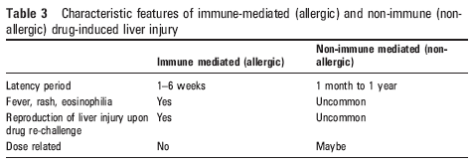

Slide 31
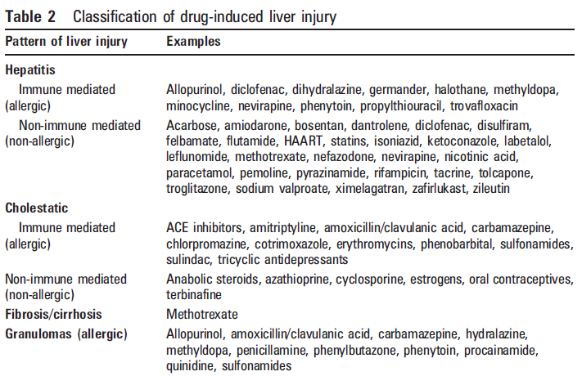

Slide 32
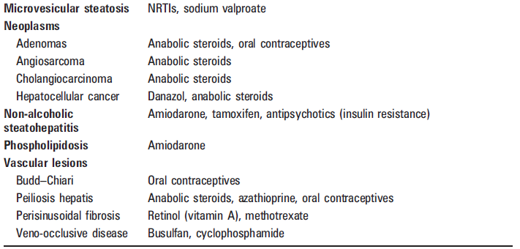

Slide 33
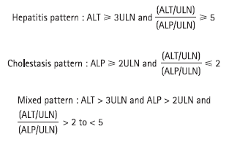
Patterns of LFTs abnormality and clinical features:

Slide 34
Hepatitis pattern:
Hepatocellular injury
Patient may be asymptomatic or present with fatigue, right upper quadrant pain
The hepatitis pattern of liver injury is most commonly accompanied by acute liver failure, defined as coagulopathy (INR ≥1.5) and hepatic encephalopathy occurring <26 weeks after onset of illness in a patient without pre-existing cirrhosis. This usually has a grave prognosis in absence of liver transplantation.

Slide 35
Indicator of severity
There is usually poor correlation between degree of ALT elevation and the severity of the liver disease.
histology being a more accurate indicator.
However, jaundice is a good predictor of mortality in drug-induced hepatitis.

Slide 36
Hy’s law
A consistent serum bilirubin ≥3 ×ULN, ( in the absence of biliary obstruction or Gilbert’s syndrome,) is associated with a mortality of approximately 10%. (range, 5–50%)

Slide 37
Cholestatic pattern:
canalicular cholestasis usually results from inhibition of bilirubin or the bile-salt transport (eg, cyclosporine or oestrogen metabolite); this is referred to as “bland”
cholestasis because histologically there is virtual absence of inflammation or necrosis.
More commonly, however, cholestasis is associated with some degree of cholangiocyte injury.
presentation can mimic biliary obstruction or the course can be more associated with jaundice and pruritus.
Mortality is less than with the hepatitis pattern (1–7.8%) and death is usually not liver-related, though chronic cholestatic injury can result in ductopenia and, rarely, cirrhosis.

Slide 38
Mixed pattern:
combination of acute hepatitis and cholestasis.
This pattern of liver injury probably has the lowest mortality
Other forms of hepatotoxicity:
granulomas, fibrosis, neoplasms, steatohepatitis and vascular lesions

Slide 39
MANAGEMENT
prompt discontinuation of the offending drug,
supportive and symptomatic therapy,
monitoring for the development of Acute liver Failure.

Slide 40
Response to Xenobiotics and Repair of Hepatotoxicity
Liver responds to increased workload by
Hypertrophy (increased cell size)
Hyperplasia (increased cell number)
Liver has enormous regenerative capacity

Slide 41
Acetaminophen (Paracetamol)
most common cause of DILI, and is an important cause of acute liver failure
single doses of acetaminophen exceeding 7 to 10 g (140 mg/kg of body weight in children) may cause liver injury
severe (as indicated by serum ALT levels greater than 1000 U/L) or fatal liver injury , usually involves acetaminophen doses of at least 15 to 25 g

Slide 42
Risk factors for acetaminophen hepatotoxicity
Age: Children may be more resistant than adults
Dose: Minimal hepatotoxic dose: 7.5 g (≈100 mg/kg) in adults, >150 mg/kg in children, Severe toxicity possible with dose >15 g
Blood level: Influenced by dose, time after ingestion, gastric emptying Best indicator of risk of hepatotoxicity
Chronic excessive alcohol ingestion: Toxic dose threshold lowered; worsens prognosis (also related to late presentation); nephrotoxicity common
Fasting: Toxic dose threshold lowered
Concomitant medication: Toxic dose threshold lowered; worsens prognosis (e.g., isoniazid, phenytoin, zidovudine)
Time of presentation: Late presentation or delayed treatment (>16hr) predicts worse outcome

Slide 43
Antibiotics/Antimicrobials
The class of drugs most frequently implicated in non-fulminant DILI
Amoxicillin/clavulanic acid is the most frequently reported antibiotic associated with DILI
Overall rate of symptomatic hepatitis < 1 in 100000 persons exposed
Pattern: cholestatic hepatitis, occurring 1-4 weeks after cessation of therapy
Most patients recover completely in 4 to 16 weeks

Slide 44
Ketoconazole
hepatitis occurs in 7 to 20 per 100,000 exposed persons
The onset is at 6 to 12 weeks after ketoconazole therapy is started, and rarely after the drug is stopped
Not dose-dependent

Slide 45
Fluconazole
elevations of LFTs occur in fewer than 5% of patients, and liver injury has been documented in only a few reports

Slide 46
Isoniazid
Hepatitis develops in approximately 21 of 1000 persons exposed to isoniazid; 5% to 10% of cases are fatal
risk and severity of isoniazid hepatitis increase with age; the risk is 0.3% in the third decade of life and increases to 2% or higher after age 50
risk of toxicity is not related to the dose or blood level of isoniazid
Risk factors: concurrent use of rifampin, pyrazinamide, acetaminophen, HBV, HCV, HIV

Slide 47
Isoniazid
serum ALT levels increase in 10% to 36% of persons taking isoniazid during the first 10 weeks
Abnormalities typically are minor and resolve spontaneously. In persons in whom hepatitis develops, the latent period from exposure to disease ranges from 1 week to more than 6 months; the median is approximately 8 weeks, and 12 weeks for severe cases
early symptoms occur in one third of patients and include malaise, fatigue, and early symptoms of hepatitis such as anorexia, nausea, and vomiting.
Jaundice appears several days later and is the only feature in approximately 10% of cases
cases with a fatal outcome have been associated with a longer duration of therapy or continued ingestion of isoniazid after the onset of symptoms
Recovery is rapid if isoniazid is discontinued before severe liver injury is established.
Management of liver failure is supportive; transplantation is indicated in the most severe cases

Slide 48
Other Antituberculosis Drugs
Most cases in which rifampin has been implicated with liver injury have occurred in patients taking isoniazid, but a few cases have been observed when rifampin was given alone to patients with underlying liver disease
Pyrazinamide (as well as the related ethionamide) was known as a dose-dependent hepatotoxin. Hepatotoxicity may be particularly severe in patients taking combinations that include isoniazid and pyrazinamide

Slide 49
Lipid-lowering medications
Statins
Nowadays, we are often faced with the question of whether or not to start statin in patients with non alcoholic staetohepatitis (NASH), hypercholesterolemia with baseline LFTs elevation
While mild aminotransferase elevations can occur in patients taking statin, clinically significant elevation leading to acute liver failure is extremely rare
Acute liver failure secondary to statins is rare and likely occurs through an idiosyncratic mechanism
Asymptomatic mild aminotransferase elevation is generally dose-related, occurs within the first 12 weeks of therapy and improves spontaneously in many cases
Incidence of mild dose-related aminotransferase elevation is 0 to 3%

Slide 50
Statins
Statins have been associated with autoimmune hepatitis in several case reports.
Clinical features in these case reports range from minimal fibrosis on biopsy with normalization of aminotransferases following treatment with prednisone alone to a lupus-like syndrome with rash, hepatic failure and improvement only with institution of triple immunosuppressive therapy with tacrolimus, mycophenolate mofetil and prednisolone.

Slide 51
Medications for diabetes
Troglitazone was the first peroxisome proliferator–activated receptor-γ (PPARγ) agonist used in type 2 diabetes
Reports of acute liver failure emerged in the postmarketing phase in which troglitazone was associated with more than 75 instances of fatal hepatotoxicity or liver failure requiring hepatic transplantation
The onset of troglitazone hepatotoxicity was often as late as 9 to 12 months after treatment was started

Slide 52
Thiazolidinediones
Serious liver injury appears to be rare with the second-generation thiazolidinediones rosiglitazone and pioglitazone.
Before treatment with drugs of this class is begun, the FDA recommends that liver biochemical tests be performed; the pretreatment serum ALT levels should be less than 2.5 times the upper limit of normal
If serum ALT levels remain persistently elevated (> 3x ULN), the thiazolidinedione should be discontinued
TZDs should not be withheld in diabetics with NASH and LFT < 2x ULN, given potential benefits

Slide 53
Antiretrovirals
the frequency of hepatic injury associated with HAART is at least 10%
Because co-infection with HBV or HCV in HIV patients increases the risk of toxicity, all patients should be screened for viral hepatitis before starting HAART
Nucleoside (or Nucleotide) Reverse Transcriptase Inhibitors
Hepatotoxicity mechanism may include oxidative stress and deletion of mitochondrial DNA
In clinical studies, zidovudine, didanosine, and stavudine are the agents most often implicated in liver injury
Hallmarks of mitochondrial hepatotoxicity include extensive microvesicular or macrovesicular steatosis, or both, lactic acidosis, and liver biochemical test abnormalities progressing to acute liver failure
onset is at a median of 6 months after initiation of treatment

Slide 54
Non-Nucleoside Reverse Transcriptase Inhibitors
Usually presents as hypersensitivity reaction within the first 6 weeks of use
Resolution occurs within 4 weeks of discontinuing the drug
Nevirapine also has been implicated in several instances of severe hepatotoxicity (including liver failure requiring liver transplant)

Slide 55
Protease inhibitors
Elevation of liver enzymes occurs commonly with protease inhibitors, but clinical hepatitis is infrequent.
The agents implicated most often in liver injury are ritonavir and indinavir.
Indinavir also may be associated with unconjugated hyperbilirubinemia in 7% of persons receiving the drug
Many protease inhibitors induce or inhibit CYP3A4, thereby causing important drug-drug interactions

Slide 56
NSAIDs
may cause drug-induced liver disease, with or without immunoallergic features and with varying degrees of hepatocellular injury and cholestasis
Diclofenac
Serious hepatotoxicity occurs in approximately 1 to 5 per 100,000 persons exposed
Risk increased in elderly and females
usually occurs within 3 months after initiation of the medication
Liver biochemical test results reflect acute hepatitis with or without cholestasis.
Reactions tend to be severe, with jaundice in 50% of cases.
Liver biopsy specimens reveal acute lobular hepatitis, but in severe cases, bridging or confluent necrosis, interface hepatitis, and fibrous expansion of the portal tracts
Diclofenac induced autoimmune hepatitis has been reported. Cases usually have improved spontaneously after discontinuation of the drug, but glucocorticoids have been used successfully in a few cases

Slide 57
Aspirin
Aspirin occasionally has been associated with major increases in serum ALT levels suggestive of drug hepatitis, but hepatotoxicity occurs only when blood salicylate concentrations exceed 25 mg/dL
Most cases of aspirin-induced hepatotoxicity have been identified by liver biochemical testing, rather than clinical features
Reye’s syndrome:
characterized by acute encephalopathy and hepatic injury that is documented by a three-fold or greater rise in serum aminotransferase or ammonia levels and by characteristic histologic findings.
This has been observed in aspirin use in febrile children.
usually occurs between 3 and 4 days after an apparently minor viral infection, Produces microvesicular steatosis with severe liver dysfuntion.

Slide 58
Chemotherapy
Risk of hepatotoxicity increases with the number of chemotherapeutic agents used
Risks of hepatic injury: drug interaction leading to altered metabolism of the chemotherapeutic agents (ie, toxicity), drug-induced inhibition of biliary excretion, altered metabolism of chemotherapeutic agents due to hepatic dysfunction from liver metastasis, underlying liver disease (viral hepatitis, NASH, cirrhosis from other causes)
Hematopoietic stem cell transplantation
Sinusoidal obstruction syndrome (veno-occlusive disease), is the most common type of hepatic vascular injury from certain chemotherapy drugs.
SOS is usually caused by synergistic toxicity from drugs used in high-dose combination chemotherapy or high-dose chemotherapy plus total body irradiation

Slide 59
Chemotherapy
For example, cyclophosphamide is particularly toxic to the sinusoidal endothelial cells.
Busulfan predisposes to SOS by depletion of glutathione in hepatocytes.
SOS presents clinically with tender hepatomegaly, fluid retention, weight gain, and jaundice.
Transjugular liver biopsy and measurement of hepatic venous pressure gradient offer objective criteria for the diagnosis (however, sometimes these are not possible due to refractory thrombocytopenia or coagulopathy)

Slide 60
Methotrexate:
has been used in treatment of hematologic malignancies, and inflammatory conditions (eg, psoriasis).
It is a dose-dependent toxin, and can cause severe liver fibrosis/cirrhosis over time.
Risk factors: alcohol intake, obesity, DM and pre-existing liver disease
Scheduled liver biopsies are recommended after a cumulative methotrexate dose of 4 g or therapy duration of 2 years

Slide 61
AFLATOXIN B1
This is a mould metabolite well established as a hepatic toxin and carcinogen in rats and humans.
The crucial reaction is cytochrome P450 activation of aflatoxin B1 to the 2,3-epoxide.
Elevated levels of particular glutathione transferases will protect by conjugating the epoxide with glutathione. If no, alkylation of guanine at N4 or 06 leads to neoplasia.
Although reactions with DNA appear to be simple it is a complex process which determines whether DNA alkylation actually leads eventually to cancer.

Slide 62
Management
take a good drug and exposure history
lab monitoring
discontinuation of the possible offending drugs
specific therapy may not be available, and most of the time, management is supportive
liver biopsy may be helpful in excluding other causes of liver injury
if there’s evidence of acute liver failure/fulminant liver failure, then refer patient to a liver transplant center

Slide 63
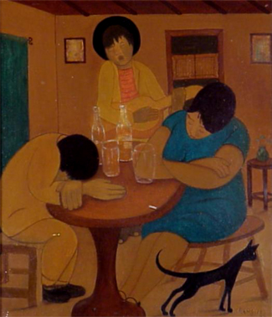
Alcholic liver disease
(Ethanol Metabolism)

Slide 64
Epidemiology
It develop only after a "threshold" dose
600 kg for men and 150 to 300 kg for women.
one must consume eight 6-oz beers, 1 L of wine, daily for a period of 20 years
Almost all people who exceed this threshold dose of ethanol exhibit some biochemical or histologic abnormality suggestive of liver injury

Slide 65
Epidemiology
fewer than 50% of people who ingest the calculated threshold dose of ethanol eventually develop serious alcoholic liver disease (e.g., alcoholic hepatitis or fibrosis).
This suggest that the pathogenesis involves hereditary and enviromental disorders.

Slide 66
Alcohol
Not related to type of beverage
Is related to ‘dose’
Women more susceptible - lower body weight
- lower relative lean body mass
- lower gastric ethanol dehydrogenase

Slide 67
Metabolism
Liver. 3 enzyme systems:
  ADH
  MEOS (micfosomal ethanol oxidixing system)
  Catalase.
There exist several isoforms of the ADH enzyme (alfa, beta and gamma) and its variation changes the metabolic rate of ethanol.
ADH acts alone when tissue levels do not exceed 10 mmol/L

Slide 68
MEOS
Cytochrome P-450 2E1 (CYP2E1)
also the metabolism of other drugs such as acetaminophen, haloalkanes, and nitrosamines
Chronic ethanol consumption up-regulates CYP2E1
CYP2E1-mediated ethanol oxidation yields reactive oxygen intermediates
These are capable of provoking hepatocellular damage

Slide 69
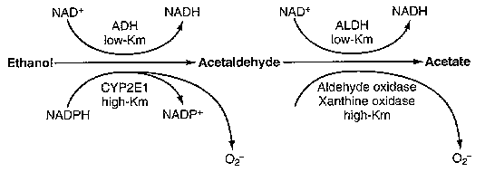

Slide 70
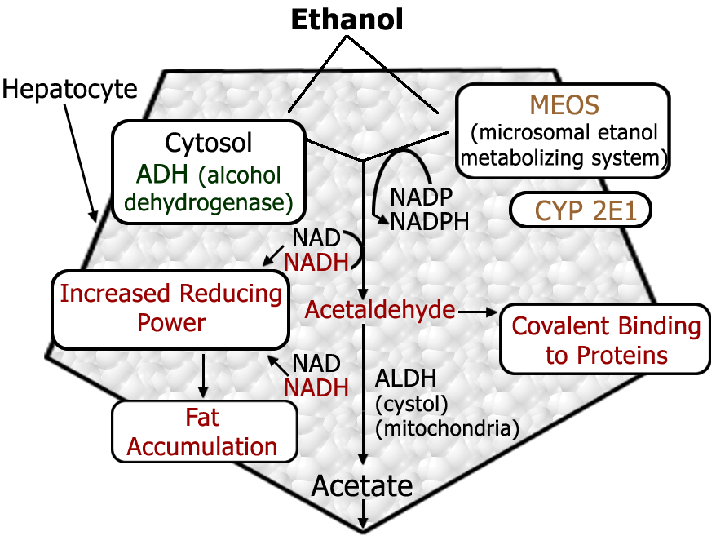
Metabolism of Ethanol in the Liver—Direct Toxicity

Slide 71
Pathogenesis of Ethanol Toxicity
Direct
  Production of reactive acetaldehyde
  Increased levels of reducing co-factors
Indirect
  Affects cell membrane fluidity
  Formation of a unique phospholipid (phosphatidylethanol)
  Formation of toxic fatty acid ethyl esters
  Mitochondrial inner membrane damage
    Promotes formation of Reactive Oxygen Species (ROS)Formation of hydroxymethyl radical
    ROS produced by CYP2E1

Slide 72
MECHANISMS OF TISSUE DAMAGE
2 ways of damage: Indirect
Ingestion of Ethanol
Increases the release of endotoxins, from the gram negative bacteria in the natural flora of the intestinal tract
Kupffer cells release toxic mediators:Reactive Oxygen Intermediates (ROIs) and Tumor Necrosis Factor (TNF)
Synergize to cause oxidative damage to hepatocytes.
the inflammatory response.

Slide 73
Possible Mechanisms of Toxicity
Fat - storing para-sinusoidal cells transform into myofibroblasts
Animal studies suggest that alcohol metabolites directly hepatotoxic even in the presence of adequate nutrition

Slide 74
Stages of Alcoholic Liver Disease
1. Fatty liver (steatosis) synthesis oxidation transport
2. Acute alcoholic hepatitis
Neutrophil infiltrate
Perivenular fibrosis
Alcoholic hyaline (eosinophile substance)
Cholestasis
Inflamed portal tracts

Slide 75
Stages of Alcoholic Liver Disease (Cont.)
3. Cirrhosis
Disturbed lobular architecture
Increased fibrous tissue
Reduced functioning hepatocyte mass
Shunting

Slide 76
Clinical manifestations
Vomiting
Diarrhea
Jaundice
Psychological disturbances.
Hepatic encephalopathy
Ascites
Bleeding esophageal
Varices (varicose veins in the esophagus), abnormal blood clotting and coma.

Slide 77
Lab
AST to ALT ratio = 2:1
Alkaline Phosphatase elevated
Gamma glutamyl transferase (GGT)
Hypoalbuminemia
Management
Alcohol Cessation
Increased caloric and protein intake
Vitamin supplementation (Thiamine)
Corticosteroids

Slide 78
THE END

