Slide 1

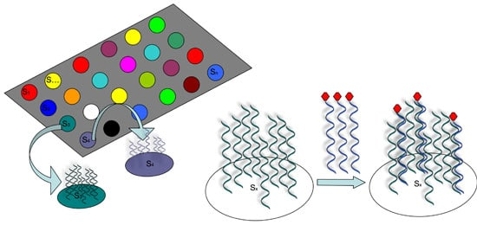
THE UNIVERSITY OF ZAMBIA
SCHOOL OF HEALTH SCIENCES
DEPARTMENT OF BIOMEDICAL SCIENCES
9
8
MICROARRAY TECHNIQUES AND RNA Seq
7
6
Advanced Biotechniques presentation
5
4
3
2
Wednesday, 23th October, 2024.
1

Slide 2
Microarrays
Microarrays are laboratory techniques used to analyze gene expression, genotyping and molecular interactions.
Types: DNA, Oligonucleotide, cDNA microarray
The resulting “grid” of probes can hybridize to complementary “target” sequences derived from experimental samples.
9
8
7
6
5
4
3
2
1

Slide 3
Principle of DNA microarray
The principle is based on hybridization between probes and targets.
Key steps
Probe preparation:
2. Sample preparation.
3. Hybridization
4. Scanning and analysis: A laser scanner detects the fluorescence signal, and the data are analyzed to determine gene expression levels or detect genetic variants.
9
8
7
6
5
4
3
2

Slide 4
Application of DNA microarray
Disease diagnosis
Pharmacogenomics
Biotechnology
9
8
7
6
5
4
3

Slide 5
Advantages of DNA microarray
Enables high-throughput analysis
Cost-effective (Re-use) though most are single use
Well-established technology with a strong track record
9
8
7
6
5
4

Slide 6
Limitations
Limited sensitivity and specificity
Difficult to detect new or lowly expressed transcripts
Requires prior knowledge of the target genes
There can be issues with cross-hybridization and background noise.
9
8
7
6
5

Slide 7
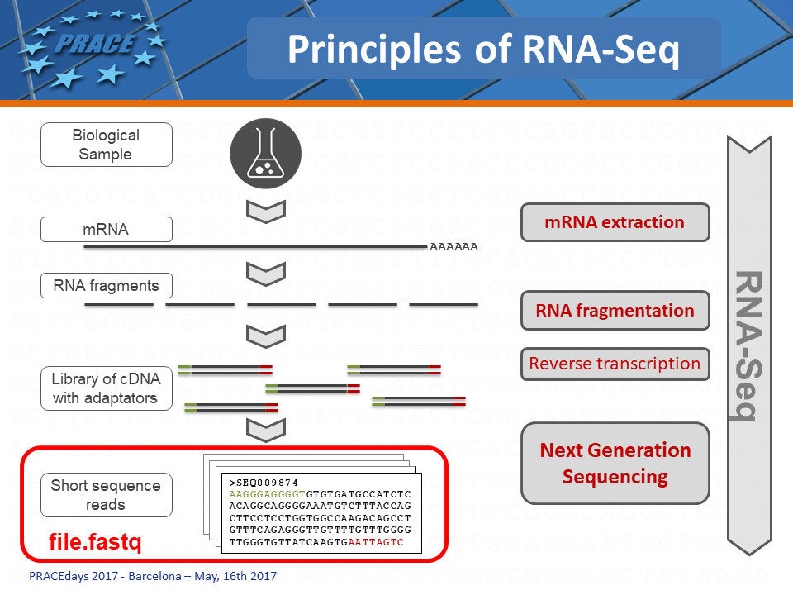
RNA-seq is a next generation-sequencing (NGS) technology used to analyze the quantity and sequences of RNA in a sample.
RNA Sequencing
RNA-seq is a next generation-sequencing (NGS) technology used to analyze the quantity and sequences of RNA in a sample.
9
8
7
6

Slide 8
Principle
The principle is based on next generation sequencing
How it works;
Sample preparation- mRNA extraction
2. Library preparation- RNA converted to cDNA then addition of sequencing adaptors. This library is then amplified and fragmented.
3. Sequencing using NGS platforms
4. Data analysis which involves alignment and quantification. Gene expression levels are quantified based on read counts.
9
8
7

Slide 9
Types
  Bulk RNA-seq: involves extracting RNA from a large number of cells and sequencing the collected RNA samples to obtain an average gene expression profile across the population.
  Single cell RNA-seq (scRNA-seq): involves isolating and sequencing RNA from single cells in a population of cells.
9
8

Slide 10
Application
Differential gene expression analysis
Transcriptome analysis
Fusion gene detection
Non-coding RNA analysis (miRNA, siRNA, IncRNA)
Alternative splicing analysis
Gene expression profiling
9

Slide 11
Advantages
High sensitivity and specificity
Wide dynamic range
Can detect both known and novel transcripts, including alternative splicing variants
Ability to analyze non-coding RNAs and other RNA species
Provides insights into the structure of transcripts and isoforms.
10

Slide 12
Limitations
More expensive, especially for large-scale studies
Requires more complex bioinformatics for data analysis and interpretation
May require a larger amount of RNA for successful library preparation
11

Slide 13
Comparison of microarray and RNA-seq
 | microarray | RNA-seq
Sensitivity | lower | higher
specificity | lower | higher
Novel transcript discovery | limited | higher
Cost | lower | higher
Dynamic range | limited | wide
12

Slide 14
13
Both microarrays and RNA-seq are valuable tools in genomic research with RNA-seq been widely used due to its comprehensive nature and ability to provide deeper insights into gene expression and transcriptome complexity.
Thus, the choice between the two depends on the specific research questions, available resources and desired outcomes.

Slide 15
References
14
Schena, M., Shalon, D., Davis, R., Brown, P. (1995). Pararell human genome analysis: Microarray technology. Science, 270 (5235), 467 – 470
Lockhart, D., Dong, H., Byrne, M. C., et al. (1996). Expression monitoring by hybridization. Nature biotechnology, 14(10)1-67 – 1071
Alon, U., Barkai, N.,Noetterman, D.,Gish, K., et al. (1999). Broad patterns of gene expression, 96(7), 6789 – 6793

Slide 16

15
Thank you !
Wednesday, 23th October, 2024.

