Slide 1
Adrenal glands
Z Ngwira

Slide 2
Lecture objectives
To know the hormones produced by adrenal glands and their functions.
To know effects of hyperfunction and hypofunction of adrenal gland hormones.
To know biochemical tests used to evaluate adrenal gland disorders.

Slide 3
Introduction
The hormones of the adrenal (suprarenal) glands are essential for survival.
The adrenal cortex is the source of the two important steroid hormones, aldosterone and cortisol.
The adrenal medulla is embryologically and histologically distinct from the cortex and is part of the sympathetic nervous system.
Medullary cells synthesize, store and secrete adrenaline, along with noradrenaline.

Slide 4
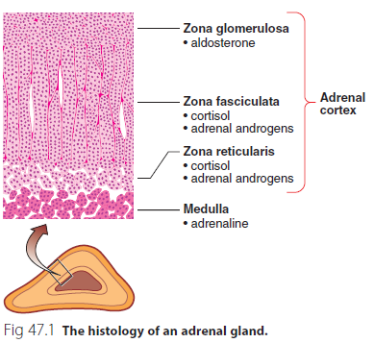

Slide 5
Cortisol
Cortisol is produced mainly in the zona fasciculata and in small quantities in the zona reticularis of the adrenal cortex.
This is the end product of a cascade of hormones that make up the hypothalamic– pituitary–adrenocortical axis.

Slide 6
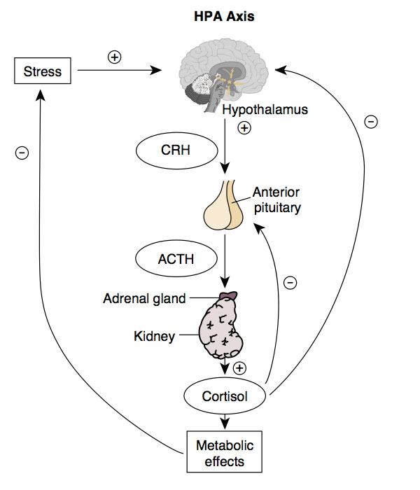
The hypothalamic-pituitary-adrenocortical-axis

Slide 7
Cortisol cont..
Corticotrophin releasing hormone (CRH) is secreted by the hypothalamus under the influence of cerebral factors.
Adrenocorticotrophic hormone (corticotrophin, or simply ACTH) is secreted by the anterior pituitary under the control of CRH to maintain the fascicular and reticular zones of the adrenal cortex and to stimulate the secretion of cortisol.
Hypothalamic secretion of CRH and pituitary secretion of ACTH are modulated by cortisol in negative feedback loops.

Slide 8
Actions of cortisol
Natural or synthetic steroids with cortisol like effects are called glucocorticoids.
Actions of cortisol include:
Mobilisation of energy supplies
Maintenance of plasma volume
Suppression of inflammatory response
Suppression of immune system

Slide 9
Adrenal androgens
The adrenal androgens –androstenedione, DHA (dehydroepiandrosterone) and DHA sulphate – are produced predominantly by the zona reticularis.
These compounds probably owe their androgenic activity to peripheral conversion to testosterone.
In females the adrenal cortex is an important source of androgens, but in adult males this source is insignificant compared with testosterone made by the testes.

Slide 10
Aldosterone
Aldosterone is produced exclusively by the zona glomerulosa and is primarily controlled by the renin–angiotensin system.
Other factors, including ACTH, are also involved in the regulation of aldosterone synthesis.
Aldosterone is responsible for promoting sodium reabsorption and potassium excretion in the kidney.
A natural or synthetic steroid with aldosterone-like activity is called a mineralocorticoid.

Slide 11
Hypofunction of the adrenal gland-adrenal insufficiency
Acute adrenal insufficiency is a rare condition that if unrecognized is potentially fatal.
Because of its low incidence it is often overlooked as a possible diagnosis.
It is relatively simple to treat once the diagnosis has been made, and patients can lead a normal life.
In areas where tuberculosis is endemic, adrenal gland destruction may be due to TB; in developed countries autoimmune disease is now the main cause of primary adrenal failure.

Slide 12
Hypofunction of the adrenal gland-adrenal insufficiency cont..
Both cortisol and aldosterone production may be affected.
Secondary failure to produce cortisol is more common. Frequently, this is due to long-standing suppression and subsequent impairment of the hypothalamic–pituitary–adrenocortical axis from therapeutic administration of corticosteroids.

Slide 13
Biochemical features
In addition to the clinical observations, a number of biochemical results may point towards adrenocortical insufficiency.
These are hyponatraemia, hyperkalaemia and elevated serum urea, and may be seen in many patients with Addison’s disease.
In primary adrenal insufficiency, patients become hyponatraemic for two reasons.
The lack of aldosterone leads to pathological sodium loss by the kidney that results in a contraction of the extracellular fluid volume, causing hypotension and pre-renal uraemia.

Slide 14
Biochemical features cont..
Patients may develop life-threatening sodium depletion and potassium retention due to aldosterone deficiency.
The hypovolaemia and hypotension stimulate AVP secretion, thus causing water retention.
In the absence of cortisol, the kidneys’ ability to excrete a water load is impaired, thus exacerbating hyponatraemia.
Overall, however, the total body water is reduced and this is reflected by the increase in the serum urea.

Slide 15
Biochemical features cont..
Lack of negative feedback of cortisol on the anterior pituitary results in an excessive secretion of ACTH.
The structure of this hormone contains part of the amino acid sequence of melanocyte stimulating hormone.
Where excessive ACTH secretion occurs, patients may show darkening of the skin and mucous membranes.

Slide 16
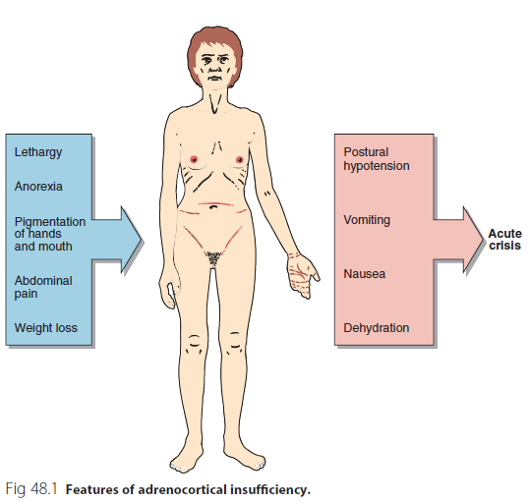

Slide 17
Diagnosis
If a patient is suspected to be suffering from adrenal insufficiency, it is essential to ensure that they have an adequate sodium intake whilst investigations proceed.
It is important to remember that patients with adrenal insufficiency are not able to retain sodium effectively, so sodium requirements may be higher than normal.

Slide 18
Synacthen tests
Formal diagnosis or exclusion of adrenal insufficiency requires a short Synacthen test (SST).
Synacthen is a synthetic 1-24 analogue of ACTH and is administered intravenously at a dose of 250 μg.
Cortisol is measured at 0, 30 and sometimes 60 minutes.

Slide 19
Synacthen tests cont..
Equivocal or inadequate responses to a SST may require a long Synacthen test (LST) to be performed in order to establish whether adrenal insufficiency is primary, or secondary to pituitary or hypothalamic disease.
Here, depot Synacthen (1 mg) is given intramuscularly daily for 3 days and the SST repeated on the fourth; a normal response makes primary adrenal insufficiency unlikely.

Slide 20
Synacthen tests cont..
Measurement of ACTH may obviate the need for a LST.
Unequivocally elevated ACTH in the presence of an impaired response to Synacthen confirms the diagnosis of primary adrenal failure.

Slide 21
Adrenal Insufficiency
Also called ADDISON’S DISEASE.
Is a hormone deficiency caused by damage to the outer layer of the adrenal gland (adrenal cortex).
Addison's disease is a disorder that results in the body producing insufficient amounts of certain hormones produced by the adrenal glands.
Addison's disease can be life-threatening.

Slide 22
Aetiology of ADDISON’S DISEASE.
Autoimmune diseases
Tuberculosis
Metastases (cancer)
Arterial diseases – inflammatory
HIV virus and opportunistic infections in AIDS.

Slide 24
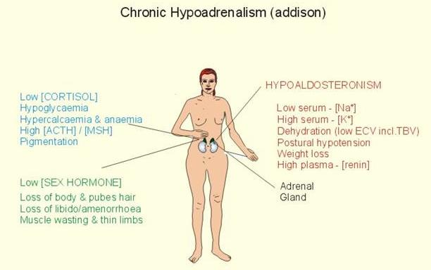

Slide 25
Addison’s Crisis
Acute adrenal insufficiency: life threatening event
Generally, the patient already has an adrenal insufficiency and is on glucocorticoid replacement therapy
After a prolonged stress event the cortisol reserve is ‘used up’ which means the patient can no longer cope with any additional stressors
If stressed, a sudden decrease in cortisol occurs causing the patient to collapse
Symptoms: rapidly evolves into circulatory shock vascular collapse coma and death
Requires aggressive treatment , Glucocorticoid supplements required during times of stress, illness

Slide 26
WATERHOUSE-FRIDERICHSEN SYNDROME
Acute, bilateral hemorrhagic infarction of the adrenals.
Occurs secondary to shock and DIC, in a septicemic infection. Endotoxic hemorrhaging.
Tiny fibrin thrombi occlude the vessels going to the adrenal glands ------> infarction.
Neisseria Meningitidis is the most common agent causing the infection.
Also Pneumococci, Staph, Strep, Haemophilus, Diphtheria. Herpes Virus can cause it.
Complete and sudden collapse of cortical function
SYMPTOMS: like symptoms of shock ,infection and DIC.

Slide 27
Isolated aldosterone deficiency
This is rare and may be due to an adrenal lesion, such as an 18-hydroxylase defect, or to primary renin deficiency, as in the anephric patient.

Slide 28
Hyperfunction of the adrenal cortex
Hyperfunction of the adrenal cortex can be conveniently discussed in terms of the overproduction of the three main products:
Cortisol
Adrenal androgens
Aldosterone.

Slide 29
Cortisol excess
These clinical features are caused by high glucocorticoid levels of any origin (i.e., from an adrenal adenoma or carcinoma, ectopic production of ACTH or CRH by a tumor or exogenous administration of corticosteroids).
Thus, hypercortisolism from any cause is now called Cushing syndrome; the term Cushing disease is reserved for excessive secretion of ACTH by pituitary corticotrope tumors.

Slide 30
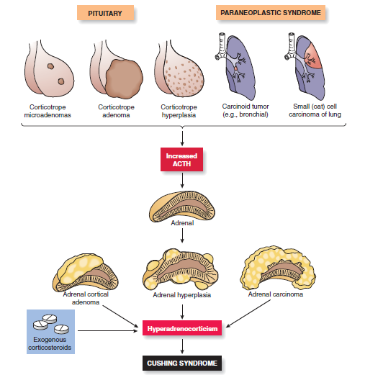
Rubin, et al. 2012

Slide 31
Pathophysiology of cushing syndrome
The effects of high cortisol include:
Insulin resistant diabetes and glycosuria due to increased gluconeogenesis.
Muscular wasting
Osteoporosis
Atrophy of collagen
Increased body fat
Moon face, buffalo hump and hypertriglyceridaemia

Slide 32
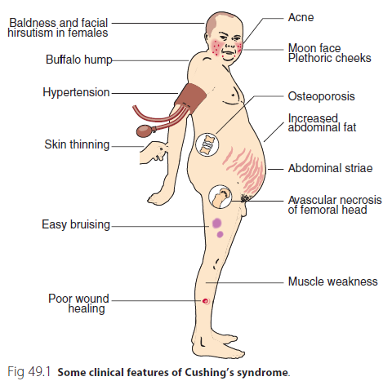

Slide 33
Diagnosis of cushing syndrome
Cortisol, secreted in excess by the adrenal cortex, will rapidly exceed the available capacity of the plasma binding protein, cortisol binding globulin.
Unbound cortisol is filtered readily into the urine.
Urinary free cortisol’ in a 24-hour collection.
Failure of 1 mg of dexamethasone taken at 23:00 to suppress the serum cortisol level at 08:00 the following morning, or failure to suppress urinary cortisol secretion overnight is another pointer towards the presence of Cushing’s syndrome.

Slide 34
Diagnosis of cushing syndrome
Failure of the serum cortisol to rise after insulin-induced hypoglycaemia is also a characteristic feature of Cushing’s syndrome.

Slide 35
Dexamethasone suppression tests
Dexamethasone is an exogenous steroid that mimics the negative feedback of endogenous glucocorticoids.
Dexamethasone suppression tests (DSTs) are important in the investigation of suspected overactivity of the hypothalamic-pituitary-adrenal axis.

Slide 36
Low dose dexamethasone suppression test
In its simplest form, the low dose DST– usually performed on an outpatient basis – involves the patient taking 1 mg dexamethasone orally at 23:00 and attending for a cortisol blood test the following morning at 08:00 or 09:00.
If the cortisol has suppressed to <50 nmol/L, cortisol overproduction is unlikely and no further action is normally required.

Slide 37
High dose dexamethasone suppression test
Failure to suppress in response to low dose dexamethasone may occur because of autonomous ACTH production by the pituitary (Cushing’s disease), or ectopic ACTH production (usually malignant), or adrenal production of cortisol.
The high dose DST (8 mg) is used to distinguish the first two of these options. ACTH production in Cushing’s disease does usually suppress in response to high dose dexamethasone, whereas malignant production of ACTH usually does not.

Slide 38
Androgen excess
Adrenocortical tumours, particularly adrenal carcinomas, may produce excess androgens (DHA, androstenedione and testosterone) causing hirsutism and/or virilization in females.
This may not necessarily be accompanied by cortisol excess, and signs of Cushing’s syndrome may be absent.
Patients with congenital adrenal hyperplasia may also present with signs of increased androgen production.

Slide 39
Aldosterone excess
Primary hyperaldosteronism (Conn’s syndrome) is rare.
In most cases, the disease is due to a single adrenocortical adenoma.
Patients may present with polydipsia and polyuria, symptoms of neuromuscular abnormalities such as weakness, paraesthesiae and tetany, and hypertension.
All symptoms other than hypertension are attributable to potassium depletion.

Slide 40
Aldosterone excess
Preliminary investigations must include determination of serum and urine electrolytes over several days, with adequate sodium intake.
Serum potassium will be low, and urinary potassium excretion will be elevated.
Documented, careful collection of specimens for assay of aldosterone, renin or ‘plasma renin activity’, may be made to confirm the diagnosis.

Slide 41
Aldosterone excess
The diagnosis of hyperaldosteronism may be made in the hypokalaemic patient if the serum aldosterone level exceeds the upper limit of normal or if the level is persistently inappropriate to the serum potassium.
In primary hyperaldosteronism, where the excess aldosterone arises from an adrenal adenoma, the levels of plasma renin will be low.

Slide 42
The adrenal medulla
The chromaffin cells of the medulla secrete adrenaline and noradrenaline.
Tumours of the adrenal medulla which may secrete these hormones are:
Pheochromocytoma (usually benign)
Paraganglioma (from chromaffin tissue elsewhere).
These tumours produce adrenaline and noradrenaline in excess.

Slide 43
Clinical features
Progressive sustained or paroxysmal hypertension.
Paroxysms of headache and sweating.
Increased glycogenolysis with mild impairment of glucose tolerance, hyperglycaemia, glycosuria and low plasma insulin.
Vanil mandelic acid (VMA) is end product of catecholamine metabolism and is increased in such conditions.

Slide 44
The End

