Slide 1
Chemical pathology of the kidney
Z Ngwira

Slide 2
Normal renal physiology
It maintains the constancy of the ECF by:
Excreting dietary surplus and metabolic waste-urea, creatinine, uric acid, H+ etc.
Retaining necessary substances e.g glucose, a.as, HCO3- by reabsorption.
Maintaining water and electrolyte as well as acid-base balance.
Endocrine functions-renin, erythropoietin, calcitriol, prostaglandins.
The nephron is the functional unit of the kidney.

Slide 3
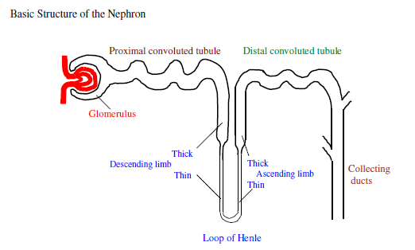

Slide 4
Glomerular function
The first step in urine formation is filtration of plasma at the glomerulus.
Blood is supplied by the renal artery, which branches repeatedly, finally ending in the afferent arterioles, each supplying one single glomerulus of one single nephron.
The filtrate is produced by the hydrostatic pressure gradient across the glomerular membranes; an overall negative charge due to abundant sialic acid groups prevents large anions, such as most proteins, from crossing.

Slide 5
Glomerular function cont..
The filtrate produced is known as an ultrafiltrate because its composition is essentially the same as that of plasma, apart from the absence of large molecules.
The kidneys use ¼ of the total cardiac output, and produce 180 l/day (or 125 ml/min) of glomerular filtrate.
The hydrostatic pressure across the membrane which carries the ultrafiltrate is only about 1 kPa, and if blood pressure falls only moderately, the oncotic pressure due to the plasma proteins is sufficient to cause filtration to slow or even stop. This explains the oliguria in shocked patients.
(NB polyuria = more than normal urine; oliguria = less than normal; anuria = no urine).

Slide 6
Tubular function
Proximal tubule- reabsorbs what is necessary.
Sodium and water:- 80% reabsorbed. High capacity active sodium uptake, with chloride following passively. A low plasma chloride can limit recovery of sodium- important later for understanding how this can cause or perpetuate alkalosis after prolonged vomiting.
K+: 95% reabsorbed usually, but diet dependant
Phosphate : active reabsorption which is inhibited by PTH

Slide 7
Proximal tubule cont..
HCO3- : mostly absorbed
Glucose and amino acid absorption is normally nearly complete
Certain low molecular weight proteins e.g. cystatin C and vitamin D binding protein
Also secretes waste products: organic acids, urate, drugs

Slide 8
Fanconi syndrome
Is loss (inherited or acquired) of proximal tubular functions and is characterised (logically from the above) by glycosuria, amino aciduria, and phosphaturia.
May also have acidosis and polyuria.
Classic cause is cystinosis, an inherited disease of lysosomal membrane transport, but it can also be acquired.

Slide 9
2. LOOP OF HENLE
Only found in birds and mammals.
Its counter-current multiplier effect is the basis for creating either dilute or concentrated urine.
Key features are an active NaCl pump in the thick ascending limb, and water impermeability of the whole of the ascending limb.

Slide 10
2. LOOP OF HENLE cont..
Fluid emerges hypotonic at the end of the loop of Henle, at about ½ the osmolality of body fluids (~ 120-150 mosmoles/l, as compared with 250-300 mosmoles/l in plasma).
Further salt may be removed in the collecting ducts under conditions of water diuresis, causing further dilution.

Slide 11
3. DISTAL CONVOLUTED TUBULE (DCT)
Little change in volume or concentration
Secretion of Aldosterone causes sodium to be exchanged for K+ and/or H+.
Conn's syndrome, Addisons disease, and RTA type I all affect DCT function.

Slide 12
4. COLLECTING DUCTS
Anti Diuretic Hormone (ADH, Vasopressin, Pitressin), synthesised in the hypothalamus and released from the posterior pituitary in response to an increase in extracellular osmolality, increases water permeability of tubular cells (and urea permeability in the lower medullary part).
ADH linked pathology exerts its effect here and consists of
Diabetes insipidus (DI): Two forms, both of which give rise to polyuria with dilute urine

Slide 13
4. COLLECTING DUCTS cont..
Central DI, where no ADH is synthesized due to damage to the pituitary.
Nephrogenic DI, where renal tubular cells do not respond to normal levels of ADH. Both forms give rise to polyuria with dilute urine.
Syndrome of inappropriate secretion of ADH (SIADH): low output of inappropriately concentrated urine in the presence of hypervolaemia and dilutional hyponatraemia.

Slide 14
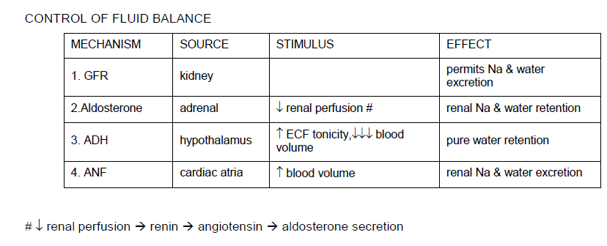

Slide 15
Renal function tests
These include tests of
Glomerular function and
Tubular function

Slide 16
Glomerular function tests
The serum analytes classically referred to as “renal function tests” are serum creatinine and (to a lesser extent) serum urea since they depend on glomerular function for their elimination.
These show characteristic changes in renal failure, but are not accurate markers for glomerular filtration rate (GFR), and are not reliable indicators of acute kidney injury (AKI).

Slide 17
Serum creatinine
Normal range: 49 – 90 umol/L in females, 64 – 104 umol/L in males.
Breakdown product from creatine phosphate in muscle.
Filtered at the glomerulus and eliminated without significant reabsorption or secretion in the tubules.
Serum levels are related to age, gender and muscle mass, and influenced by dietary meat intake.

Slide 18
Serum creatinine cont..
Increases in chronic renal disease as renal mass is lost, but not in a linear fashion.
Increases in acute renal failure, but is an unreliable indicator during acute changes in renal function, as its level may not change until a significant amount of kidney function is lost.

Slide 19
Serum urea
Normal range: 2.6 – 7.0 mmol/L.
Derived in the liver from protein breakdown.
Filtered at the glomerulus and partially reabsorbed (30–40%) by the tubules.
Levels are affected by renal glomerular function, but also by high protein intake, catabolic states, post-surgery and trauma, and gastro-intestinal haemorrhage, all of which cause increased urea production from protein.
Blood urea increases when renal function deteriorates.

Slide 20
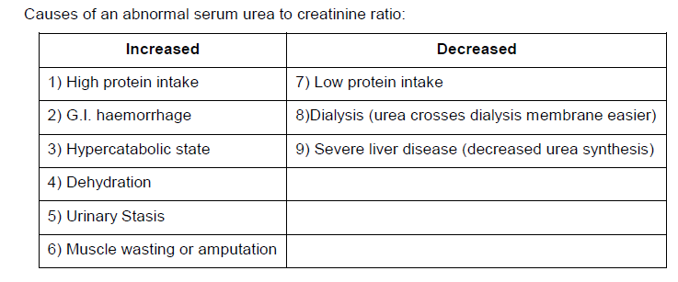

Slide 21
3. GLOMERULAR FILTRATION RATE (GFR):
The most common assessment of renal glomerular function is to measure GFR.
GFR is measured by measuring the clearance of substances that are only dependant on glomerular filtration, which are not affected by tubular function, i.e., substances that are not secreted or re-absorbed by the tubules.

Slide 22
4. CREATININE CLEARANCE
Normal range: 75 – 115 ml/min in females, 85 – 125 ml/min in males.
Owing to creatinine not being significantly reabsorbed or secreted by the renal tubules, creatinine clearance is an indicator of the glomerular filtration rate (GFR).
This remains the most common, if not the most accurate way to determine GFR.
The units for creatinine clearance are a flow rate, ml/min.

Slide 23

4. CREATININE CLEARANCE cont..
If the clearance is corrected for the Body Surface Area (BSA) (e.g., with the Du Bois formula which uses the patient’s height and weight), then the units are ml/min/1.73 m2.
When clearance is corrected for Body Surface Area (BSA) it is a better indicator of GFR.

Slide 24
4. CREATININE CLEARANCE cont..
Creatinine clearance decreases in renal failure.
Creatinine clearance changes more linearly in proportion to renal mass loss than does plasma creatinine or urea (creatinine clearance decreases while the latter two increase) so is the best measure of progress in chronic renal failure.
It is of no value in acute renal failure since it needs a steady state situation to obtain a meaningful result.

Slide 25
5. ESTIMATED CREATININE CLEARANCE (OR ESTIMATED GFR):
Due to the impracticality of accurately obtaining a 24 hour urine collection, various calculation formulas were developed, using only blood creatinine plus other patient data, to “estimate” either creatinine clearance (in ml/min) or to estimate GFR (in ml/min/1.73 m2).
These formulas are typically developed using one type of creatinine measurement method (chromatographic, or enzymatic), and are only valid for that specific method.

Slide 26
5. ESTIMATED CREATININE CLEARANCE (OR ESTIMATED GFR): cont..
Therefore, when estimating GFR, it is imperative to be aware of the specific method used in the measurement of creatinine.
The Cockcroft-Gault formula (uses creatinine, age and weight) estimates creatinine clearance, in ml/min. This is only valid with non-standardized creatinine methods. Since it is based on weight, it will incorrectly estimate the creatinine clearance in significantly underweight or overweight individuals.

Slide 27
5. ESTIMATED CREATININE CLEARANCE (OR ESTIMATED GFR): cont..
The Schwartz formula (uses creatinine and height) estimates GFR, in ml/min/1.73 m2. This was developed for children < 18 years, and only for enzymatic creatinine.
The MDRD formula (uses creatinine and age) estimates GFR, in ml/min/1.73 m2. This was developed for adults > 18 years. There are several versions of the formula, including different constant factors for different creatinine methods.

Slide 28
6. CLEARANCE OF RADIO-ISOTOPE TRACERS:
More accurate ways to determine GFR are by measuring clearance of radio-isotope tracers of exogenous substances that are exclusively cleared by glomerular filtration.
These investigations require the injection of a radio-labelled substances, collection of serial blood samples to measure the radio-isotope, and calculation of their rate of clearance.
Performed in Nuclear Medicine Labs.

Slide 29
6. CLEARANCE OF RADIO-ISOTOPE TRACERS: cont..
Inulin: The gold standard for GFR assessment. Inulin is completely filtered at the glomerulus and neither secreted nor reabsorbed by the tubules. The technique is difficult and time consuming to perform and is inappropriate for routine clinical use.
Cr-51 EDTA: A more practical technique than inulin. Used as the standard in the UK.
Tc-99m DTPA: Used as the standard in the USA.

Slide 30
6. CLEARANCE OF RADIO-ISOTOPE TRACERS: cont..
Para-aminohippuric acid (PAH): PAH is partially filtered from plasma at the glomerulus and the remainder is secreted into the tubules.

Slide 31
TUBULAR FUNCTION TESTS
Urinary Na+ concentration. Normally low relative to serum concentration unless on a dietary high salt intake.
Concentration tests (usually after Pitressin), and Dilution tests, after a water load. Ratio of osmolality (or urea) in urine relative to that in plasma is a simple practical measure.
Acidification tests, after administration of NH4Cl ( → NH3 + H+ + Cl- ).

Slide 32
Urine protein
Normally, no detectable albumin or other protein appears in the urine.
Normal losses: < 150 mg/day protein; < 15 mg/day albumin
A mild increase in urine protein may occasionally be normal (e.g., orthostatic proteinuria, during pregnancy) or be due to non-renal causes (e.g., vigorous exercise, blood in the urine, urinary tract infection, dehydration, and some drugs).

Slide 33
Urine protein cont..
A mild increase of albumin in the urine (less than 300mg/24h - also referred to as “microalbuminuria”) can be an early indicator of renal dysfunction.
Levels of microalbumin are actively monitored in diabetes and hypertension
Significant proteinuria > 2.5 g/day indicates nephrotic syndrome

Slide 34
Mechanisms of proteinuria
Tubular: Failure of Proximal Convoluted Tubule to absorb filtered low molecular weight (MW) proteins e.g. ß2 microglobulin; immunoglobulin light chains; lysozyme
Glomerular: Higher proteins are not normally filtered, especially if anionic (e.g. albumin) due to repulsion by negatively charged glycoproteins on foot processes of the glomerular epithelium.

Slide 35
Specific urinary proteins: cystatin C
A small protein, produced by all nucleated cells of the body at a constant rate.
Production rates and serum levels are not affected by age, gender, body composition, diet or disease.
It is filtered freely by the glomerulus, and is neither reabsorbed nor secreted by the tubules, thus making serum cystatin C suitable as a serum marker for GFR.

Slide 36
Specific urinary proteins: cystatin C CONT..
It is metabolised by the tubules, so urine cystatin C cannot be used to assess GFR.
Several of the new formulas developed to “estimate” GFR use cystatin C.
Urine Bence-Jones Protein indicates myeloma.

Slide 37
ß2-microglobulin
A small protein, freely filtered then re-absorbed by the tubules.
Urine ß2-microglobulin is a sensitive test of tubular function.
(Serum ß2-microglobulin is increased in some malignancies and inflammatory conditions).

Slide 38
Haem pigments (haemoglobin and myoglobin):
All have peroxidase activity which results in oxidation of o-toluidine (available on urine test strips).
This test may be positive due to bleeding (RBC present in urine) in the genitor-urinary tract (e.g. tumours, injuries, etc), haemoglobinuria (no RBC present in urine) occurring with severe intravascular haemolysis (exceeding haptoglobin binding capacity – therefore low serum haptoglobin) and myoglobinuria from muscle injury (differentiated from haemoglobin on size basis)

Slide 39
NEW INDICATORS OF ACUTE KIDNEY INJURY (AKI)
All the previously mentioned kidney function tests can detect renal dysfunction after it is established.
None can detect early signs of acute kidney injury.
For this, new biomarkers are being developed.
These are not yet in routine clinical use.

Slide 40
NEW INDICATORS OF ACUTE KIDNEY INJURY (AKI) CONT..
Neutrophil gelatinase-associated lipocalin (NGAL)
Interleukin-18 (IL-18)
Kidney injury molecule-1 (KIM-1)
N-acetyl-[beta]-D-glucosaminidase
Asymmetric dimethylarginine (ADMA)
Liver-type fatty acid-binding protein (L-FABP)

Slide 41
OTHER TESTS
Microscopy : look for casts, cells, or crystals
Urine dipstick analysis (dipstix): Test for haematuria (blood), haemoglobinuria (Hb), glycosuria (glucose), proteinuria

Slide 42
Renal stones
Renal stones (calculi) produce severe pain and discomfort, and are common causes of obstruction in the urinary tract
Types of stone include
Calcium phosphate: may be a consequence of primary hyperparathyroidism or renal tubular acidosis.
Magnesium, ammonium and phosphate: are often associated with urinary tract infections.
Oxalate: may be a consequence of hyperoxaluria
Uric acid: may be a consequence of hyperuricaemia
Cystine: these are rare and a feature of the inherited metabolic disorder cystinuria

Slide 43
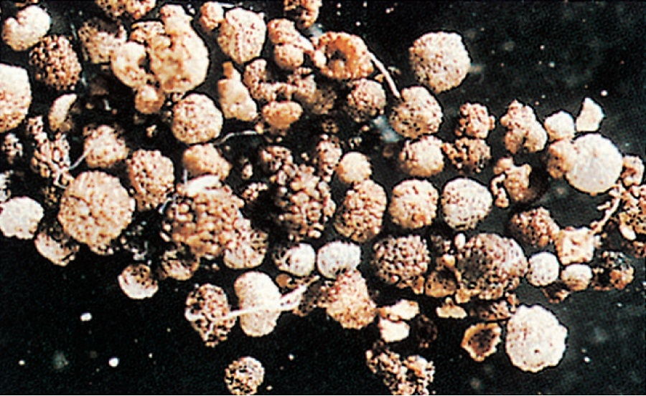
Renal stones

Slide 44
Renal failure
It is when the kidneys fail to carry out their functions.
It is divided into two types:
Acute renal failure
Chronic renal failure

Slide 45
ACUTE RENAL FAILURE (ARF):
Definition: Renal pathology involving all nephrons (glomeruli plus tubules).
Loss of glomerular and tubular function.
Acute (sudden) in onset.
Non-steady state.

Slide 46
ACUTE RENAL FAILURE (ARF): cont..
Initially oliguric (urine output less than 450 ml/day, in adult).
Urine excretion of urea and creatinine is less than production, therefore rising blood urea and creatinine.
(Blood urea typically rises by 5 mmol/l/day, but in surgical, trauma, or gastro-intestinal bleeding it can rise by up to 15 mmol/l/day).
ARF is a common medical emergency

Slide 47
Classification of ARF by cause
Pre-renal failure (defect before the kidney)
Intra-renal failure (defect in the kidney e.g., acute tubular necrosis, glomerulonephritis)
Post-renal failure (defect after the kidney, e.g., prostatic enlargement, urolithiasis).

Slide 48
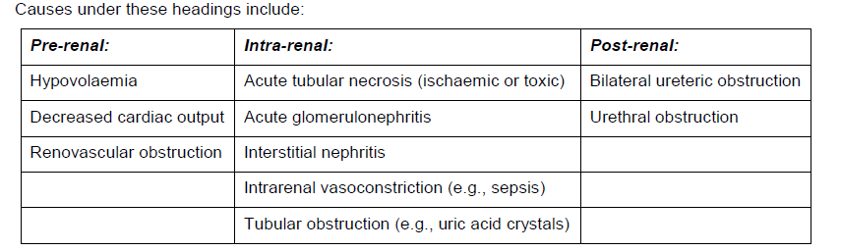

Slide 49
Features of ARF
Oliguric phase:
Oliguria
Rising blood urea and creatinine
Rising blood K+
metabolic acidosis
Polyuric phase:
Polyuria
Rapid loss of water and electrolytes - can lead to dehydration, hyponatraemia and hypokalaemia

Slide 50
CHRONIC RENAL FAILURE (CRF):
DEFINITION : Permanent loss of nephrons.
Remaining nephrons are intact and retain normal function, establishing a new ‘steady-state’.
Blood urea and creatinine are high but unchanging.
The key characteristic of well developed CRF is polyuria - the opposite to the oliguria or anuria of ARF.

Slide 51
Aetiology of CRF
Many but the most important are:
Glomerulonephritis
diabetes mellitus
hypertension
The net effect is a progressive loss in the number of functioning nephrons.

Slide 52
Classification of CRF
Stage 1 – kidney damage with normal or ↑GFR. It has a GFR of greater than or equal to 90mL/minute
Stage 2 – kidney damage with normal or ↓ GFR. It has a GFR of 60-89mL/minute
Stage 3 – moderate kidney damage with ↓ GFR. It has a GFR of 30-59mL/minute
Stage 4 – severe kidney damage with ↓ GFR. It has a GFR of 15-29mL/minute
Stage 5 – kidney failure. It has a GFR of <15mL/minute

Slide 53
Features of CRF
Initial features are those of decreasing glomerular function
Increase in urea, giving chronic uraemia, (sometimes called azotaemia)
increase in creatinine and progressive decrease in Cr clearance
increase in urate, phosphate, sulphate, etc.

Slide 54
Features of CRF
Later are added features of decreasing tubular function caused by:
actual tubular damage
increased tubular flow due to (urea) osmotic diuresis

Slide 55
Features of CRF
polyuria with fixed output
loss of concentrating and diluting abilities
metabolic acidosis.
sodium instability - overload or deficiency can easily occur

Slide 56
THE END

