Slide 1
GONADS
Z Ngwira

Slide 2
Sex steroid hormones
Testosterone- principle androgen synthesised by the testes in the male.
Oestradiol- secreted by the ovaries varies widely in concentration in plasma throughout the female menstrual cycle.
Steroids with oestradiol like action are called oestrogens.
Progesterone is also a product of the ovary and is secreted when a corpus luteum forms after ovulation.

Slide 3
Sex steroid hormones cont..
Normal female plasma also contains a low concentration of testosterone.
About half of which comes from the ovary.
And another half from peripheral conversion of androstenedione and dehydroepiandrosterone (DHA) sulphate, which are secreted by the adrenal cortex.
Some oestradiol is present in low concentration in normal male plasma.
Testosterone and oestradiol circulate in plasma mostly bound to plasma proteins, particularly sex hormone-binding globulin (SHBG).

Slide 4
Hypothalamic-pituitary-gonadal axis
The episodic secretion of the hypothalamic hormone, gonadotrophin releasing hormone (GnRH).
Which stimulates synthesis and release of the gonadotrophins, LH (luteinizing hormone) and FSH (follicle-stimulating hormone), from the anterior pituitary.
Despite the names, both gonadotrophins act cooperatively on the ovaries in the woman and the testes in the man to stimulate sex hormone secretion and reproductive processes.

Slide 5
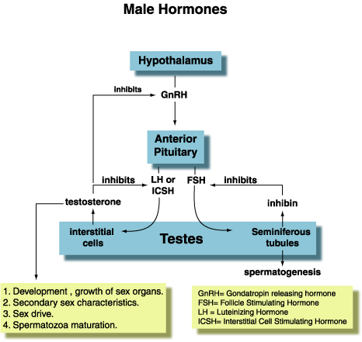
Hormonal Regulation

Slide 6
Male gonadal function
The testes secrete testosterone and manufacture spermatozoa.
Before puberty, gonadotrophin and testosterone concentrations in plasma are very low.
The development of the Leydig cells and their secretion of testosterone is influenced by LH, whereas Sertoli cell function is influenced by FSH.
Testosterone is responsible for the development of the male secondary sex characteristics such as hair growth, deep voice and characteristic musculature.

Slide 7
Disorders of male sex hormones
Hypogonadism may result in deficient sperm production and decreased testosterone secretion.
This may be due to a testicular deficiency (primary disorders or hypergonadotrophic hypogonadism)
Or
to a defect in the hypothalamus or pituitary (secondary disorders or hypogonadotrophic hypogonadism).
In hypogonadotrophic hypogonadism both gonadotrophins, or only LH, may be reduced.
There may be a generalized failure of pituitary function.

Slide 8
Disorders of male sex hormones
Causes of primary hypogonadism:
congenital defects such as Klinefelter’s syndrome or testicular agenesis
Acquired defects due to testicular infections (e.g. mumps), trauma, irradiation, or cytotoxic drugs.
Causes of secondary hypogonadism:
pituitary tumours
hypothalamic disorders such as Kallmann’s syndrome.
Dynamic tests such as stimulation with GnRH may help to establish the cause of the hypogonadism in some patients.

Slide 9
Disorders of male sexual development
Disorders of male sexual differentiation are rare.
Testosterone production may be impaired.
In the testicular feminization syndrome, androgen receptors are inactive and target tissues cannot respond to stimulation by circulating testosterone, leading to a female phenotype.

Slide 10
Female gonadal function
Oestradiol is responsible for:
female secondary sex characteristics
stimulation of follicular growth
development of the endometrium.
Concentrations are low before puberty, but then rise rapidly and fluctuate cyclically during reproductive life.
After the menopause, plasma oestradiol concentrations fall despite high circulating concentrations of the gonadotrophins.

Slide 11
Disorders of female sex hormones
Disorders of female sex hormones include:
Subfertility, amenorrhoea and oligomenorrhoea
Hirsutism. This is an increase in body hair with male pattern distribution.
Virilism. Although uncommon it is a sign of serious disease. Testosterone concentrations are markedly elevated in the virilized patient and there is evidence of excessive androgen action such as clitoral enlargement, hair growth in a male pattern, deepening of the voice and breast atrophy. Tumours of the ovary or of the adrenal cortex are the likely cause.

Slide 12
Infertility
Definition:
  Failure of a couple to conceive after 1 year of regular, unprotected intercourse

Slide 13
Background
Infertility may be caused by endocrine problems:
  This is common in the female
  But rare in the male
Elevated serum [progesterone] at day 21 of the menstrual cycle indicates that ovulation has occurred
In both men & women infertility, a serum [FSH] > 25U/L indicates primary gonadal failure

Slide 14
Clinical History taking
Should be full clinical history
Before physical examinations
Information about:
  Previous pregnancies
  Contraceptive practice
  Serious illnesses
  Past chemotherapy or radiotherapy
  Congenital abnormalities
  Smoking habits
  Drug usage
  STD
  Frequency of intercourse

Slide 15
Physical Examination
Should look for indications of:
  Hypothalamic-pituitary or thyroid disorders
  Cushing’s syndrome
  Galactorrhoea (inappropriate breast milk production; i.e. in the absence of pregnancy most commonly caused by hyperprolactinaemia)
  Hirsutism (an increase in body hair with male pattern distribution)

Slide 16
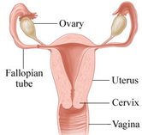

INVESTIGATION OF FEMALE INFERTILITY
http://www.webmd.com/hw-popup/female-reproductive--system

Slide 17
Diagnostic approach to infertility in the woman
History & Examination
Normal menses
Amenorrhoea, Oligomenorrhoea
?Ovulating
Measure [Progesterone] in day 21 (mid luteal)
Perform pregnancy test
+ ve
No further tests required
>30nmol/L
<10nmol/L
-ve
Measure [LH], [FSH], & [Prolactin]
Ovulating
Not ovulating
High FSH. (+ LH)
High LH
Low FSH
High Prolactin
All Normal
Further investigate hyperprolactinaemia
Further tests indicated
Ovarian failure
PCOS

Slide 18
Endocrine causes of infertility in women
↑ ovarian androgen secretion:
  e.g.: obesity → Insulin resistance → ↑ ovarian androgen secretion)
Primary ovarian failure:
  postmenoposal hormonal pattern: (↑ gonadotrophins & ↓ oestradiol)
  Hormone replacement therapy can be given (this will not treat the infertility)
Hyperprolactinaemia
PCOS:
  ↑ serum [LH]
  Normal (or low) [FSH]
Cushing’s syndrome
Hypogonadotrophic hypogonadism:
  Rare
  due to hypothalamic-pituitary lesion

Slide 19
Diagnosis of PCOS*
In 2003, the European Society for Human Reproduction and Embryology (ESHRE) and the American Society for Reproductive Medicine (ASRM) recommended that at least 2 of the following 3 features are required for PCOS to be diagnosed:
Oligo-ovulation or anovulation manifested as oligomenorrhea or amenorrhea
Hyperandrogenism (clinical evidence of androgen excess) or hyperandrogenaemia (biochemical evidence of androgen excess)
Polycystic ovaries (as defined on ultrasonography)
*PCOS Consensus Workshop Group. Rotterdam ESHRE/ASRM-Sponsored PCOS Consensus Workshop Group. Revised 2003 consensus on diagnostic criteria and long-term health risks related to polycystic ovary syndrome. Fertil Steril. Jan 2004;81(1):19-25

Slide 20
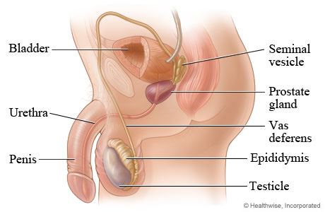
INVESTIGATION OF MALE INFERTILITY
http://www.webmd.com/hw-popup/male-reproductive-system

Slide 21
Diagnostic approach to subfertility in the man
History & examination
Normal sperm analysis, eugonadal
Abnormal sperm count
No endocrine tests are required
Measure testosterone, gonadotrophins, and Prolactin
↓Testosterone
↑Gonadotrophins
↓Testosterone
↓ Gonadotrophins
Testosterone
↑ Prolactin
Hypogonadotrophic hypogonadism: due to hypothalamic-pituitary disease
Primary testicular failure
Hyperprolactinaemia: rare

Slide 22
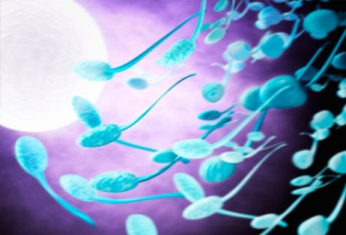
Semen Analysis
Comment on:
  Volume
  Liquefaction time
  sperm density (count)
  Motility
  the presence of abnormal spermatozoa (abnormal shape, or motility)
  pH
  WBCs?
http://www.webmd.com/baby/slideshow-understanding-fertility-ovulation

Slide 23
HYPERPROLACTINAEMIA

Slide 24
Prolactin and hyperprolactinaemia
Prolactin is an anterior pituitary hormone
Its secretion is tightly regulated:
- Stimulated by TRH from the hypothalamus
- Inhibited by dopamine from hypothalamus
It acts directly on the mammary glands to control lactation

Slide 25
Prolactin and hyperprolactinaemia, continued..
Hyperprolactinaemia is elevated circulating [Prolactin]
A common condition
It causes infertility in both sexes due to gonadal function impairment.
What is the early indication of hyperprolactinaemia?
- In women: amenorrhoea & galactorrhoea
- In men: none

Slide 26
Causes of hyperprolactinaemia
Stress
Drugs
e.g. oestrogens, phenothiazines, metoclopramide, α-methyl dopa
Seizures
1^{ary} hypothyroidism (prolactin is stimulated by the raised TRH)
Other pituitary disease
Prolactinoma (commonly microadenoma)
Idiopathic hypersecretion (e.g. due to imparied secretion of dopamine that usually inhibits prolactin release)

Slide 27
Diagnosis of the cause of hyperprolactinaemia
Exclude:
  Stress
  Drugs
  Other disease
Differential diagnosis:
    prolactinoma or
    idiopathic hypersecretion

Slide 28
The End

