Slide 1
Hyperuricaemia & Gout
Z Ngwira

Slide 2
Overview
Nucleic acids contain bases of two different types, pyrimidines and purines.
The catabolism of the purines, adenine and guanine, produces uric acid.
At physiological hydrogen ion concentration, uric acid is mostly ionized and present in plasma as sodium urate.

Slide 3
Overview cont..
An elevated serum urate concentration is known as hyperuricaemia.
Uric acid and sodium urate are relatively insoluble molecules that readily precipitate out of aqueous solutions such as urine or synovial fluid.
The consequence of this is the medical condition gout.

Slide 4
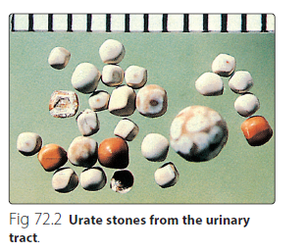

Slide 5
Urate formation
Urate is formed in three ways. These are:
by de novo synthesis
by the metabolism of endogenous DNA, RNA and other purine-containing molecules such as ATP
by the breakdown of dietary nucleic acids.

Slide 6
Urate excretion
Urate is excreted in two ways:
Via the kidney.
The majority of urate is excreted via the kidney.
Renal handling of urate is complex.
It is freely filtered at the glomerulus, but 99% is reabsorbed in the proximal tubule.
The distal tubules also secrete urate, but again much is reabsorbed.
The amount of urate excreted in the urine is around 10% of that filtered at the glomerulus.

Slide 7
Urate excretion cont..
2. Via the gut.
Smaller amounts of urate are excreted into the gut where it is broken down by bacteria.
This process is called uricolysis.

Slide 8
Uric acid metabolism
Urate concentrations in serum are higher in men than women.
Even within the reference interval, serum urate is near its aqueous solubility limit.
The presence of protein helps to keep the molecule in solution.
A high serum urate may arise from increased urate formation, or from decreased excretion.

Slide 9
Uric acid metabolism cont..
The common causes of hyperuricaemia are summarized in Figure 72.3.
Genetic causes of hyperuricaemia are known as primary disorders, and there are also secondary causes.
Most primary causes are due to decreased excretion of urate (90% of cases) rather than increased production (10%).

Slide 10
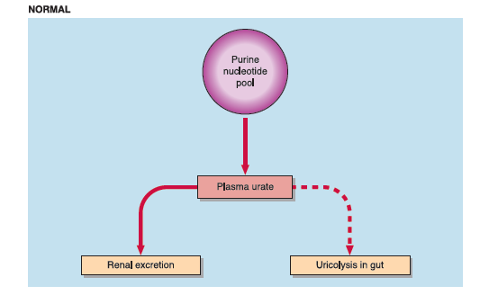

Slide 11
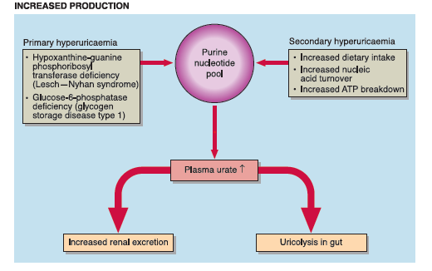

Slide 12
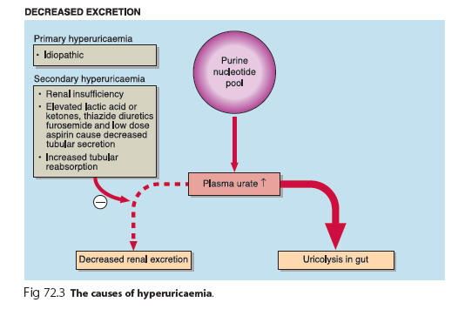

Slide 13
Lesch–Nyhan syndrome
One genetic disorder that should be singled out is Lesch– Nyhan syndrome, an X-linked disorder caused by a deficiency of hypoxanthine-guanine phosphoribosyltransferase, an enzyme that is involved in salvaging purine bases for resynthesis to purine nucleotides.
The syndrome is characterized clinically by excessive uric acid production, hyperuricaemia and neurological problems that include self-mutilation and mental retardation.

Slide 14
Gout
Gout is a clinical syndrome that is characterized by hyperuricaemia and recurrent acute arthritis.
Whereas all patients who develop gout will have had hyperuricaemia at some point in the development of the disease, only a minority of patients with hyperuricaemia develop gout.
The reason for this is not known.

Slide 15
Gout cont..
Acute gout is triggered by the tissue deposition of sodium urate crystals that cause an intense inflammatory response.
In the chronic situation, tophaceous deposits of sodium urate may form in the tissues (Fig 72.4).

Slide 16
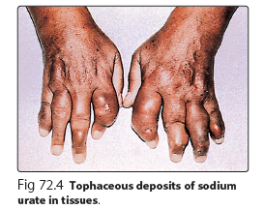

Slide 17
Gout cont..
Gout is exacerbated by alcohol.
The reason for this is twofold.
Ethanol increases the turnover of ATP and urate production.
Ethanol in excess may cause the accumulation of organic acids that compete with the tubular secretion of uric acid.

Slide 18
Gout cont..
Disorders such as ethanol intoxication, diabetic ketoacidosis and starvation lead to elevations of lactic acid, β-hydroxybutyric acid and acetoacetic acid, and will cause hyperuricaemia.

Slide 19
Treatment of Gout
The symptoms of acute gout respond to anti-inflammatory drugs such as indomethacin, but it should be noted that these drugs have no direct effect on the serum urate level.
Low-dose aspirin should be avoided as it inhibits renal urate excretion.
Treatment must also be directed at the hyperuricaemia.

Slide 20
Treatment of Gout cont..
Drugs such as probenecid, which promote urate excretion, can be used prophylactically.
A diet that is low in purines and alcohol may be prescribed in an effort to reduce the plasma urate concentration.
Allopurinol, a specific inhibitor of the enzyme xanthine oxidase that catalyses the oxidation of hypoxanthine to xanthine and uric acid, may also be effective in reducing urate concentrations.

Slide 21
Treatment of Gout cont..
A number of other crystalline arthropathies may present as gout but are not associated with hyperuricaemia (so-called pseudogout).
Most notably, pseudogout is due to the deposition of calcium pyrophosphate crystals.

Slide 22
Renal disease and hyperuricaemia
Renal disease is a common complication of hyperuricaemia.
Several types of renal disease have been identified.
The most common is urate nephropathy, which is caused by the deposition of urate crystals in renal tissue or the urinary tract to form urate stones.
This may be associated with chronic hyperuricaemia.

Slide 23
Renal disease and hyperuricaemia cont..
Acute renal failure can be caused by the rapid precipitation of uric acid crystals that commonly occurs during treatment of patients with leukaemias and lymphomas.
nucleic acids are released as a result of tumour cell breakdown, are rapidly metabolized to uric acid and this sometimes results in very high concentrations, precipitating gout or nephropathy.
In these cases, urate oxidase is sometimes administered prophylactically to metabolize the uric acid to allantoin, which is safely excreted by the kidney.

Slide 24
Urate in pregnancy
Serum urate is of value in the monitoring of maternal well-being in pregnancy associated hypertension (pre-eclampsia), alongside other markers such as blood pressure, urine protein excretion and creatinine clearance

Slide 25
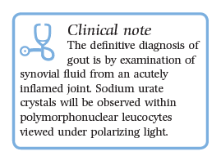

Slide 26
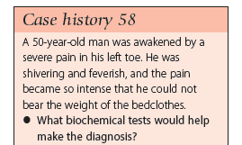

Slide 27
Summary
Uric acid is formed from the breakdown of endogenous or exogenous purines.
Hyperuricaemia may be caused by:
an increased rate of purine synthesis
an increased rate of turnover of nucleic acids, as in malignancies, tissue damage or starvation
a reduced renal excretion.

Slide 28
Summary cont..
Hyperuricaemia is a risk factor for gout that occurs when urate crystals are deposited in tissues.
Hyperuricaemia is aggravated by a diet high in purines and alcohol.

Slide 29
THE END

