Slide 1
Sample Collection, Transport and Processing
By Mulemba Samutela – Sichalwe
10/01/2019

Slide 2
Lecture Outline
Part I: Sample Collection
Part II: Sample Transportation
Part III: Sample Processing

Slide 3
Key Issues
Take the appropriate specimen correctly
Take the specimen at the proper time
Label and package the specimen up correctly
Appropriate transport and storage of specimen
microbiology is a little like a computer—wrong information in, bad result out!

Slide 4
Part I: Sample Collection
Select the correct anatomic site from which to obtain the specimen
Use proper techniques and supplies to collect sample
Package sample in a designated container
Transport to lab expeditiously or if stored, briefly and properly done

Slide 5
Sample Collection Containers
There are many types of sample containers
Always use the correct type of container to collect and transport samples!

Slide 6
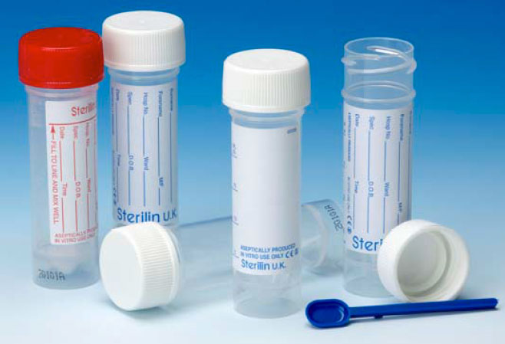
Sterile Plastic or Glass “Universal” Containers with Screw Caps
Used for urine, sputum, stool, fluids, biopsies and tissues, catheter tips and any other small specimen
60ml variety has wider mouth is preferred to the 30ml container for sputum samples
Plastic containers preferred to the glass containers
Some have spoons (for stool collection)

Slide 7
Boric Acid Containers
Sterile plastic universal containers with boric acid
Adding 15ml urine leads to final conc of 1.8% boric acid
Used when sample may not reach lab within 24hrs
Boric acid acts as a preservative and stops bacteria from growing
Rarely used nowadays and if insufficient sample some bacteria maybe killed

Slide 8
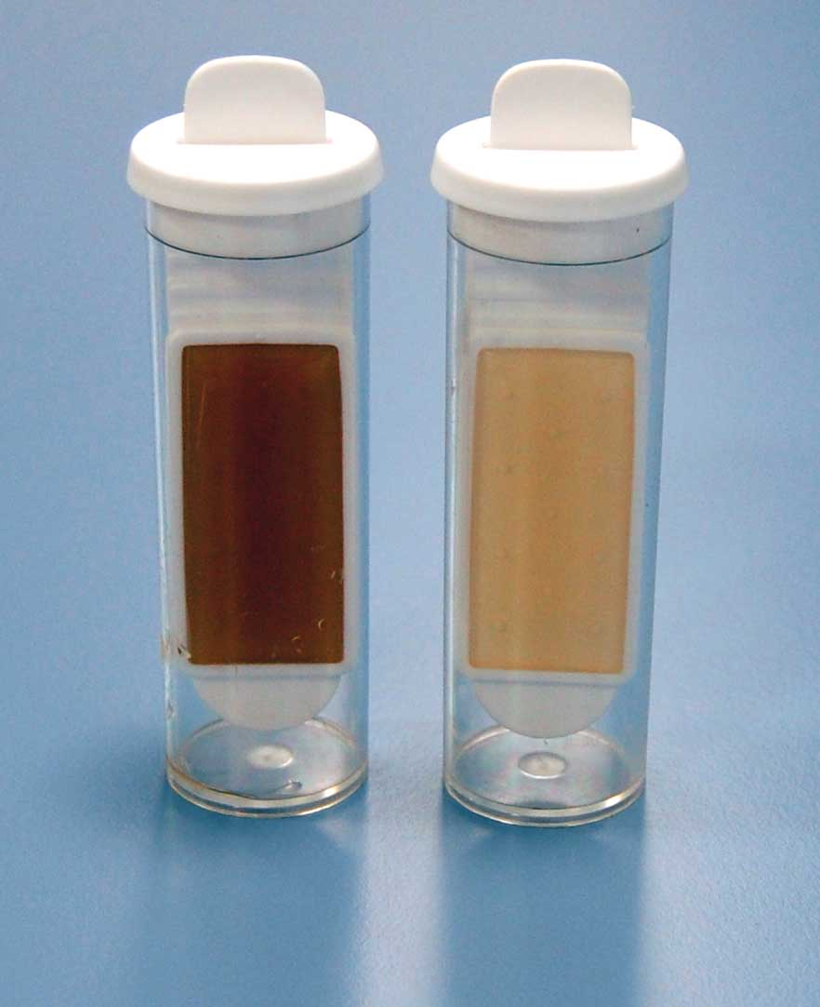
Dipslides
Sterile plastic universals with a large, flat plastic slide attached to the lid
The slide has bacterial culture media on each side
Dip slide into collected urine and discard urine
Send the slide to lab
Incubated like other media

Slide 9

Swabs
Available different tips (cotton wool, fibre, serum coated)
Transport medium swabs- keeps microbes alive
Fine-tipped swabs on flexible wire shanks- used on difficult to reach areas
Plastic shaft swabs- used were wooden ones would interfere with results.

Slide 10

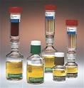
Blood Cultures Systems
Can be for manual or automated systems
Bottle with culture broth to remove antibacterial effects of normal blood or antibiotics by dilution
Or may have specialised resins, activated charcoal , sodium polyethanolsulfonate(SPS)
Anticoagulated blood lysed and centrifuged to concentrate microbes be culture

Slide 11
Methods of Sample Collection
Ensure we don’t pick contaminants, or miss the target and sample the wrong site
Discuss procedure with patient before taking the sample
Take samples before antibiotic therapy is started
Label all samples appropriately before sending to the laboratory
Wash hands with a bactericidal soap and water or alcohol and put on gloves (to avoid health-care acquired infections)

Slide 12
Urine Samples
Mid-stream Urine
Commonest and easiest to collect, most reliable non-invasive urine
Male: pull foreskin and clean tip of penis with soap and water or saline to remove contaminants
Female: clean the outer part of vagina and labia with soap or saline. Clean from front to back to avoid contamination from around the anus
Patient should urinate the first and last part of urine directly into the toilet but collect the middle part into a sterile bag (bedpan, kidney bowl bottle, etc.)
Then transfer into laboratory container

Slide 13
Catheter Stream Urine Specimen (CSU)
Catheter bags have a collection point
This should be cleaned using 70% alcohol
Insert a sterile needle and syringe into collection point and draw sufficient urine and put it into lab container

Slide 14
Bag Urine
Choose correct size of urine bag and remove protective seal
Place bag over penis or vulva, working from back to front and stick the bag to the skin
Watch bag until urine is passed, remove bag and put into lab container
Wash the genital area afterwards to prevent soreness

Slide 15
Pad Urine
Baby’s groin should be cleaned with warm water
Place urine collection pad (UCP) in nappy towards the front and check it every 15min
Wear gloves and remove wet pad
Put the tip of a sterile syringe into pad and remove as much urine as possible and send to lab in a lab container

Slide 16
Supra-pubic Aspirate (SPA)
Clean abdominal skin over bladder with alcohol-based disinfectant and allow to dry
Use a needle on a syringe to pass through the skin and directly into bladder (fairly full)
Draw a sample and send to the lab

Slide 17
Swab Samples
Convenient for collecting samples from superficial areas of body
Samples maybe taken from infected areas, any site to look for colonisation or for specific pathogen(e.g. Bordetella pertussis, Neisseria gonorrhea)

Slide 18
Wound Swabs
Select area of wound to be sampled (nearest to normal skin ideal) and gently rotate tip of swab in chosen spot
Collect as much material as possible especially if pus is present
Remove old pus to allow collection of freshest sample
Using aseptic technique place swab back in the sample tube and send to laboratory

Slide 19
Nasal Swabs
Moisten swab before collecting sample to minimise discomfort for patient
Tilt patient’s head backwards to make sample collection easier
Place swab into nose, without touching sides and move upwards into tip of nose
Gently rotate swab before withdrawing it and aseptically put back into sample tube and send to lab

Slide 20
Throat Swabs
Let patient face the light
Depress patient’s tongue with spatula to avoid it from contaminating sample if patient gags
Insert the swab into mouth without touching sides and quickly rub it gently over any inflamed area or any exudate at back or tonsil region
Then place it into sample tube aseptically

Slide 21
Eye Swabs
Patient is asked not to flinch when sample is being taken
Moistening swab with water or saline may help
Ask patient to look up, put on sterile disposable gloves and pull gently the eyelid to expose pink conjunctiva
Gently rub swab across the lower eyelid from the inner corner outwards
Try to collect as much discharge as possible
Place swab into sample tube aseptically

Slide 22
Ear Swabs
Use fine-tipped swab with a flexible wire shaft
If any pus is present, sample this with swab
Do not push swab too far into ear to avoid damaging ear drum
Gently rotate to collect any discharge
Place swab into sample tube aseptically

Slide 23
Ear Swabs
Deeper ear samples may be collected using a speculum
This should be done by an experienced person to avoid damaging the ear
Middle and inner ear cannot be sampled using a swab
If eardrum is perforated the middle ear fluid can be aspirated

Slide 24
Pernasal Swabs
Use a fine-tipped swab with a flexible wire shaft
Pass along the floor of nasal cavity to back of nasal cavity
Rotate swab gently
Withdraw it carefully and place it aseptically back in the sample tube

Slide 25
Blood Samples
Taken via venepuncture
Should be taken by well trained person
Invasive thus pose risk to patient and person taking the sample

Slide 26
Blood Cultures
Thoroughly clean patient’s skin where blood is to be taken
Use an alcohol-based disinfection and allow area to dry
Use needle and syringe to draw blood
Use new needle to inoculate into bottle
Tops of bottle must be removed to expose rubber septum through which blood will be injected
Septum must be disinfected with alcohol and allowed to dry

Slide 27
Blood Cultures
Most systems will use 5 to 10ml of blood in adults and 1 to 4 ml for children
Usually two bottles, aerobic and anaerobic; some for yeast and mycobacteria available
Inoculate blood cultures first if other blood samples are required
Mix bottles gently by inversion and send to laboratory
Avoid contamination as much as possible!

Slide 28
Other Types of Blood Samples
Blood samples for antibiotic levels
Blood Samples for bacterial and viral serology
Blood Samples for molecular investigations

Slide 29
Cerebrospinal Fluid (CSF)
Collected by medical staff via lumbar puncture
Skin is cleaned with antiseptic and a lumbar needle used to draw about 10 ml of CSF by inserting it between the 3rd and 4th lumbar vertebrae
Transport sample to laboratory promptly
Rbcs and Wbcs can deteriorate or lyse rapidly
Don’t refrigerate CSF!

Slide 30
High Vaginal Swab (HVS)
Introduce speculum into vagina to separate vaginal walls
Then insert swab and rotate it gently as highly possible in vaginal vault
Avoid outer areas
Place swab in transport media and send to lab (Diamond’s or Feinberg’s ideal for T.v)

Slide 31
Lower Vaginal Swabs
May also be sent to laboratory
Insert swab into vagina and rotate gently
Not suitable for detecting vaginal pathogens
Heavily contaminated with microbes from perineum area

Slide 32
Part II: Transportation of Samples
Usually by done potters in most hospitals
Airtube mode of transport (mostly in western countries)
All specimens must be transported to lab promptly (within 2 hours)
If processing will/or is delayed store samples according to specific storage conditions of the samples
Generally do not store bacterial samples for more than 24 hours; viruses can remain stable up to 2 to 3 days at 4°C

Slide 33
Part II: Transportation of Samples
Optimal transport of clinical specimens depend primarily on the volume of material obtained
small amounts- within 15 to 30min
biospy tissue – up to 20 to 24 h (stored at 25°C in anaerobic transport system)
Never refrigerate spinal fluid, genital, eye, internal ear specimens or any other specimen suscepted to contain environmentally sensitive agents
Shigella spp (process immediately), Neisseria gonorrhoeae, Neisseria meningitidis, Haemophilus influenzae

Slide 34
Part II: Transportation of Samples
Materials for transport must be labelled properly, packaged and protected during transport
pay particular attention to specimen packaging and labelling instructions
generally transport conditions are similar to those of storage
for transportation specimen or cultures refer to international transportation regulations

Slide 35
Transport Media
Problems in delay or inappropriate storage
Delay in diagnosis & treatment lead to:
pathogens dying
contaminant overgrowth
Transport media can be used to overcome these challenges

Slide 36
Viral Transport Media
Prevent drying
Maintain viral viability
Prevent overgrowth of contaminating bacteria
Most contain Eagles minimum essential medium / Hanks’ balanced salt solution along with fetal bovine serum or bovine serum albumin

Slide 37
Part III: Sample Processing
Accession
receiving, sorting and recording
Microbiological manipulation/Diagnostic Processing
culturing, staining, isolation, identification and/ or sensitivity test (more details)
Requisitions
importance of requisition form

Slide 38
Patient Details
Name, age, Sex (for female- pregnant or lactating)
Hospital no
Address
Suspected diagnosis, special culture request
Specific anatomic site, special specimen collection procedure
Travel history/other relevant patient history
Immunization/ antimicrobial agents patient is receiving if any

Slide 39
Identification of Specimens
Patient details
Type of specimen/ culture site
Collection date and time
Laboratory no
Test requested
Name of ordering physician

Slide 40
Specimens and Infection Control
Label hazardous specimens e.g. HIV, Hepatitis
Always treat microbiology samples as infectious

Slide 41
Factors Limiting Usefulness of Bacteriological Investigations
Wrong sample for example saliva mixed with sputum
Delay in transport / inappropriate storage e.g. CSF
Overgrowth by contaminants e.g. blood cultures
Insufficient sample / sampling error e.g. in mycobacterial diseases
Patient has received antibiotics

Slide 42
Specimen Rejection Criteria
Mismatch information
Improper container or temperature
Insufficient specimen
Leaking specimen
Formalin specimen
Dried out swab
Late specimen
Physician must be informed about rejection

Slide 43
References and Recommended Readings
Greenwood, D., Slack R.C.B., and Peutherer J.F. (Editors). (2002). Medical Microbiology A Guide to Microbial Infections: Pathogens, Immunity, Laboratory Diagnosis and Control (16th edition). Churchhill Livingstone, London
Miller, J.M. (1999). A Guide to Specimen Management in Clinical Microbiology (2nd edition).ASM Press, Washington DC

Slide 44
The End

