Slide 1
Sterilization and Disinfection
Mulemba Samutela- Sichalwe
Medical Microbiology

Slide 2
Sterilization
Sterilization is the process of killing or removing all viable organisms (including endospores)
  An item that is sterile is free from all viable organisms – in this sense, viable means capable of reproducing.
  Sterilization is achieved by physical or chemical means, either by the removal of organisms from an object or by killing the organisms in situ, sometimes leaving toxic breakdown products (pyrogens) in the object.

Slide 3
Sterilization
There are three main categories of mechanisms and processes by which a pharmaceutical or medical device might be rendered free from microorganisms (i.e., sterile)
  Physical removal: the complete removal of all microorganisms to achieve a physical absence of microorganisms e.g. filtration;

Slide 4
Sterilization
  Physical alteration: including physical destruction, disintegration of microorganisms.
    Altering, changing or deforming the physical cellular or biochemical architecture to destroy all physiological functionality;
  Inactivation: the permanent disruption of critical biochemical and physiological properties, potential and the microorganisms propensity (whether active or latent) to realize a clinical condition.
    Thus, ensuring impotency for generating an infection.
    For complete assurance of inactivation the microorganisms must, therefore, be essentially “killed” with no residual metabolic activity.

Slide 5
Sterilization: Primary Methods
There are four main categories
A) High temperature/pressure sterilization, principally by dry heat or moist heat.
Dry heat sterilization technology is less destructive to many materials than steam (may be corrosive to metal objects & damaging to certain glass surfaces).
However, the heating and cooling times of dry heat sterilizers often are lengthy.

Slide 6
Sterilization: Primary Methods
A) High temperature/pressure sterilization, principally by dry heat or moist heat.
Dry heat at 160 °C (holding temperature for 1 h is required to kill the most resistant spores) e.g. Hot air oven
Steam sterilization is performed under high pressure at temperatures that range from 121 to 140 °C (lower than temperatures required for dry heat sterilization & the sterilization times are often shorter) e.g. Autoclave
Steam (100 °C) is more effective than dry heat at the same temperature

Slide 7
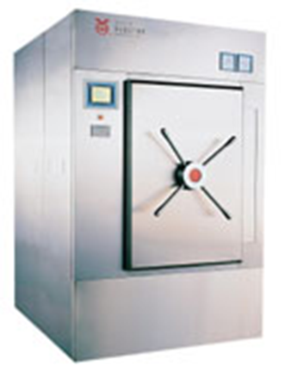
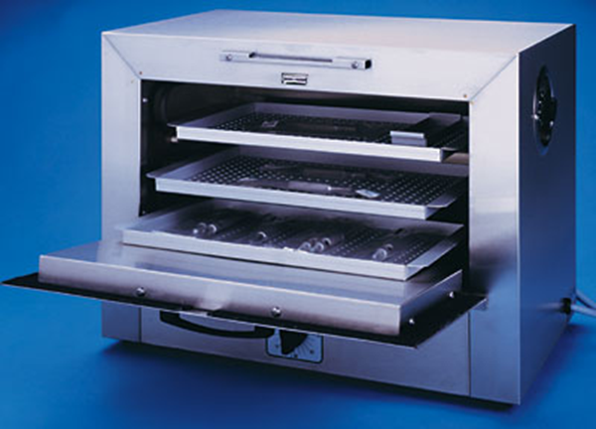
Hot air Oven
Autoclave

Slide 8
Sterilization: Primary Methods
B) Chemical sterilization: such as gassing using ethylene oxide
Active agent of the gas sterilization process can be ethylene oxide or another highly volatile substance.
The sterilizing efficiency of a chemical such as ethylene oxide depends on the concentration of the gas, the humidity, the time of exposure, the temperature, and the nature of the load.
In particular, it is necessary to ensure that the nature of the packaging is such that the gas exchange can take place.

Slide 9
Sterilization: Primary Methods
B) Chemical sterilization: such as gassing using ethylene oxide
Microbicidal activity of ethylene oxide gas is the result of alkylation of protein, DNA, & RNA.
  Alkylation, or the replacement of a hydrogen atom with an alkyl group, within cells prevents normal cellular metabolism and replication.
An alternative gaseous process is hydrogen peroxide.
  Within the pharmaceutical industry, this gas is commonly used for the biodecontamination of isolators.
  Hydrogen peroxide inactivates microorganisms primarily by the combined use of the gas and the generation of free radicals (hydroxyl and hydroproxyl free radicals) during the plasma phase of the cycle.

Slide 10
B) Chemical sterilization: such as gassing using ethylene oxide
Ethylene oxide is a gaseous chemosterilizer that is especially useful due to its extraordinary penetrating power
Ethylene oxide is employed to sterilize prepackaged laboratory equipment that is otherwise destroyed by heat (e.g., plastic petri dishes)

Slide 11
Sterilization: Primary Methods
C) Filtration
Filtration concerns the rendering of a liquid or gas as sterile by the physical removal of microorganisms.
In order to remove bacteria, the membrane pore size (primarily 0.22 μm) must be smaller than the bacteria and uniform throughout.
Filtration processes can be complicated, and the validation is dependent upon the type of material being filtered and its physical properties.

Slide 12
Sterilization: Primary Methods
D) Radiation sterilization: such as gamma radiation and electron beam.
These two radiation processes have similarities and differences and are applicable to different situations and are suited for different materials
  in relation to speed of processing, degree of penetration and validation requirements
There are two types of radiation used for sterilization: ionizing radiation and nonionizing radiation.

Slide 13
Sterilization: Primary Methods
D) Radiation sterilization: such as gamma radiation and electron beam.
Ionizing radiation is the use of short wavelength, high-intensity radiation to destroy microorganisms.
  E.g. gamma or X-rays; these react with DNA resulting in a damaged cell.
Nonionizing radiation uses longer wavelength and lower energy thereby losing the ability to penetrate substances and can only be used for sterilizing surfaces.
  E.g. ultraviolet (UV) light.

Slide 14
The process of selecting the appropriate sterilization method is driven by regulatory, economic, and scientific requirements.
In considering the scientific and practical aspects, factors to consider include:
  whether the product and its packaging fit into an existing sterilization technology. Ideally, a product will tolerate several different types of technology;
  the logistics of transporting the product to and from the site of sterilization. This is obviously easier when the sterilization takes place in-house compared with transporting the product to a contract facility;
  validation requirements to verify that the sterilization cycle is effective.

Slide 15
Factors affecting sterilization effectiveness
Number and location of microorganisms
Innate resistance of microorganisms
Physical and chemical factors
Organic and inorganic matter
Duration of exposure
Storage

Slide 16
Reading Assignment
Good manufacturing practice
Risk assessment
Sterility

Slide 17
Disinfection
Disinfection is a process of removing or killing most, but not all, viable organisms
  Designed to kill actively growing and vegetative microbial microorganisms to a certain level, and it does not, unless the disinfectant is classified as a sterilant, apply to bacterial endospores.
Disinfection employs either:
  a chemical ‘disinfectant’, which kills pathogens but may not kill viruses or spores
  a physical process such as boiling water or low-pressure steam, which reduces the bio-burden (i.e. the load of viable organisms).

Slide 18
Disinfection: Antiseptics
Antiseptics are used to reduce the number of viable organisms on the skin
Antiseptics are a particular group of disinfectants.
Some act differentially, destroying the transient flora but leaving untouched the normal skin flora deep in the skin pores and hair follicles
It is impossible to sterilize the skin, but thorough washing with antiseptic soaps can reduce the numbers of organisms on the surface considerably and therefore reduce contact spread of infection
However, the resident bacteria in the hair follicles and ducts of sweat glands can recolonize the skin surface within hours.

Slide 19
Disinfection: Pasteurization
Pasteurization can be used to eliminate pathogens in heat-sensitive products
Pasteurization reduces the total numbers of viable microbes in bulk fluids such as milk and fruit juices without destroying flavour and palatability.
It does not affect spores, but is effective against intracellular organisms such as Brucella and mycobacteria and many viruses.
Since the beginning of recorded history, various other techniques have been used to prevent the multiplication of microorganisms, such as drying and salting of food.

Slide 20
Mechanisms of action of chemical agents
Different disinfectants have different mechanisms of action
All disinfectants act by harming microorganisms in some manner including:
  Protein denaturation
  Membrane disruption
  Nucleic acid damage
  Inhibition of metabolism

Slide 21
Specific Antimicrobial Agents
  Chemical Antimicrobials

Slide 22
Quaternary Ammonium Compounds (Quats)
One type of commonly employed cationic detergent disinfectants are quaternary ammonium compounds (quats)
Problems with the use of quats as disinfectants include
  Their inactivation by soaps
  Their inhibition by divalent cations (calcium and magnesium ions)
  Their inhibition by cotton and other porous organic substances
  Their inability to kill certain species of Pseudomonas

Slide 23
Organic Acids
Various organic acids are employed especially as inhibitors of fungi and moulds in foods
For example, benzoate of soda is a sodium salt of benzoic acid, an organic acid

Slide 24
Heavy Metals
Various metals and metal salts are commonly employed to prevent microbial growth or kill microbes
For example, silver nitrate has been and increasingly is again used to treat the eyes of newborns to kill any Neisseria gonorrhea that may have been acquired during passage down the birth canal
A common example in Ohio is the treatment of ponds with copper sulfate (which is blue in water solution) as an anti-algal; note that though effective at inhibiting algal growth in ponds, it may be similarly disruptive of algal growth in down-stream ecosystems
Selenium compounds are effective antifungals

Slide 25
Chlorine and Hypochlorite ion
Drinking water is commonly disinfected using hypochlorite
Hypochlorite may either be added directly (i.e., in the form of bleach) or created within water by bubbling chlorine gas through the water
Note that chlorine is less effective in the presence of significant organic compounds (basically because the hypochlorite ion interacts with--oxidizes--organic compounds indiscriminately and thus is used up in the presence off excess organic compounds)
(bromine sometimes is employed as a substitute for chlorine)

Slide 26
Iodine
Iodine is often employed as a tincture or as an iodophor
A tincture is an alcohol solution of a substance, in this case iodine (2% I in 50% alcohol)
Iodine tinctures may be employed as antiseptics

Slide 27
Iodophors
Iodophors are organic compounds that slow the release of iodine (I with carrier)
The iodophors additionally serve as surfactants, thus increasing penetration while simultaneously steadily supplying iodine over long periods
Betadine and Isodine are examples of iodophors

Slide 28
Alcohols
Alcohols work best as 70 to 99% mixtures with water
Alcohol-water mixtures are additionally more penetrating than pure alcohols
Either ethanol or isopropyl (rubbing) alcohol may be employed for disinfecting
Alcohols are especially appropriate for application to sites in which their propensity to evaporate away is convenient (e.g., to disinfect skin prior to injection)
The down side of alcohols is that they are not terribly penetrating nor capable of killing endospores or other resistant cells
Alcohols should not be applied to wounds since they can cause tissue damage

Slide 29
Phenol and phenol derivatives (phenolics)
Phenol and their derivatives (called phenolics) are especially useful when disinfecting materials contaminated with organic materials
Lysol® employs phenolics
Some phenolics are mild enough for use as antiseptics while others are too harsh or otherwise dangerous to be employed on living tissue

Slide 30
Oxidizing agents (hydrogen peroxide)
Hydrogen peroxide (H₂O₂) is a typical oxidizing agent
Note that hydrogen peroxide is actually not a very effective antiseptic or disinfectant
This is because bacteria and body tissues contain enzymes (catalase) that inactivate hydrogen peroxide
On the other hand, the oxygen released upon inactivation can help oxygenate deep wounds and thus kill strict-anaerobe contaminants

Slide 31
Alkylating agents (formaldehyde, glutaraldehyde, ethylene oxide)
Formaldehyde, glutaraldehyde, and ethylene oxides are alkylating agents—they add carbon-containing functional groups to biological molecules
Formaldehyde is employed to inactivate viruses and toxins to produce whole-killed vaccines and toxoid vaccines [whole-killed vaccines]
Glutaraldehyde is capable of sterilizing equipment, though to effect sterilization often requires many hours of exposure

Slide 32
Characteristics of an Ideal Disinfectant
Be fast acting even in the presence of organic substances, such as those in body fluid; [resistant to inactivation]
Be effective against all types of infectious agents without destroying tissues or acting as a poison if ingested; [broadly active]
Easily penetrate material to be disinfected without damaging or discoloring the material; [not poisonous or otherwise harmful]
Be easy to prepare and stable even when exposed to light, heat, or other environmental factors; [penetrating; not damaging to non-living materials]
Be inexpensive and easy to obtain and use; [stable; easily prepared]
Not have an unpleasant odor. [not unpleasant to work with]"

Slide 33
Deciding whether sterilization or disinfection should be used
Sterilization and disinfection processes are costly, and so it is important to choose the appropriate method and the one that causes the least damage to the material involved.
A variety of considerations influence the choice of method.
The detailed mechanisms of the death process of microorganisms may vary with the sterilizing technique used, but the net effect is similar in that essential cell constituents (nucleic acids or proteins) are inactivated.

Slide 34
Deciding whether sterilization or disinfection should be used
It is easier to sterilize a clean object than a physically dirty one
  a low bioburden is a prerequisite for cost-effective sterilization.
The rate of killing of microorganisms depends upon the concentration of the killing agent and time of exposure
  The number of organisms surviving sterilization can be expressed by the equation: N is proportional to 1/CT, where N is the number of survivors, C is the concentration of agent and T is time of exposure to the agent.

