Slide 1
Sample Size and Sampling
Joseph Sichone

Slide 2
sample Size and sampling
Sample
A sample is a subset of a population which is well selected to be studied and make conclusions about the population it is drawn from.
Sampling is the process of collecting a sample

Slide 3
sample Size and sampling
Why do we sample?
When confronted with a need to investigate something in a given population, the “total best” is to measure each and every member of that population and then make a conclusion on that subject for that population.
However, in practice not possible to access every member of a population (e.g measuring height of every individual in central province and then get the mean).
Challenges with finances, availability of subjects, ease of access, compliance etc.

Slide 4
sample Size and sampling
Why do we sample?
Therefore, we get an achievable but appropriate and representative portion of members of that population “called a sample”,
Then we measure on this sample that characteristic we are investigating for the entire population.
Then we use the results obtained from the sample and “infer” it to the population (e.g based on the result from the sample, we conclude what the result would likely be in the population if we had measured the characteristic using all members of the entire population).

Slide 5
sample Size and sampling
Why do we sample?
If we measure something for a population using the entire population, we make conclusions using complete information.
If we measure something for a population using only a sample of the population, we make conclusions using in-complete information.
However, powerful statistical theories and methods are available to enable the selection of an appropriate sample that will give a good conclusion about the population with as much minimal difference between the “true” population result and the “observed” sample result.

Slide 6
sample Size and sampling
Sampling error or Margin of error denotes the difference between the "true" population result and the "observed" sample result that can be attributed to using samples rather than populations.
Sampling bias denotes: the difference between the "true" population results and the "observed" sample results that is attributed to the sampling mistakes of the researcher;

Slide 7
Sample size and sampling
Two main parts of the sampling process.
  Sample Size: Calculating the appropriate size of the sample that will be sufficient to give an estimate as close to the true population result as possible.
    This uses statistical theories such as probability distributions and interval estimations.
  Selecting Sample: Using a proper method of selecting all the members to include in the sample so that the sample is as much representative of the population as possible.
    This uses methods that either
    A) aim to achieve objectivity and eliminate bias when selecting members for the sample e.g probability sampling in quantitative research.
    B) aim to achieve optimal appropriate subjectivity when selecting members for the sample e.g purposive sampling for case studies of a rare disease. Or selecting best informants in a qualitative research.

Slide 8
Selecting the sample
Terms and levels of populations
  A population or “External Population” refers to the entire pool of possible subjects. It is the large group of individuals to whom the results of a study may be generalized.
  A Target population is the group to whom the results are intended to be generalized.
  A Sampling frame (i.e., survey population or accessible population) is the group to whom the researcher has access and from which the actual sample will be drawn. *Note* sometimes sampling frame can be same as sample.
  A Sample is the collective group of subjects or participants from whom data are collected.
  A Subject or participant is the individual from whom data are collected.

Slide 9
Example A
Level | includes
Population | Zambian High school teachers
Target population | Zambian High school teachers in central province
Sampling frame | Teachers at Kabwe, Serenje, and Mumbwa High School
Sample | {Mr Bwalya, Mr Banda, Mrs Mwanza, ……………. n.}

Slide 10
Example B
Level | includes
Population | Graduate students in Lusaka
Target population | Graduate students at UNZA.
Sampling frame | Graduate students in the school of Agriculture at UNZA
Sample | {Mr Bwalya, Mr Banda, Mrs Mwanza, ……………. n.}

Slide 11
Example C (create together with class)
Level | includes
Population | Breast feeding mothers above 35yrs
Target population | Breast feeding mothers above 35yrs in livingstone
Sampling frame | Breast feeding mothers above 35yrs attending postnatal at in livingstone central hospital
Sample | {Mrs Bwalya, Mrs Banda, Mrs Mwanza, ……………. n.}

Slide 12
Selecting the sample cont..
There are different sampling approaches or techniques for selecting sample.
Each of these sampling techniques has its own strengths and weaknesses.
The idea behind adequate sampling, however, remains the same i.e. to gather a sample of subjects that is representative of the greater population.
The ideal research sample is therefore often referred to as a representative sample.

Slide 13
Selecting the sample cont…
Two types of sampling approaches: probability sampling and non-probability sampling
Probability sampling.
  statistically driven sampling techniques. The probability of any subject to be selected to the sample is known and is usually equal for all. the purpose is to select a group of subjects representative of the larger group of subjects from which they are selected.
  For example in a sample of 10 from a population of 100, each subject has a 10% chance of being included in the sample; in a sample of 50 from a population of 100, each subject has a 50% chance of being included in the sample.
  Mostly used for Quantitative research.

Slide 14
Selecting the sample cont…
Types of probability sampling procedures
A) Simple random sampling
all individuals in the defined population have an equal and independent chance of being selected.
considered best single way to obtain a representative sample for inferential statistics.
For small sample sizes E.g picking 20 out of 100 subjects: use names in a hat, or lottery type mechanism etc

Slide 15
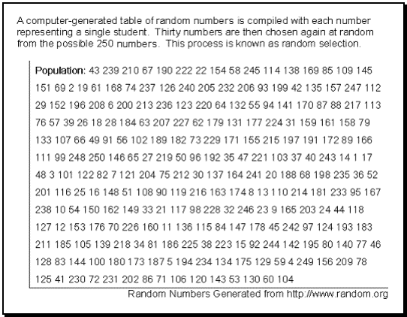
Selecting the sample cont…
Simple random sampling cont..
For larger sample sizes, Help of technology e.g assign numbers to each subject and use a random number generator to pick numbers

Slide 16
Selecting the sample
B) Systematic sampling
Also suitable for large samples. Every ith subject is picked.
E.g 1. (sampling teachers). you have list of names for all teachers in Lusaka printed on a paper. Start with any name somewhere in the middle of list, choose a random number e.g 80, and start counting and pick every 80th name. go through until sample size is full
E.g 2 (sampling cows). Cows are passing through a gate, shortly after they have started passing, pick a random number e.g 14 and starting with any cow start picking every 14th cow to pass through the gate.

Slide 17
Selecting the sample
C) Stratified sampling
Similar to random sampling with the exception that subjects are selected randomly from strata or subgroups of the population.
Strata are homogeneous subgroups within a population (e.g., males and females; low, middle and high socio-economic status; certified and non-certified teachers working with special needs students; etc.)
Strata are normally homogenous within strata and heterogeneous across strata.
Strata ensure adequate numbers of subjects from specific subgroups
Strata members in the sample can be proportional or disproportionate.

Slide 18
Selecting the sample
D) Cluster sampling
Similar to random sampling except that naturally occurring groups are randomly selected first, then subjects are randomly selected from the sampled groups.
This method is useful when it is impossible to identify all of the individuals in a population. Typical educational clusters are districts, schools, or classrooms.
Example - 27 of the 54 school districts were randomly selected, one secondary school in each district was randomly selected, and students randomly selected from each school were tested
Clusters are normally homogenous within cluster and also homogenous across clusters

Slide 19
Selecting the sample
Conclusion on probability sampling
Steps in Selecting Probability Samples
  a) Define the target population and sampling frame
  b) Determine the sample size
  c) Select the sampling strategy (i.e., procedure)
  d) Select the sample

Slide 20
Selecting the sample
Non-probability sampling
  involves pragmatically driven sampling techniques where the probability of being selected is not known. The purpose is to select subjects who can be particularly informative about the research issues.
  Also driven by challenges concerning ease of accessing all subjects
  Mostly used for qualitative research
  The goal is to identify information-rich participants

Slide 21
Selecting the sample
Types of non-probability sampling procedures
Convenience sampling
  Selecting a subject or group of subjects based on their availability to the researcher.
  This is typical of much educational research given the constraints under which it is conducted.
  Of major concern is the limited generalizability of the results from the sample to any population

Slide 22
Selecting the sample
Types of non-probability sampling procedures
Purposive sampling
  Selection of particularly informative or useful subjects: This method typically selects a few information-rich subjects who are studied in-depth.
  example in case study e.g case study of a rare disease
  Also example, in case study of a perculiar case e.g a failing student

Slide 23
sample Size
Sample size calculation
Various methods are available for calculating the required sample size
Most applicable to quantitative studies
Sample size calculation ensures researcher to come up with sufficient number of sample subjects to estimate a population parameter with high level of “precision” (e.g observational studies) or to truly detect an effect (e.g clinical trials)

Slide 24
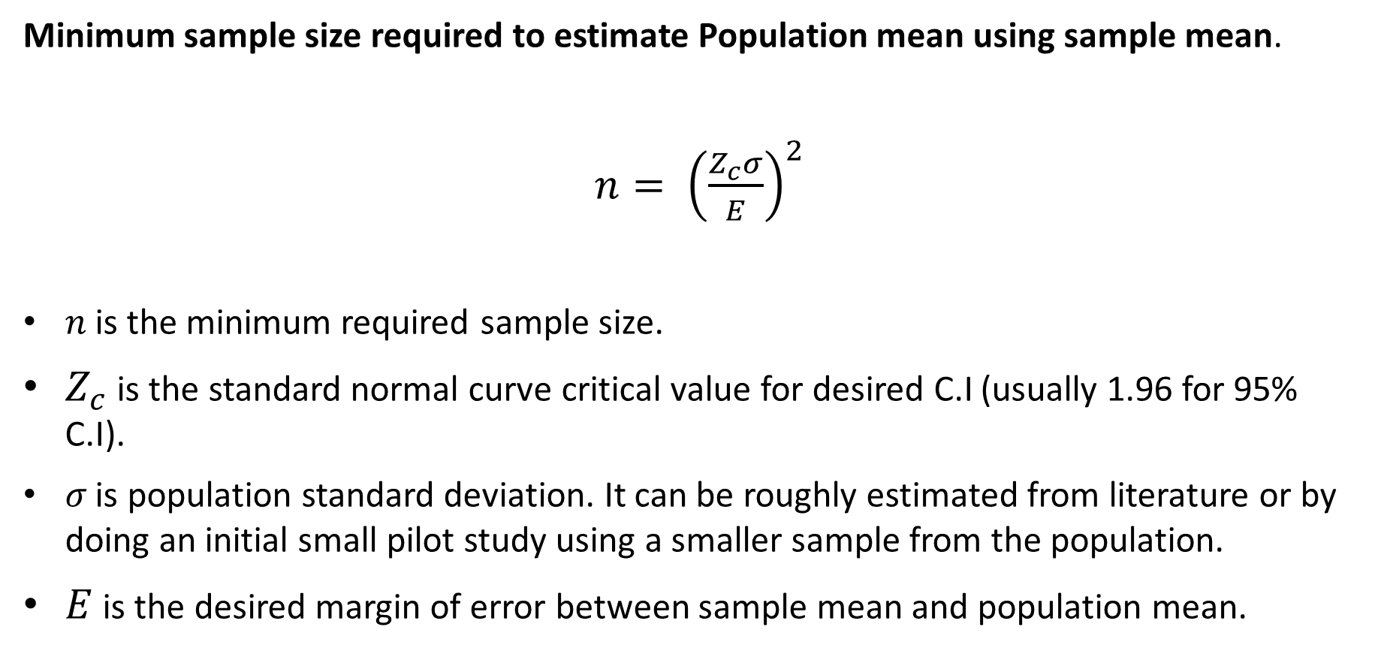
sample Size
Minimum sample size required to estimate Population mean using sample mean.
$n= {\left(\frac{Z_{c}σ}{E}\right)}^{2}$
𝑛 is the minimum required sample size.
$Z_{c}$ is the standard normal curve critical value for desired C.I (usually 1.96 for 95% C.I).
𝜎 is population standard deviation. It can be roughly estimated from literature or by doing an initial small pilot study using a smaller sample from the population.
$E$ is the desired margin of error between sample mean and population mean.

Slide 25
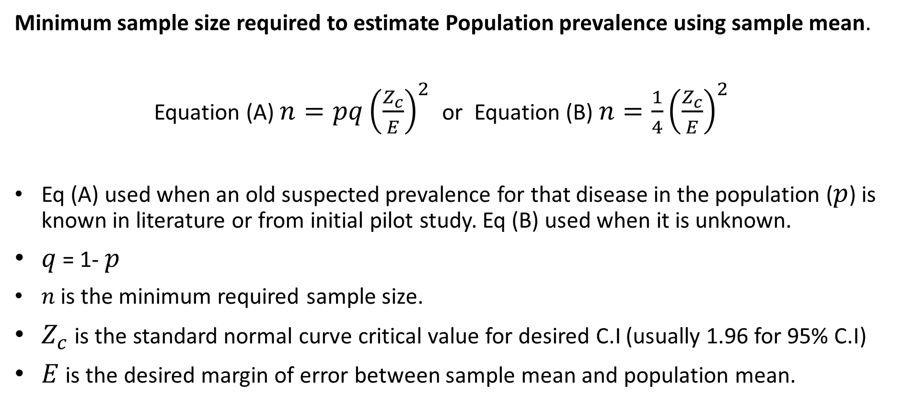
sample Size
Minimum sample size required to estimate Population prevalence using sample mean.
Equation (A) $n=pq{\left(\frac{Z_{c}}{E}\right)}^{2}$ or Equation (B) $n={\frac{1}{4}\left(\frac{Z_{c}}{E}\right)}^{2}$
Eq (A) used when an old suspected prevalence for that disease in the population ($p$) is known in literature or from initial pilot study. Eq (B) used when it is unknown.
$q$ = 1- $p$
𝑛 is the minimum required sample size.
$Z_{c}$ is the standard normal curve critical value for desired C.I (usually 1.96 for 95% C.I)
$E$ is the desired margin of error between sample mean and population mean.

Slide 26
sample Size
Calculating Sample size using measures of effect (e.g CLINICAL TRIALS)
These are studies where effect of intervention in one group is investigated in relation to a similar group without the intervention.
Various methods available to estimate required sample size in each group to get significant results about the difference between the groups e.g due to effect of an intervention.
Notable method is power analysis.

Slide 27
sample Size
Calculating Sample size using measures of effect (e.g CLINICAL TRIALS)
The Null hypothesis says there is no difference between two groups
The alternative hypothesis says there is a difference between two groups
Type I error is rejecting the null hypothesis when it is infact true, denoted as α.
Type II error is accepting the null hypothesis when it is actually false, denoted as β.
1-β is called the power of the study. It therefore represents the ability to reject the null hypothesis when it is false. Mean being able to correctly detect a true difference.

Slide 28
sample Size
Calculating Sample size using measures of effect (e.g CLINICAL TRIALS)
In a power analysis, e.g for an intervention study, there are some statistical elements that are related.
These are: level of significance (α), sample size (n), sample standard deviation (𝑠), effect size (ɛ (epsilon)) and power (1 – β)
Therefore, you can define the other elements in order to get the required sample size for your intervention study.

Slide 29
sample Size
Calculating Sample size using measures of effect (e.g CLINICAL TRIALS)
The elements listed:
level of significance (α): usually 0.05 is used in medical practice
power (1 – β): can be 0.4, 0.5….0.8, 0.99 it is the probability or our ability to correctly detect a difference.
sample size (n),
a combined standard deviation between two groups (𝑠),
effect size (ɛ)

Slide 30
sample Size
Calculating Sample size using measures of effect (e.g CLINICAL TRIALS)
For example if you are conducting a research on a new drug which is supposed to control the glucose levels in chronic diabetic patients, one measure of the effect of that drug is to measure and compare the mean glucose concentration between those in group A who are receiving the drug and those in group B who are not (controls).
effect size (ɛ); is the measure of the magnitude of differences between the sample means for the two groups being compared.

Slide 31
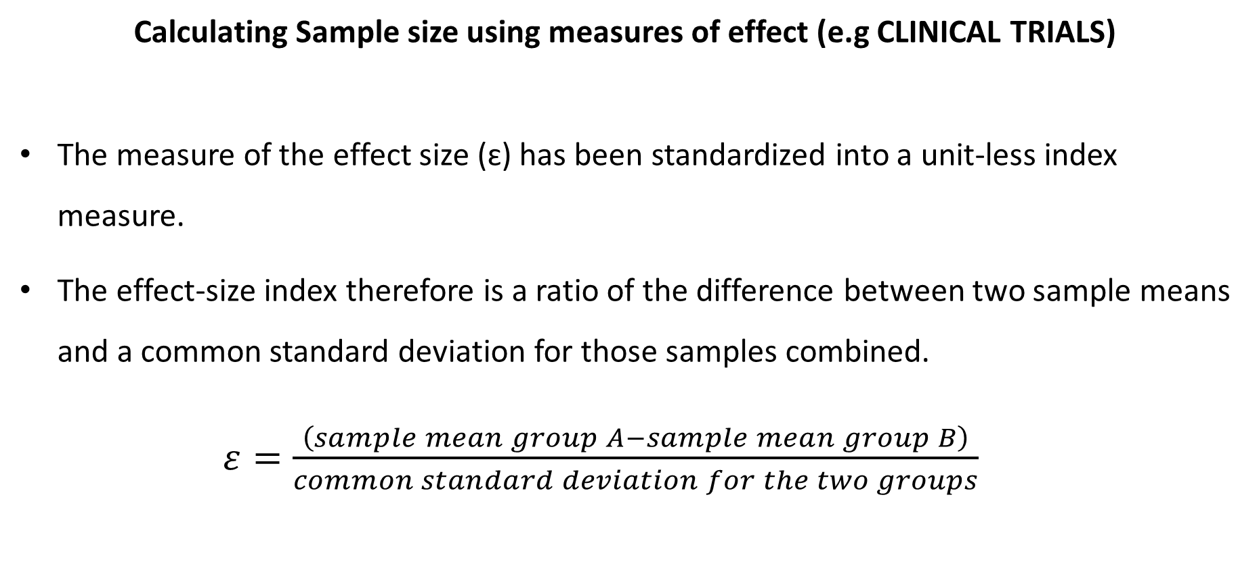
sample Size
Calculating Sample size using measures of effect (e.g CLINICAL TRIALS)
The measure of the effect size (ɛ) has been standardized into a unit-less index measure.
The effect-size index therefore is a ratio of the difference between two sample means and a common standard deviation for those samples combined.
$ε=\frac{\left(sample mean group A−\left.sample mean group B\right)\right.}{common standard deviation for the two groups}$

Slide 32
sample Size
Standardized index for effect size (ɛ)
Large effect size (ɛ = .80) implies there is a large degree of separation and therefore very little potential overlap between groups. These differences should be obvious by observation, and statistics should be applied only to legitimately document them.
Medium effect size (ɛ = .50) implies an observable difference may be noted by the trained observer. Testing is necessary to verify the differences.
Small effect size (ɛ = .20) implies the differences, if any, are so small as to be invisible to the observer, and testing is necessary to identify differences in performance and/or behaviors.

Slide 33
sample Size
Calculating Sample size using measures of effect (e.g CLINICAL TRIALS)
Example.
A large study is to be conducted to determine if a new Drug (drug J) significantly reduces glucose levels in chronic diabetes patients with persistently high blood sugar. Two groups of similar chronic diabetes patients are to be formed, group A receiving the drug and group B not receiving the drug (control group). What minimum sample size is required to get a good conclusion about the effect of drug J.

Slide 34
sample Size
Calculating Sample size using measures of effect (e.g CLINICAL TRIALS)
Further information.
A pilot study was done for a sample of n=5 (pilot group A and group B each with sample size of 5) and the results were that for group A ( who received drug J) the mean glucose concentration was 12.1 with standard deviation of 3.4 while for group B (the control group) the mean glucose concentration was 15.0 with standard deviation 4.4. this information will help get a rough estimate of (ɛ) for the drug.
All glucose measurements are in mmol/L.

Slide 35
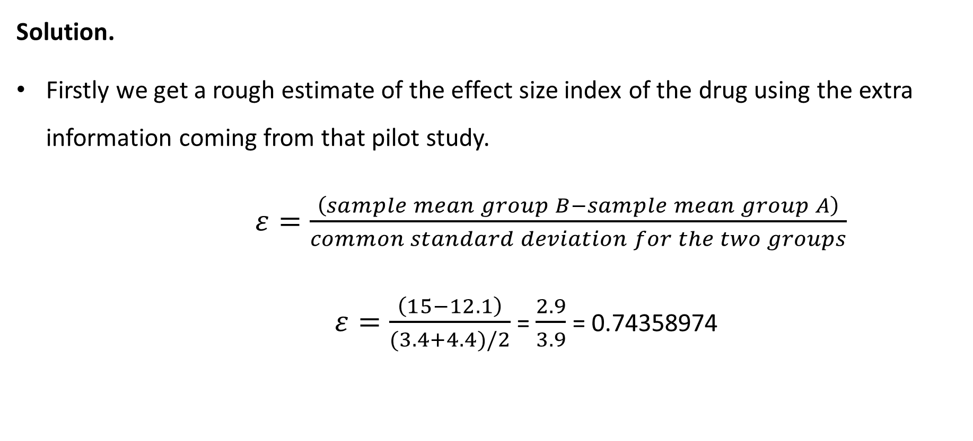
sample Size
Solution.
Firstly we get a rough estimate of the effect size index of the drug using the extra information coming from that pilot study.
$ε=\frac{\left(sample mean group B−\left.sample mean group A\right)\right.}{common standard deviation for the two groups}$
$ε=\frac{\left(15−\left.12.1\right)\right.}{(3.4+4.4)/2}$ = $\frac{2.9}{3.9}$ = 0.74358974

Slide 36
sample Size
Solution.
So it can be seen that the drug has a high effect size index of about 0.74358974
But how large a sample size do we need to correctly detect a difference in the two groups.
Next we simply use a Power Table which is normally set at 0.05 α level of significance.

Slide 37
sample Size
Power table (α = .05 (two tailed)
𝜀 Power | .10 | .20 | .30 | .40 | .50 | .60 | .70 | .80 | 1.00 | 1.20 | 1.40
.70 | 1235 | 310 | 138 | 78 | 50 | 35 | 26 | 20 | 13 | 10 | 7
.80 | 1571 | 393 | 175 | 99 | 64 | 45 | 33 | 26 | 17 | 12 | 9
.90 | 2102 | 526 | 234 | 132 | 85 | 59 | 44 | 34 | 22 | 16 | 12
.99 | 3675 | 920 | 409 | 231 | 148 | 103 | 76 | 38 | 28 | 27 | 20

Slide 38
sample Size
Solution.
So seeing from the power table, at α = .05 (two tailed), with the drug effect size at about 0.74358974 and we want a power (1-β of correctly detecting a difference if it exists) of about 0.8, then we will need a minimum sample size of about 33 in each group (group A and Group B).
Note at the same desired power of 0.8 a higher sample size will be needed if the effect size of the drug was smaller.

Slide 39
Conditions that guide sampling method and sample Size
Reference
1) RESEARCH METHODOLOGY AND COMPUTER APPLICATIONS MODULE (VMM 7091)
School of vet medicine, University of Zambia.
2) Charles Brace, Understanding basic statistics (4th edition)

